Slide 1
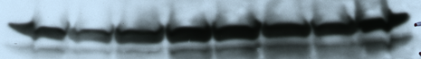
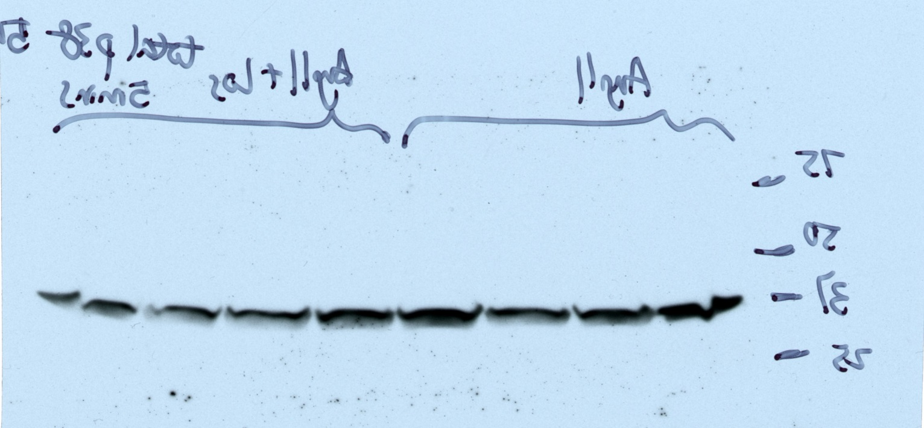
Supplemental Figure.1
A.
AngII + Vehicle |  |  |  | AngII + Losartan |  |  |  | Phospho-p38
0 | 10 | 30 | 60 | 0 | 10 | 30 | 60 | minutes
B.
AngII + Vehicle |  |  |  | AngII + Losartan |  |  |  | total-p38
0 | 10 | 30 | 60 | 0 | 10 | 30 | 60 | minutes

Slide 2
Supplemental Figure.1
C.
RANKL+ Vehicle |  |  |  | RANKL+ Losartan |  |  |  | Phospho-JNK
0 | 10 | 30 | 60 | 0 | 10 | 30 | 60 | minutes
D.
RANKL+ Vehicle |  |  |  | RANKL+ Losartan |  |  |  | total-JNK
0 | 10 | 30 | 60 | 0 | 10 | 30 | 60 | minutes

