Slide 1
Finding the best location for a New Restaurant using Foursquare API

Slide 2
Finding a location
Location is the most important factor leading to the success of a private or public sector organization.
A good location for a restaurant with a local clientele can profit the organization
Location can help keeping fixed and overhead costs low and accessibility high.
Restaurant site selection is a complex decision which needs proper planning and sufficient information.

Slide 3
Data acquisition and cleaning
Population data for each borough in New York City was obtained at data.beta.nyc (2019)
Geographical borough information was obtained at https://cocl.us/new_york_dataset.
In total there are 306 rows with 6 features in a row data set
Both data sets had no missing values or data type mismatch issues
So no features were dropped in both data sets

Slide 4
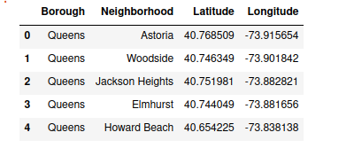
Feature Selection
The Borough with the highest population/neighborhoods was considered for analysis.
This means this borough has more customer demographics than any other.
Therefore Queens data only was extracted and used for further analysis

Slide 5
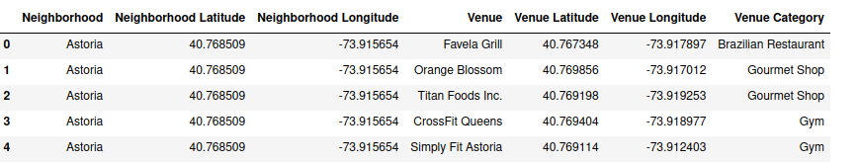
Using Foursquare to get venue and category information
Foursquare is a social location service that allows users to explore the world around them.
The Foursquare API was used to get the venue and category information.
The information retrieved was for the 100 most popular spots for each neighborhood,within 500m radius

Slide 6
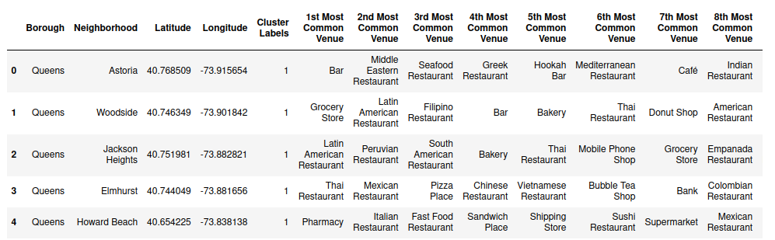
Analyzing each neighborhood
K-means clustering was used for analyzing the neighborhoods.
The 10 most common venues were considered in the analysis
The data had to be first converted to numerical using onehot encoding
5 clusters were used to segment the data and viewed using a map

Slide 7
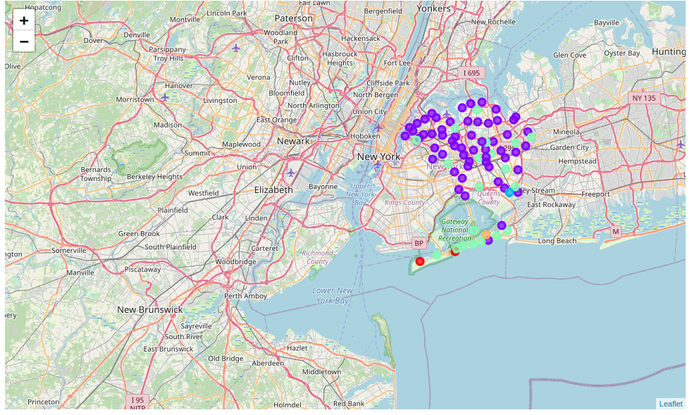
Viewing the clusters on a map

Slide 8
Examining each and every cluster
The restaurant of interest is an Italian Restaurant
So the whole idea was to find a location in a cluster with the following characteristics:
The highest number of Italian Restaurants
Italian restaurants being within the first 5 most common venues
Restaurants being the most common business
This guarantees a good clientele since it’s clear that a ready market for Italian food already exists and restaurants are already popular in that cluster.

Slide 9
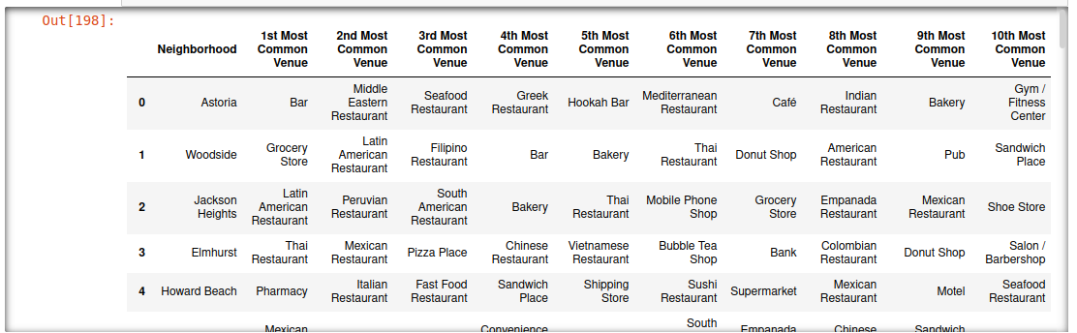
Cluster Analysis
Cluster 2 with highest number of restaurants

Slide 10
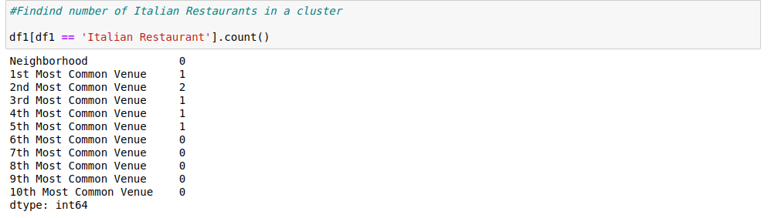
Cluster 2 characteristics
The following was observed from this cluster:
It had the highest number of Italian restaurants, which is 6.
All these restaurants are in the top 5 most common venues
It had the highest number of restaurants

Slide 11
Discussion
Cluster 2 was the one with the characteristics to be considered for determining the location of the restaurant.
Therefore the location will be in Cluster 2, in the Auburndale neighborhood
This is because in this neighborhood, an Italian Restaurant is the most common venue.

Slide 12
Conclusion
Foursquare data and a machine algorithm were successfully used to determine the location of a new Italian Restaurant.
It is recommended that, in future, other factors like distances between neighbors, demographic factors like age, average income, etc be considered as well
Also a function should be written to determine the best value for the number of clusters.

