Slide 1
Metastability

Slide 2
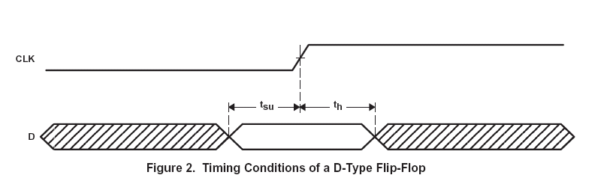

Slide 3
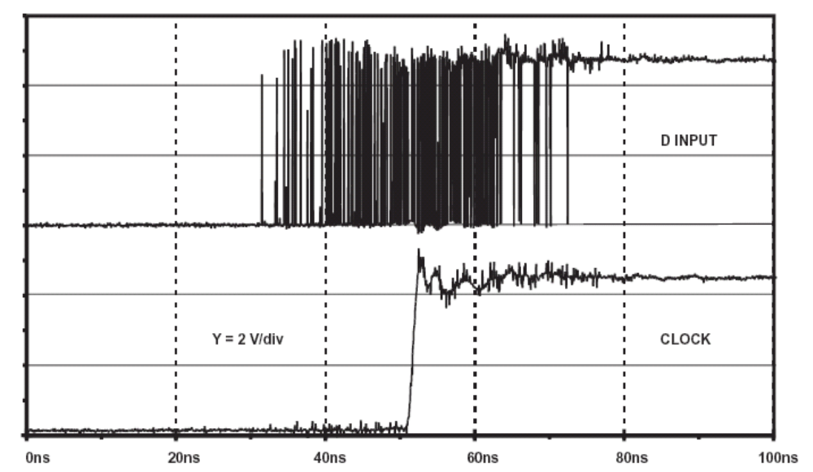
Metastable state

Slide 4
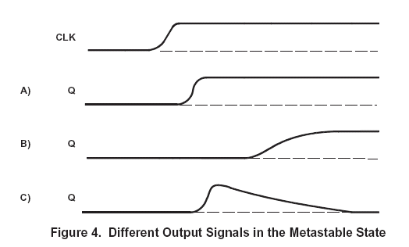
Metastable state

Slide 5
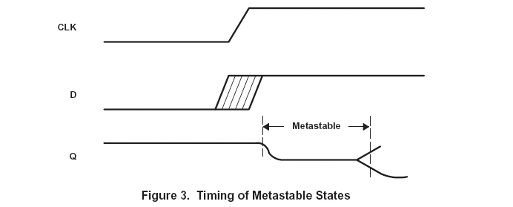
Metastable state

Slide 6
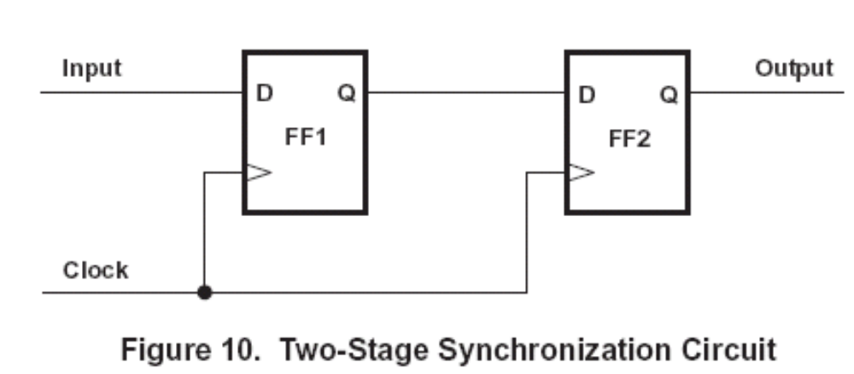
Solution for Metastability problem

Slide 7
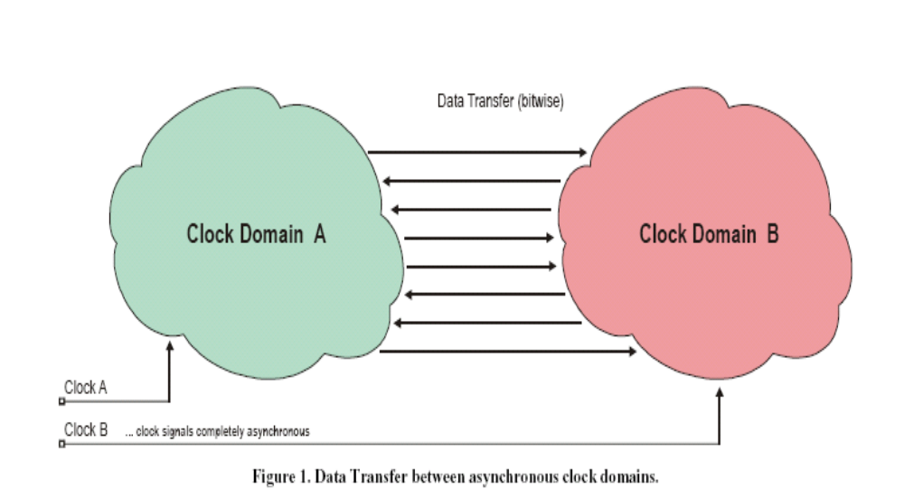
Data transfer between asynchronous clock domains

Slide 8
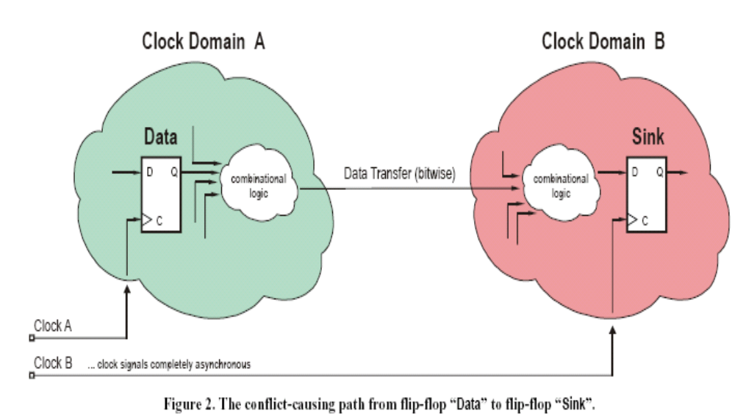
Conflict-causing path from flip-flop “Data” to flip-flop “Sink”.

Slide 9
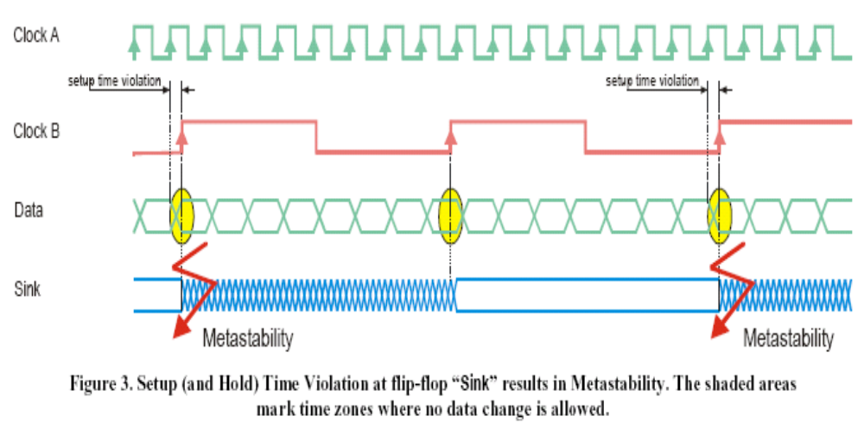
Setup and Hold time violation

Slide 10
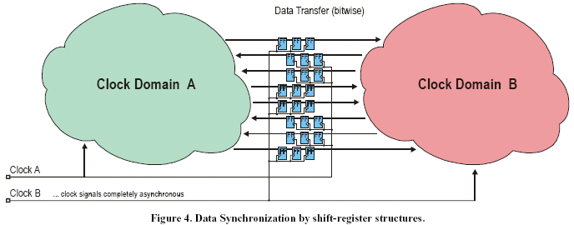
Standard Approach

Slide 11
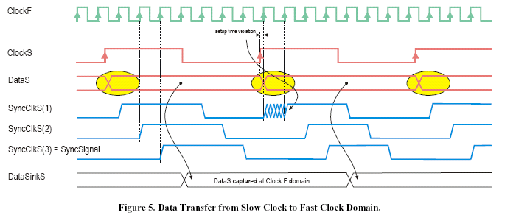
Data Transfer from Slow Clock to Fast Clock Domain.

Slide 12
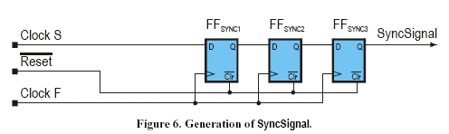
SyncSignal

Slide 13
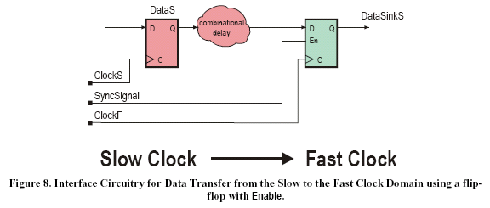
Interface Circuitry for Data Transfer from the Slow to the Fast Clock Domain

Slide 14
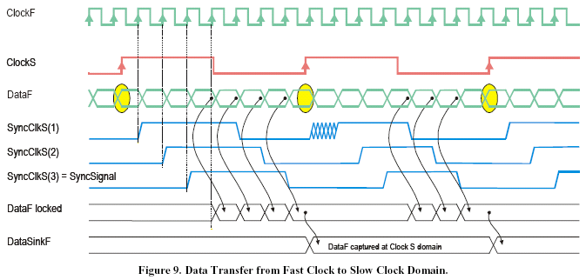
Data Transfer from the Fast to the Slow Clock Domain

Slide 15
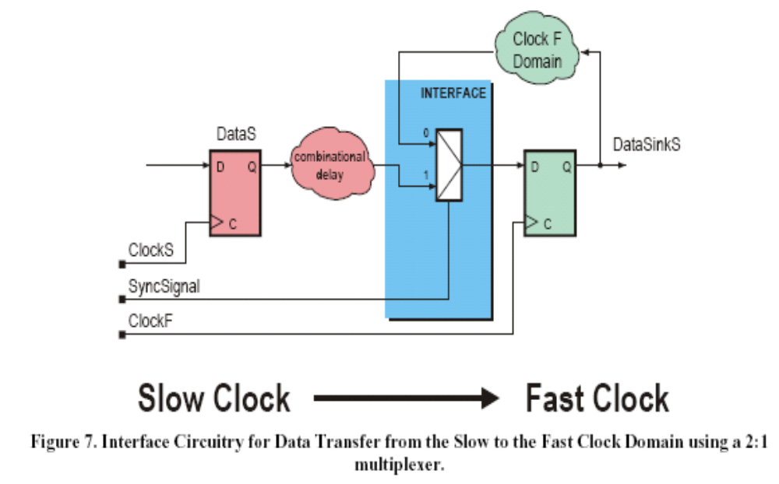
Interface circuitry

Slide 16
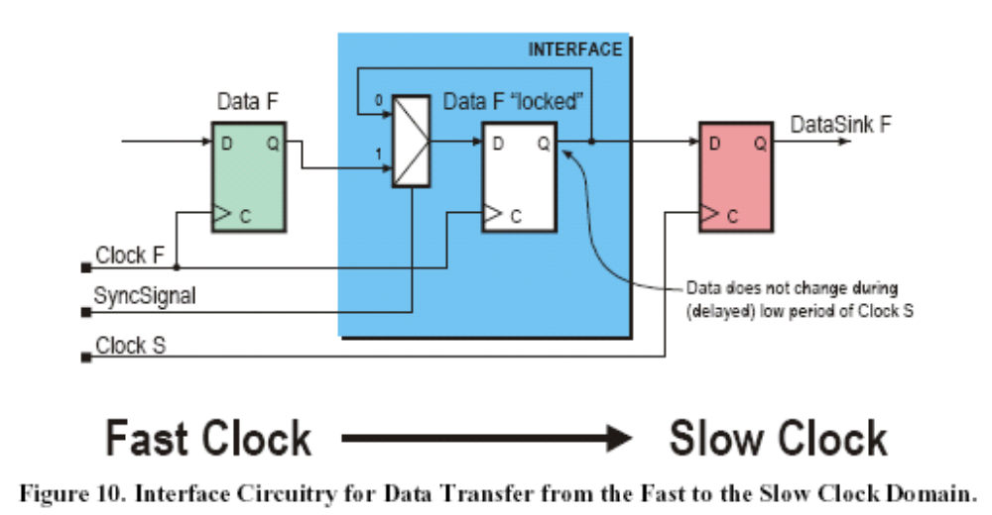
Interface Circuitry for Data Transfer from the Fast to the Slow Clock Domain.

Slide 17
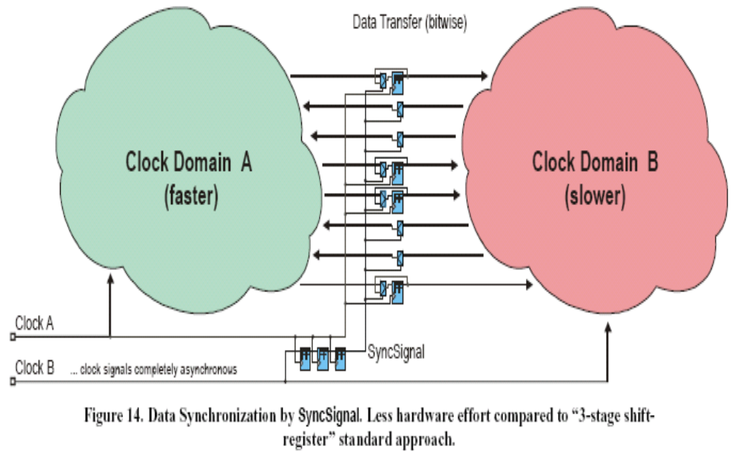
Data Synchronization by SyncSignal.

Slide 18
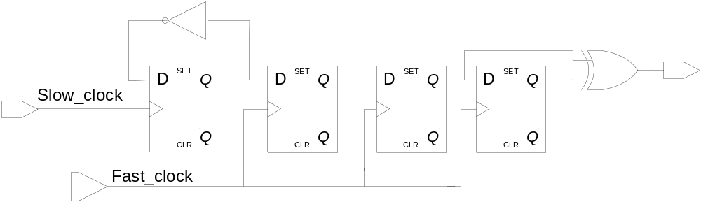
Synchronizer

Slide 19
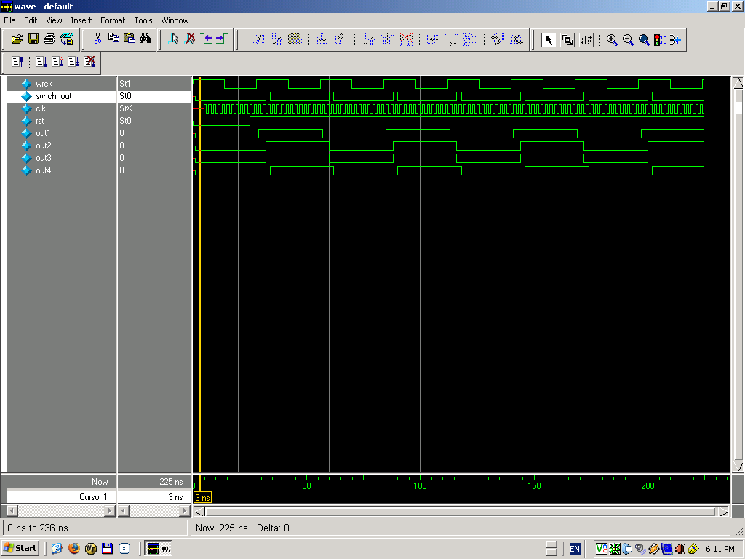
Synchronizer

