Slide 1
®
Unlock your destiny

Slide 2

"
Revolutionizing spiritual wellness
®
"
for the digital age​​​
Unlock your destiny
Priyanka Aeron, Founder
Astrologer, Vastu specialist, Energy Healer, Numerologist and Tarot Reader
www.tathasstu.com​

Slide 3

Profile
Name – Asish Tikari
Date of birth – 20 May 1971
Birth of place – New Delhi
Birth time - 8:30 AM as per scanner
Issue – Money flow, open blockages and court cases

Slide 4
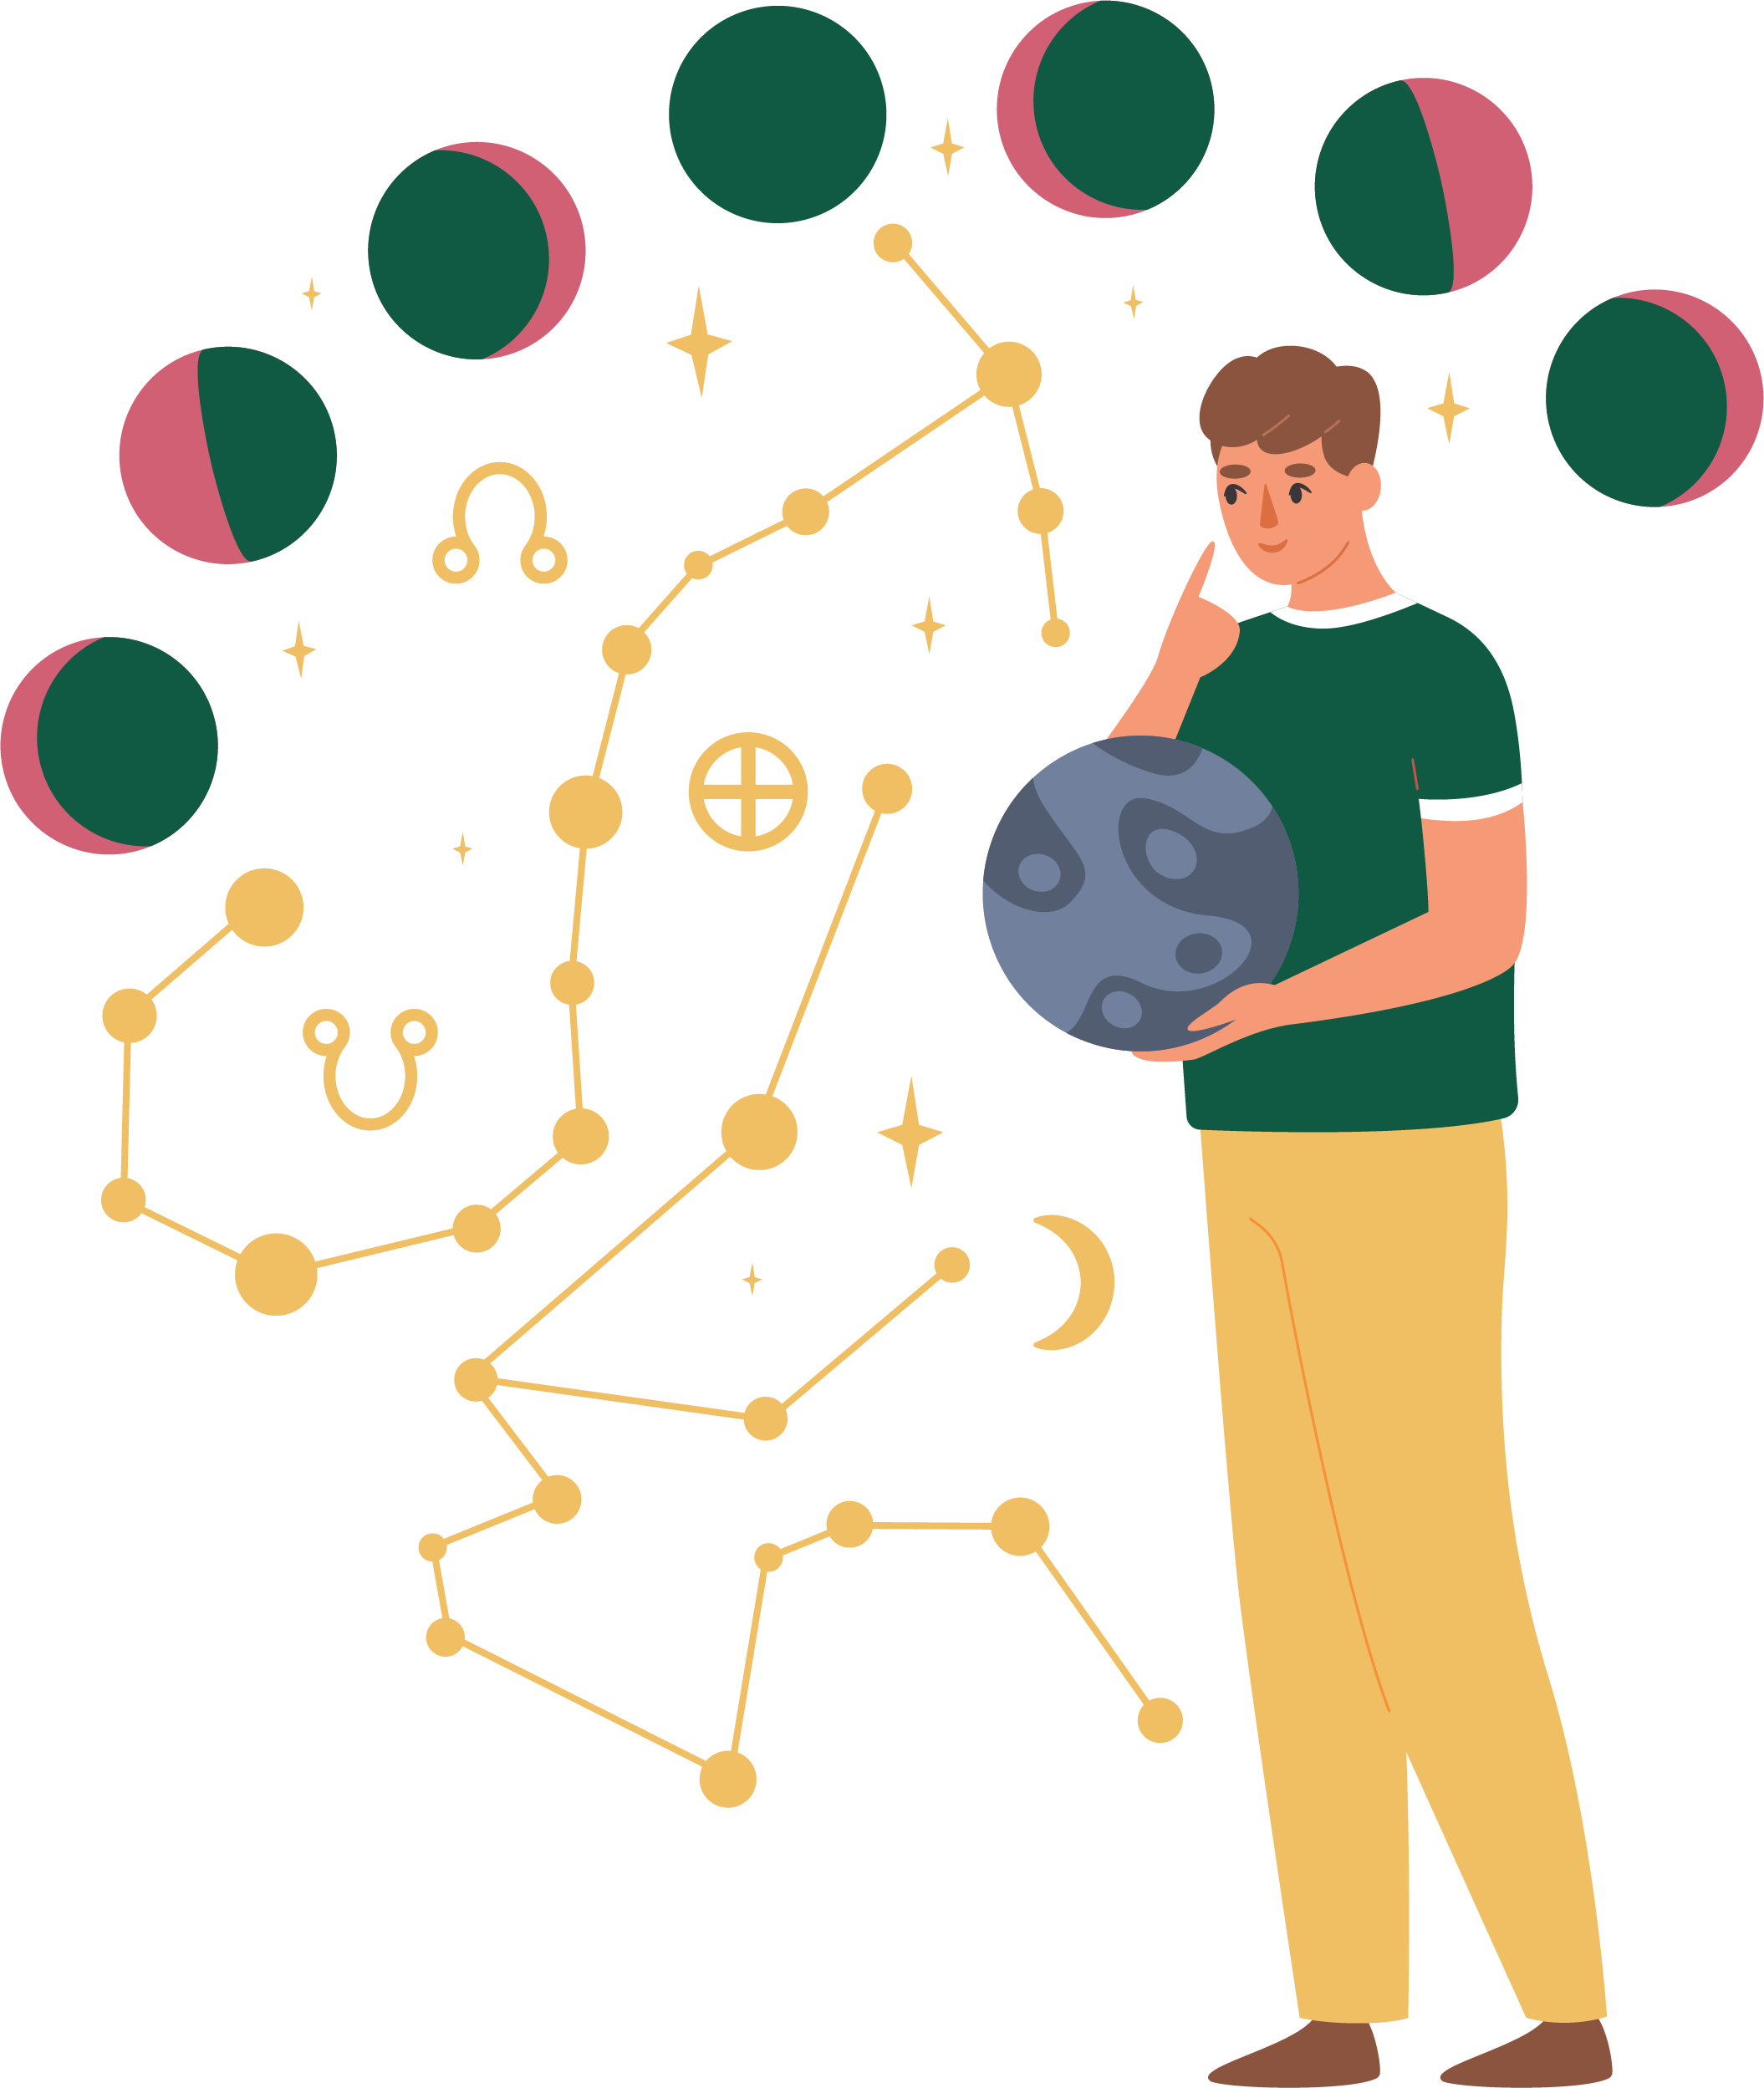
Reading on 10/May/2026
Kaal sarp dosh – yes, but no upay needed
Mangal Dosh – No
Pitra Dosh – Yes
Bandhan yog – Yes
Pishach yog – No
Tona totka – No
Nazar dosh – Yes
Positivity – Yes
Sun – 100%
Mon – 20%
Mercury – 100%
Venus – 100%
Jupiter – 10 0%
Saturn – 100% - 3 Saturday, Shani mandir mein daan + naak ragad kar aayein – Iron chimta, iron angithi, Kale til 500 gm, Urad dal – 4 kg, Sarso tel – 1 bottle
Rahu – 50%
Ketu – 50%
Mangal – 100% - 1 Tuesday – 2 kg Boondi – Hanuman mandir

Slide 5
Upay as per scanner
  Pitr Dosh Upay
  3 Male clothes – Brahmin
  3 Female set of clothes – Brahmin
  2 set of bedding
  3 days – roti on churaha
  Feed ants – peepal ke ped ke neeche – Nariyal + Bura+ Khas Khas + Kale til + safed til + bhuna hua aata – Sukhe nariyal mein bharkar peepal ki jad mein rakhein.
  For Aura cleansing
  Salt bathing – 7 days – Buy pink salt 1 kg. Take a mug and add salt to it, scrub your entire body with it and then wash it off.
  Court Cases -
  Maa Bagla Mukhi hawan for court cases
  Court cases chant – 8877192
  In case of any problem – chant – Durant Dev
  In order to come out of unnecessary problems chant – Convelexa
  Crystal -
  Manjusha place near your bed or where you spend most of your time.
  Crystals – Place them infront of your picture.

Slide 6
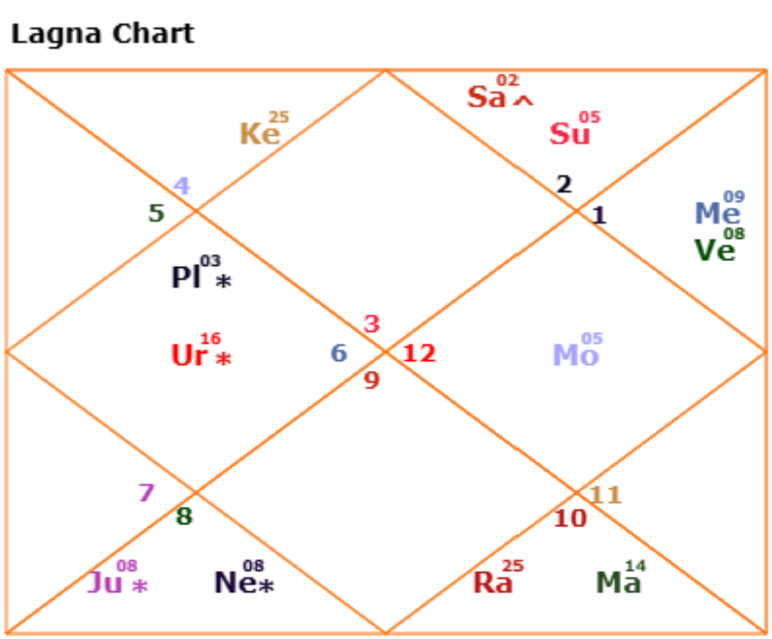

Lagan Kundli

Slide 7
Kundli prediction
Lagan – Mithun
Rashi – Meen
Dasha – Venus
Shani ki sade Satti – till Feb 2028
Strong and understanding personality. Situation ko dekh kar samajh lena and best action lena. Bahar ke circle ke liye doosri personality and inner circle ke liye different personality. Kharab situation mein bhi strongly act karte hain.
Rin –
Aajaanmkrit Rin – 2027 May mein bday ke baad upay karna hai
Pitr Rin – Peepal ka ped seenche, Sunday ko peepal par paani na chadayein. 43 days continuously paani chadayein.
Nirdayi Rin -

Slide 8
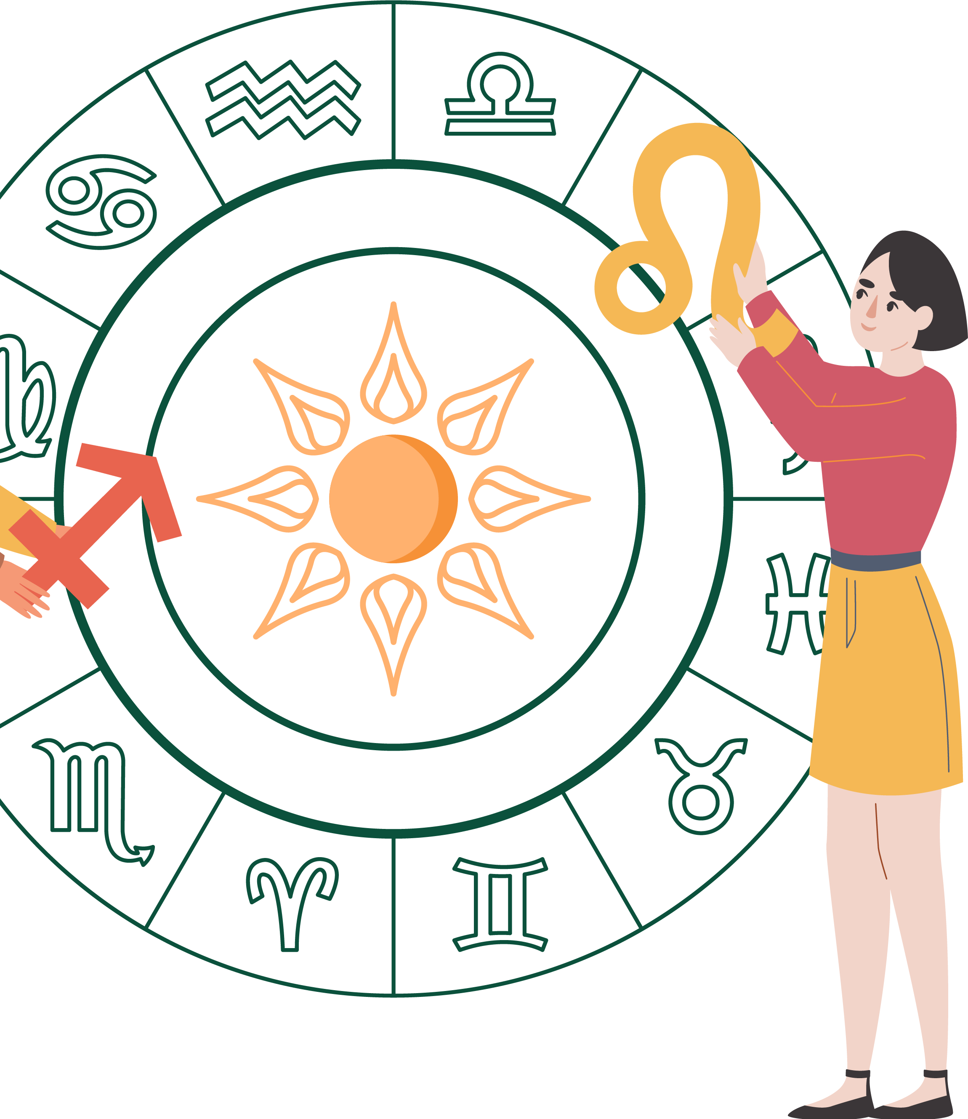
Prediction
  Will have lot of secrets within his heart.
  Will have heavy physical build.
  Will have a habit of waking up late in the morning.
  Will always feel insecure with people around, lagega ki koi sazish kar raha hai.
  Life will be full of ups and down, kabhi bahut paisa and kabhi tangi
  Sasural mein nahi banegi
  Gold bechna padta hai ye gold ki chori hui hoti hai.
  Nail bitting ki habit hogi.
  Gussa bahut tez hoga.
  Jeewan bhar pita se nahi banegi.
  Court cases mein bahut phansenge.
  Kharche bahut jyada honge and income less.
  Dost and family dhokha denge.
  Jaadu toona ka asar bahut jaldi hoga.

Slide 9
Prediction to be contd…..
  Skin related problems aayengi
  Life mein paisa and luxury and females ka hamesha support milega.
  Paise dekar wapis nahi aate hain.
  Maan izzat kar par lanchan lagenge.
  Kaam mein uttar chadav laga rahega – peak par kaam jayega, josh bhi bahut lagega, phir kaam and josh dono kum ho jaate hain.
  Samay samay par kaam badalne padte hain.
  Life mein gadi ya bike ka accident zarur hua hoga.
  Bante bante kaam atak jana.
  Log aapke sukh se dukhi hote hain.
  Business mein hisaab kitab ka dhyaan nahi rakhte hain.
  Is saal mein naye ghar ya renovation ka yog hai.
  Videsh se dhan phalega.

Slide 10
Upay as per Kundli
  Ujjain managal nath mandir mein mangal shanti pooja karein. Mangal shanti pooja ke baad Ujjain mein night stay nahi karna hai.
  Teerthyatra karein – pahado wali Devi ke mandir hokar aayein.
  Cherry wale buns dogs ko khilayein.
  3 dhatu ka challa pehne – 1gm sona, 1 gm chandi, 1 gm tamba.
  3 kele – 3 din - 3 brahmin ko dein – Thursday.
  Hospital mein 6 pani ki bottle, 6 din Gareeb ko daan dein.
  Pakshiyon ko hari moong ki daal daalein – 43 days, start from Wednesday.
  Hanuman ji ki pooja karein.
  South and South east saaf rakhein.
  Billi ki jail orange color ke kapde mein rakh sakte hain.
  Gale mein sone ki chain phene
  Branded perfume use karein
  Gyming karein, tez walk karein.
  Apni baatein confidential rakhein.
  Paani, doodh, dahi, chawal daan mein na dein.
  Ghar mein dhuan na karein.
  Ghar mein bade patton wale money plant na lagayein, chote patton wale money plant lagayein.
  Ghar mein pooja bhi rakh na rakhein.
  Kisi se prasad na lein.
  Ghar ki achi safai karwayein, unused items/ toota foota samaan furniture nikal dein
  Apne dada ke naam par kaam karein – vo phal dega
  Videshi kaam suit Karega.

Slide 11
Thanks a lot
For any doubts please contact – 9109118888
​​​
®
Unlock your destiny
Priyanka Aeron, Founder
Astrologer, Vastu specialist, Energy Healer, Numerologist and Tarot Reader
www.tathasstu.com​

