Slide 1

HARMONIQ: DYNAMIC MOOD-SHIFT ENABLED MUSIC GENERATION
TATHAGATA GHOSH
RITABRATA CHAKRABORTY
PROF. SANDEEP CHAURASIA

Slide 2
Harmoniq,a journey of music genre
[Music generation with dynamic genre transition]
Tathagata Ghosh
Ritabrata Chakraborty
Dr. Sandeep Chaurasia

Slide 3
The Goal
Piano Music Generation having mood transition ability!
Control + generate using RNNs, GRUs and LSTMs.
Deploy as an interactive space for qualitative inference.
Notes:
•The goal of this assignment is to design and implement a deep learning model for piano music generation with dynamic genre control using RNNs, GRUs, and LSTMs. The model will be capable of composing piano music based on a specific genre or mood and will offer genre transitions throughout the generated piece.
•In this project we will :-
•1. Build a custom model using recurrent neural networks (RNNs, GRUs, and LSTMs)
•2. Implement a mechanism for genre/mood control.
•3. Explore ways to introduce smooth genre transitions during music generation.
•4. Investigate how attention mechanisms can improve sequence generation.
•5. Discuss future improvements using transformer-based models.

Slide 4
DATASETS

Slide 5
MAESTRO (MIDI and Audio Edited for Synchronous TRacks and Organization)
200 hours of virtuosic piano performance → Extensive dataset !
Available as open-source data
Composer metadata is given → Can approximate some properties related to particular score.

Slide 6
Datasets :-
To train a music generation model, we need high-quality MIDI data for piano music.
Datasets available –
◦1. Maestro Dataset :
◦Description – A large dataset for classical piano performances
◦Genre use – Can approximate genres by filtering based on composers; examples include romantic, classical, modern etc)
◦URL - Maestro Dataset
◦2. Emopia Dataset :
◦Description – Contains MIDI files labelled with emotional attributes such as happy, sad, angry, or calm, providing an emotional tone for mood control.
◦URL - Emopia Dataset
◦3. Giant-MIDI Piano :
◦Description: A dataset of classical piano performances, which can be filtered by composer to emulate genres
◦URL - GIant-MIDI Piano

Slide 7
Selecting and understanding the Dataset
The Emopia dataset is chosen for this particular project as; after comparing with the other two datasets; we found that the Emopia dataset is well structured than the other two.
The dataset comprises of only piano music; which will help us understand the emotion portrayed in the music and analyse better which would not be possible if there were multiple instruments and vocals in the music pieces. In the dataset, there are piano pieces; where we will be able to identify each note correctly and identify the mood of the music piece and in turn understand the genre of the music well.
The midi files in the dataset has a prefix attached to them separated by underscores. The prefixes are Q1, Q2, Q3 and Q4. Here the Q1, Q2, Q3 and Q4 are the quadrants. The emotions portrayed by the piano pieces in the form of midi files are divided into 4 quadrants, representing 4 basic emotions - “HAPPY”, “ANGRY/RAGED”, “SAD” and “RELAXED”. Amount of “valence” and “arousal” is also associated with these 4 quadrants.

Slide 8
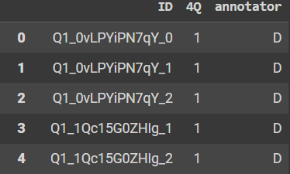
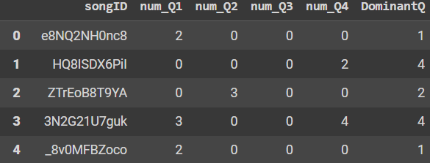
labels.csv :- contains 3 columns -
ID - comprises of the midi file name with the appropriate prefix.
4Q - has entries like 1, 2, 3 or 4; signifying in which quadrant is the music is lying and how much arousal and valence does it comprise of.
annotator - represents the scale of the music piece, as the scale of the music is also important to obtain the mood of the music.
metadata_by_song.csv :- contains 6 columns -
songID - comprises a part of the YouTube video link from where the music is downloaded.
num_Q1, num_Q2, num_Q3 and num_Q4 [4 columns] - represents how likely the music piece is to lie in the respective quadrant.
DominantQ - represents the dominant quadrant of the music piece. For example if num_Q1 has 3, num_Q2 has 0, num_Q3 has 0 and num_Q4 has 2; then the dominant quadrant of the music is Q1.
A part of the csv file is shown below -

Slide 9
Data preprocessing :-
Steps to Preprocess the MIDI Data:
MIDI Parsing:
Use libraries like pretty_midi or mido to parse MIDI files.
Extract musical features such as pitch, velocity, and timing information.
Sequence Representation:
Convert MIDI events into sequences of note representations (e.g., a 128-dimensional vector for each note, where 1 represents a played note, and 0 represents silence).
Standardize the time step across sequences (e.g., 1/16 or 1/32 notes) to make the sequences uniform in time.
Genre/Mood Labeling :
Emopia: Utilize the mood labels provided by the dataset.
Padding and Truncation:
Pad sequences to a fixed length (eg. 100 notes per sequence) or truncate longer sequences.
Normalization :
Normalize note velocities (dynamics) between 0 and 1
Train/Test split :
Split the dataset into training (80%), validation (10%) and test (10%) sets for proper model evaluation

