Slide 1
EDGE AI • SEMESTER 2
Air-Writing Digit
Recognition
✍️
IMU + Vision-Based Ensemble Learning on Edge Hardware
Team Members
Amisha Sadhukhan (MTech CPS)
Tathagata Ghosh (MTech CDS)
Gaurav Chaudhary (Mtech CDS)
🔗 github.com/team/air-writing-recognition

Slide 2
Problem Statement & Motivation
📡
💡
⚡
Noisy Sensor Data
Lighting Sensitivity
Edge Constraints
IMU signals from accelerometer, gyroscope & magnetometer suffer from drift and inconsistency during free-hand air writing.
Vision-based trajectory tracking using a green LED light source is affected by varying ambient lighting conditions.
The system must run in real-time on Raspberry Pi and Arduino Nano—no cloud, low latency, minimal compute.
🎯 Objectives
Multimodal real-time digit recognition • Edge-deployable AI models • Ensemble learning for robustness

Slide 3
System Architecture
Two parallel sensing branches — fused with ensemble learning
Arduino Nano 33 BLE Sense
Air Writing
✍️
IMU
Data
Feature
Extraction
Random
Forest
Ensemble
Prediction
Trajectory
Capture
Trajectory
Process
GhostNet
CNN
Raspberry Pi 4 + Camera
🏆 Final Digit Output

Slide 4
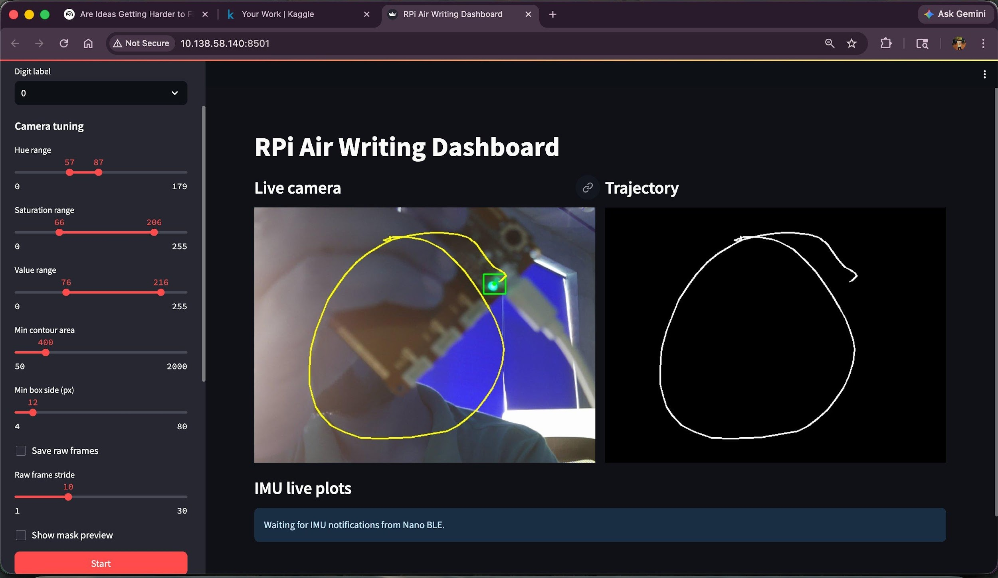
Data Collection & Dashboard
1,000+
Total Samples
100+
Per Digit (0–9)
2
Modalities
Preprocessing Pipeline:
HSV Thresholding • Contour Extraction
Trajectory Smoothing • Augmentation

Slide 5
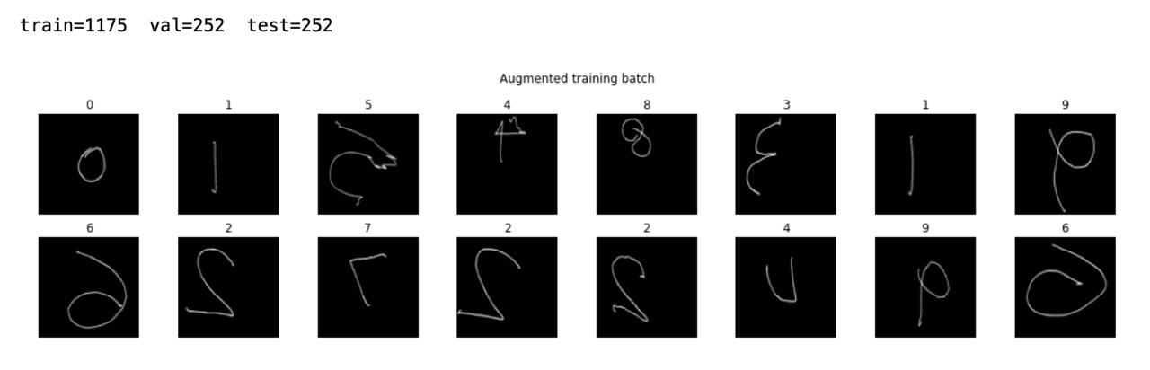
Trajectory Dataset — Sample Images
Augmented training batch: digits 0–9 captured via Raspberry Pi camera + green LED tracking
train = 1,175 | val = 252 | test = 252

Slide 6
Model Design & Training
IMU Branch — Random Forest
Vision Branch — GhostNet CNN
• 195 handcrafted features
• Mean, Std Dev, FFT, Energy
• Correlation & Magnitude
• Deployed via micromlgen on Arduino
• On-device inference (C++ header)
• Lightweight GhostNet-inspired CNN
• Efficient Channel Attention (ECA)
• Mixup & label smoothing augment.
• Cosine LR scheduler
• Quantization-Aware Training (QAT)
Accuracy: ~88%
Accuracy: ~99%

Slide 7
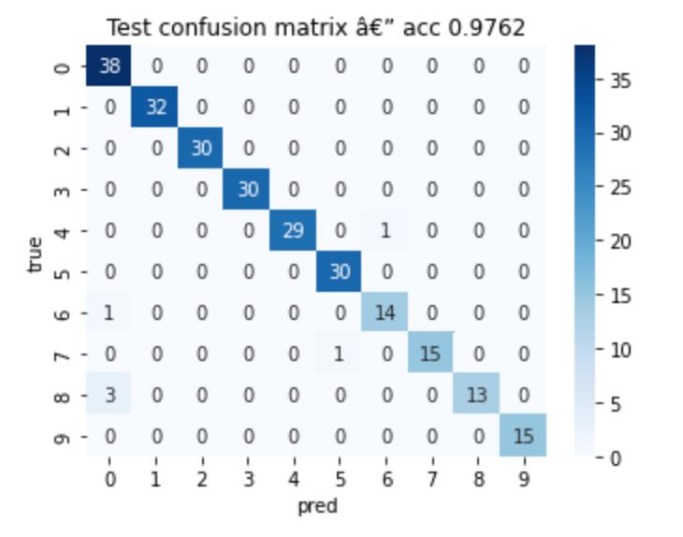
Results & Evaluation
~88%
~99%
~100%
IMU
Random Forest
Vision
GhostNet CNN
Ensemble
Prediction
Test Confusion Matrix (Vision Model)
Key Findings
✔ Vision model correctly classified all digits in most test sessions
✔ Digit '8' had slight confusion with '0' (IMU branch)
✔ Ensemble resolved all ambiguous IMU predictions
✔ QAT retained accuracy with smaller model footprint

Slide 8
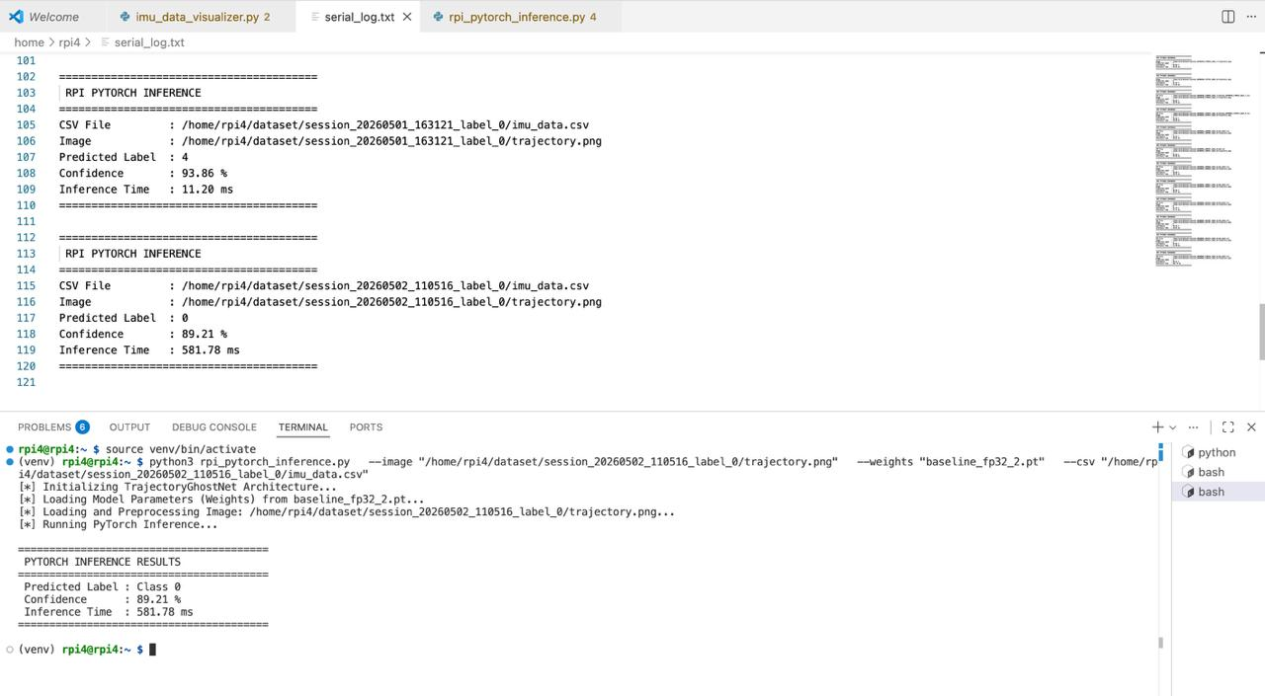
Edge Deployment
Raspberry Pi PyTorch Inference Log
Deployment Details
Arduino:
Random Forest in C++
via micromlgen
Raspberry Pi:
GhostNet CNN via
PyTorch + QAT
Latency:
~11 ms (RPi)
Real-time on Arduino
Confidence:
89–94% typical
per inference

Slide 9
Challenges & Future Work
⚠️ Key Challenges
🚀 Future Work
Raspberry Pi lag → separated IMU & vision pipelines
🔤
Alphabet & word recognition
Noisy IMU signals → feature engineering & normalization
📶
BLE synchronized acquisition
Inconsistent trajectories → augmentation & smoothing
📱
Mobile deployment
Lighting sensitivity → HSV threshold tuning
🤖
Transformer-based sequence models
Embedded constraints → GhostNet + QAT compression
🥽
AR/VR integration

Slide 10

Demonstration

Slide 11
Thank You!
✍️
Air-Writing Digit Recognition
Edge AI • Semester 2
Amisha Sadhukhan • Tathagat Ghosh • Gaurav Chaudhary
🔗 github.com/team/air-writing-recognition
Questions?

