Slide 1

Analytics
Hackathon 2023

Slide 2

Strategies
§ Understanding the given Problem Statement.
§ Researching on the factors that can affect the
unemployment rate for each of the G7 countries over
the years.
§ Gathering necessary and relevant historical data on the
factors as much as possible at monthly level from
reliable sources.
§ Applying a suitable forecasting technique, a statistical
model which would be apt to predict the
unemployment rates of the future months.
7
2

Slide 3
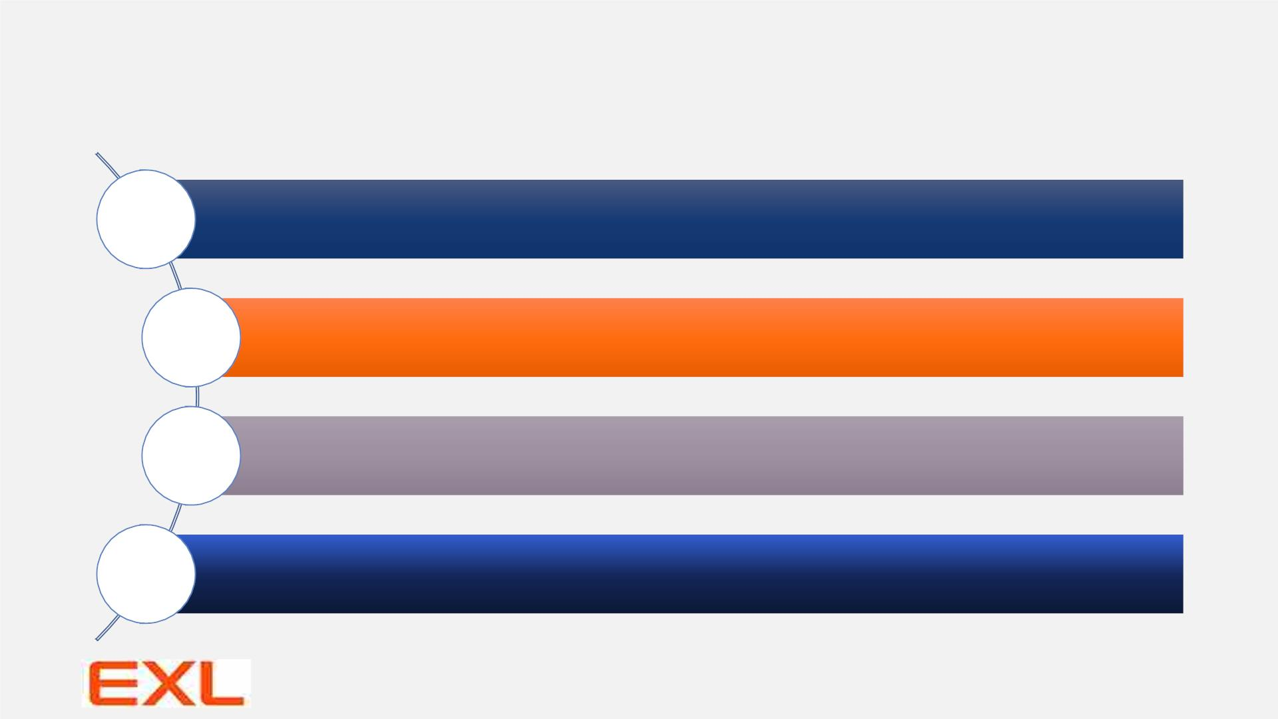
External factors considered
Population
figures
Working-age population, Labour force, Unemployment level of males, females & overall,
Part-time & full-time employment numbers
Rates &
Proportions
Employment rates, Inactivity rates/Labour Force Participation rates
Economic
factors
Consumer Price Index (CPI)/ Producer Price Index (PPI)/ Gross Domestic Product
(GDP)/ Monthly Inflation rates of any of these factors etc.
Average working hours, Wages of labourers, Total new job vacancies, Monthly labour costs,
Other
factors energy costs, other derived variables etc.
7
3

Slide 4

Data Sources
1. Unemployment - Unemployment rate - OECD Data
2. https://www.e-stat.go.jp/en/stat-
search/files?stat_infid=000040046676
3. https://fred.stlouisfed.org/tags/series?t=france%3Bu
nemployment
4. www.ons.gov.uk
5. www.istat.it
6. www.statista.com
7
4

Slide 5
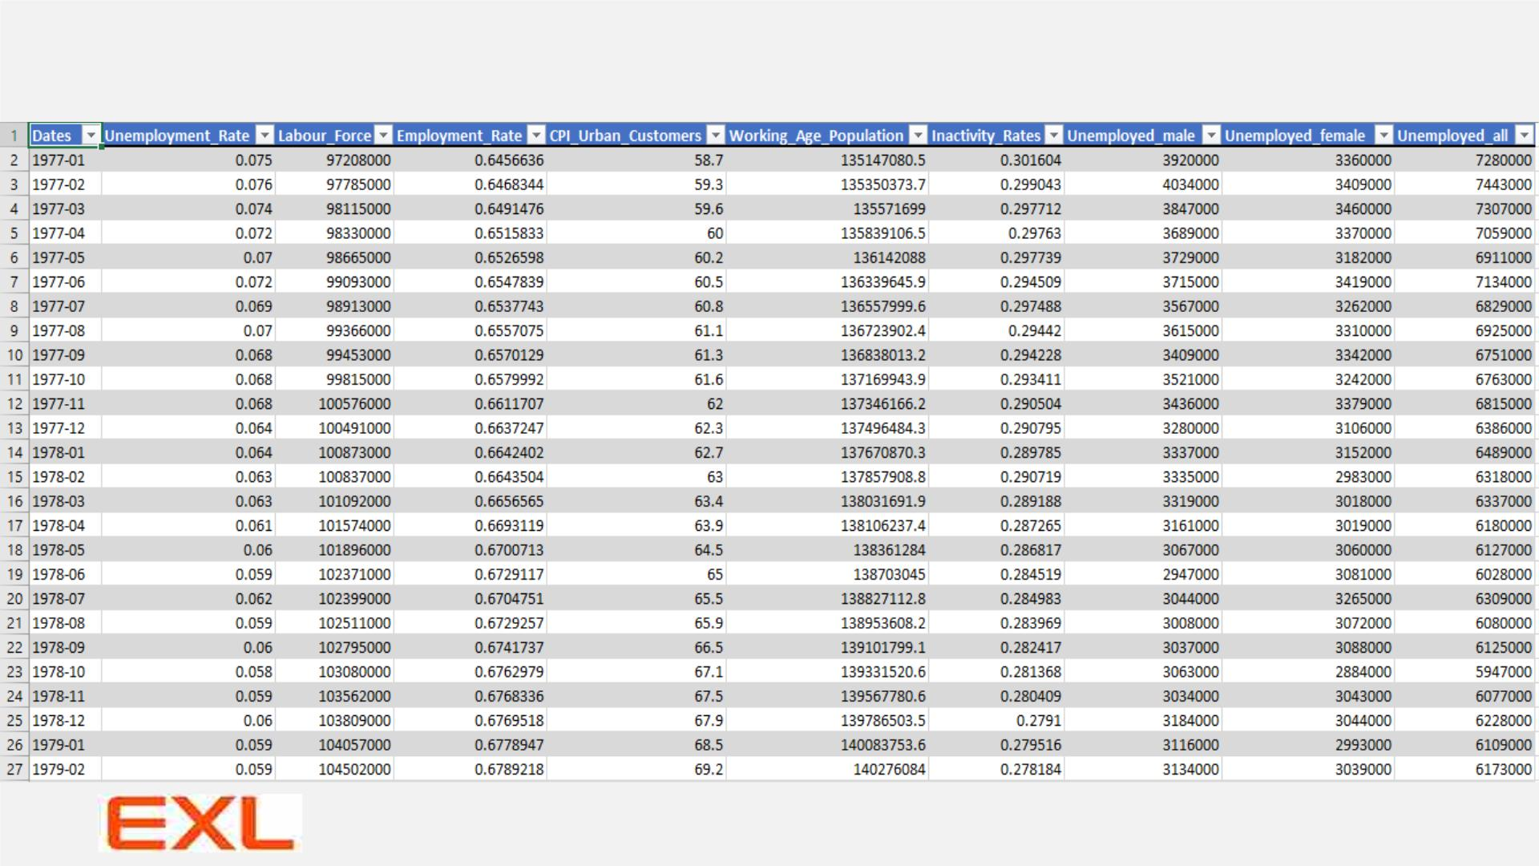
One example of the type of datasets used
7
5

Slide 6
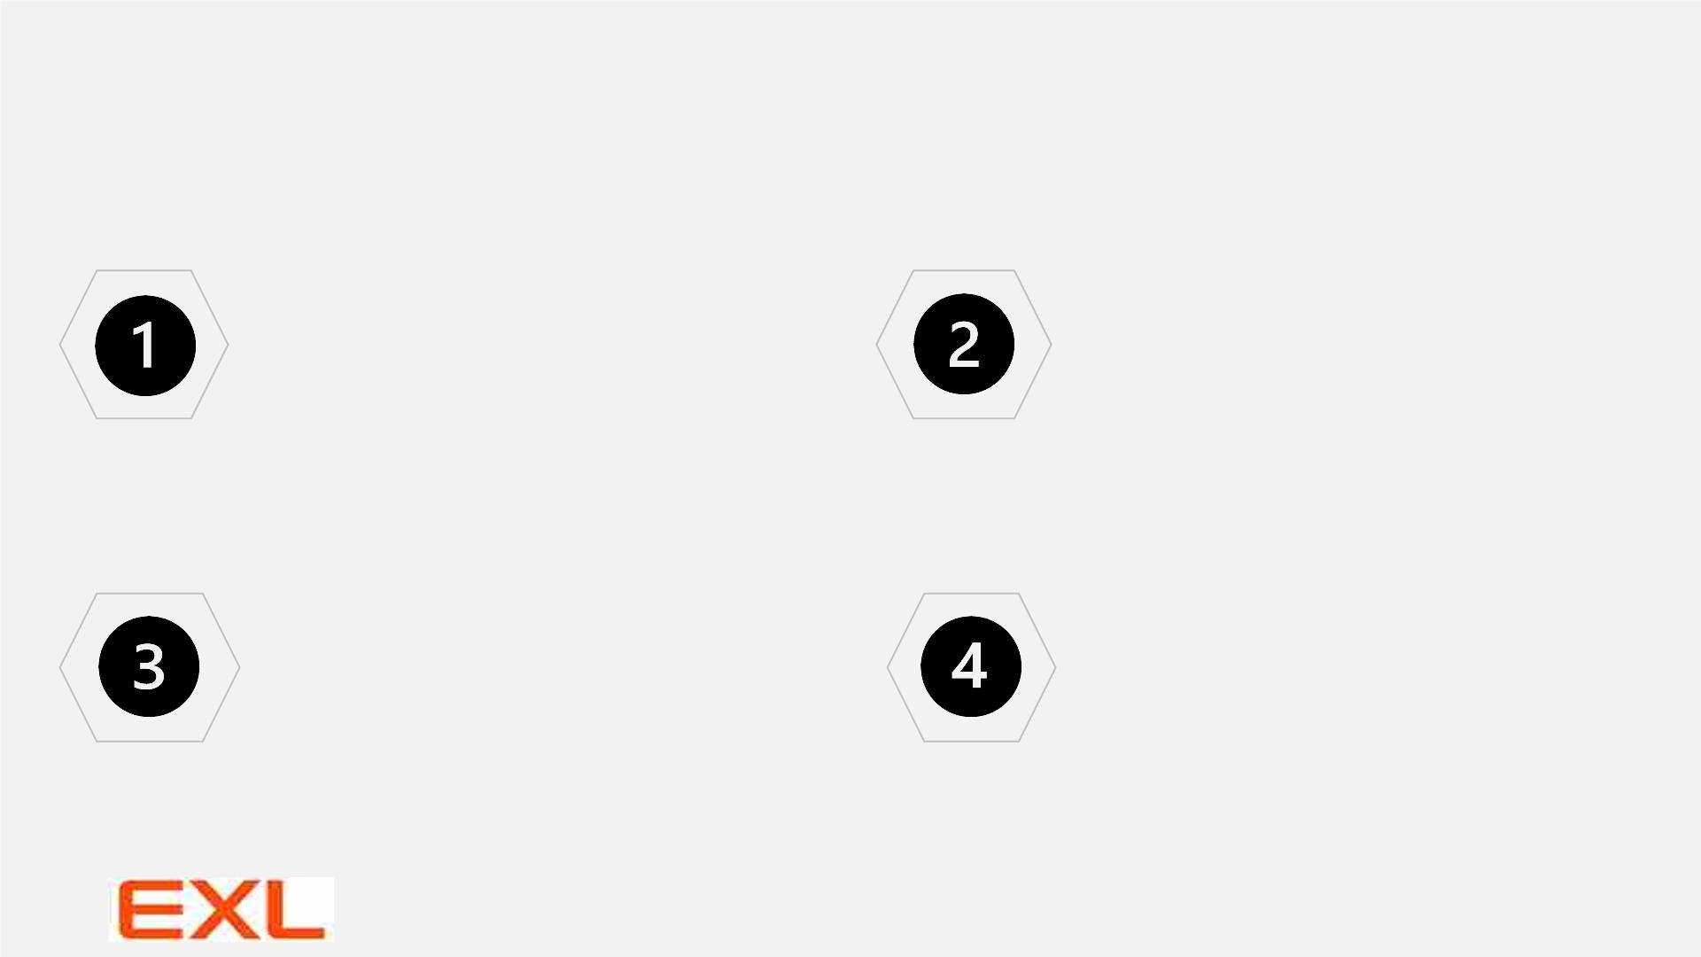
Methodologies & Workflow
Importing & preparing the datasets
Splitting the datasets –Train & Test parts
Historical data at monthly level for all the factors
have been imported into the Analytical tool, R Studio
from the reliable websites.
The latest 6 months data has been taken into “Test”
data and the rest has been taken into “Train” data
which is used to build and finalize the model.
Data preparation includes adding new derived
variable from the existing factors & deciding upon
the final sets of external variables based on
Multicollinearity.
The “Test” data has been used for validating the final
model by comparing the actual values with the
predicted ones.
Deciding upon the model parameters and
finalizing it using the “Train” set
Obtaining modelled values & future forecasts
The model, trained on the Train set has been validated
on the “Test” set and wherever external regressors are
present in final model, the values of those are
forecasted for the future months and then used as input
Future forecasts are then obtained as required.
Here the parameters p, d and q has been finalized where
p, d, q are the orders of Auto-Regressive, differencing
and Moving Average processes respectively.
Only the significant coefficients are kept in the final
model which are decided from the table of test of
significance with the corresponding p-values.
The upper & lower limits are the 95% Confidence
intervals.
7
6

Slide 7
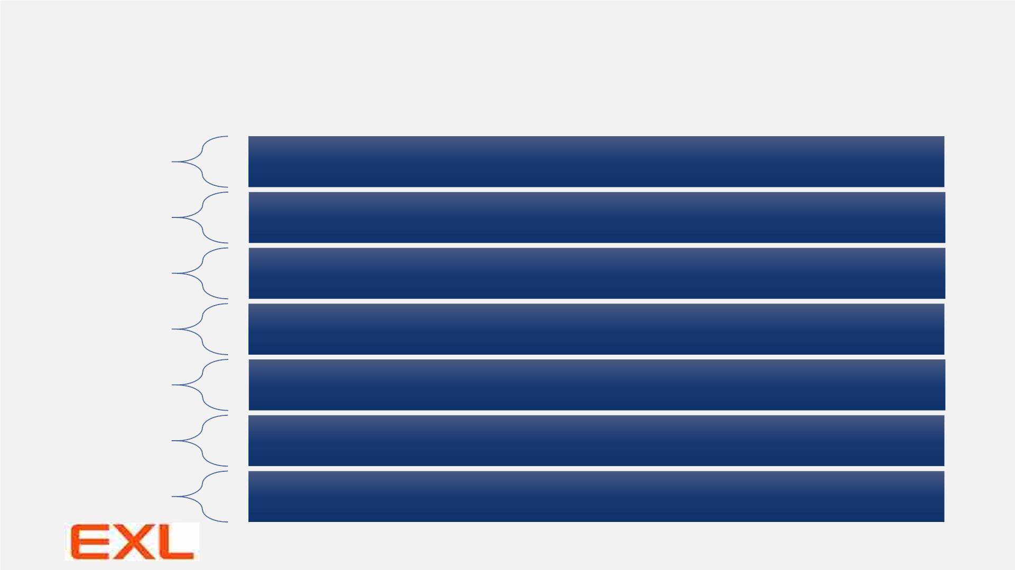
Final models used for prediction
Canada
• Time Frame –> 1976 Jan – 2023 Mar
• Final model –> Regression with ARIMA(1,1,2) or ARIMAX(1,1,2)
France
Germany
Italy
• Time Frame –> 1989 Jan – 2023 Feb
• Final model –> ARIMA(1,1,1)
• Time Frame –> 1991 Jan – 2023 Mar
• Final model –> ARIMA(1,2,2)
• Time Frame –> 2004 Jan – 2023 Mar
• Final model –> Regression with ARIMA(0,2,1) or ARIMAX(0,2,1)
Japan
UK
• Time Frame –> 1976 Jan – 2023 Mar
• Final model –> ARIMA(2,1,1)
• Time Frame –> 1997 Jan – 2023 Feb
• Final model –> Regression with ARIMA(1,1,1) or ARIMAX(1,1,1)
USA
• Time Frame –> 1977 Jan – 2023 Mar
• Final model –> Regression with ARIMA(1,1,2) or ARIMAX(1,1,2)
7
7

Slide 8

Results from
the fitted
models

Slide 9
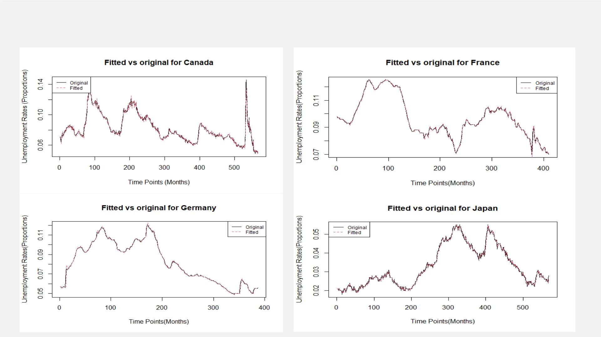
Examples of Actual vs Fitted plots for some of the countries over the years

Slide 10
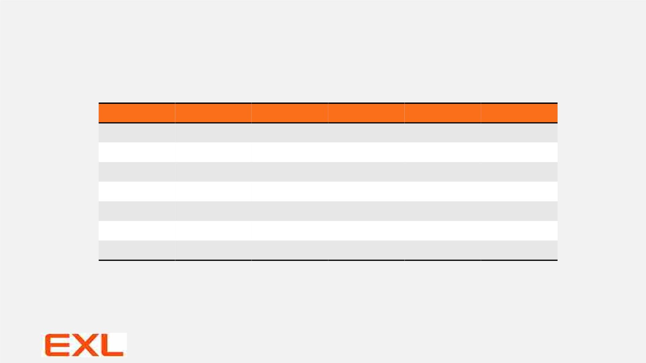
Comparison b/w Actual & Forecasts of the
months that were asked for
Countries
Canada
France
Germany
Italy
Months
May 2023
April 2023
May 2023
April 2023
April 2023
March 2023
May 2023
Actuals
5.20%
7.00%
5.60%
7.80%
2.60%
3.90%
3.70%
Forecasts
5.01%
6.86%
5.63%
7.72%
2.74%
3.82%
3.52%
Upper Bound Lower Bound
5.62%
7.09%
5.90%
8.12%
2.94%
3.99%
3.62%
4.41%
6.64%
5.36%
7.31%
2.54%
3.64%
3.42%
Japan
UK
USA
Ø Root Mean Square Error (RMSE) – 0.00131
Ø Mean Absolute Percentage Error (MAPE) – 2.775%
7
10

Slide 11
Some key findings
Ø Inactivity Rates or in other words Labour Force participation rate
plays significant role in prediction of unemployment rates in
countries like Canada, Italy, USA. As participation of Labour Force
decrease, unemployment increases.
Ø For instance, on an average, decrease in participation rate of 100
people leads to unemployment of 65 people in Canada.
Ø CPI plays significant role in unemployment prediction in Italy.
Ø Ratio of male to female unemployment plays more or less
significant role in unemployment in UK & USA where we say that
the increase in female unemployment may be a cause of concern
towards total unemployment.
Ø Average actual weekly hours of work plays moderately significant
role towards unemployment in UK.
7
11

Slide 12

What’s next?
Things that were beyond
the scope like
incorporating more factors
which can play a vital role
in prediction of
unemployment, that
couldn’t be added here
because of limitations,
may be due to
unavailability of proper
reliable data

Slide 13

Hack-HPT - Bibliography
Name – Tathagata Bardhan
THANK
YOU
1
2
3
Emp id - 165123
Team – NRG
Name – Priyanka Sarkar
Emp id - 164423
Team – NRG
Name – Harshit Gola
Emp id - 175058
Team – NRG

