Slide 1
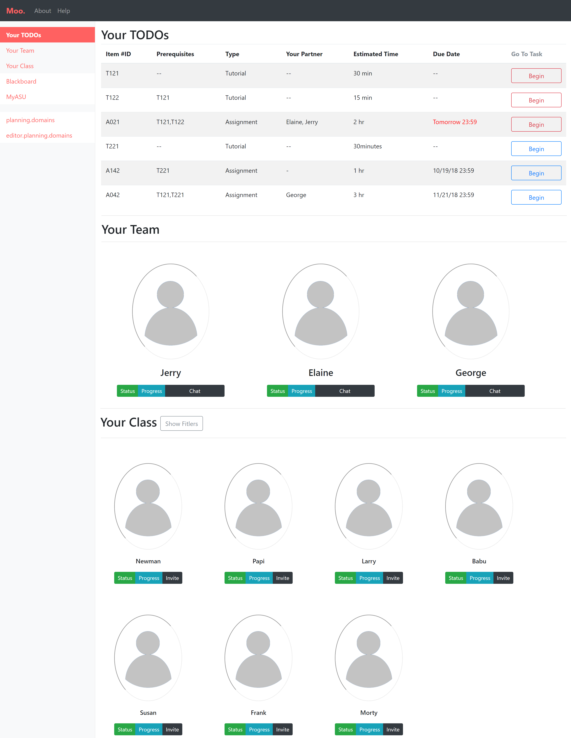
Tips and hints on how to use Moo.
List of tutorials and assignments
Quicklinks to features / resources
Endpoint to blackboard
Embedded chat functionality (yet to implement).
Details of study partners
(as made public)
Details of the current study group for a student
Filter to find classmates
Details of individual classmates (as made public)
Details of
the class

Slide 2
Tips and hints on how to use Moo.
Quicklinks to features / resources
List of tutorials and assignments
Embedded chat functionality (yet to implement).
Details of the current study group for a student
Filter to find classmates
Details of
the class

Slide 3
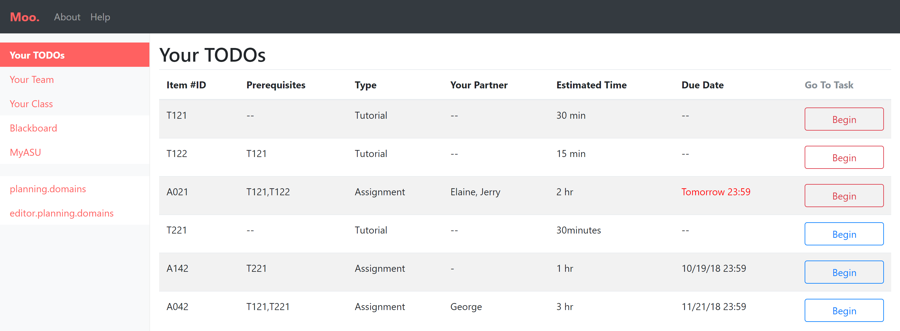
Details of tutorials / assignments for the student
Endpoint to blackboard
Prerequisites for an assignment / tutorial (used internally by Moo. to come up with dynamic curriculum and potential student partners.
Student partners assigned for collaborative work on an assignment (recommended by Moo. and accepted by student)

Slide 4
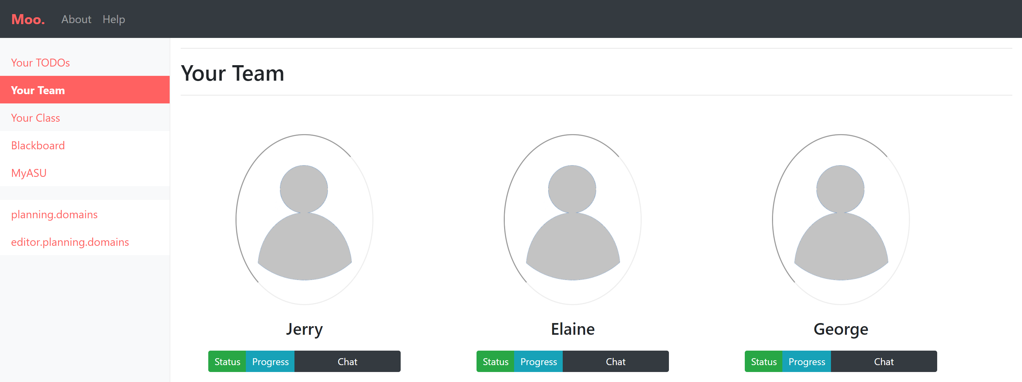
Profile of study partner (as made public)
Community status, e.g. whether already part of other groups
Progress in their own curriculum
Chat directly with study partner

Slide 5
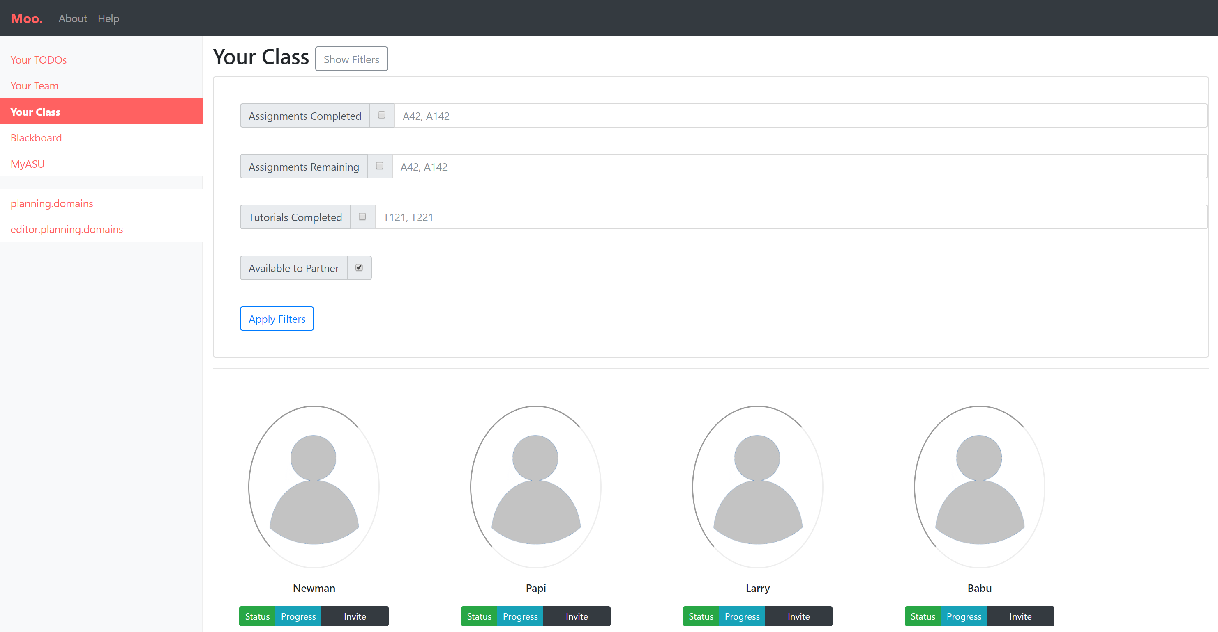
Filters to search potential study partners, e.g. assignments or tutorials completed.
Moo. is intended to add to this filter
Profile of study partner (as made public)
Moo. is intended to recommend potential useful partnerships
Community status, e.g. whether already part of other groups
Invite to form study group
Progress in their own curriculum

