Slide 1

ICAPS 2019
Berkeley, California, USA
Conference Chairs: J. Benton and Siddharth Srivastava
Program Chairs: Nir Lipovetzky, Eva Onaindia, and David E. Smith

Slide 2
Organizing Team
Novel Applications Track Chairs | Simon Parkinson (Hud) and Shirin Sohrabi (IBM)
Robotics Track Chairs | Kostas Bekris (Rutgers) and Alberto Finzi (UniNa)
Planning and Learning Track Chairs | Alan Fern (OSU) and Timothy Mann (DeepMind)
Journal Presentation Track Chairs | Amanda Coles (KCL) Christian Muise (IBM) and Daniel Bryce (SIFT)
Workshop Chairs | Sara Bernardini (RHUL) and Tiago Vaquero (JPL)
Tutorial Chairs | Mark Roberts (NRL) and Kartik Talamadupula (IBM)
System Demonstration Chairs | Erez Karpas (Technion) and Tim Niemueller (RWTH Aachen)
Doctoral Consortium Chairs | Christopher Amato (NEU) Akshat Kumar (SMU) and Andrey Kolobov (MSR)
Local Arrangements Chair | Richa Varma (UTRC)
Publicity Chair | Tathagata Chakraborti (IBM)
Sponsorship Chairs | Jeremy Frank (NASA) Daniele Magazzeni (KCL) and Hankz Hankui Zhuo (Sun Yat-sen)
Advisory Chair | Stuart Russell (UC Berkeley)

Slide 3
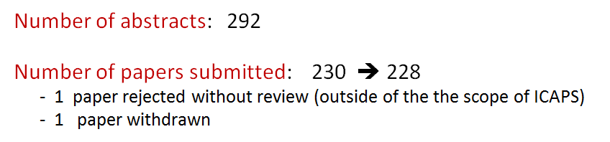
Main Technical Program

Slide 4
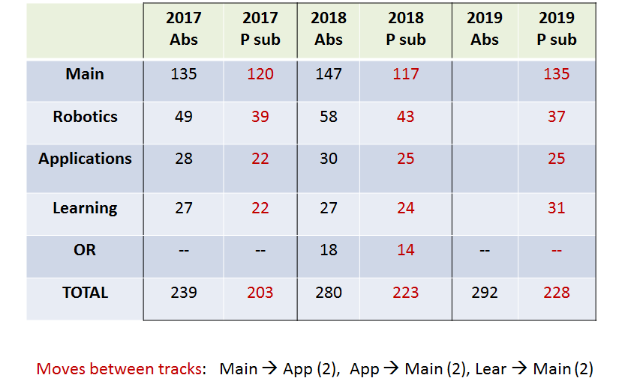
Submission by area

Slide 5
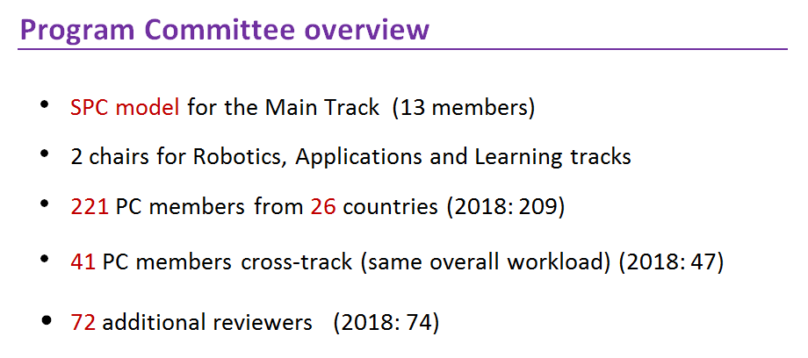

Slide 6
SPC model (13 members)
10-12 paper per member
SPC member leading discussion and metareview
Advantages
Dedicated senior person assigned to a paper
Notices problems and conflicts
Informs chairs about the need of finding additional reviewers
Follows discussions
Reviews paper if needed
Disadvantages
Fewer people in the PC

Slide 7
Program Committee: Main Track (2)
Senior Program Committee
Pascal Bercher · Ulm University
Patrik Haslum · Australian National University
Shlomo Zilberstein · University of Massachusetts Amherst
Sven Koenig · University of Southern California
Blai Bonet · Universidad Simon Bolivar
Daniele Magazzeni · King's College London
Erez Karpas · Technion - Israel Institute of Technology
Gabriele Röger · University of Basel
Roman Barták · Charles University
Chris Beck · University of Toronto
Jörg Hoffmann · Saarland University
Scott Sanner · University of Toronto
Ronen Brafman · Ben-Gurion University

Slide 8
2010 | 39/113 = 34.5%
2011 | 48/138 = 34.8%
2012 | 45/132 = 34.1%
2013 | 60/146 = 41.1%
2014 | 62/164 = 37.8%
2015 | 45/138 = 32.6%
2016 | 64/184 = 34.8%
2017 | 71/203 = 35.0%
2018 | 65/220 = 29.5%
2019 | 89/228 = 39.0%

Slide 9
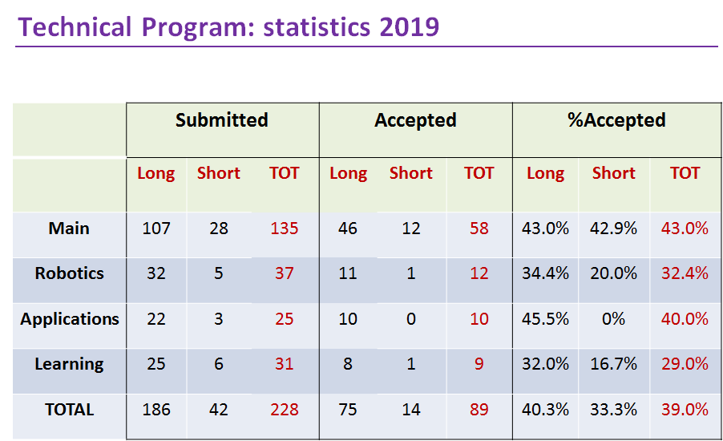

Slide 10
 | ICAPS 2017 | ICAPS 2018 | ICAPS 2019
Total submissions | 203 | 220 | 228
Main (acc/sub) | 43/120 (35.8%) | 35/117 (29.9%) | 58/135 (43.0%)
Robotics (acc/sub) | 15/39 (38.5%) | 13/43 (30.2%) | 12/37 (32.4%)
Applications (acc/sub) | 7/22 (31.8%) | 8/25 (32%) | 10/25 (40%)
Learning (acc/sub) | 6/22 (27.3%) | 5/24 (20.8%) | 9/31 (29%)
OR (acc/sub) |  | 4/14 (28.6%)
TOTAL ACCEPTED | 71 (35%) | 65 (29.5%) | 89 (39.0%)

Slide 11
Journal Presentation Track
6 submissions, all accepted
Journal of Artificial Intelligence Research
Constraints
INFORMS Journal of Computing
Theory and Practice of Logic Programming
Optimization
Journal of Field Robotics

Slide 12
ICAPS 2019: special sessions
9 Workshops
8 Tutorials
21 System demonstrations
14 applications to the Doctoral Consortium

Slide 13
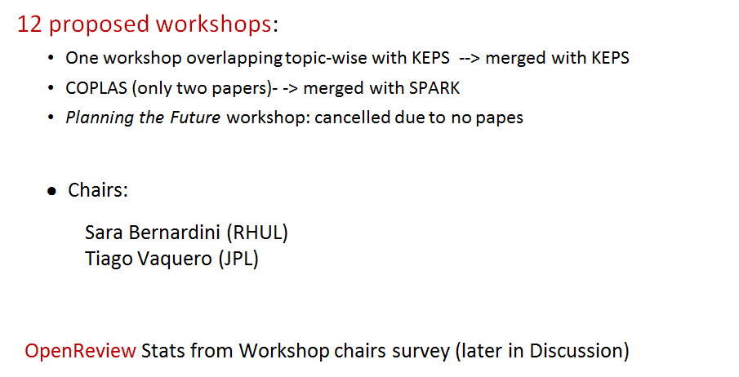
Workshops (I)

Slide 14
Workshops (II)
 | 9 workshops | #accepted papers | #express interest
Hierarchical Planning | Hierarchical Planning | 7 | 78
HSDIP | Heuristics and Search for Domain-Independent Planning | 12 | 83
IntEx | Integrated Planning, Acting and Execution | 9 | 72
WIPC | The International Planning Competition | 9 | 49
KEPS | Knowledge Engineering for Planning and Scheduling | 11 | 67
PlanRob | Planning and Robotics | 16 | 109
SPARK | Scheduling and Planning applications woRKshop | 11 | 84
XAIP | EXplainable AI Planning | 21 | 103
Actions | Reasoning about Actions and Processes: Highlights of Recent Advances | 13 | 46

Slide 15
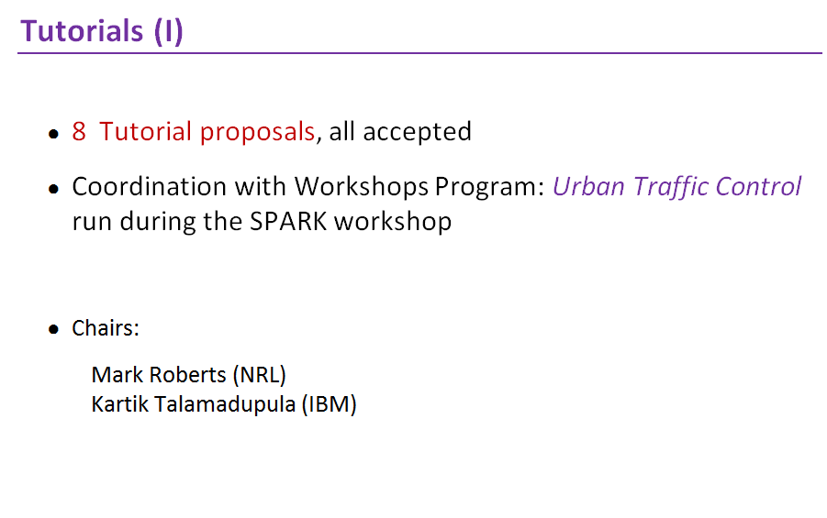

Slide 16
Tutorials (II)
 | 8 Tutorials | Presenters | #express interest
T1 | Multi-Agent Pathfinding: Models, Solvers, nd Systems | Roman Barták, Philipp Obermeier, Torsten Schaub, Tran Cao Son, Roni Stern | 68
T2 | Planning and Scheduling Approaches for Urban Traffic Control | Scott Sanner, Stephen F. Smith, Mauro Vallati | 67
T3 | Temporal Reasoning | Nikhil Bhargava, Brian Williams | 64
T4 | AI Planning for Robotics with ROSPlan | Michael Cashmore, Daniele Magazzeni | 67
T5 | From Teaching the PDDL Novice to Empowering the Planning Solution Integrator | Jan Dolejsi, Derek Long, Maria Fox, Christian Muise | 48
T6 | Integrated Tasks and Motion Planning | Malik Ghallab, Felix Ingrand, Rachid Alami, Thierry Simeon | 57
T7 | Goal Reasoning Design | Sarah Keren, William Yeoh | 53
T8 | Deep Reinforcement Learning with Applications in Transportation | Zhiwei (Tony) Qin, Jian Tang, Jieping Ye | 89

Slide 17
System Demonstrations
21 demos accepted (out of 23 proposals):
Chairs:
Erez Karpas (Technion)
Tim Niemueller (RWTH Aachen)
A record number of demos this year (6 at ICAPS 2017, 9 at ICAPS 2018)
Chairs e-mailed authors of ICAPS papers that the reviewers
indicated might be suitable for a demonstration.

Slide 18
Doctoral Consortium (I)
14 applications, all accepted for mentoring program (12 student attendance, 2 visa issues)
7 mentors
Chairs:
Christopher Amato (NEU)
Akshat Kumar (SMU)
Andrey Kolobov (MSR)

Slide 19
Doctoral Consortium (II)
Schedule
11:15 - 11:30 Arrival and check-in
11:30 - 11:45 Opening remarks
11:45 - 12:30 Spotlight talks
12:30 - 2:00 Lunch (catered) & mentee poster session
2:00 - 2:45 Invited Talk: Anca Drǎgan, “Learning Robot Reward Functions”
2:45 - 3:30 Invited Talk: Mykel Kochenderfer, ”Robust Decision Making for
Safety Critical Applications”
3:30 - 4:00 Coffee break/discussion with mentors
4:00 - 4:45 Panel on careers in planning and scheduling
4:45 - 5:00 Closing remarks

Slide 20
Discussion: OpenReview (I)
Stats from Workshop Survey:
31 responses (authors, reviewers and workshop chairs)
https://docs.google.com/forms/d/1BCeQqUI-q-5BKeWd394Gitn29sWXaZXYvhy3Ml27pJE/edit?ts=5d111142#responses
Participation in workshops using OpenReview:
XAIP (3)
SPARK (2)
KEPS (5)
WIPC (11)
HSIP (15)
Hierarchical Planning (8)

Slide 21
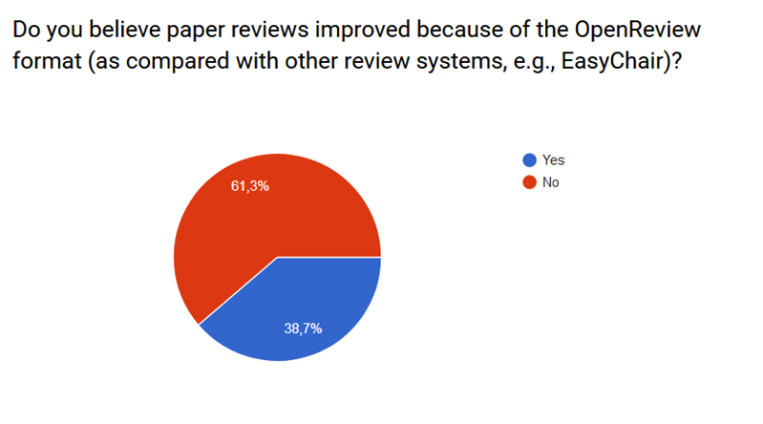
Discussion: OpenReview (II)

Slide 22
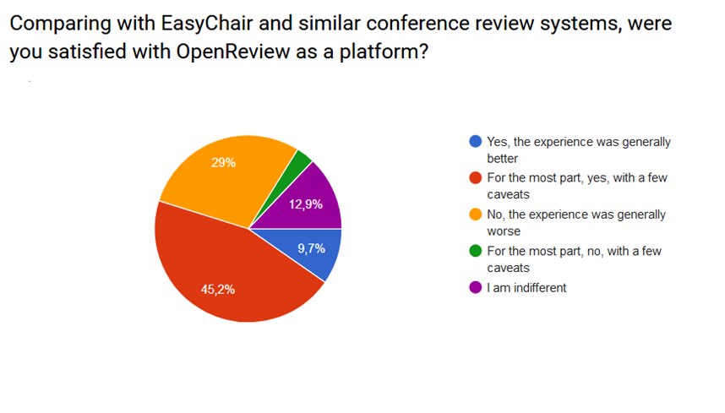
Discussion: OpenReview (III)

Slide 23
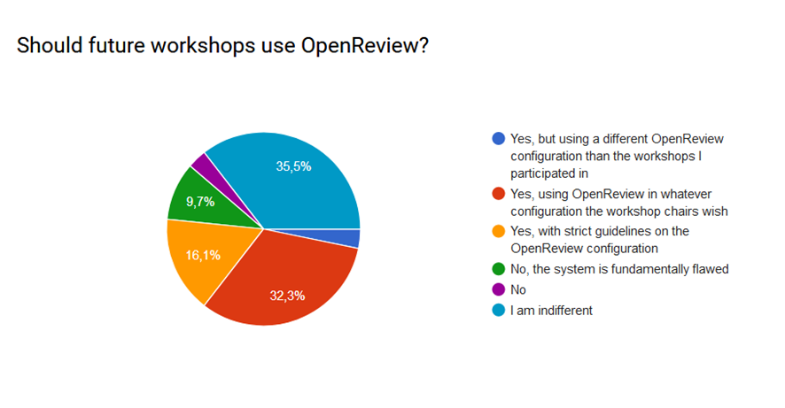
Discussion: OpenReview (IV)

Slide 24
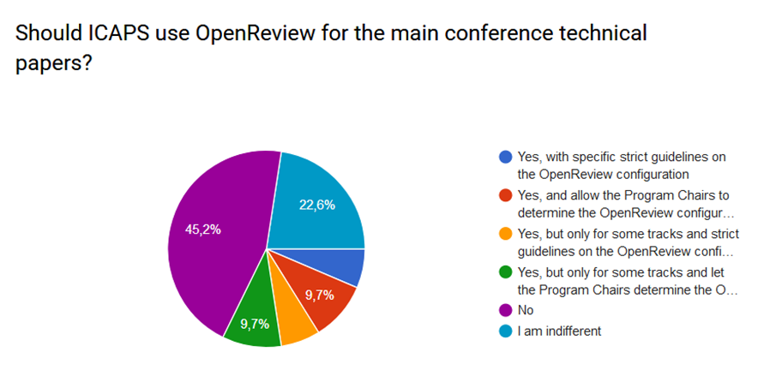
Discussion: OpenReview (V)

Slide 25
Discussion: Issues
Advice for Workshop Chairs ICAPS 2020 (OpenReview)
Need to provide OpenReview guidelines on best practice and explore different reviewing models
● Gabriele Röger (University of Basel)
● Christian Muise (IBM)
AAAI Press?
Many issues. Should reconsider agreement. Help AAAI press transition, and find out alternative until they are in good shape? Would be beneficial to support a strong AAAI press to support AI research.
Tracks
● difficulty of recruiting reviewers and assigning the right number of papers
● papers submitted to the wrong track & paper transfers
● Easychair management more complex
Alternative: One or two SPC members for area instead of track chairs. One global pool of reviewers.

Slide 26
Discussion: KR and tools for future ICAPS-XX
Github project:
Repo: https://github.com/nirlipo/ICAPS19
kanban board: https://github.com/nirlipo/ICAPS19/projects/1
Reviewers, SPC and Paper assignment scripts adapted from Blai for ICAPS:
scraping easychair,
assigning papers to PC and SPC (greedy algorithm)
uploading assignment
Timetabling solver for assigning papers to sessions (visualised with spreadsheet)
https://github.com/nirlipo/ICAPS19/tree/master/scheduler
Future organisers can create a new kanban project, and reuse all the cards with useful info, which will show the tasks to complete
Every year we should refine and improve our tools

Slide 27
ICAPS Attendance
 | 2015 | 2016 | 2017 | 2018 | 2019
early regular | 75 | 96 | 88 | 111 | 135
early student | 57 | 78 | 60 | 93 | 88
late regular | 20 | 43 | 30 | 52 | 40
late student | 11 | 9 | 23 | 6 | 17
total student | 68 | 87 | 83 | 99 | 106
total regular | 95 | 139 | 118 | 163 | 175
total | 163 | 226 | 201 | 262 | 280
As of July 8

Slide 28
ICAPS Attendance by Country
Country | #
United States | 127
Germany | 29
United Kingdom | 22
Australia | 14
Canada | 12
France | 10
Italy | 8
Israel | 8
Spain | 7
Switzerland | 6
Singapore | 5
Brazil | 4
Czech Republic | 4
Country | #
Austria | 3
India | 3
Japan | 3
South Korea | 3
Hungary | 2
Netherlands | 2
Portugal | 2
Taiwan | 2
Belgium | 1
China | 1
Ireland | 1
New Zealand | 1
As of July 8

Slide 29
ICAPS Student Attendance by Country
Country | #
United States | 45
Germany | 14
United Kingdom | 7
Canada | 6
Australia | 6
Israel | 5
India | 3
Spain | 3
Austria | 2
Brazil | 2
France | 2
Netherlands | 2
Singapore | 2
Country | #
Switzerland | 2
Belgium | 1
Italy | 1
Japan | 1
New Zealand | 1
Portugal | 1
Only non-students from Czech Republic, Austria, Hungary, China, Ireland, Taiwan, and South Korea
As of July 8

Slide 30
Costs
Fixed Costs
Variable Costs
Category | Cost
Venue Rental | $17919.00
Invited Speakers | $3690.00
Student Support | $33000.00
Event Management | $16150.00
Proceedings | $10668.12
Giveaways | $3634.99
Awards | $4500.00
Video Recording | $19682.40
Total | $109238.51
Category | Cost
Council Dinner | $4500.00
Reception Catering | $13355.50
Break Catering | $34312.25
Poster Session Catering | $6221.00
Banquet | $21959.25
Badges/Signs | $2200.00
Security | $3360.00
Est. Total | $85908.00
Fixed Costs | $109238.51
Est. Variable Costs | $85908.00
Est. Grand Total | $195172.76

Slide 31
Sponsors
Sponsor | Amount | Notes
Red Canyon Software | $2000 | via ICAPS 2019
SIFT | $2500 | via ICAPS 2019, Best Demo Sponsor
IBM | $2000 | via AAAI
NSF | $15000 | via Arizona State University, student support
David Smith | $5000 | via AAAI
DIDI | $5000 | via AAAI
AIJ | $7592.90 | via ICAPS 2019
Adventium Labs | $2000 | via ICAPS 2019
UTRC | $3000 | via AAAI, Best Applications Paper Award Sponsor
Nissan | $3000 | via AAAI
Safran | $3000 | via AAAI
Unipower | $3000 | Difficulty transferring funds
Total | $53092.90
As of July 6

Slide 32
Budget Summary
Category | Cost
Total Sponsorship | $53092.90
Estimated Registration | $154828.80
Total Est. Revenue | $207921.70
Total Est. Costs | $195172.76
Estimated Return | $12748.94

Slide 33
Other Comments
Student housing
Two Options:
Suite (130 USD/night) with dedicated bathroom
Resident Hall (118 USD/night) with shared bathroom
Includes access to a dining hall for breakfast, lunch, and dinner
Initially only open to students - opened up June 14 to all
All attendees - 39 of 280, or 14%
Students - 30 of 108, or 28%
Event Management Company (ExecutivEvents)
Pros
Frees up resources (helped to collect and analyze venue options)
Invaluable help in arranging caterers, contracts with venues
Cons:
Forced to use their registration system
High cost to use their payment gateway (42.50 USD per early registration transaction!). Opted to use our own for lower cost, which led to headaches
Handled one outside event, one conference hotel only

Slide 34
Other Comments - Financials/Payment Processing
Our bank account - Convenient but not necessarily ideal
USA: Sole proprietor owner (Sid) with authorized signer (J.) almost works
Account could go into probate court as if its an asset of the owner (i.e., in the event of owner death)
Payment processors (to avoid high cost associated with ExecutivEvents)
USA: Important to give Employer Identification Number (EIN)
Slow to approve payment processing
International transaction requirements (<30% of transactions allowed to be non-USA) - cancelation of account without notice
Went with PayPal after cancelation, but PayPal kept locking our account and asking for “proof of service delivery” or “supplier invoices/receipts”
Required a phone call each time (3 in total)
PayPal did not allow payment without an account for some non-USA
Some organizations/individuals needed to perform wire transfers

