Slide 1
SLMs vs LLMs:
The Data Efficiency Breakpoint
When Does Fine-Tuning a Small Model Beat Few-Shot Prompting a Large One?
Tathya Shah (tts49) · Dev Shah (djs525)
Rutgers University · NLP Final Project · Spring 2025

Slide 2
ROADMAP
01
02
03
Problem Statement
The Datasets
The Models
The core NLP trade-off: big & smart vs. small & efficient
GoEmotions, AG News, SNLI, CoLA
Mistral-7B (Goliath) vs. DistilBERT (David)
04
05
06
Experiments & Methodology
Results
Conclusion
Pipelines, training, evaluation protocols
Data Efficiency Curves & Breakeven Points
Findings, limitations, and next steps

Slide 3
01
The Core Problem
LARGE LANGUAGE MODELS (LLMs)
SMALL LANGUAGE MODELS (SLMs)
✓ Remarkably smart out-of-the-box
✓ Learn new tasks with just a few examples
✓ No labeled training data needed
✗ Computationally expensive
✗ Slow at inference in production
✗ High cost per query
Example: Mistral-7B (7 billion parameters)
✓ Lean, fast, and highly efficient
✓ Cheap to deploy at scale
✓ Updatable with task-specific data
✗ Data-hungry — need labeled examples
✗ Poor zero-shot generalization
✗ Require fine-tuning investment
Example: DistilBERT (~66M parameters)
VS
❓ At what point does it become worth it to invest in labeled data for a SLM rather than paying to run a LLM?
Currently, researchers and developers lack a precise map to navigate this trade-off. We do not know the exact "Breakeven Point” - the point where the specific volume of training data at which the efficiency of a fine-tuned SLM finally overtakes the raw power of a few-shot LLM.

Slide 4
02
The Datasets
🎭 GoEmotions
📰 AG News
Emotion Classification (Primary)
Topic Classification
Size: 58K Reddit comments
Size: 120K news articles
Labels: 12 of 27 emotion classes
Picked 12 to make the results more manageable and ensure a focused experiment for interpretation and robustness
Labels: 4 classes: World, Sports, Business, Sci/Tech
🧩 SNLI
✏️ CoLA
Natural Language Inference
Grammatical Acceptability
Size: 570K sentence pairs
Size: 10,657 sentences
Labels: 3 classes: Entailment, Neutral, Contradiction
Labels: Binary: Acceptable vs. Unacceptable

Slide 5
03
The Models
MISTRAL-7B — THE GOLIATH
DISTILBERT — THE DAVID
The Few-Shot Powerhouse
The Efficient Specialist
Model Type: LLM
Scale: 7 Billion Parameters
Task Approach: In-Context Learning
Given k examples in the prompt →
classifies without any weight updates. Using in-context learning, it learns tasks via prompt examples (k-shots) without updating underlying weights.
Evaluated across k ∈ {12, 24, 36, 48, 60, 96}
shot examples, averaged over 4 random trials
to mitigate sensitivity to prompt selection
Model Type: SLM Distilled Transformer (Encoder-Only)
Scale: ~66M Parameters
Task Approach: Supervised Fine-Tuning
Full fine-tuning on n labeled examples →
weights update based on training data/labeled dataset examples (n)
Trained across n ∈ {50, 150, 300, 450,
600, 750, 1000, 1200} training examples,
averaged over 2–4 random seeds
45% smaller 60% faster

Slide 6
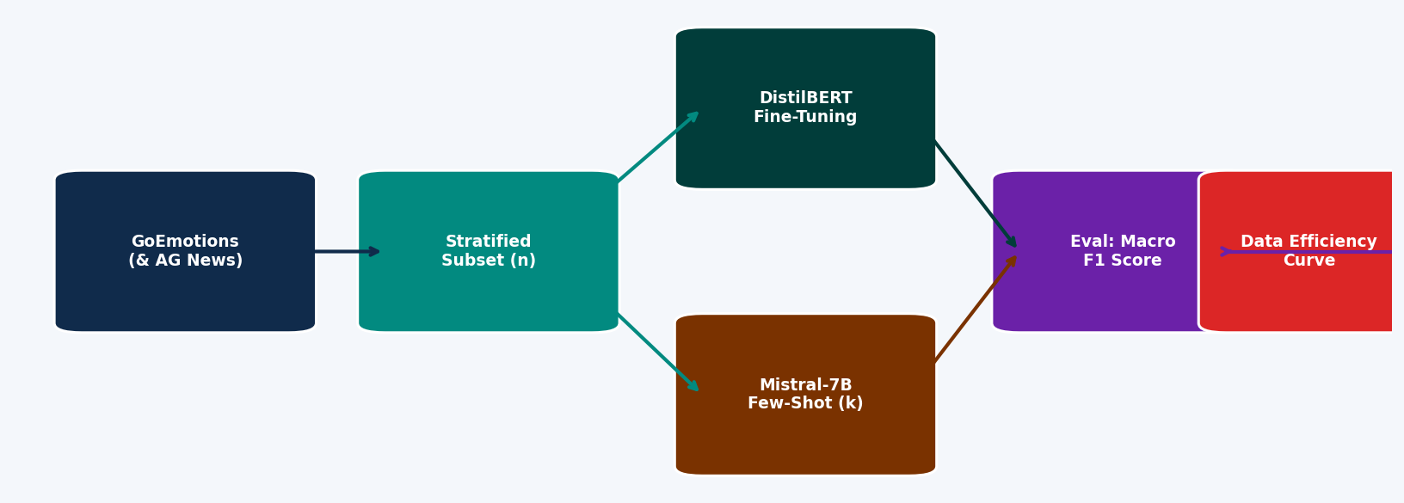
04
Experiment Design
Key Experimental Parameters
Training Sizes (n):
Few-Shot Shots (k):
50, 150, 300, 450, 600, 750, 1000, 1200
12, 24, 36, 48, 60, 96
Trials:
Metric:
2–4 random seeds averaged
Macro F1 Score on held-out test set

Slide 7
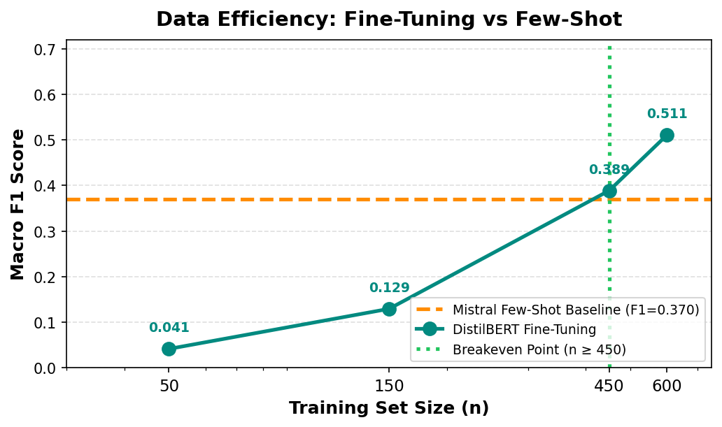
05
Results: GoEmotions — Primary Experiment
Key Findings
Mistral Baseline:
F1 = 0.370 (k=36 shots)
DistilBERT @ n=50:
F1 = 0.041 — well below baseline
DistilBERT @ n=150:
F1 = 0.129 — still catching up
DistilBERT @ n=450:
F1 = 0.389 — crosses baseline!
DistilBERT @ n=600:
F1 = 0.511 — surges ahead
Breakeven Point:
n ≈ 450 examples (37.5/class)

Slide 8
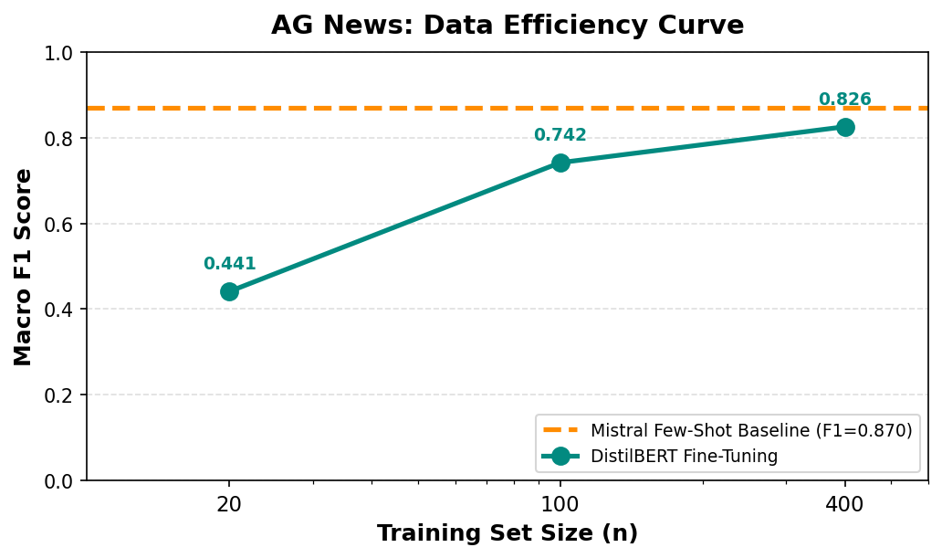
05
Results: AG News — Easier Task, Different Pattern
Insight: Task Complexity Matters
AG News is a simpler 4-class task vs.
GoEmotions' complex 12-class emotion
classification.
Mistral starts much higher (F1=0.87)
because topic classification requires
less nuanced understanding.
DistilBERT quickly learns the topic
structure — F1 of 0.74 with only 100
training examples.
Despite this, Mistral maintains its
lead through n=400, showing LLMs
excel at simple structured tasks.
Breakeven: n > 400 (not yet reached)

Slide 9
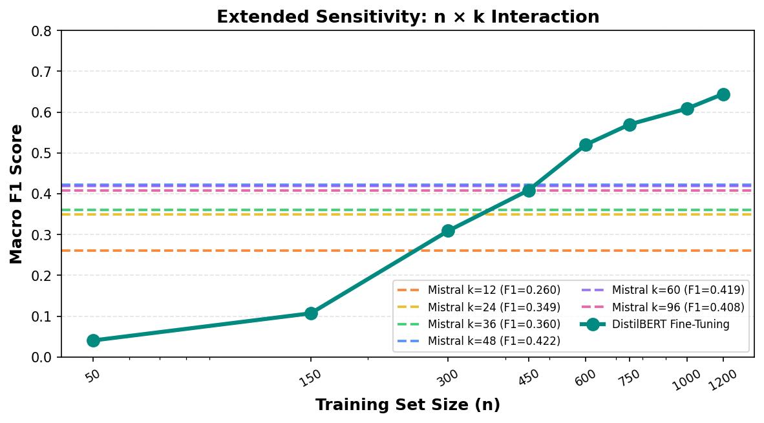
05
Sensitivity Analysis: How k Interacts with n
Observations
More shots (k) = higher Mistral baseline, harder for DistilBERT to catch up.
At k=12, breakeven is n≈150. At k=96, breakeven is n≈600+.
DistilBERT shows consistent learning curve regardless of k.
Around n=750–1000, DistilBERT surpasses even the best Mistral k=96 baseline.
High-k prompting has diminishing returns — going from k=60 to k=96 yields minimal gain.

Slide 10
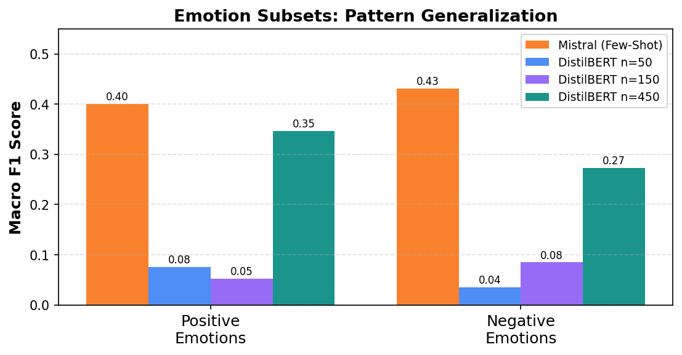
05
Results: Generalization Across Emotion Subsets
Generalization Findings
Pattern holds across both subsets:
• Mistral consistently outperforms
DistilBERT at low data regimes (n=50,150)
• Both subsets show DistilBERT
approaching Mistral around n=450
— consistent with primary results
• Negative emotions are harder
— both models score lower overall
on negative vs. positive subsets
• Mixed/cognitive emotions show
the highest task complexity and
slowest DistilBERT convergence
→ The Breakeven Point phenomenon
is robust across emotion groupings

Slide 11
05
Summary: Breakeven Points Across Tasks
Task
Mistral Baseline (F1)
DistilBERT @ Breakeven
Approx. Breakeven n
Task Complexity
GoEmotions (12 emotions)
0.370
0.389
~450
High (12 classes)
AG News (4 topics)
0.870
0.825
> 400 (not reached)
Low (4 classes)
Positive Emotions (12 labels)
0.401
0.347 @ n=450
~450+
High
Negative Emotions (12 labels)
0.431
0.273 @ n=450
~600+
Very High
📌 Core Finding: The Breakeven Point is real and consistent — DistilBERT catches up to Mistral faster on simpler tasks. More data = bigger advantage for SLMs. The more labeled data we have, the more efficient it will be to use SLMs when compared to LLMs, even for highly complex tasks. A bit of finetuning and labeled data is all you need to scale this at much cheaper costs and get much more efficient outputs.

Slide 12
06
Conclusion
What We Found
Limitations
✓
The Breakeven Point exists and is identifiable
• Small test sets used for speed (n=10–30 / class)
• GoEmotions subset is 12/27 classes only
• SNLI & CoLA pipelines in progress
• Results may vary with different LLMs
For GoEmotions, it occurs around n ≈ 450 labeled examples.
✓
Task complexity determines the crossover
Simpler tasks (AG News) keep LLMs dominant longer.
✓
Pattern generalizes across emotion subsets
Future Work
Both positive and negative subsets confirm the trend.
• Extend to SNLI (NLI) and CoLA (grammaticality) – this is much
• Test with LoRA / PEFT instead of full fine-tuning
• Explore quantized LLMs for fairer cost comparison
• Build a cost-aware Breakeven calculator to show the real implications and integrations of such SLM models instead of LLMs to make it cheaper and more efficient. 2 birds 1 stone.
✓
More shots (k) shifts the breakeven right
Harder to beat a well-prompted LLM — need more data.
→
Practical implication
If you can label ~450 examples, fine-tune. If not, prompt.

Slide 13
Thank You
Tathya Shah · tts49@scarletmail.rutgers.edu
Dev Shah · djs525@scarletmail.rutgers.edu
Rutgers University · NLP Final Project · Spring 2026
Models: mistralai/Mistral-7B-Instruct-v0.2 · distilbert-base-uncased · Dataset: go_emotions

