Slide 1
LISBON COWORKING
Lisbon Coworking Market
Opportunity Analysis
Research question
Which three Lisbon parishes should a coworking company study next?
Tatiana Krasilnikova
Notes:
Problem and decision scope.
[Sources]
- Project README and docs/project_brief.md

Slide 2
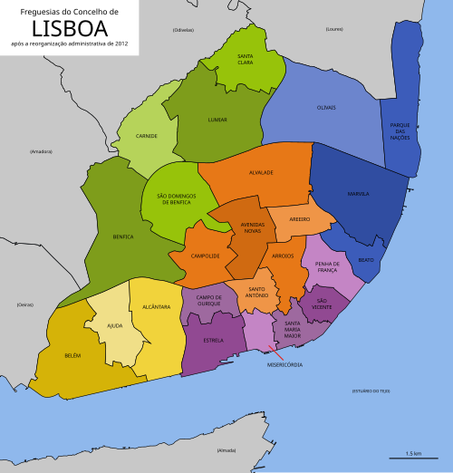
DATA
The data compares all 24 Lisbon parishes (areas)
24
67
191
10
official parishes (areas)
verified active
coworking locations
office rent listings
candidates with enough
rent data
Public sources
What we compare
Lisbon city data
INE Census
OpenStreetMap
Official coworking websites
Public office listings (Idealista)
Demand
Public transport
Coworking competition
Office rent
Rent was added after the first three-factor screening.
24 official parishes with defined boundaries
02
Notes:
Dataset overview.
[Sources]
- data/processed/coworking_locations.csv
- data/processed/parish_analysis_base.csv
- data/processed/commercial_rent_listings.csv
- https://www.lisboa.pt/en/municipality/parishes - https://commons.wikimedia.org/wiki/File:Lisboa_freguesias_2012.svg

Slide 3
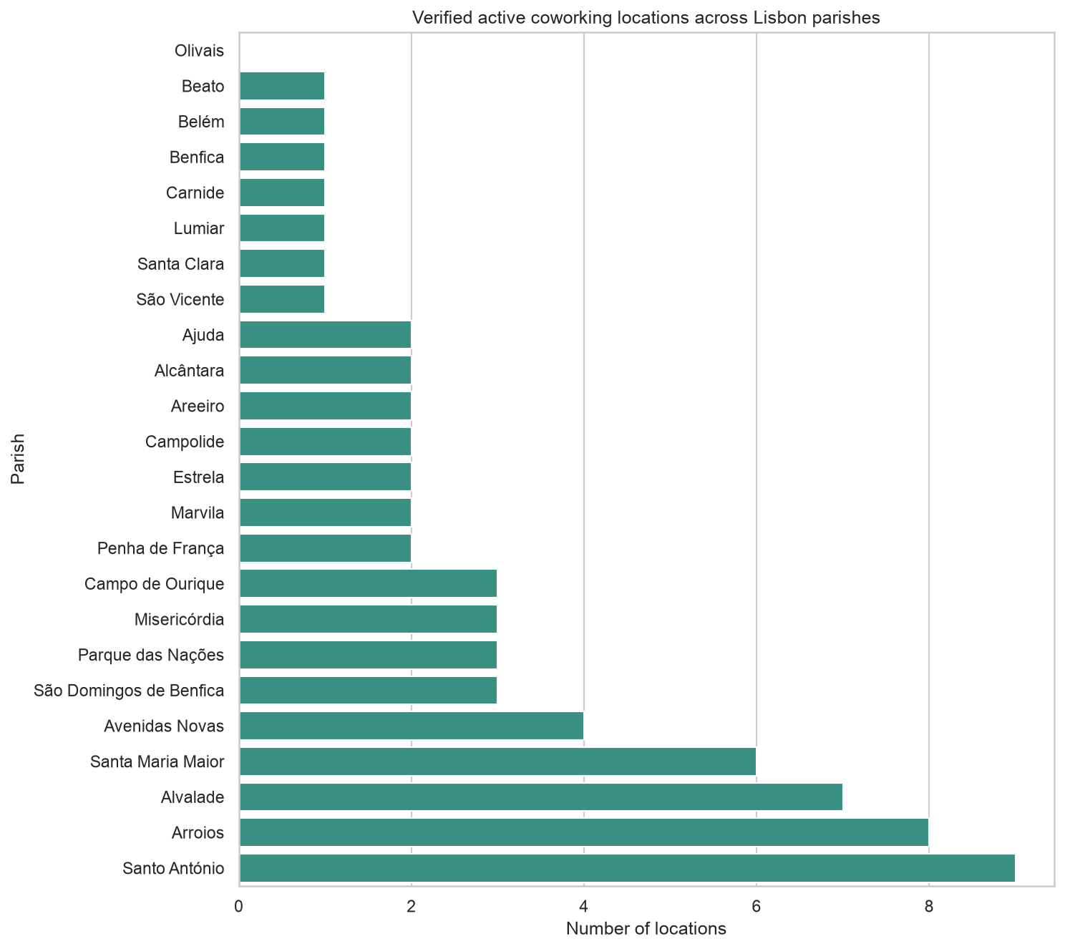
FINDING 1
Coworking supply is uneven across Lisbon
What the data shows
•
Olivais: no verified active coworking location found.
•
Top supply: Santo António 9, Arroios 8 and Alvalade 7.
•
Counts show verified locations found, not a complete market census.
03
Notes:
Verified public-source supply is uneven; counts are not a complete census.
[Sources]
- reports/figures/02_coworking_supply_all_parishes.png
- reports/tables/parish_eda_summary.csv

Slide 4
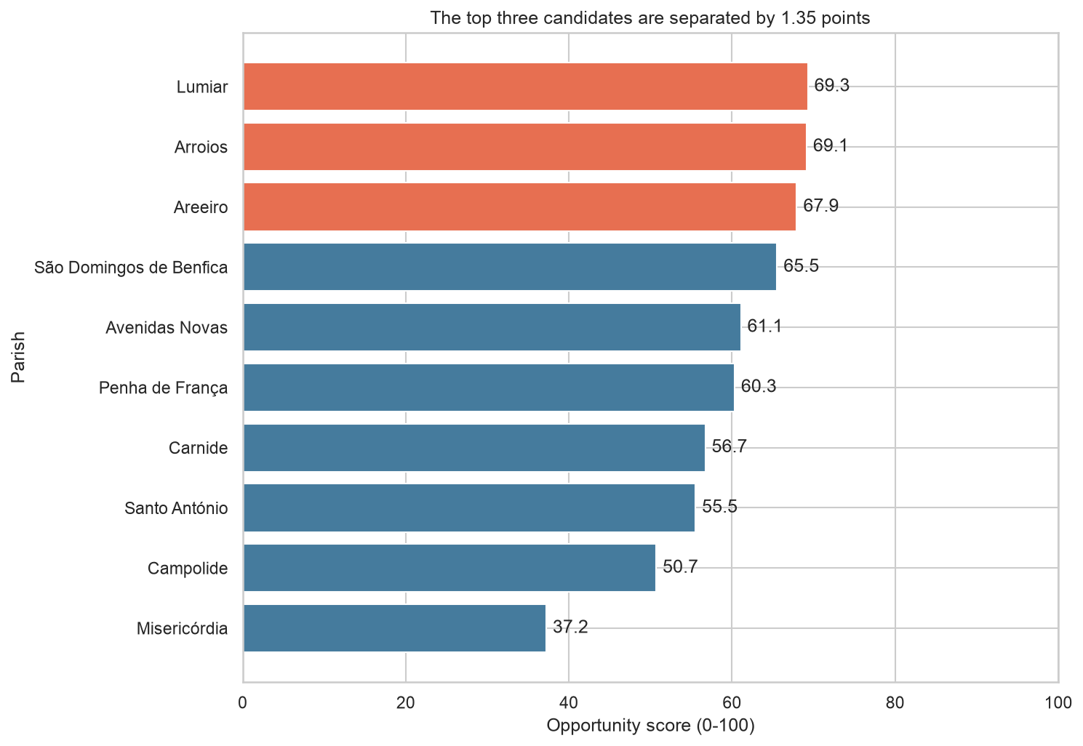
FINDING 2
Three areas form a close Opportunity Score shortlist
TOP 3
CLOSE SHORTLIST
67.9-69.3
Only 1.35 points separate Areeiro, Arroios and Lumiar.
04
Notes:
The top three scores are close, so the business interpretation is a shortlist.
[Sources]
- reports/figures/10_rent_inclusive_shortlist.png
- reports/tables/rent_inclusive_pilot_ranking.csv

Slide 5
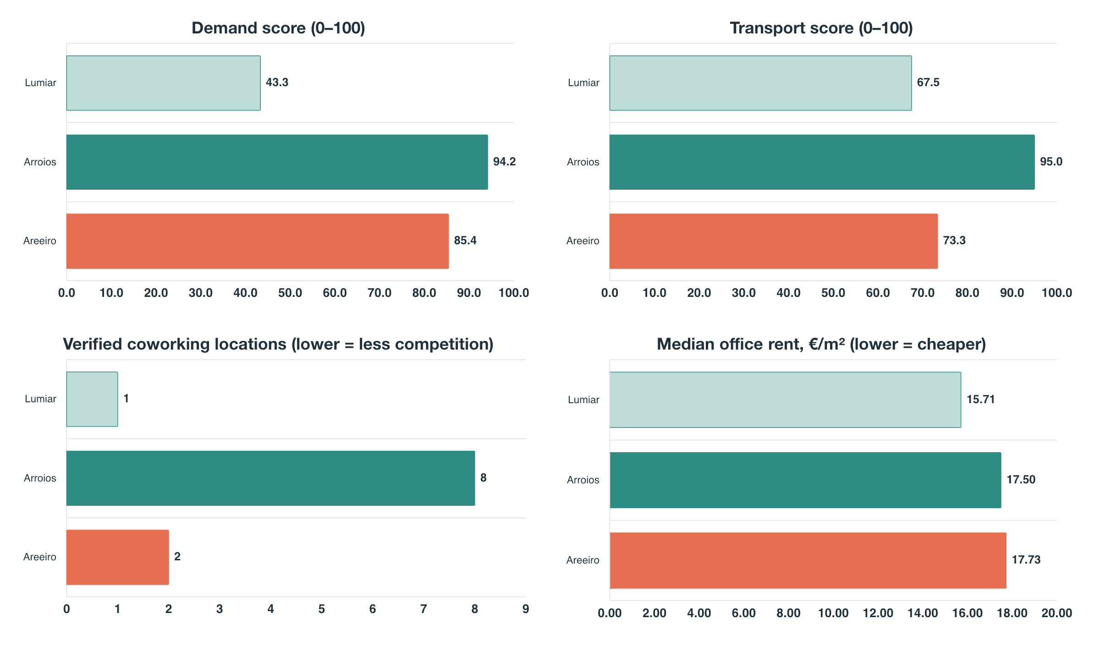
FINDING 3
Four measures show different strengths in each area
Three profiles
Areeiro: balanced
Arroios: strong demand
Lumiar: lower rent
No area is strongest
on every factor.
05
Notes:
Each area reaches the shortlist for a different reason.
[Sources]
- data/processed/parish_analysis_base.csv
- data/processed/commercial_rent_parish_summary.csv
- reports/tables/final_shortlist.csv
All four charts use raw values and a zero baseline.

Slide 6
RECOMMENDATION 1
Areeiro offers the clearest balance
Situation
S
Demand: 85.4 — strong
Transport: 73.3 — good
Competition: 2 verified coworking locations
Complication
C
Rent: €17.73/m² — highest of the three
€2.02/m² above Lumiar and only €0.23 above Arroios.
Resolution
R
Four-week site comparison
Suitable spaces in Areeiro
Rent, lease terms and nearby competition
06
Notes:
Areeiro SCR recommendation.
[Sources]
- README.md Business recommendations
- reports/tables/recommendation_evidence.csv

Slide 7
RECOMMENDATIONS 2 AND 3
Lumiar lowers rent
Arroios offers stronger demand
S
Rent: €15.71/m² — lowest
Transport: 67.5 — good
Competition: 1 verified location
S
Demand: 94.2 — strongest
Transport: 95.0 — best
Competition: 8 verified locations
C
Demand: 43.3 — much lower than in Areeiro or Arroios
C
Competition: highest of the three
R
Two-week demand check
Daytime workers and students
Then compare suitable spaces
R
Two-week competitor review
Prices, capacity and customer segments
Identify a clear market gap
07
Notes:
Lumiar and Arroios SCR recommendations.
[Sources]
- README.md Business recommendations
- reports/tables/recommendation_evidence.csv

Slide 8
CONCLUSION
Three shortlisted Lisbon parishes to study next
01
Choose the business priority
Balance · Lower rent · Stronger demand
02
Compare available spaces and lease terms in all three areas
STUDY NEXT
Areeiro
Arroios
Lumiar
03
Study local demand and competitor offers in more detail
Notes:
Conclusion and local due-diligence boundary.
[Sources]
- docs/methodology.md
- reports/tables/rent_inclusive_shortlist_sensitivity.csv

