Slide 1

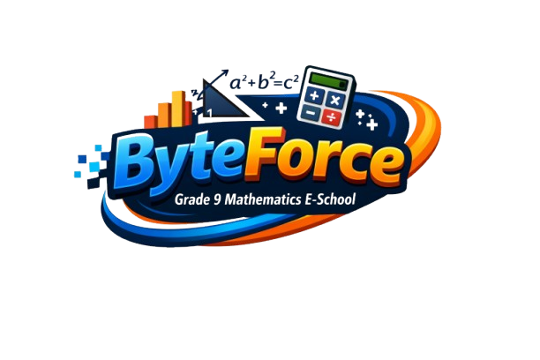

Byte force

Slide 2
About the project
ByteForce is a console-based interactive e-school for Grade 9 Mathematics. It offers 4 lessons: Linear Equations, Algebraic Expressions, Geometry, and Statistics Basics. Students can complete 2 practice sets and 3 homework assignments. The Test Center generates 20-question multiple-choice tests from a 32-question bank, tracking name, score, percentage, and grade. A statistics screen shows all results, best/worst student, class average, and performance by category.

Slide 3
Gameplay Overview
Students interact with ByteForce entirely in the console. They start by choosing a lesson to study, then complete practice tasks to reinforce concepts. Homework assignments allow independent learning. In the Test Center, students take auto-generated multiple-choice tests that track their performance. The statistics screen summarizes results, showing scores, grades, class averages, and category-wise strengths and weaknesses.

Slide 4
Features
Learning Content — 4 lessons covering Linear Equations, Algebraic Expressions, Geometry, and Statistics Basics.
Practice Tasks — 2 practice sets with worked problems to reinforce each topic.
Homework Tasks — 3 homework assignments for independent study.
Test Center — auto-generated 20-question multiple-choice tests drawn from a bank of 32 questions across 4 categories. Questions are shuffled every run. Tracks student name, score, percentage, and grade.
Statistics — results table for all attempts, best/lowest student, class average, and per-category performance breakdown.

Slide 5
TEST STRUCTURE
Category
In Bank
Per Test
Points Each
Linear Equations
8
6
3
Expressions
8
5
2
Geometry
8
5
2
Statistics
8
4
1
GRADING SCALE
≥ 90%
Grade 6
≥ 75%
Grade 5
≥ 60%
Grade 4
≥ 45%
Grade 3
< 45%
Grade 2
ByteForce · Grade 9 Mathematics

Slide 6




Our team
Tatiana Dimitrova Kovacheva
Plamen Nikolaev Rusev
Mustafa Husein Mustafa
Selin Aydanova Vatansever
SCRUM TRAINER
FRONT-END DEVELOPER
BACK-END DEVELOPER
DESIGNER

Slide 7







Technologies used

Slide 8
Let's go to our project.

