Slide 1

G2M Case Study
Virtual Internship
23-Sep-2022

Slide 2
Agenda
Executive Summary
Problem Statement
Approach
EDA
EDA Summary
Recommendations

Slide 3
Background –G2M insight for Cab Ivestment case study
XYZ is a private firm in US. Due to remarkable growth in the Cab Industry in last few years and multiple key players in the market, it is planning for an investment in Cab industry.
Objective : Provide actionable insights to help XYZ firm in identifying the right company for making investment.
The analysis has been divided into four parts:
Data Understanding
Forecasting profit and number of rides for each cab type
Finding the most profitable Cab company base on features
Recommendations for investment

Slide 4
Data Exploration
14 Features
Timeframe of the data: 2016-01-31 to 2018-12-31
Total data points :359,392
Assumptions:
Outliers are present in Price_Charged feature but due to
unavailability of trip duration details ,we are not treating this as outlier.
Profit of rides are calculated keeping other factors constant and only
Price_Charged and Cost_of_Trip features used to calculate profit.
Users feature of city dataset is treated as number of cab users in the city.
we have assumed that this can be other cab users as well(including Yellow and
Pink cab)
Cab_Data.csv
Customer_ID.csv
Transaction_ID.csv
City.csv
Final cab data

Slide 5
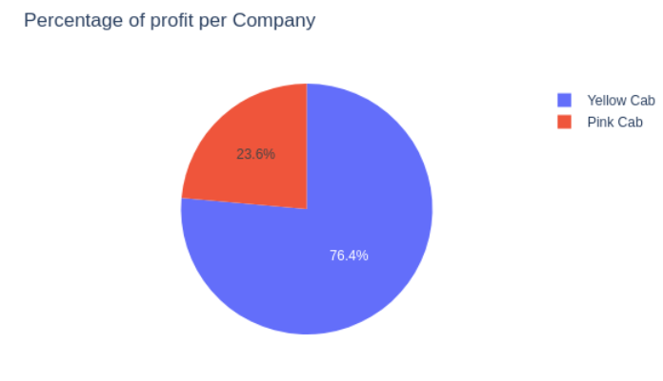
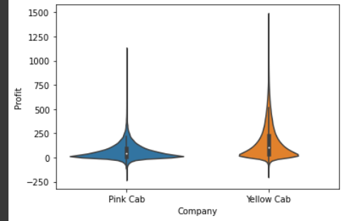
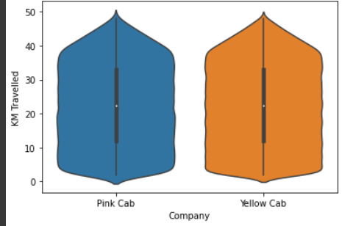
Profit Analysis
Profit Analysis
Company | Profit | Total Rides
Pink Cab | 5,307,328 | 84,711
Yellow Cab | 44,020,373 | 274,681

Slide 6
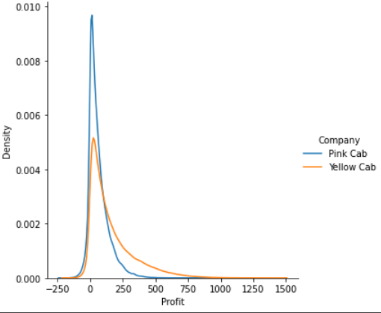
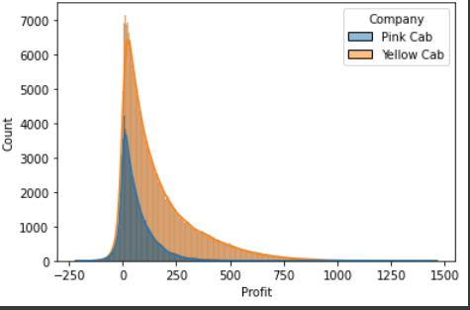
Density Profit Analysis

Slide 7
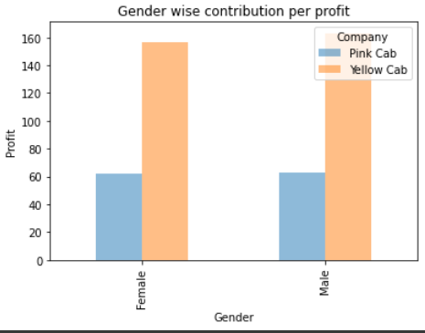
Profit and customer base Analysis Gender wise
There is almost equal distribution of gender in the Profit and customer base of both the cabs and whenever the gender, Yellow Cab shows high distribution.

Slide 8
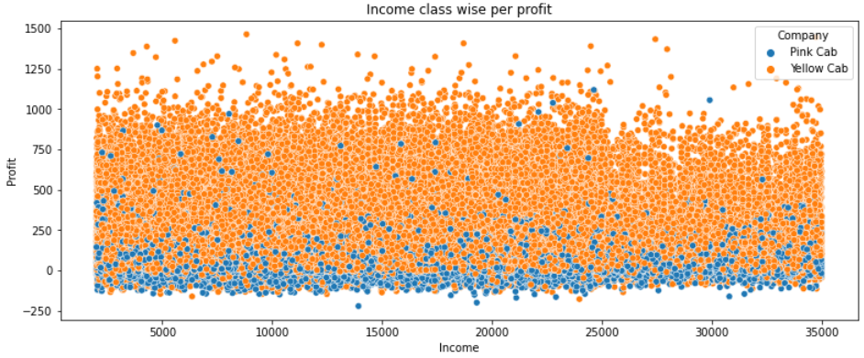
Income Class wise Profit and customer base Analysis
Middle class and high class contributes more in the profit as well as in the customer base of both the cabs and we cans see high contribution for the Yellow Cab company

Slide 9
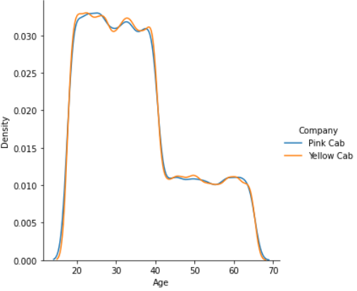
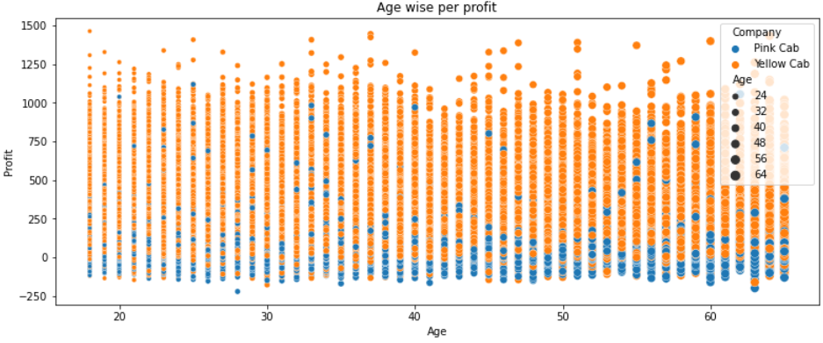
Age GroupWise Profit And Customer Base Analysis
People between 15-40 contribute more in the profit as well as in the customer base of both the cabs and we cans see high contribution for the Yellow Cab company

Slide 10
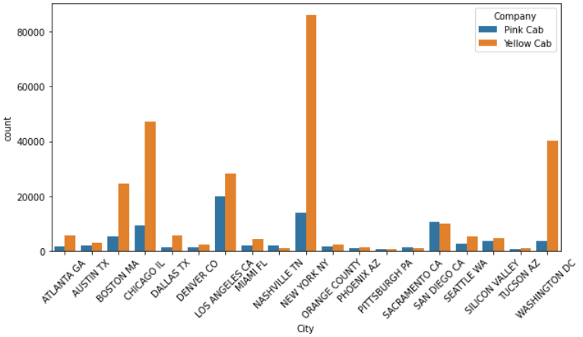
City Wise Cab Users Covered By Company
This is the number
of users covered by
Yellow and Pink cab
In the city against
all cab users present
In the city

Slide 11
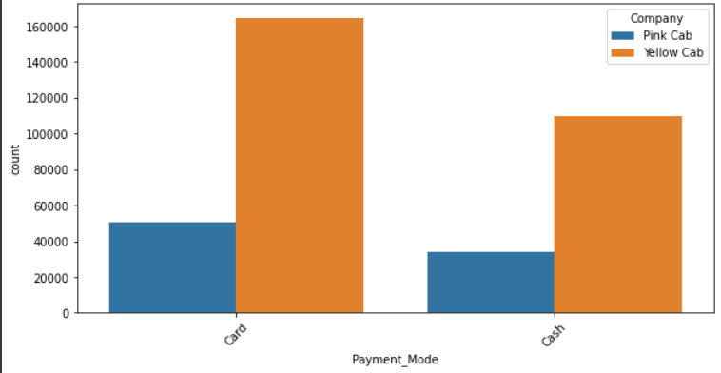
Payment method wise
People use more Card than Cash for both cabs

Slide 12
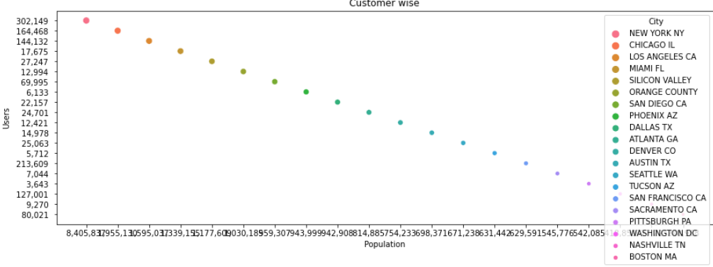
Customer Presence in the city
Customers are more present in the cities below:
New York NY
Chicago IL
Los angeles CA
MiamiFL

Slide 13
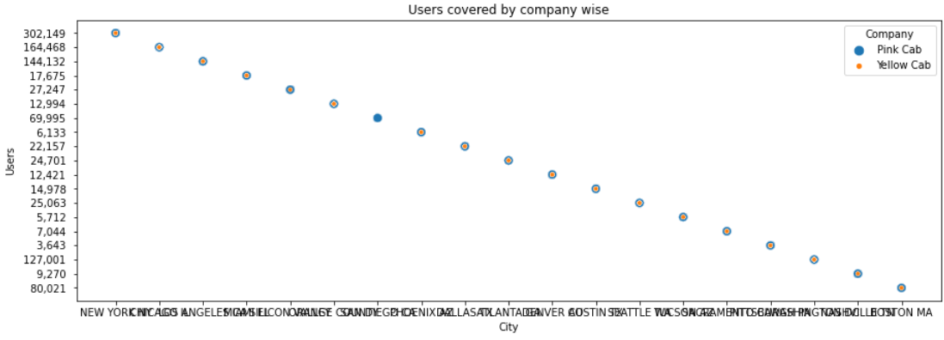
User Covered by Company wise
Yellow cab higher customer base as compared to Pink cab.
There is an equality distribution of Yellow Cab and Pink Cab at Diego city

Slide 14
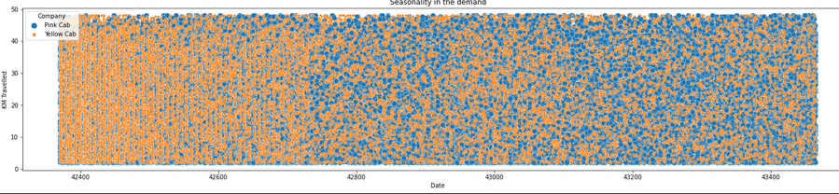
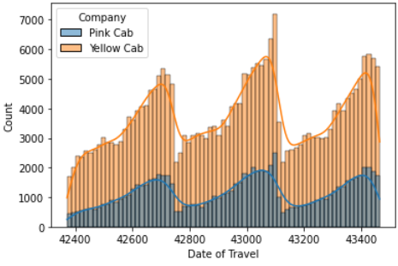
Seasonality in the demand
Seasonal component is present in
both the cabs.
Demand is high from 43000 and is repeat after a certain number of days

Slide 15
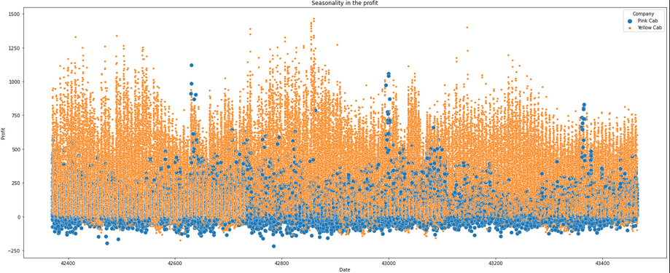
Seasonality in the Profit

Slide 16
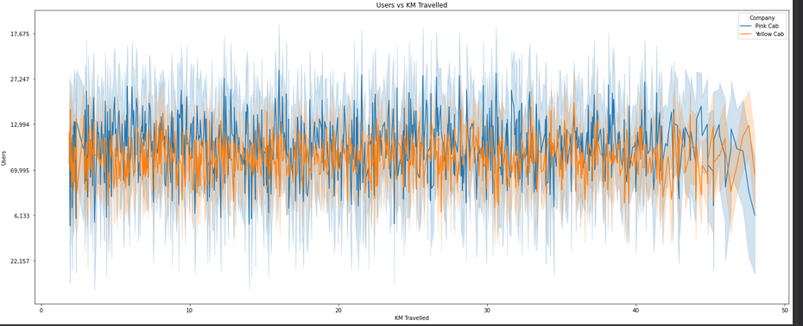
Customer analysis based on ride distance
Customers for Yellow Cab are almost constant for short, medium and long
Trip. Which shows yellow cab is offering better customer
plan for short, medium and
long Trip.
5-40 KM trips are contributing more In both the cabs profit
There is a huge difference between yellow and pink cab in customer reach for short and long trip. Yellow cab has very good customer reach in this segment as well

Slide 17
Recommendations
We have evaluated both the cab companies on following points and found Yellow cab better than Pink cab:
Customer Reach : Yellow cab has higher customer reach while Pink cab has lower customer reach . We have also observed that Yellow cab is doing good in covering other cab users as compared to Pink cab.
Age wise Reach : Yellow cab has customer in all age group and it’s been observed that it’s even popular in 60+ age group as equally as its in 18-30 age group.
Profit and City wise Reach: Yellow Cab has a higher total number of profit than Pink Cab whenever the city which means that there is a high demand of using Yellow Cab.
Payment mode wise Reach: We can observe that customers pay more by card and Yellow Cab has a high percentage than Pink Cab which means that the more customers use card, they most likely to use the Cab.
Average Profit per KM: Yellow cab’s average profit per KM is almost three times the average profit per KM of the Pink cab.
Income wise Reach :Both the cabs are very popular in high and medium income class but here also Yellow cab is performing better than Pink cab in offering their services to all the three income class group (low, medium and high)
On the basis of above point , we will recommend Yellow cab for investment.

Slide 18
Thank You

