Slide 1

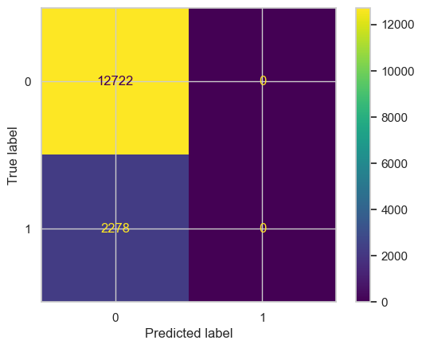
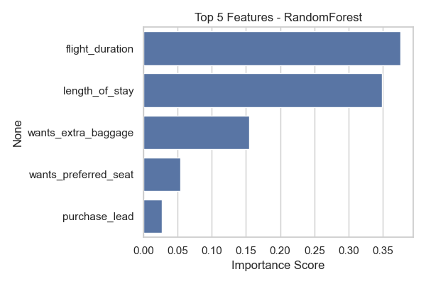
BritshAirways - Booking Prediction Model - Summary
✅ Dataset prepared (cleaning, encoding, feature engineering)
✅ Models used: Random Forest, KNN
Performance Metrics:
- Accuracy: 0.8316
- Precision: 0.252
- Recall: 0.0553
🔑 Top Features Driving Predictions:
1. flight_duration
2. length_of_stay
3. wants_extra_baggage
4. wants_preferred_seat
5. purchase_lead
📌 Conclusion: Random Forest predicts British Airways bookings reliably and highlights key factors influencing bookings.

