Slide 1
Master’s Degree in Automation Engineering and Control of Complex Systems Complex Adaptive Systems
Biorobotics project
Quadupred Locomotion and Control
Students:
Luca Reitano
Nabil Taher
Emanuele Manfré

Slide 2
Introduction to CPG
The Central Pattern Generator is a neural complex located in the Central Nervous System. The signal patterns generated by the CPG are able to give rise to different types of locomotion.

Slide 3
Cellular Neural Networks
The rhythmic pattern of the CPG can be recreated by using a Cellular Neural Network.
A CNN consists of a multidimensional array of locally coupled nonlinear dynamic systems

Slide 4
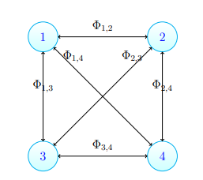
Neural Structure
For the CPG Structure, to each leg we assigned a Neuron. The phase shift between each Neuron define the gait of the robot.

Slide 5
Steering with CPG
Here we’ll explore some modifications to the CPG equations in order to implement a Bio-inspired steering for the Quadruped.
The main idea was to achieve different amplitudes in the CPG signals sent to a set of legs.

Slide 6
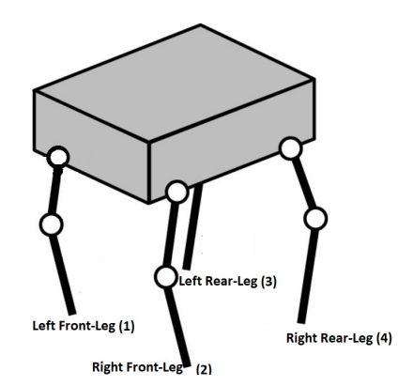

Steering with CPG
Each leg is controlled by a Neuron.
We can tune the piecewise nonlinearity gain «k» between the neurons.

Slide 7
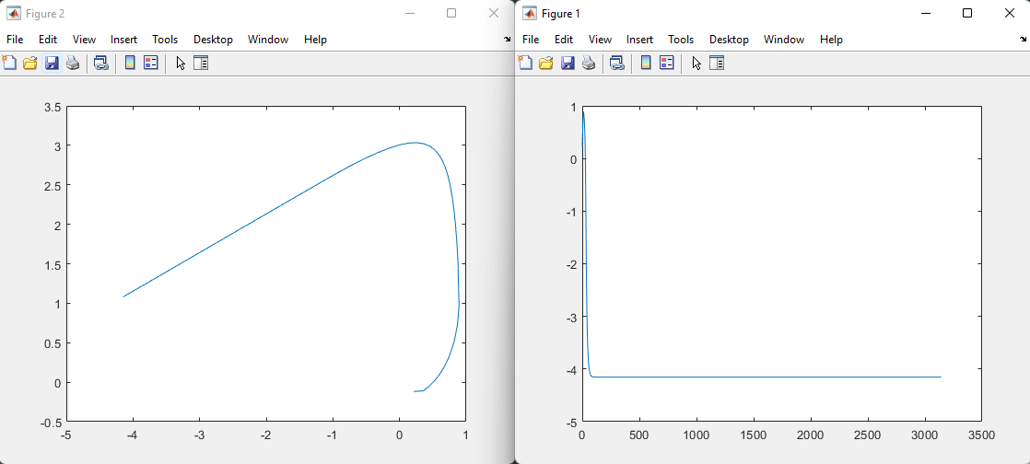
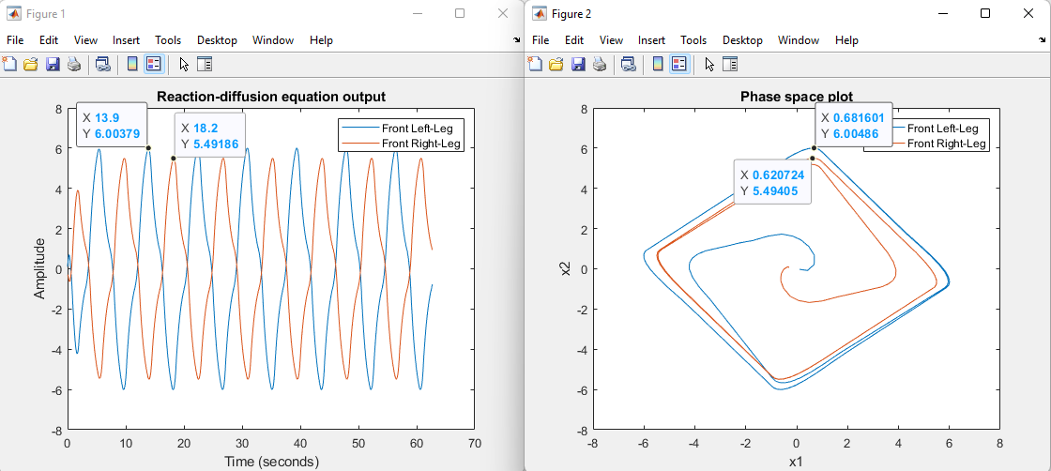
Steering with CPG
The gain could not be increased above 1
By tuning s1 we restored the limit cycle, therefore the oscillating behavior

Slide 8
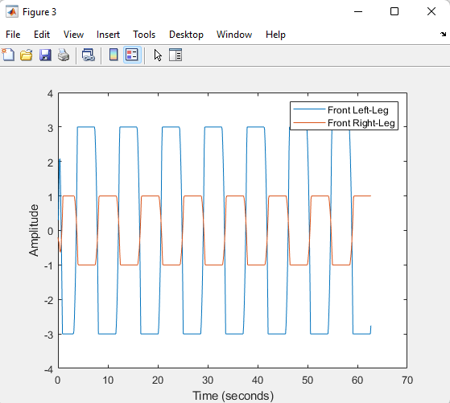
Steering with CPG
The difference in amplitude between the left and right legs weren’t big enough, so we opted to use the outputs.
The discoveries in matlab were implemented in the arduino code to check how the robot performed

Slide 9
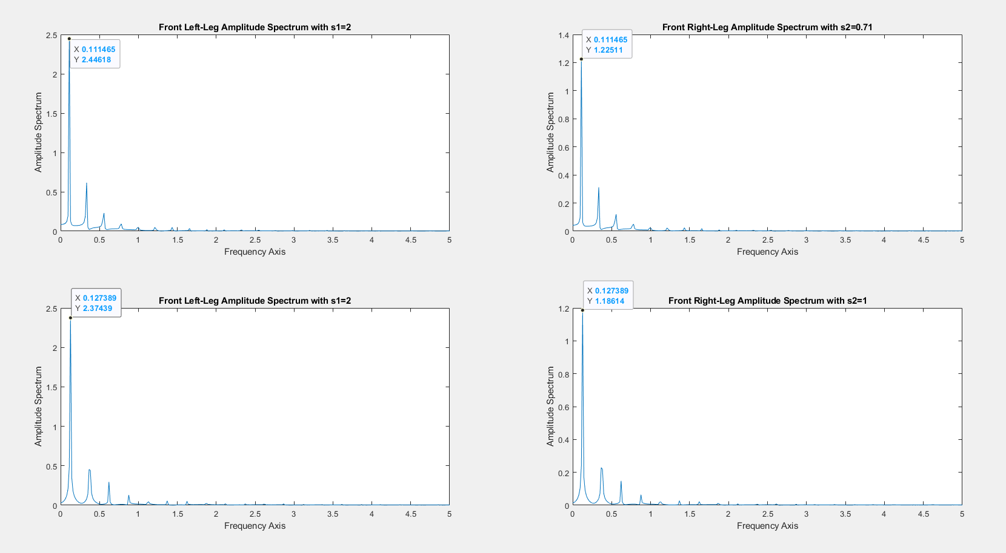
Steering with CPG
The robot performed well, but we noted that by changing “s2” we would get better performance.

Slide 10
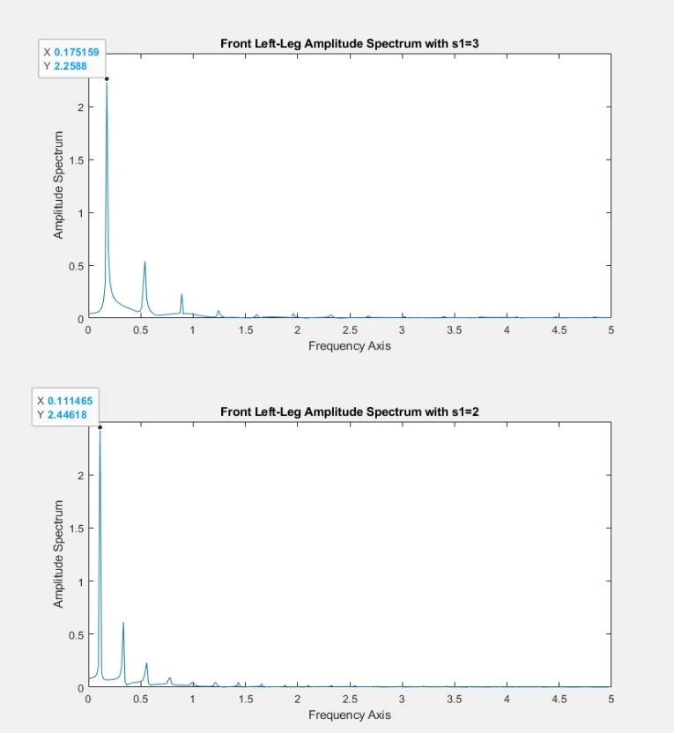
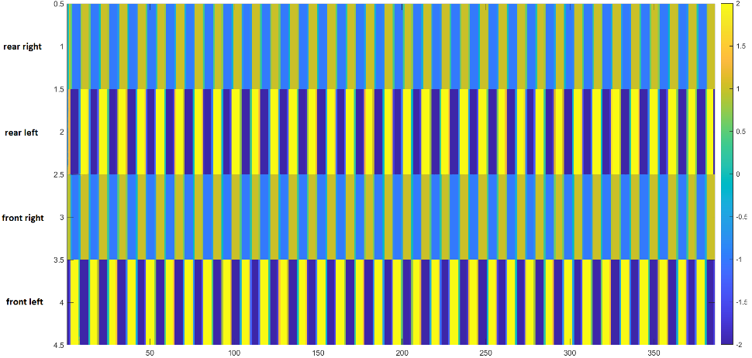
Steering with CPG
Stepping Diagram
With s1=3, we got a much worse performance even though the frequency increased by quite a lot, because the robot wasn’t propelling forward
Curvature radius for s1=2.5 was 78cm, with s1=2.1 we got 72cm

Slide 11
Conclusions
Most of the issues faced during the making of this project were thoroughly resolved, other issues need further tweaking and testing.
Resolved issues:
Deprecated libraries
New wiring and supply chain
Steering
Unresolved issues:
Implementation of the steering for every gait
Robot stability

Slide 12
Future developments
The steering was implemented “a priori” through feedback, without real feedback from the environment. We suggest to add a camera on top of the robot and use Edge Computing technologies in order to process the images through a nearby node and send the commands to the Microcontroller
The phone-holder that we installed can be used to exploit the sensors of a phone such as accelerometer and gyroscope, and use the informations as “feedback” to better balance the robot. With advanced signal processing it’s also possible to recognize the terrain in which the robot is moving and adapt accordingly

Slide 13
Thank you for bearing with us <3

