Slide 1

Master’s Degree in Automation Engineering and Control of Complex Systems
Biorobotics project
Quadruped Locomotion and Control
through CPG Neural Architecture
Students:
Luca Reitano
Nabil Taher
Emanuele Manfré

Slide 2
ROADMAP
Introduction
Central Pattern Generator (CPG)
Wiring scheme for Control
Arduino Optimizations
Steering with CPG
Conclusion and future developments

Slide 3
INTRODUCTION
To control the locomotion of the quadruped we used the bio-inspired algorithm called CPG.
The CPG produces rhythmic patterns of motor activity.
It’s experimentally found in invertebrates and vertebrates.

Slide 4
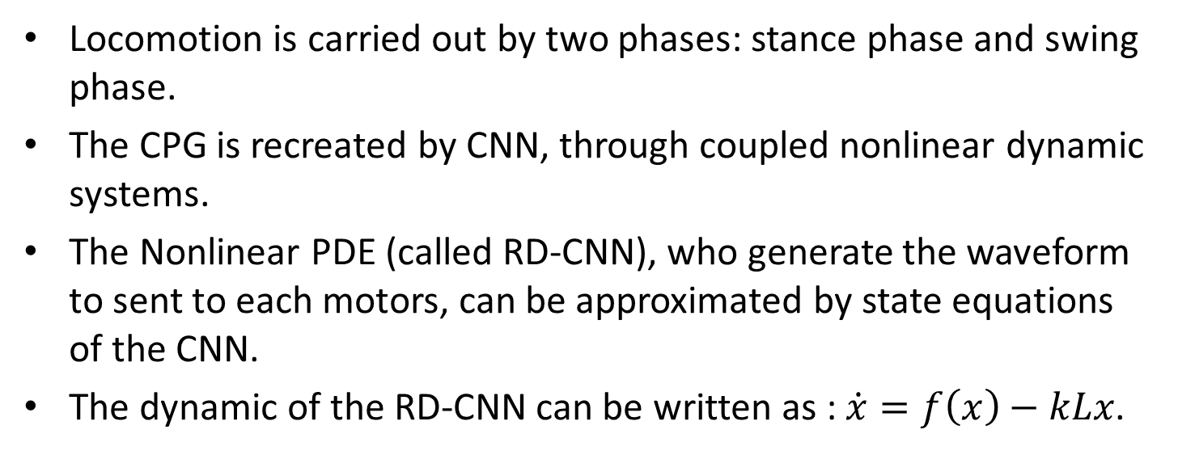
CPG EQUATIONS & CELLS COUPLING
Locomotion is carried out by two phases: stance phase and swing phase.
The CPG is recreated by CNN, through coupled nonlinear dynamic systems.
The Nonlinear PDE (called RD-CNN), who generate the waveform to sent to each motors, can be approximated by state equations of the CNN.
The dynamic of the RD-CNN can be written as : $\dot{x}=f\left(x\right)−kLx$.

Slide 5
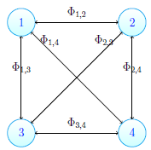
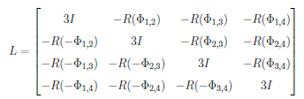
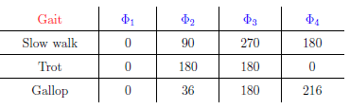
CPG & GAIT
In our case the CPG scheme is:
The Laplacian for this network is:
The phase shifts between the different legs creates different type of gait:

Slide 6
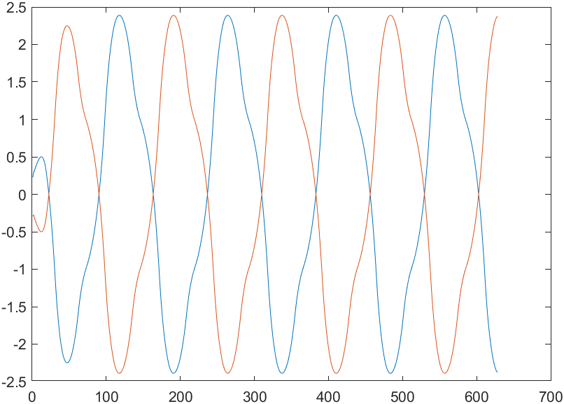
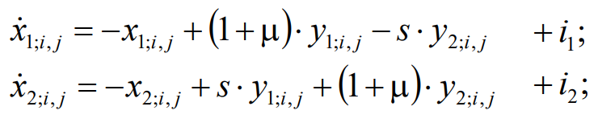
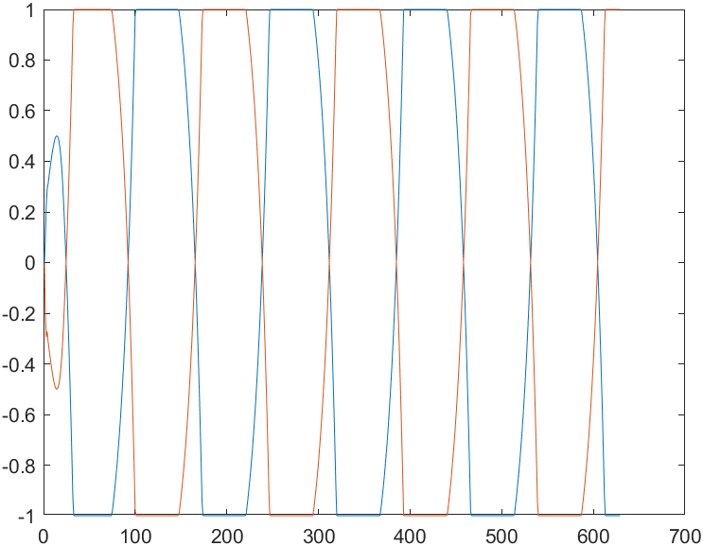


CPG on MATLAB
CPG
The purpose of the CPG is just to generate signals with phase shift (imposed by the desired gait through laplacian).
All the equation (dynamics and coupling) were reproduced in MATLAB.
Control with state variable [+2.4,-2.4]
Control with output variable [+1,-1]

Slide 7
Using CPG for CONTROL
The signals generated by CPG are in the interval [-2.4,2.4].
You can use both cells state variables or cells outputs.
Measure maximum amplitude of CPG signals
Normalize the samples in the interval [0,1]
CPG signal sampling
Send the result to the motors
Multiply for an offset value to obtain
the gait amplitude

Slide 8
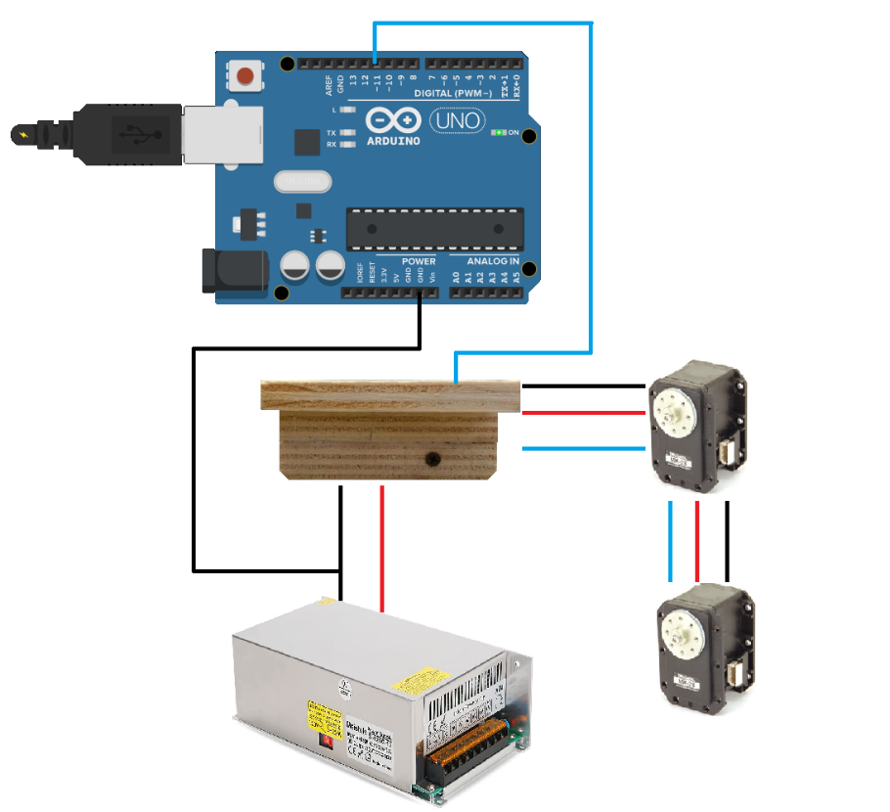
WIRING SCHEME for CONTROL
Arduino UNO → one hardware serial port (limit to overcome) → Software Serial Ports
External power supply (12V, 30 A) → safety of microcontroller;
Common ground between Arduino and power supply;
Use one pin to control an entire leg (two MX-28s) → communication bus;
This scheme is for the motor locomotion, not for setup.

Slide 9
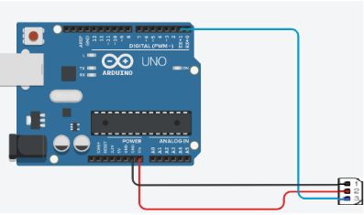
MOTOR ID for COMMUNICATION
Each motor has his own fixed ID;
Each shoulder has ID = 1 and each elbow has ID = 2;
Each motor is distinguished not only by the ID code but also from the leg where it is mounted;
To control a motor, we firstly select a leg and after send the command to the higher or lower part of the leg;
It is crucial to check the correctedness of the ID since they are used in the motors control.
Dynamixel code example : “Move_In_Servo_Mode” or “Baudrate_and_ID_Setup”.
Wiring Connection for Single Motor and ID check
Sources of errors: wrong motor ID or wrong baud rate

Slide 10
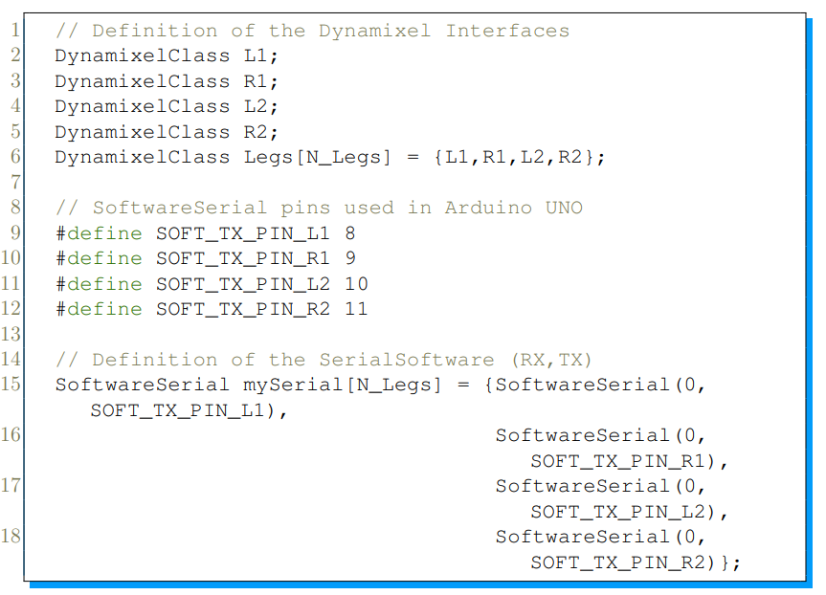
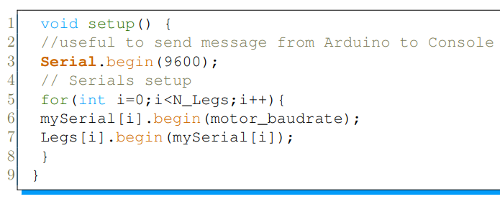
ARDUINO CODE HIGHLIGHS: FIRST PROBLEM
Arduino UNO has just one hardware serial port.
Enable software serial port to control four legs also with Arduino UNO (cheaper than MEGA).
Modified libraries needed.
Note: this setup is not complete (servo mode, max torque, rise phase of robots).
BINDING BETWEEN LEGS AND PORTS DECLARATION OF LEGS AND SOFTWARE PORTS

Slide 11
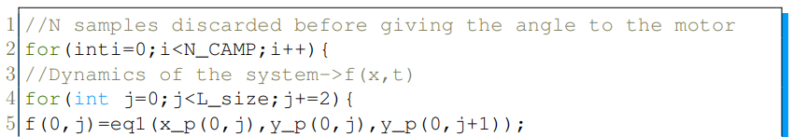
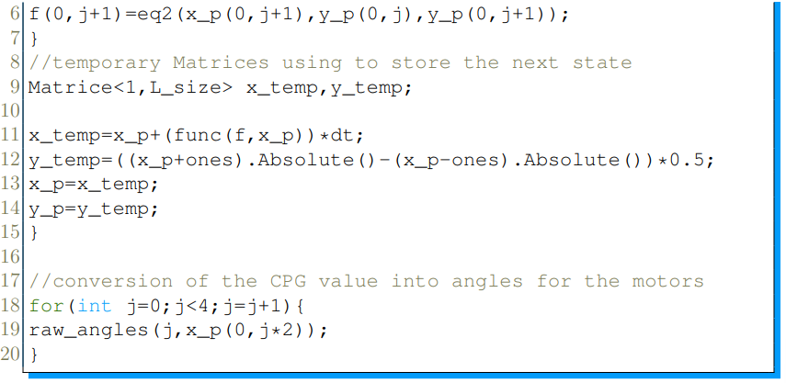
OPTIMIZED CPG for ARDUINO UNO
The laplacian matrix is calculated on MATLAB and just pasted in C code for computational efficiency.
Usage of vector of dimension [1x8] due to Arduino limited memory for variable storing (avoiding «matrix» data structure). One sample for each state variable for four neurons → for control j=0,2,5,7.
Variable N_CAMP is used to discard sample and make a signal sampling before the angle conversion.
Note: the equation are the same shown in MATLAB.
Two-dimensional flow dynamics for each oscillator «j»
RD equations
1x8 vectors
From CPG values to angles for motors.

Slide 12
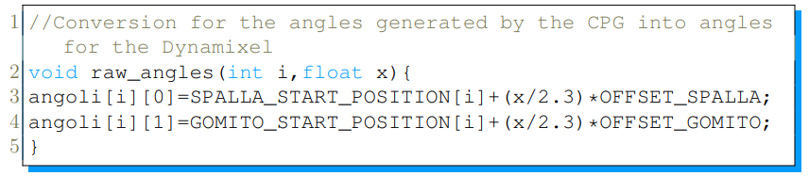
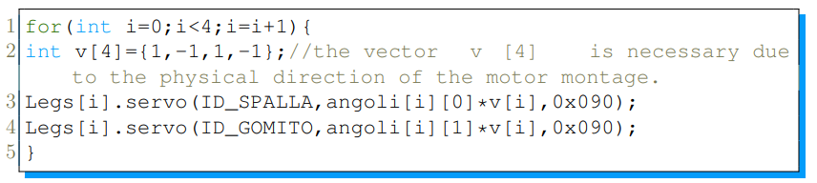
FINAL MOTOR CONTROL
Raw Angles function needs the index of the leg and the sampled value of CPG.
Note: you can make convergence operations by using different offsets for different legs.
«servo» is a function of the Dynamixel Library to control the motors.
This function is used in the object of Dynamixel Class «Legs».

Slide 13
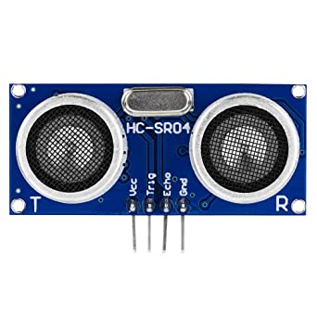
TIMER BASED STEERING – AMPLITUDE CONTROL
Downsample timer starts
Downsample timer ends
Measure distance using HC-SR04
Activate a timer2
&
Change offsets to steer
If distance is lower than a threshold
timer2 ends
Offset RESTORING
Notes:
Downsampling timer is needed to avoid the delay effect of the TOF on the control loop.
Advantages: intuitive to control, drawbacks: not bioinspired.

Slide 14
Steering with CPG
Here we’ll explore some modifications to the CPG equations in order to implement a Bio-inspired steering for the Quadruped.
The main idea was to achieve different amplitudes in the CPG signals sent to a set of legs.

Slide 15
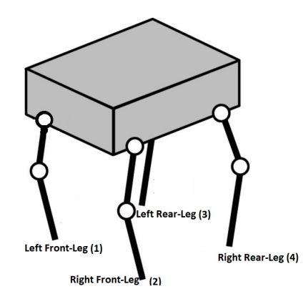

Steering with CPG
Each leg is controlled by a Neuron.
We can tune the piecewise nonlinearity gain «k» between the neurons.

Slide 16
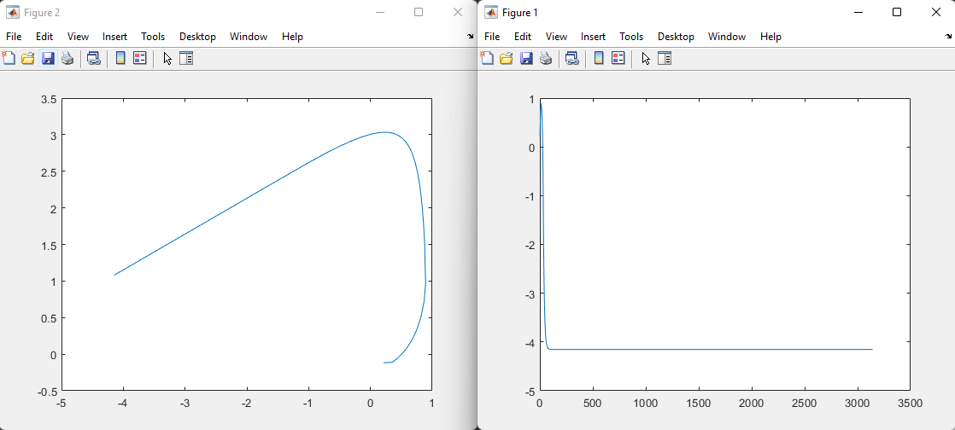
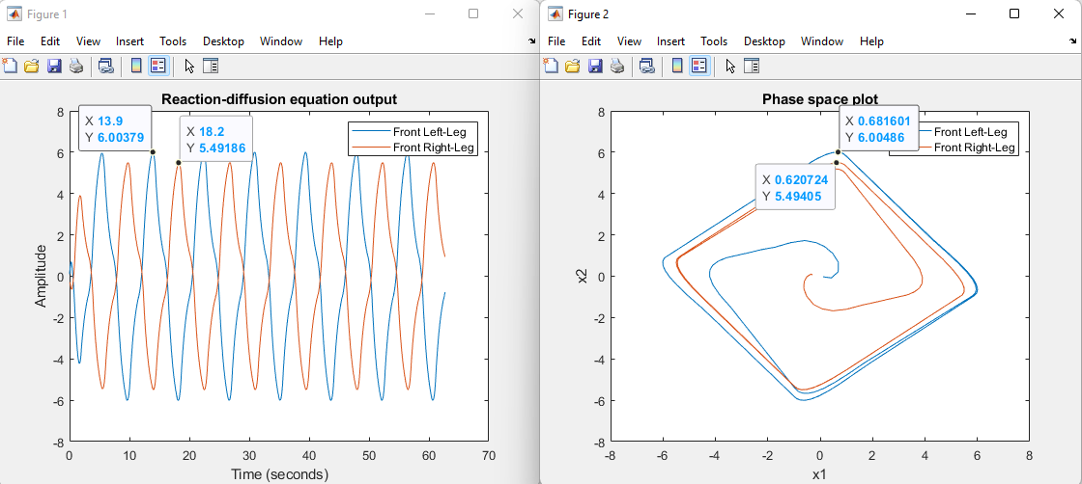
Steering with CPG
The gain could not be increased above 1
By tuning s1 we restored the limit cycle, therefore the oscillating behavior

Slide 17
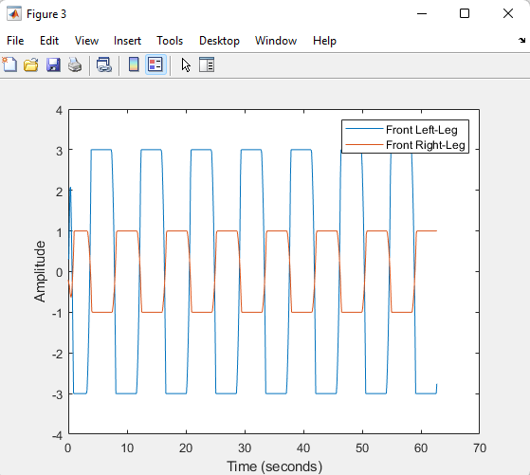
Steering with CPG
The difference in amplitude between the left and right legs weren’t big enough, so we opted to use the outputs.
The discoveries in matlab were implemented in the arduino code to check how the robot performed.

Slide 18
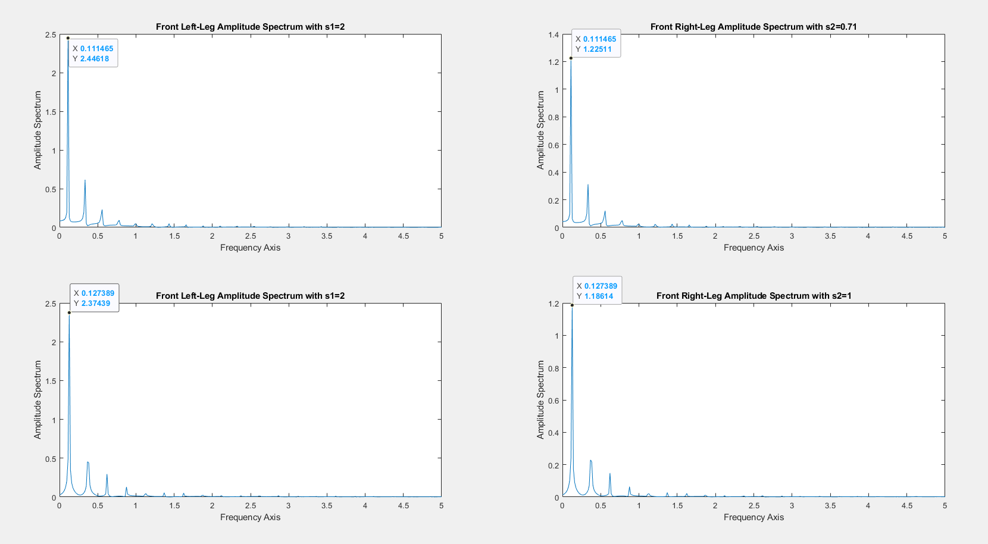
Steering with CPG
The robot performed well, but we noticed that by changing “s2” we would get better performance.

Slide 19
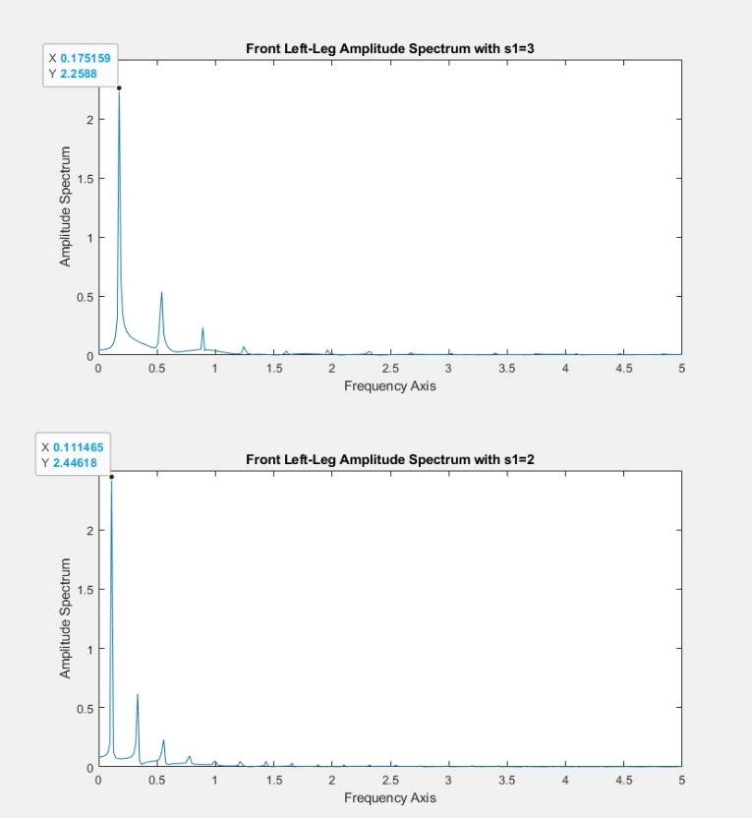
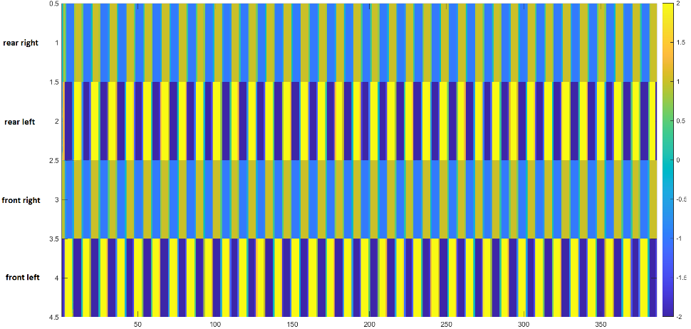
Steering with CPG
Stepping Diagram
With s1=3, we got a much worse performance even though the frequency increased by quite a lot, because the robot wasn’t propelling forward
Curvature radius for s1=2.5 was 78cm, with s1=2.1 we got 72cm
CPG steering is centralized and easier to tune (s1 param).

Slide 20
Conclusions
Most of the issues faced during the making of this project were thoroughly resolved, other issues need further tweaking and testing.
Resolved issues:
Deprecated libraries
New wiring and supply chain
Steering on CPG
Unresolved issues:
Implementation of the steering for every gait
Robot unbalance

Slide 21
Future developments
The steering was implemented “a priori” through feedback, without real feedback from the environment. We suggest to add a camera on top of the robot and use Edge Computing technologies in order to process the images through a nearby node and send the commands to the Microcontroller.
The phone-holder that we installed can be used to exploit the sensors of a phone such as accelerometer and gyroscope, and use the informations as “feedback” to better balance the robot. With advanced signal processing it’s also possible to recognize the terrain in which the robot is moving and adapt accordingly.

Slide 22
DEMO VIDEO

Slide 23
Thank you for bearing with us <3

