Slide 1
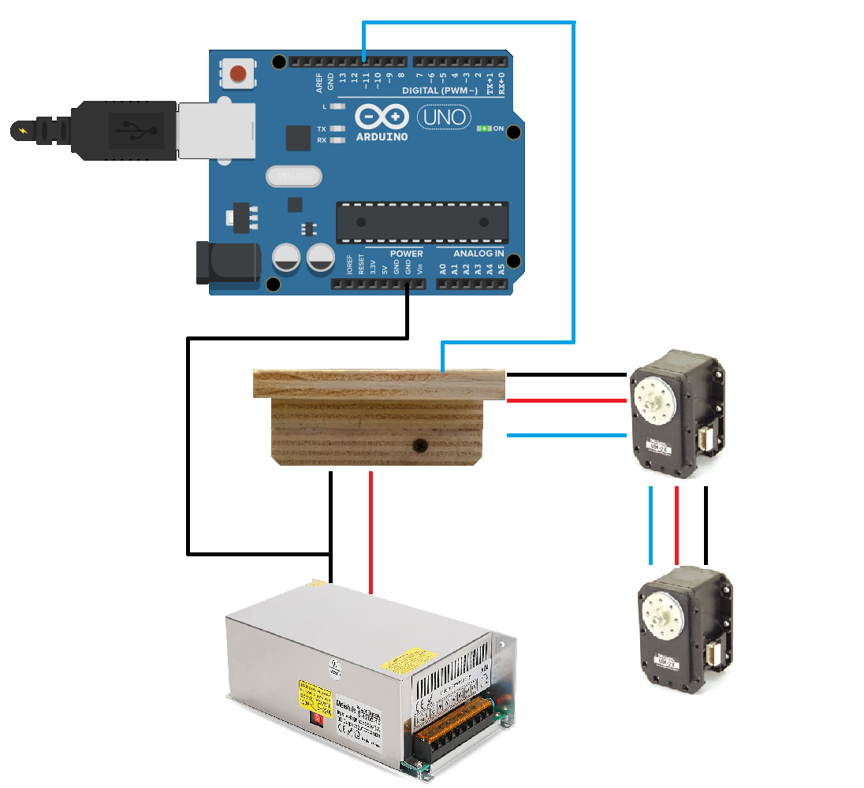
WIRING SCHEME for CONTROL
Arduino UNO → one hardware serial port (limit to overcome);
External power supply (12V, 30 A) → safety of microcontroller;
Common ground between Arduino and power supply;
Use one pin to control an entire leg (two MX-28s);

Slide 2
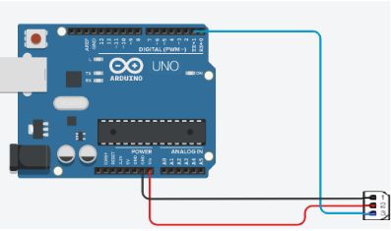
MOTOR ID for COMMUNICATION
Each motor has his own fixed ID;
Each shoulder has ID = 1 and each elbow has ID = 2;
Each motor is distinguished not only by the ID code but also from the leg where it is mounted;
To control a motor, we firstly select a leg and after send the command to the higher or lower part of the leg;
It is crucial to check the correctedness of the ID since they are used in the motors control.
Dynamixel code example : “Move_In_Servo_Mode” or “Baudrate_and_ID_Setup”.
Sources of errors: wrong motor ID or wrong baud rate

Slide 3
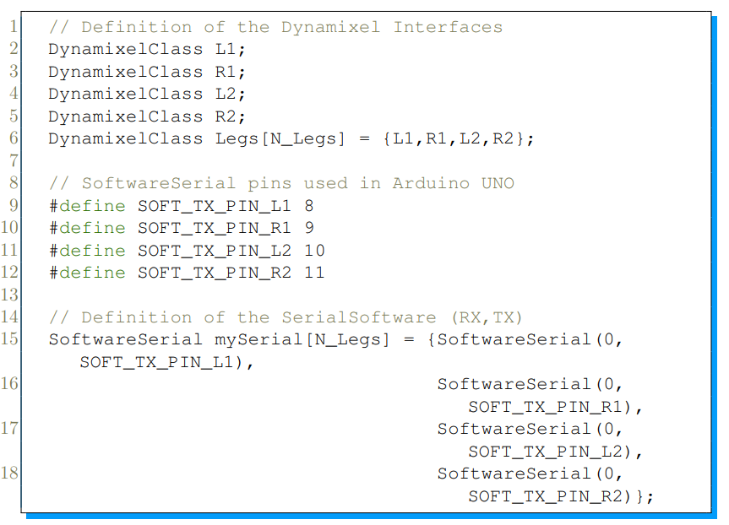
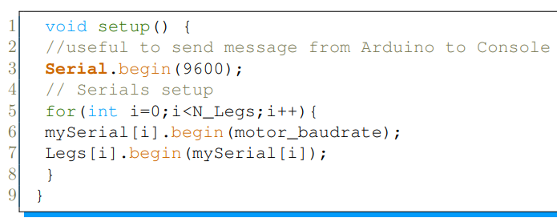
ARDUINO CODE HIGHLIGHS: FIRST PROBLEM
Arduino UNO has just one hardware serial port.
Enable software serial port to control four legs.
Modified libraries needed.
Note: this setup is not complete (servo mode, max torque, rise phase of robots)
BINDING BETWEEN LEGS AND PORTS DECLARATION OF LEGS AND SOFTWARE PORTS

Slide 4
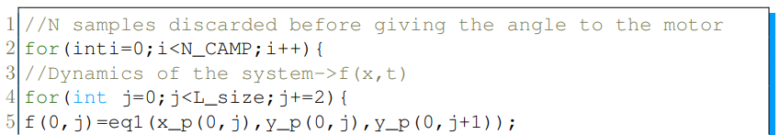
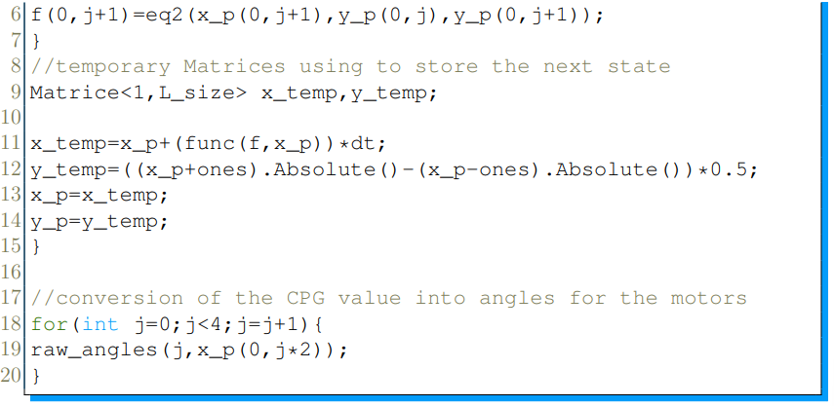
OPTIMIZED CPG for ARDUINO UNO
Two-dimensional flow dynamics for each oscillator «j»
The laplacian matrix is calculated on MATLAB and just pasted in C code for computational efficiency.
Usage of vector of dimension [1x8] due to Arduino limited memory for variable storing. One sample for each state variable for four neurons → for control j=0,2,5,7.
Variable N_CAMP is used to discard sample and make a signal sampling before the angle conversion.
RD equations
1x8 vectors
From CPG values to angles for motors.

Slide 5
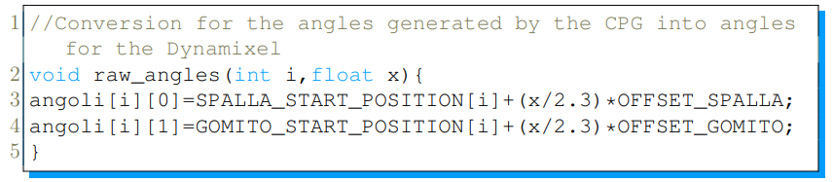
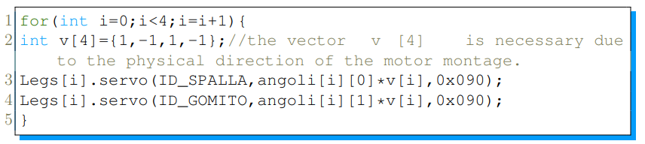
FINAL MOTOR CONTROL
Raw Angles function needs the index of the leg and the sampled value of CPG.
Note: you can make convergence operations by using different offsets for different legs.
«servo» is a function of the Dynamixel Library to control the motors.

Slide 6
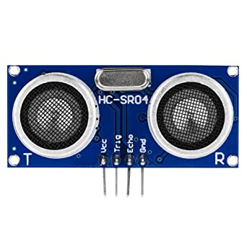
TIMER BASED STEERING – AMPLITUDE CONTROL
Downsample timer starts
Downsample timer ends
Measure distance using HC-SR04
Activate a timer2
&
Change offsets to steer
If distance is lower than a threshold
timer2 ends
Offset RESTORING
Notes:
Downsampling timer is needed to avoid the delay effect of the TOF on the control loop.
Advantages: intuitive to control, drawbacks: not bioinspired

