Slide 1

Don’t Make Me Turn This Chairlift Around
A Guided Capstone Case Study on Big Mountain Resort

Slide 2

Problem Identification

Slide 3
Big Mountain Resort bought a new chairlift
Big Mountain is one of the top resorts in Montana
They recently purchased a new chair lift, adding about $1.4 million USD in operation costs
They are looking for ways to increase revenue

Slide 4
Recommendations and Key Findings

Slide 5
A Two Prongs Strategy
Ultimately, we decided on raising ticket prices by $10.
The way we justify this price rise is by using a two prongs strategy:
Research which run is the lowest performing/hardest to maintain, and close one of them
Create a new run that begins 150 feet higher than the highest run, thus raising the vertical drop at the resort, and increase snowing making capabilities for more guaranteed powder, which would increase appeal to the customer base.

Slide 6

Modeling Results and Analysis

Slide 7
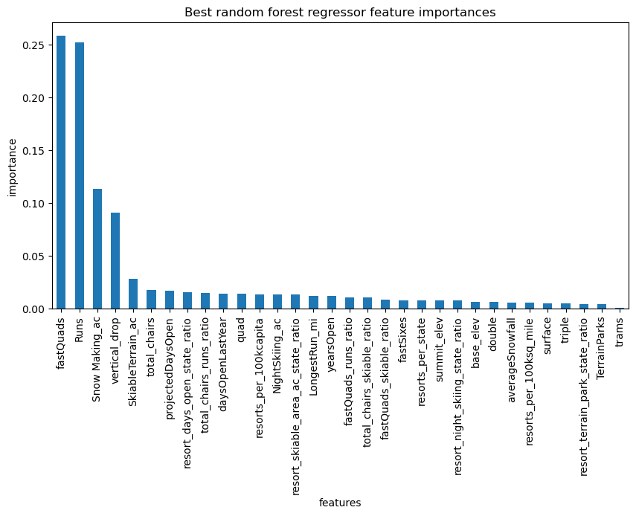
When looking at the model using a random forest regressor, we found the four most popular features in resorts across the country. They are:
Fast Quads
Runs (number of)
Snow Making
Vertical Drop

Slide 8
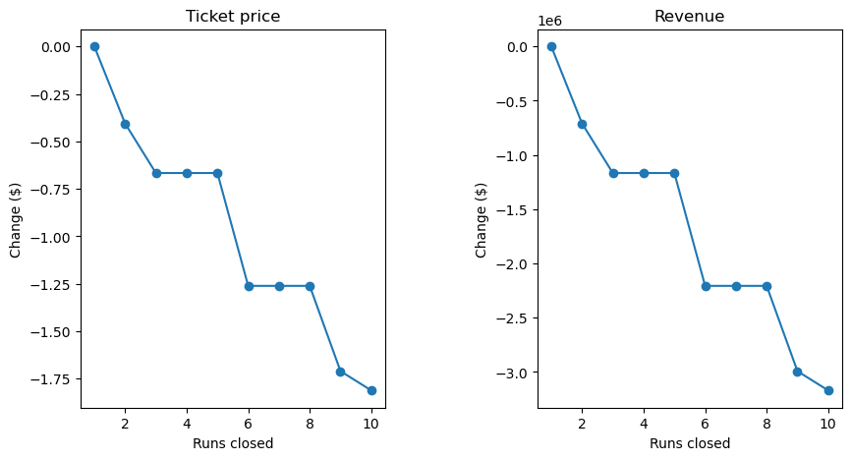
When comparing closing up to 10 runs we saw how the revenue was directly affected, but noticed that closing one run does not make a difference.

Slide 9
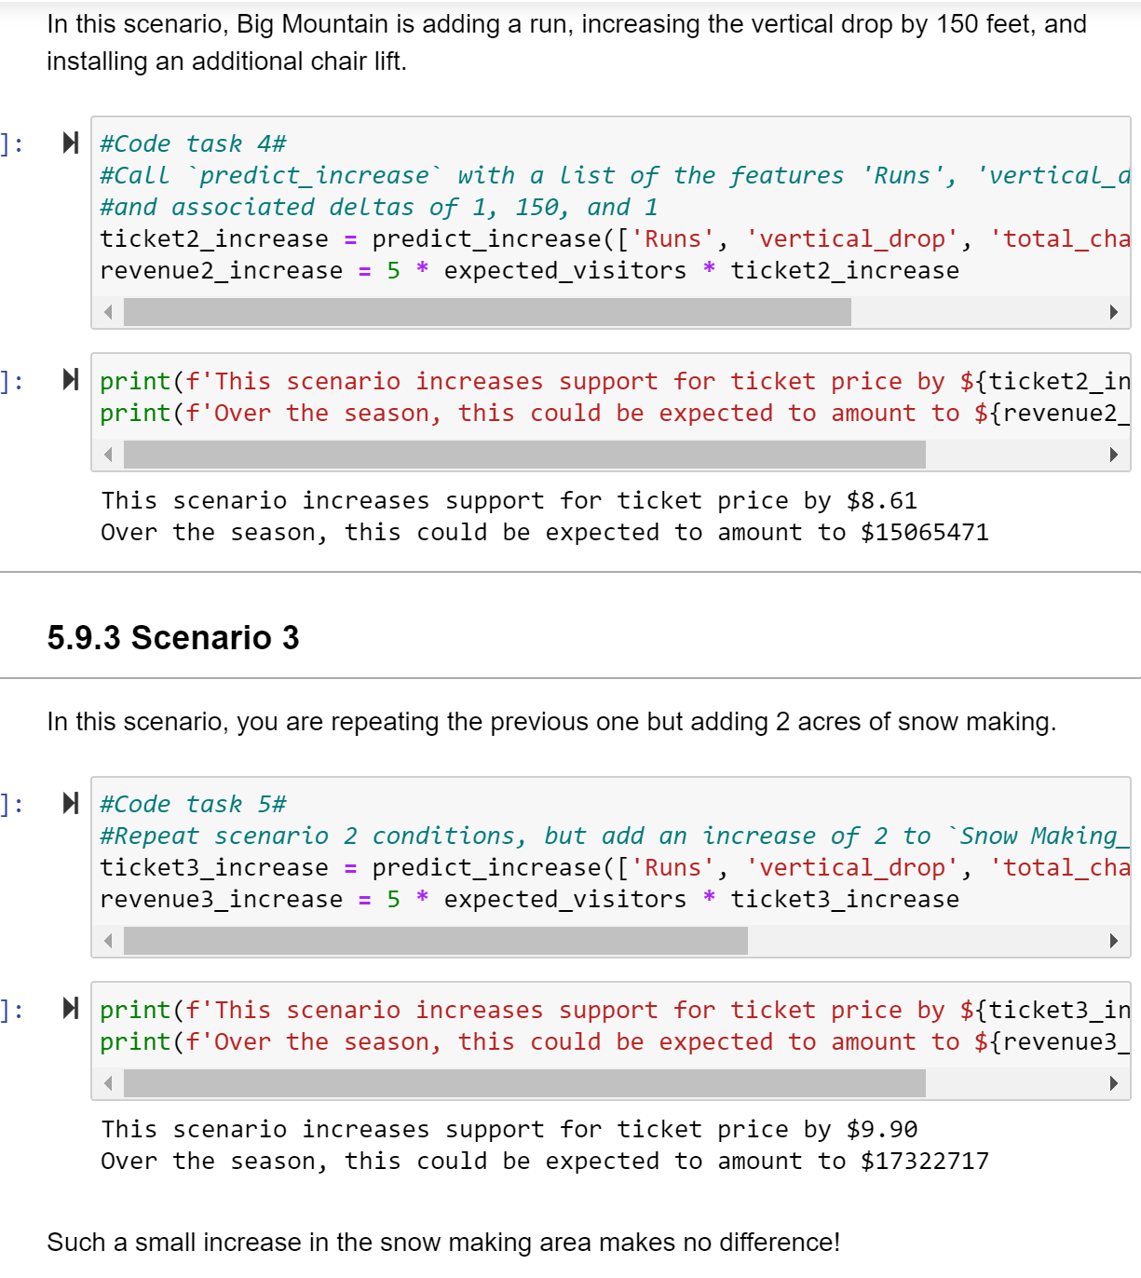
Using an excerpt from our modeling Jupyter Notebook, we can see that running both scenarios of adding a run, increasing vertical drop, and installing a chair lift (which was already done), we can see that the added bonus of creating more snow is a minimal change in the cost of ticket price.

Slide 10
Conclusion

Slide 11
I believe we have a strong plan to move forward to create an increase in revenue to cover the rise in operating costs, without cutting labor/salaries.
If you have any questions, please contact my lead Andrea.

