Slide 1

NAME: NITIN SINGH TATRARI BRANCH: 1825
FAKE NEWS DETECTION

Slide 2
Problem statement
With the advancement of technology, digital news is more widely exposed to users globally and contributes to the increment of spreading hoaxes and disinformation online. Fake news can be found through popular platforms such as social media and the Internet and even print media. The rise of fake news affects not only individuals, narratives, and the platforms that publish them, but also businesses and jobs across all manner of industries, as well. Thus this false news can adversely impact the businesses, as they can alienate their portion of target market due to false fact spread to them.

Slide 3
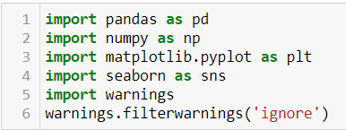

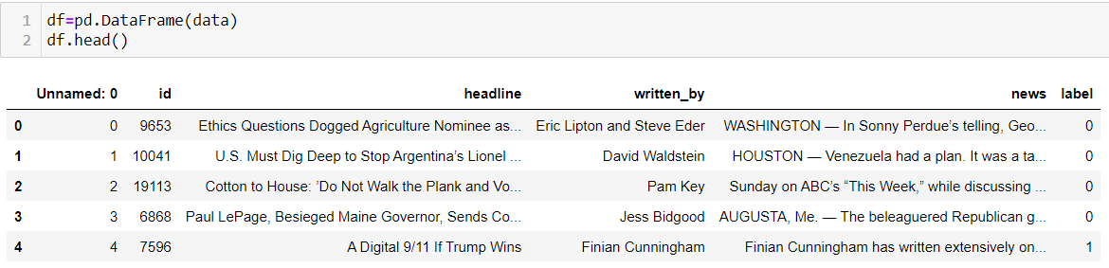
Steps followed(1): Loading the data
Loading libraries
Uploading data from ‘train_news.csv’
Loading data into Data Frame

Slide 4
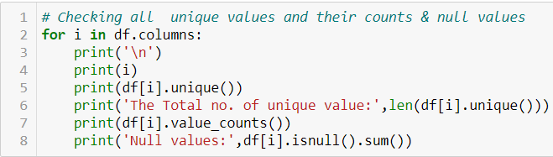

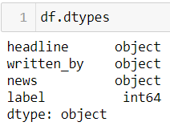
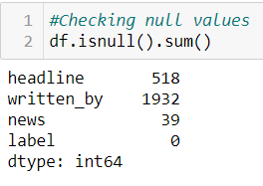


(2) Understanding the data
Since column ‘Unnammed: 0’ is just index column and column ‘Id’ have all unique values, we can drop them.
All the variables have string data type expect target variable ‘label’ which is integer type.
There are null values in ‘headline’, ’written_by’& news.
We drop all rows having null values in ‘news’ column
We fill all null values in ‘written_by’ columns with ‘No_data’

Slide 5
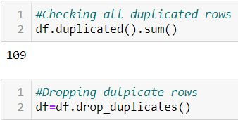
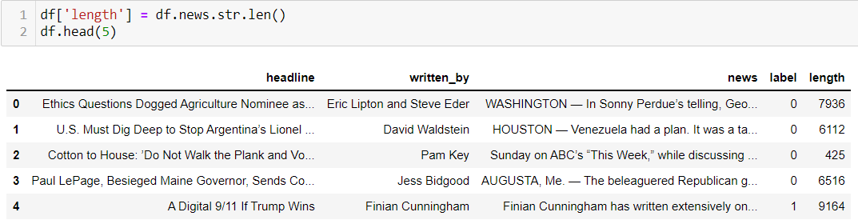
There 109 duplicate rows.
We drop them.
We add new column ‘length’ which shows length of text in ‘news’ column

Slide 6
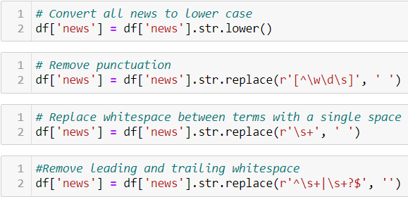
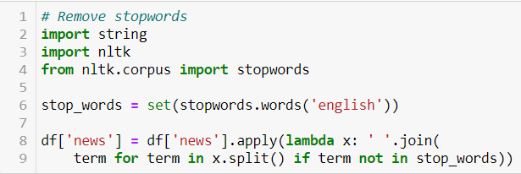
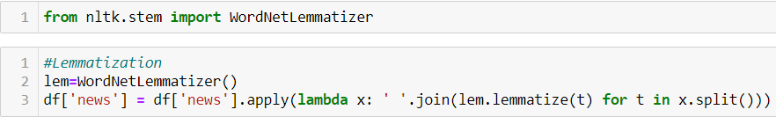
(3) Cleaning the data
1) Converted the text into lower case.
2) Removed punctuation
3) Replace whitespaces
We have remove stop word
We lemmatized the text in ‘news’ column.

Slide 7
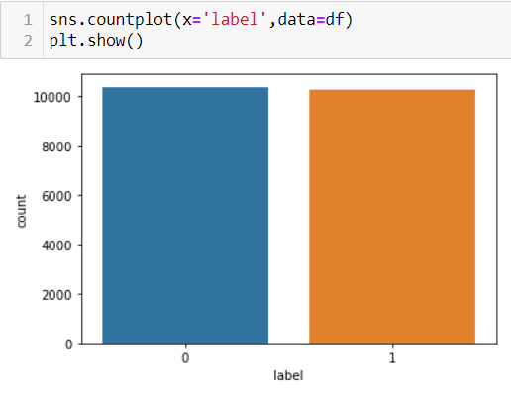
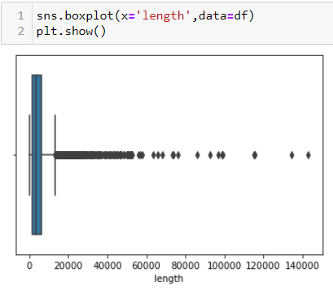
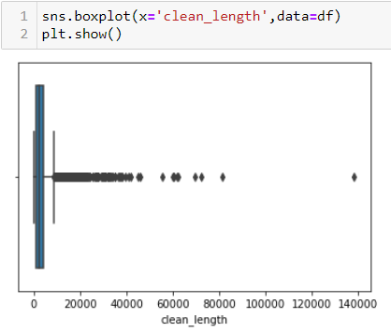
(4) Graphical Analysis
1) We can the data is balanced
2) The target variable have nearly equal values of 0(no fake news) & 1 (fake news)
We can see the length is reduced significantly after cleaning.

Slide 8
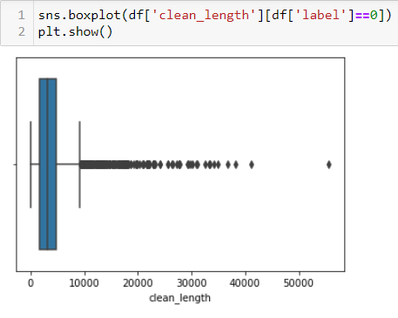
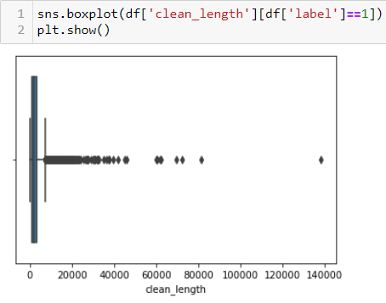
We can see news which is not fake have length not more than 55000.
2) The mean length is around 3000.
We can see fake news could have length more than 55000 lengths.
The mean length is around 1000.

Slide 9
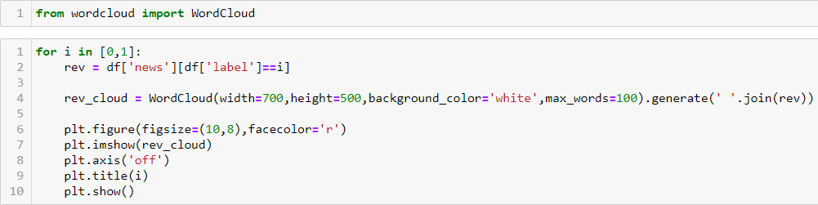
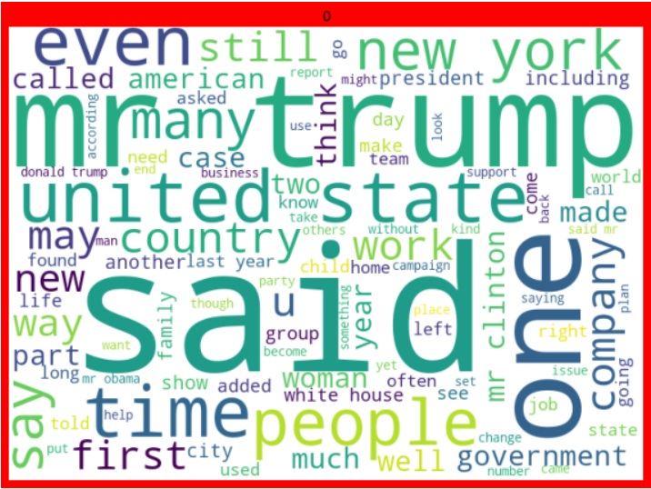


Slide 10
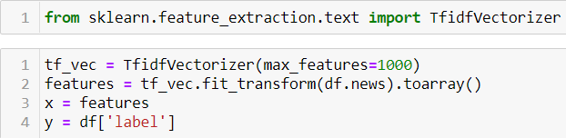
(5) Preprocessing
We transform the text into vector using Tfidf Vectorizer

Slide 11
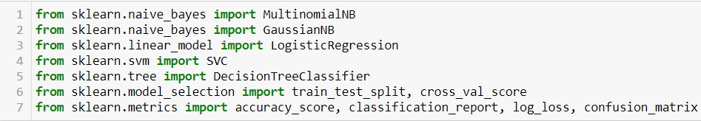
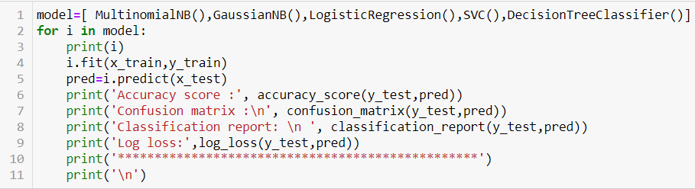
(6) Model selection
Importing all algorithms and performance metric
We split the data into train and text
We train the data with different algorithm

Slide 12
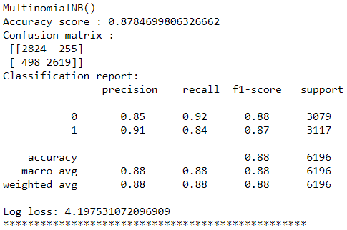
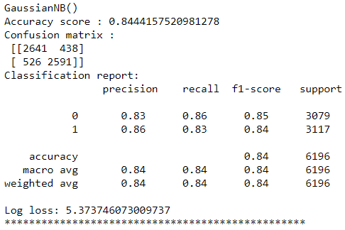
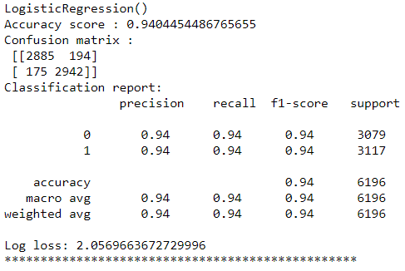
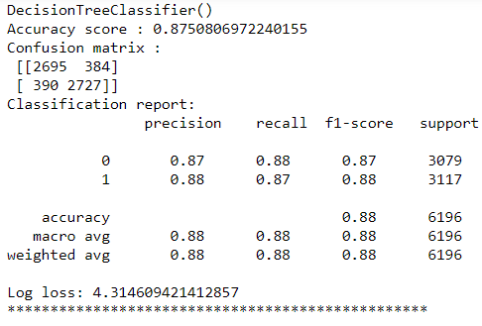
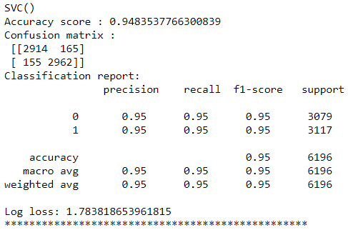
1) The maximum accuracy of 94.8% is given by SVC()
2) Minimum log loss of 1.78 is given by SVC()

Slide 13
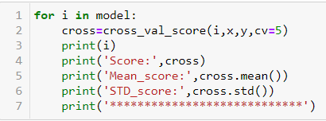
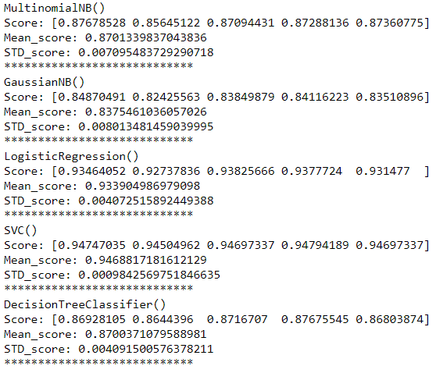
(7) Cross Validation
The standard deviation in the accuracy score of all algorithm is acceptance.

Slide 14
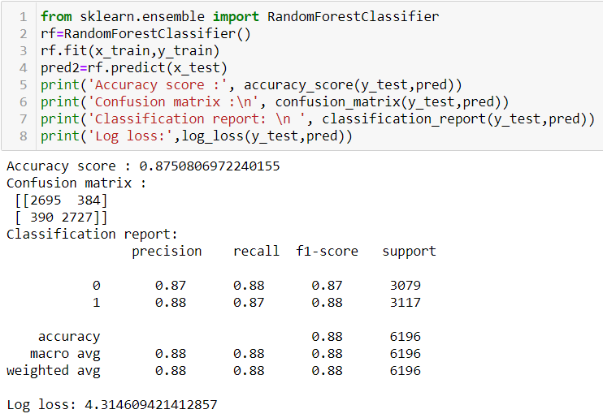
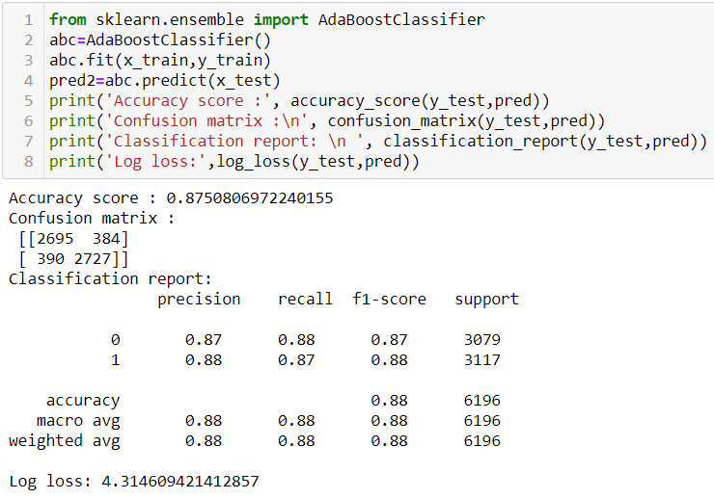
(8) Ensemble technique
Thus we can SVC() gives better accuracy score than ensemble technique.

Slide 15
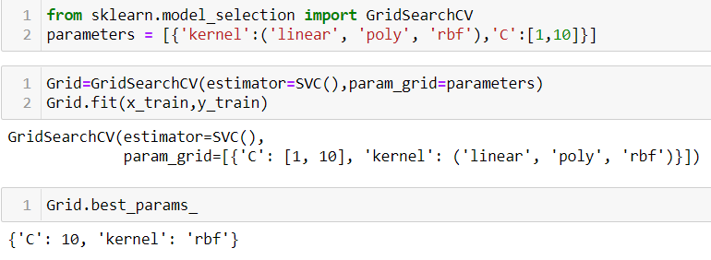
(9) Hyper parameter tuning
Best parameter is given by radial basis function (rbf) kernel
And C value 10.

Slide 16
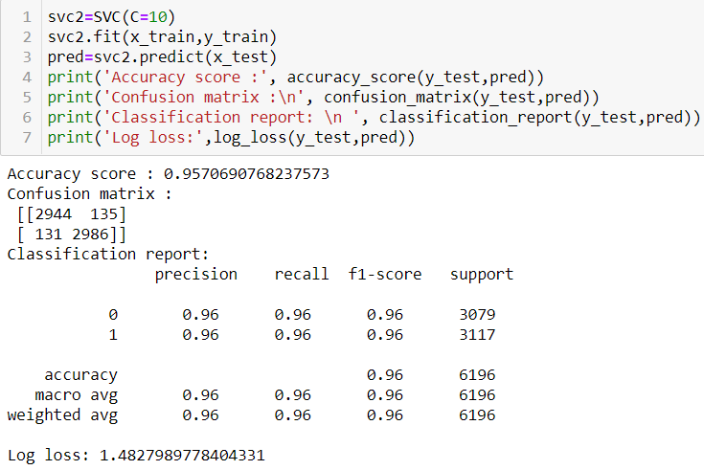
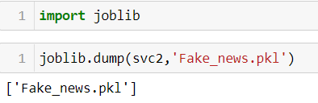
(10) Saving the best model
Best accuracy score of 95.7% is achieved with log loss of 1.48.
Saving the model

Slide 17
Thank you!!!

