Slide 1
SEND AND RECEIVE USING CAN PROTOCOL

Slide 2
TABLE OF CONTENTS
1. Introduce
2. Hardware Requirement
3. Wiring The Circuit

Slide 3
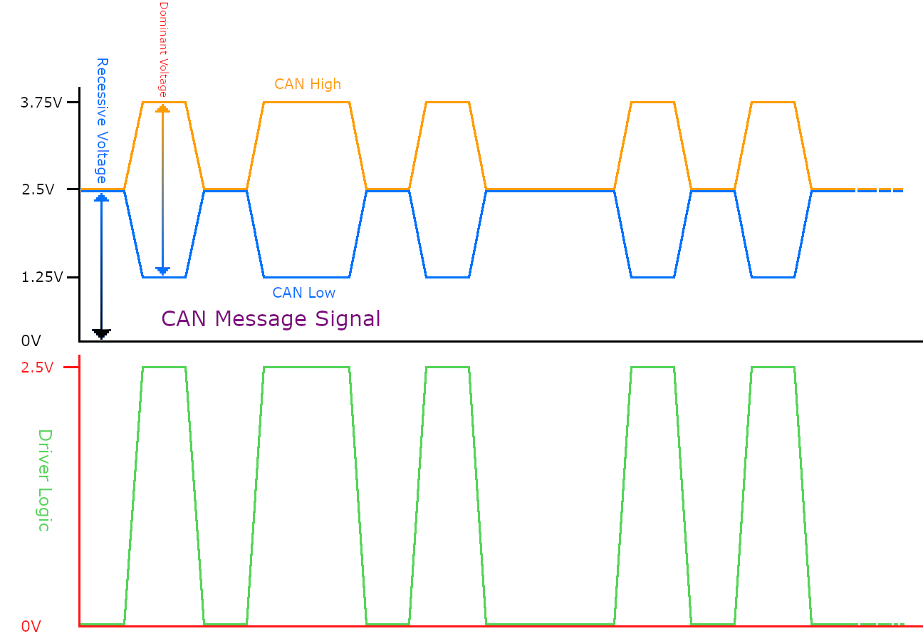
1. Introduce
Controller Area Network (CAN or CAN Bus) is a serial, high-speed, half-duplex, two-wire network technology, so CAN has good interference tolerance.

Slide 4
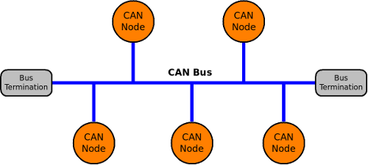
1. Introduce
The Controller Area Network (CAN) protocol allows communication between nodes on a common data bus. Each node in the CAN network can send and receive data on this bus.

Slide 5
2. Hardware Requirement
1: 2 x Can Transceiver
2: 2 x Board STM32f407
3: 1 x Module DHT11
4: 1 x Usb - Uart

Slide 6
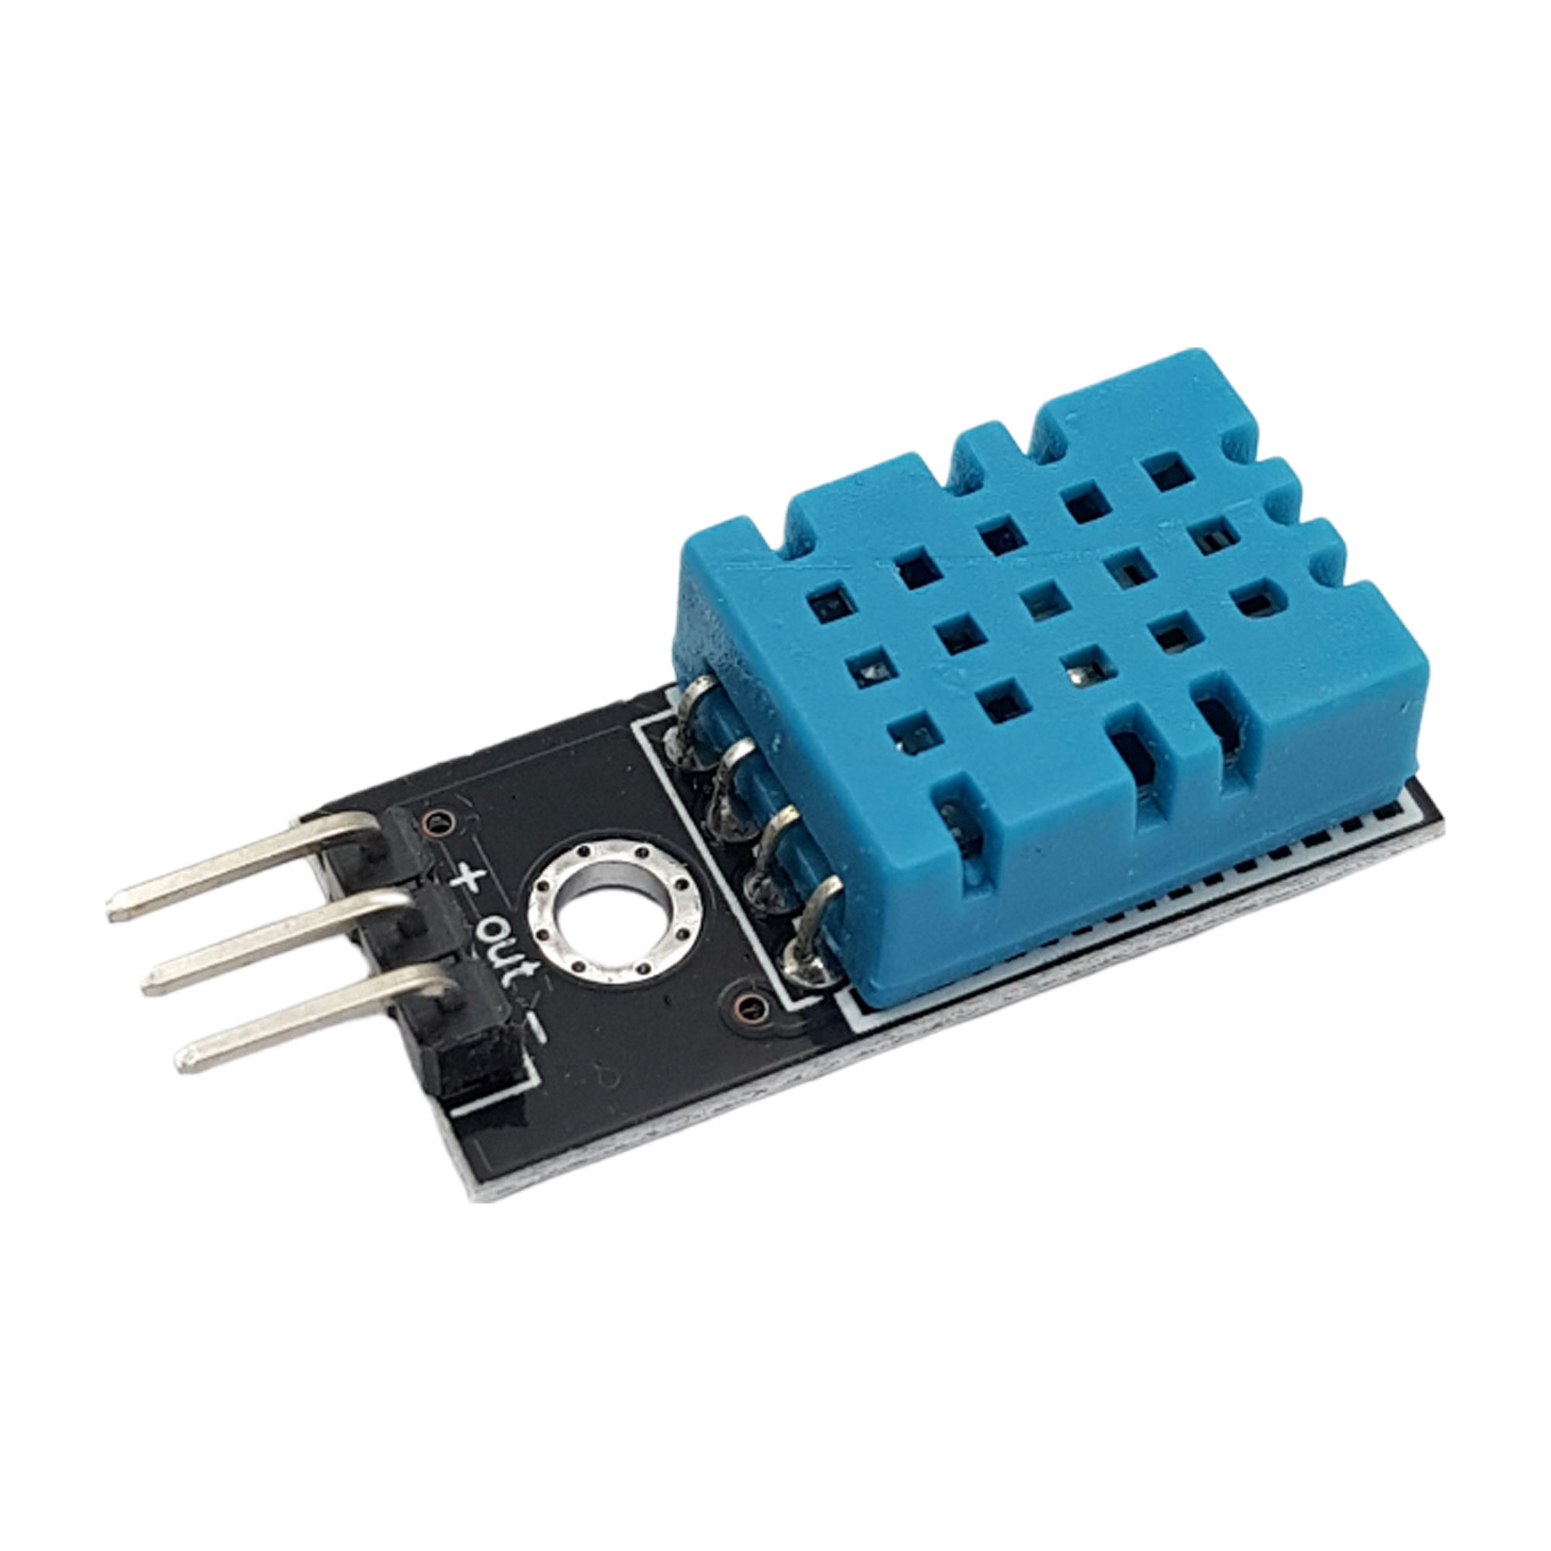
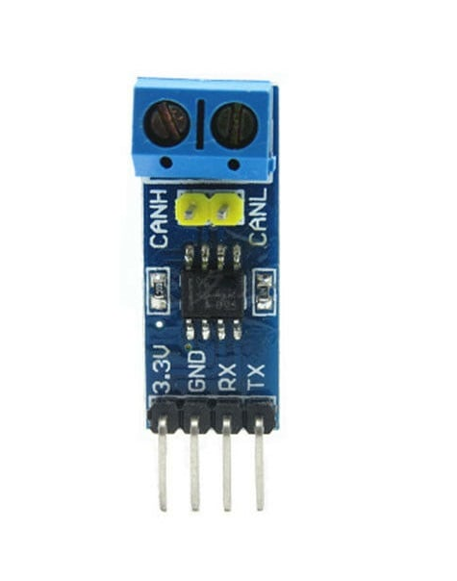
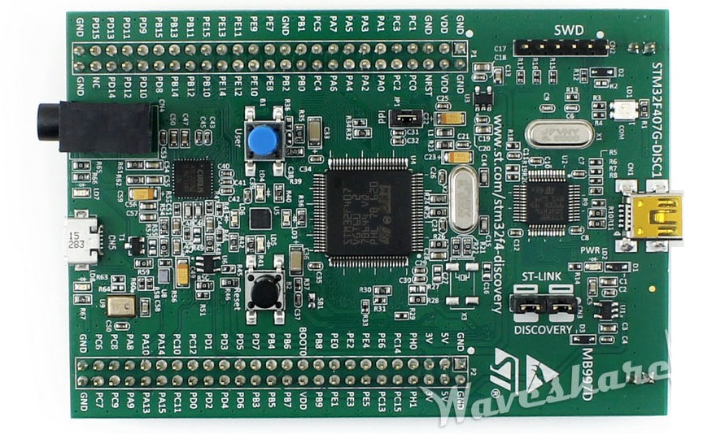
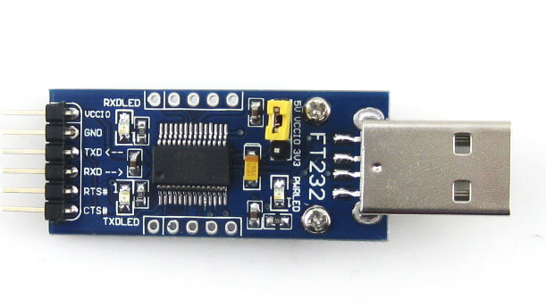
2. Hardware Requirement
1: Can Transceiver
3: Module DHT11
2: Board STM32f407
4: Usb - Uart

Slide 7
3. Wiring The Circuit
CANH
CANH
CANL
CANL
TX
RX
GND
OUT
TX
RX
TX
RX
PA1
PD1
PD0
PD1
PD0
PD2
PC12
GND
MASTER
SLAVE

