Slide 1


Slide 2
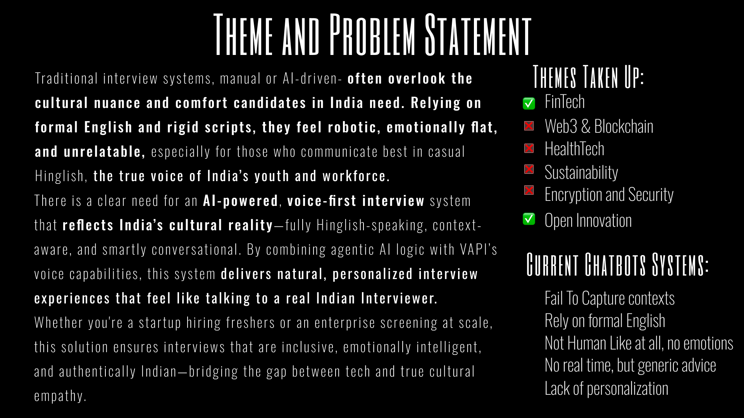

Slide 3
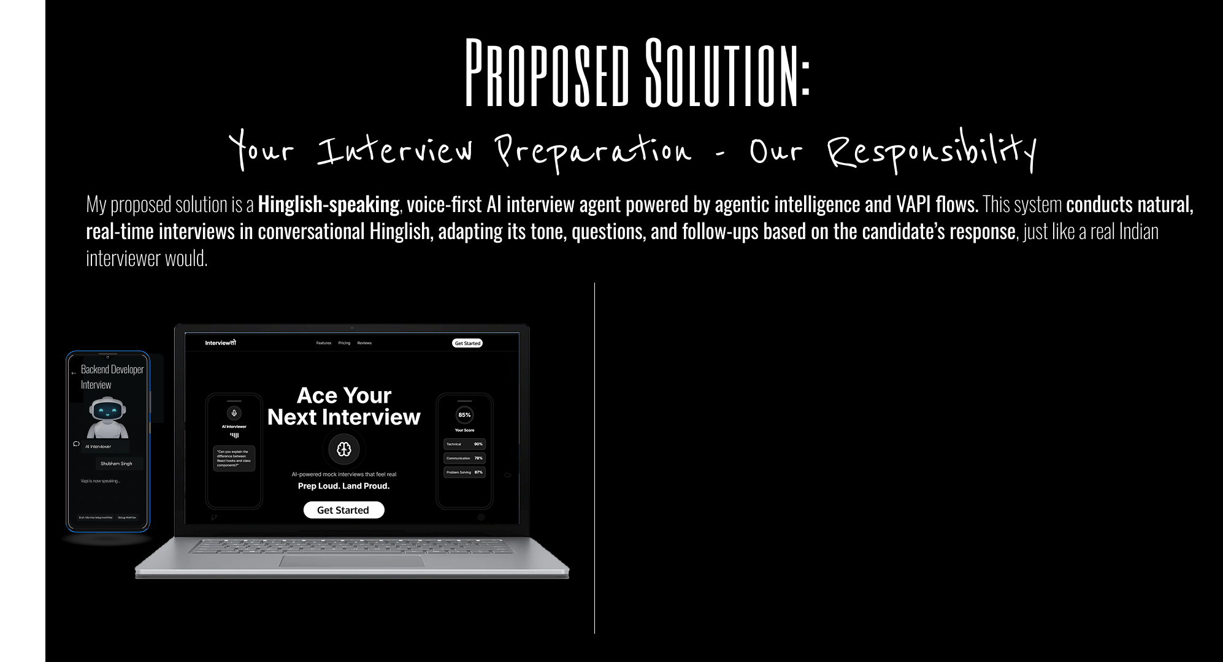
DEMO IN THE LINK BELOW:
https://drive.google.com/file/d/1XbxDGs0CBJZisDmm6NiaQ3LT-qzcZw8I/view?usp=drive_link

Slide 4
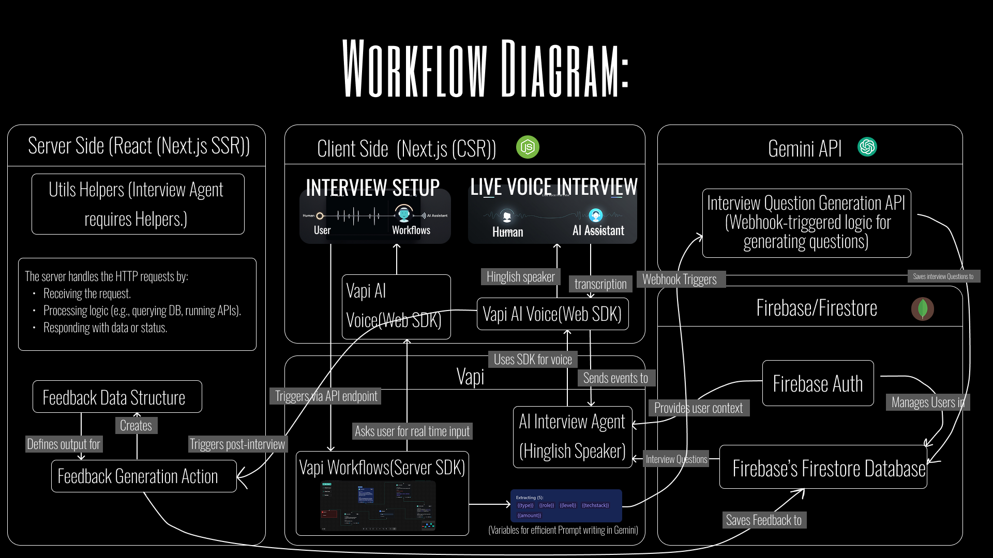

Slide 5
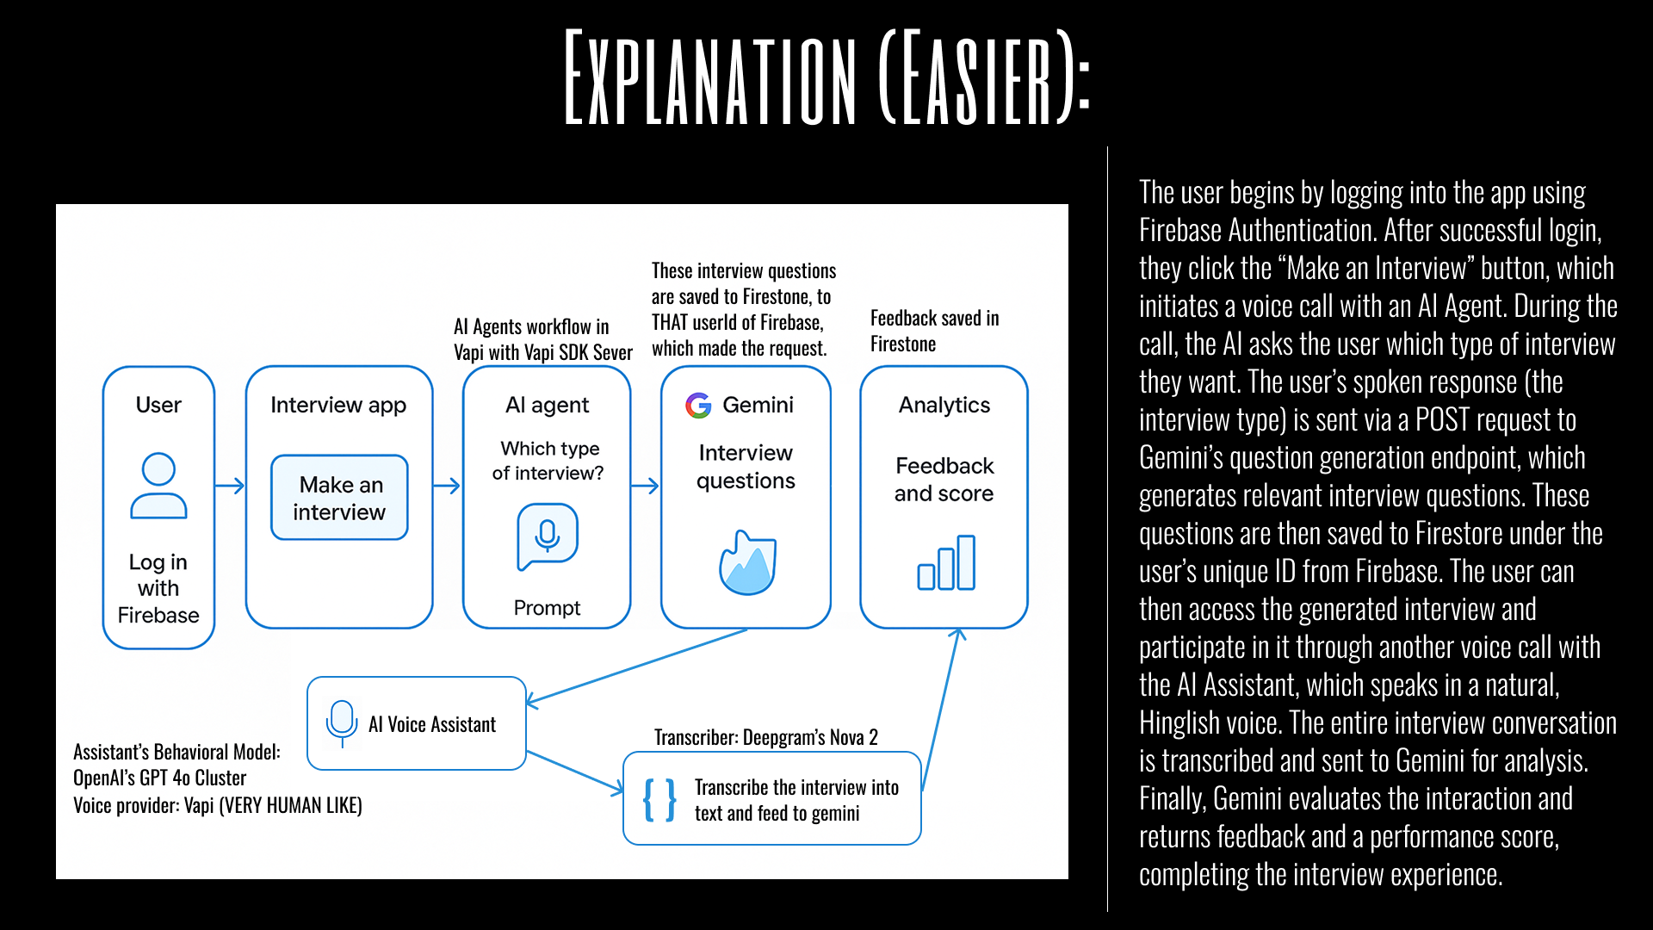

Slide 6
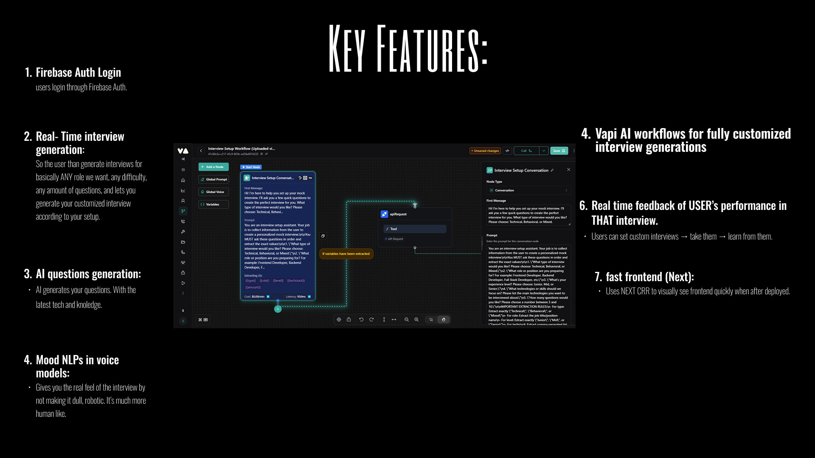

Slide 7
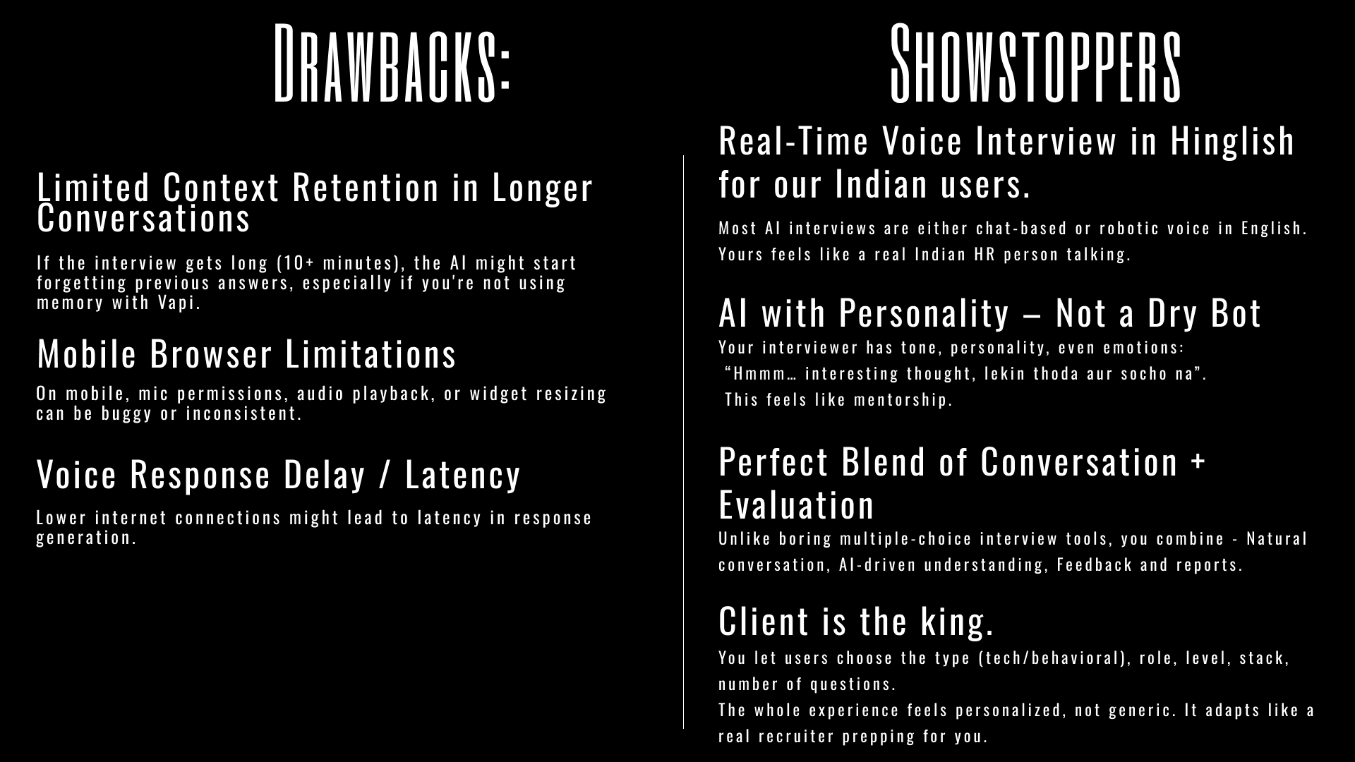

Slide 8
