Slide 1
Don't trust that storage medium
Tatu Erkinjuntti

Slide 2
So, what is a storage media?
A physical device that can store data.
In IT, these are commonly:
Hard disc drives (HDDs)
Solid-state drives (SSDs)
USB mass storage devices are commonly SSDs
Magnetic-tape drives
Floppy discs
Optical media
CD’s
DVD’s
Blu-ray’s

Slide 3
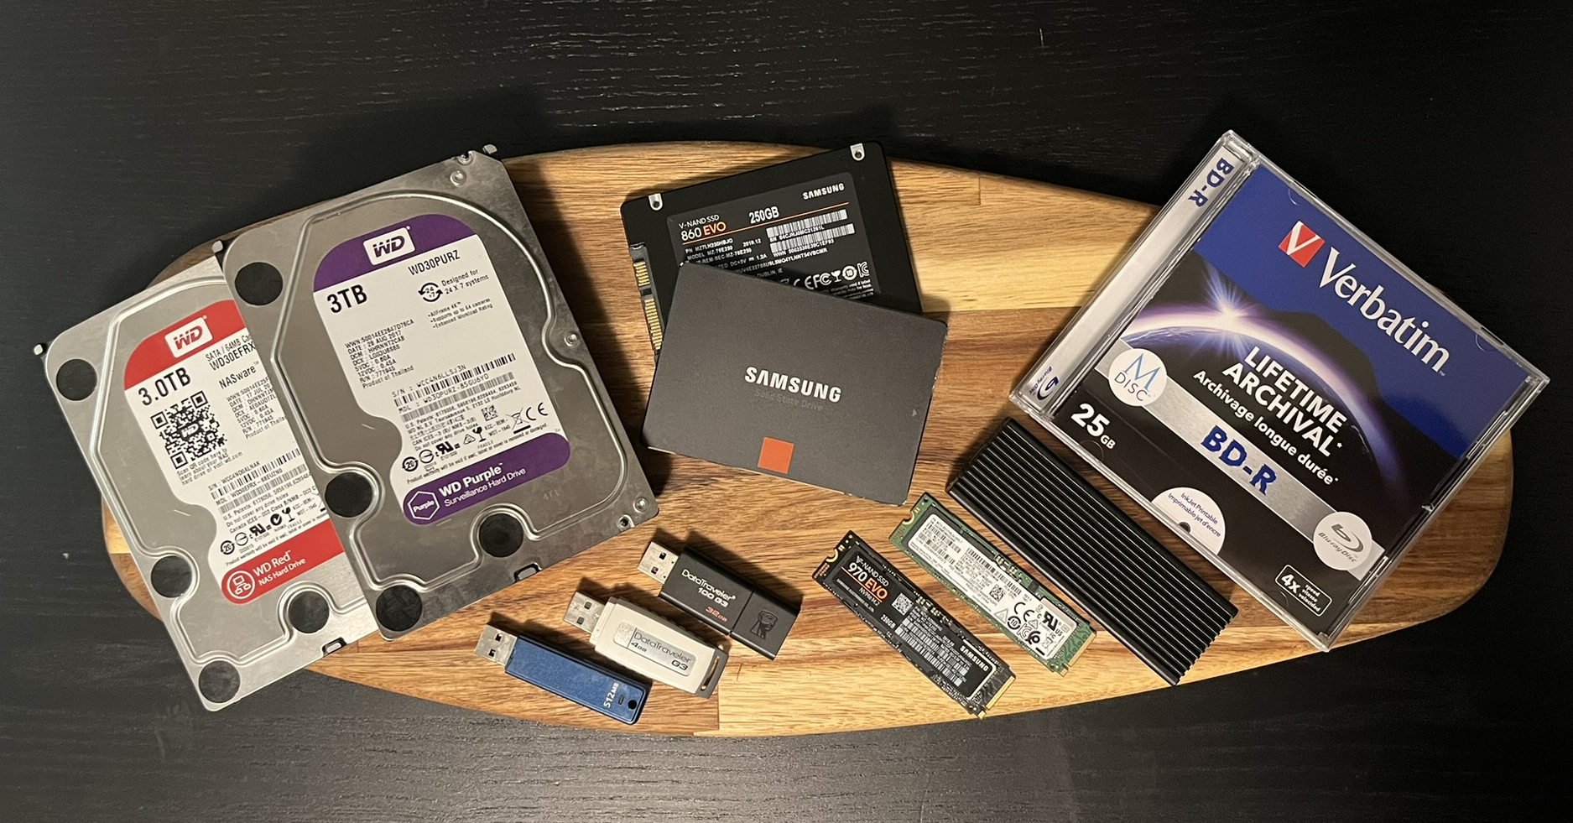
What are the areas we are interested in?
USB mass storage devices
Optical media
Hard disc drives (HDD) & Solid-state drives (SSD)
Excluding USB devices

Slide 4
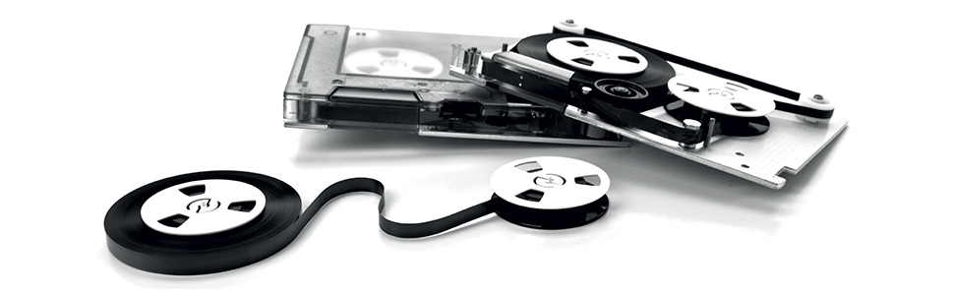
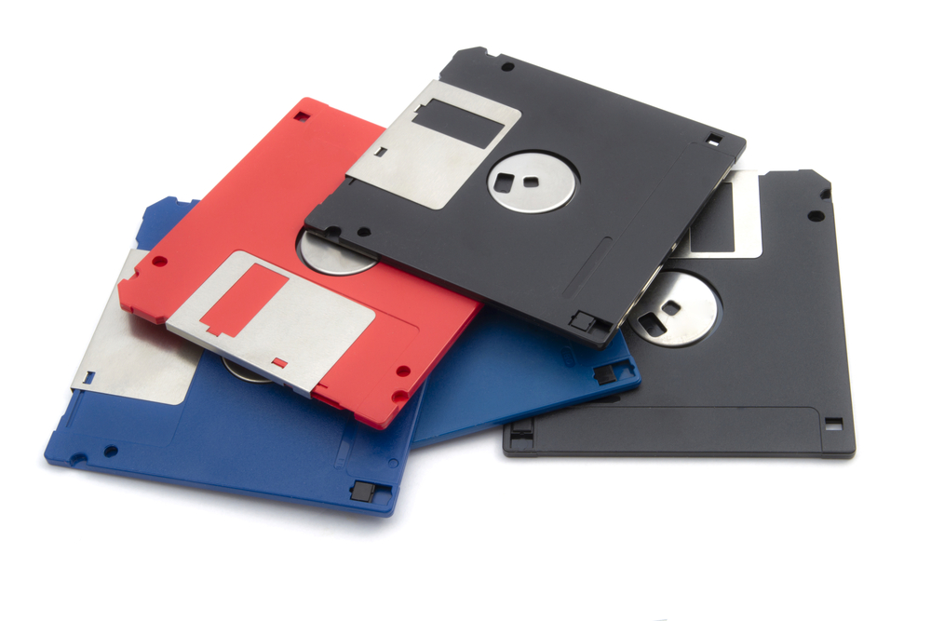
What is out of scope for this presentation?
Floppy discs
Magnetic-tape drives
To be considered legacy.
Not used in consumer electronics anymore.
Windows 10 / 11 no longer offer device drivers by default.
Linux should offer support in the stock kernel.
Mainly used for long-term storage and archiving.
Doesn’t really have a place in consumer electronics at the moment.

Slide 5
What should we consider when dealing with storage media?
Generally, If you do not know the device origin, don’t use it.
If you must check an unknown storage medium, sandbox it.
Virtual environment.
Nonessential computer with no network access.
Even up to date virus protection might not protect your system.
“Curiosity killed the cat”, just inserting the device might be enough to be compromised.
In some cases, even formatting the device does not offer protection.

Slide 6
So, what should we be worried about when dealing with storage media?
May contain malicious software (Malware), examples are:
Worms
Trojan horses
Ransomware
Spyware
Adware / Scareware
Wipers
Keyloggers
Payload can be delivered/executed by various ways:
User interaction
Infected boot sector
USB device enumeration
Autorun / Autoplay on insertion
Corrupted disc firmware
Payload hiding in an overprovisioned part of the SSD (theoretical)

Slide 7
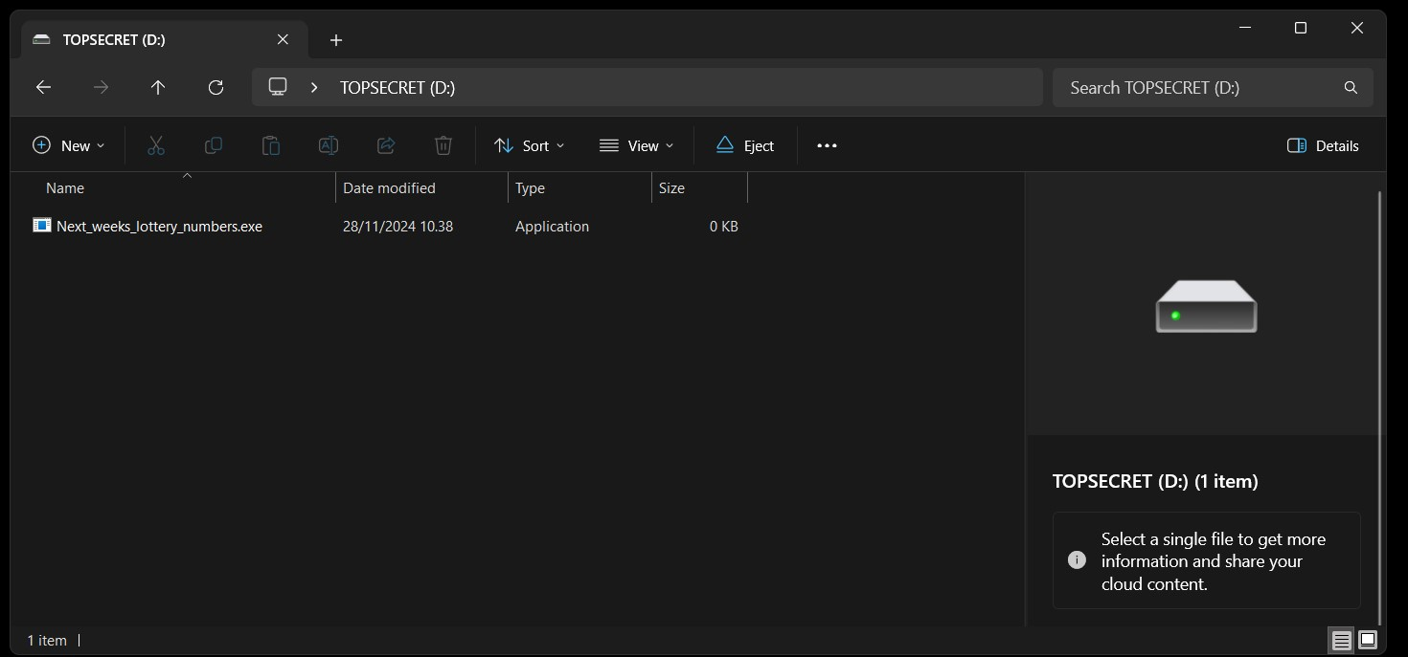
User interaction, a universal way of executing a payload.
Regardless of device type or attack vector, getting the user to execute the malicious payload is the most convenient way to infect the target host.
This can be achieved by trickery
Swapping a device or file with a something similar
This can be achieved by social engineering
Raising curiosity
Pass on as a legitimate article
Inducing fear and panic

Slide 8
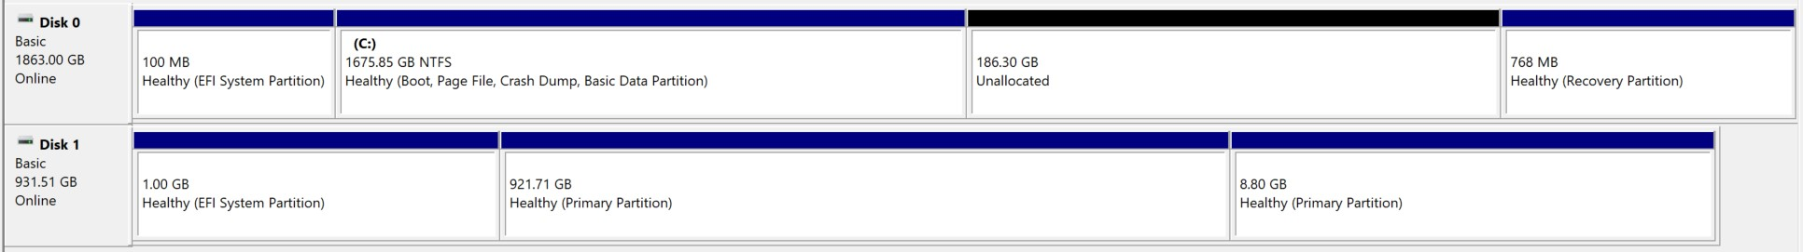
Infected boot sector, the silent killer
Boot sector is an area located usually in the first partition of a disc.
At boot, computers look at the active partitions and checks if they are bootable.
Does it contain code that the computers firmware (BIOS / UEFI) can execute.
This is a normal procedure and is how operating systems are loaded.
An infected boot sector loads malicious code to RAM, altering or replacing the computers original boot code.
After this the malware is loaded every time the computer boots.

Slide 9
USB mass storage devices
By far the most convenient way to deliver a payload on a physical device
Devices are cheap, can be produced in mass
A common and familiar storage device for people
Since USB (Universal Serial Bus) is an industry standard, this creates an intriguing attack vector for payload delivery.
Computers use USB enumeration on device insertion to determine what device was inserted, malware can be delivered without user interaction.
Examples:
BadUSB: Can act as a human interface device (Emulates a Keyboard for Keystroke Injection) or a storage device
KillerUSB: Aims to harm or destroy the computer that it’s attached to by discharging electricity to it.

Slide 10
Optical media
Optical discs aren’t that widely used as in the past, but they still have a place in IT.
Efficient malware delivery relies on operating system autorun/autoplay function in insertion.
Today, this functionality is usually disabled by default, but some operating systems (example Windows) gives the users a popup dialog on what to do with the inserted disc.

Slide 11
Hard disc drives (HDD) & Solid-state drives (SSD)
HDD’s and SSD’s offer more persistence for an attack.
This attack vector usually requires much more effort from the attacker and after successful insertion, are harder to mitigate.
Two examples for HDD’s and SSD’s related vulnerabilities.
Corrupted disc firmware.
Malware hiding in an overprovisioned part of the SSD.

Slide 12
Hard disc drives (HDD) & Solid-state drives (SSD)
Corrupted disc firmware.
Hard drive firmware (“device operating system”) is an essential part of HDDs and SSDs, without it, it they can’t operate.
Unseen to the user, since its not apart of the disc partitioning table.
Because of this, normal disc formatting will not remove the malicious content
Corrupted disc firmware can execute malicious code on host device boot (like infected boot sector).

Slide 13
Hard disc drives (HDD) & Solid-state drives (SSD)
Malware hiding in an overprovisioned part of the SSD
Note! Issue reported by IEEE, I could not find a real-world example of use.
SSD overprovisioning is a method to extend SSD longevity and improve performance by reserving a portion of the disc.
Malware could be hidden in an overprovisioned area of the disc and accessed by resizing the disc overprovisioning
This could be done by the attacker
Unintentionally by the device user

Slide 14
What recomendations are there to mitigate storage media related threats?
User training and increased awareness
Securing computer from BIOS / UEFI
Enable Trusted Platform Module (TPM)
Secure device boot
Using secure boot (Windows)
Limiting bootable devices
Can only boot from operating system disc
Limit boot priority or boot order
Disable unneeded boot devices or locations
Network (HTTP(S) or PXE for example), USB, Optical drives

Slide 15
What countermeasures are there to mitigate storage media related threats?
Use up to date virus protection
Restrict system administrator rights

Slide 16
Thank you!

