Slide 1
Don't trust that storage medium
Tatu Erkinjuntti

Slide 2
So, what is a storage media?
A physical device that can store data.
In IT, these are commonly:
Hard disc drives (HDDs)
Solid-state drives (SSDs)
USB mass storage devices are commonly SSDs
Magnetic-tape drives
Floppy discs
Optical media
CD’s
DVD’s
Blu-ray’s

Slide 3
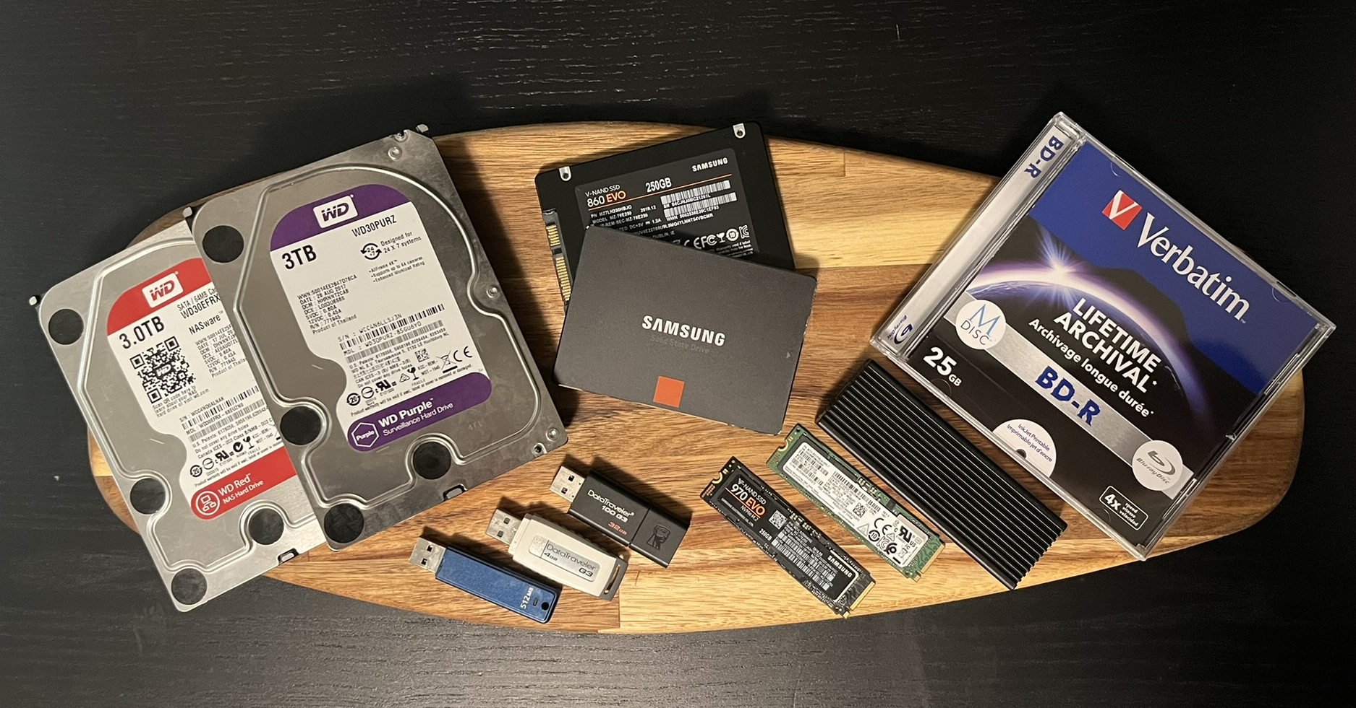
What are the areas we are interested in?
USB mass storage devices
Optical media
Hard disc drives (HDD) & Solid-state drives (SSD)
Excluding USB devices

Slide 4
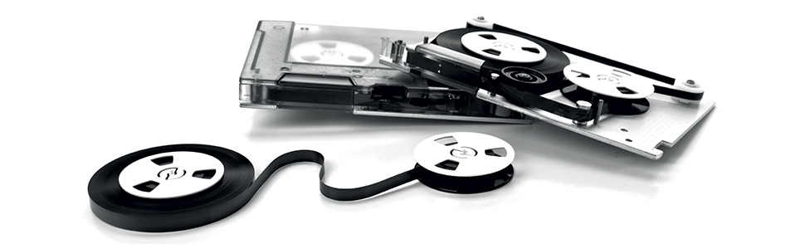
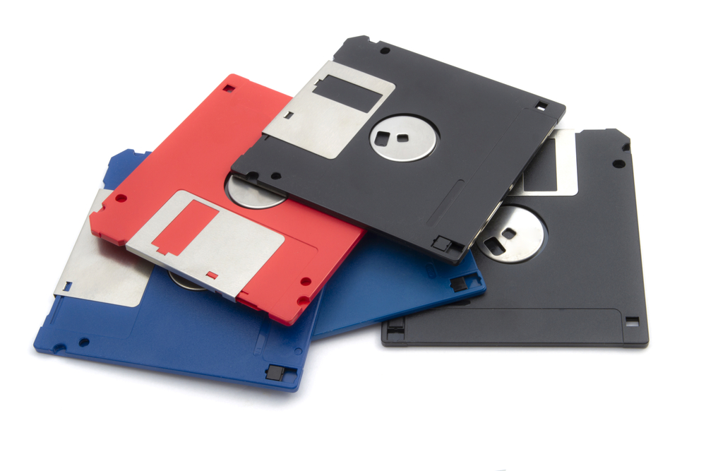
What is out of scope for this presentation?
Floppy discs
Magnetic-tape drives
To be considered legacy.
Not used in consumer electronics anymore.
Windows 10 / 11 no longer offer device drivers by default.
Linux should offer support in the stock kernel.
Mainly used for long-term storage and archiving.
Doesn’t really have a place in consumer electronics at the moment.

Slide 5
What should we consider when dealing with storage media?
Generally, If you do not know the device origin, don’t use it.
Even up to date virus protection might not protect your system.
“Curiosity killed the cat”, just taking a peek might be enough to be compromised.

Slide 6
So what should we be worried when dealing with storage media?
May contain malicious software (Malware)
Examples are:
Worms
Trojan horses
Ransomware
Spyware
Adware / Scareware
Wipers
Keyloggers
Payload can be delivered/activated by:
User interaction
USB device enumeration
Boot sector on host device boot
Corrupted disc firmware
Autorun / Autoplay on insertion
Payload hiding in a overprovisioned part of the disc

Slide 7
User interaction, a universal way of executing a payload.
Regardless of device type or attack vector, getting the user to execute the malicious payload is the most convenient way to infect the target host.
This can be achieved by social engineering
Raising curiosity
Past as a legitimate device

Slide 8
USB mass storage devices
By far the most convenient way to deliver a payload
Devices are cheap, can be produced in mass
A common and familiar storage device for people

Slide 9
USB mass storage devices
By far the most convenient way to deliver a payload
Devices are cheap, can be produced in mass
A common and familiar storage device for people

Slide 10
Optical media
Optical discs aren’t that widely used as in the past, but they still have a place in IT.

Slide 11
Hard disc drives (HDD) & Solid-state drives (SSD)

Slide 12
What countermeasures are there to mitigate storage media related threats?

Slide 13
Thank you!

