Slide 1
Don't trust that storage medium
Tatu Erkinjuntti

Slide 2
So, what is a storage media?
A physical device that can store data.
In IT, these are commonly:
Hard disc drives (HDDs)
Solid-state drives (SSDs)
USB mass storage devices are commonly SSDs
Magnetic-tape drives
Floppy discs
Optical media
CD’s
DVD’s
Bluray’s

Slide 3
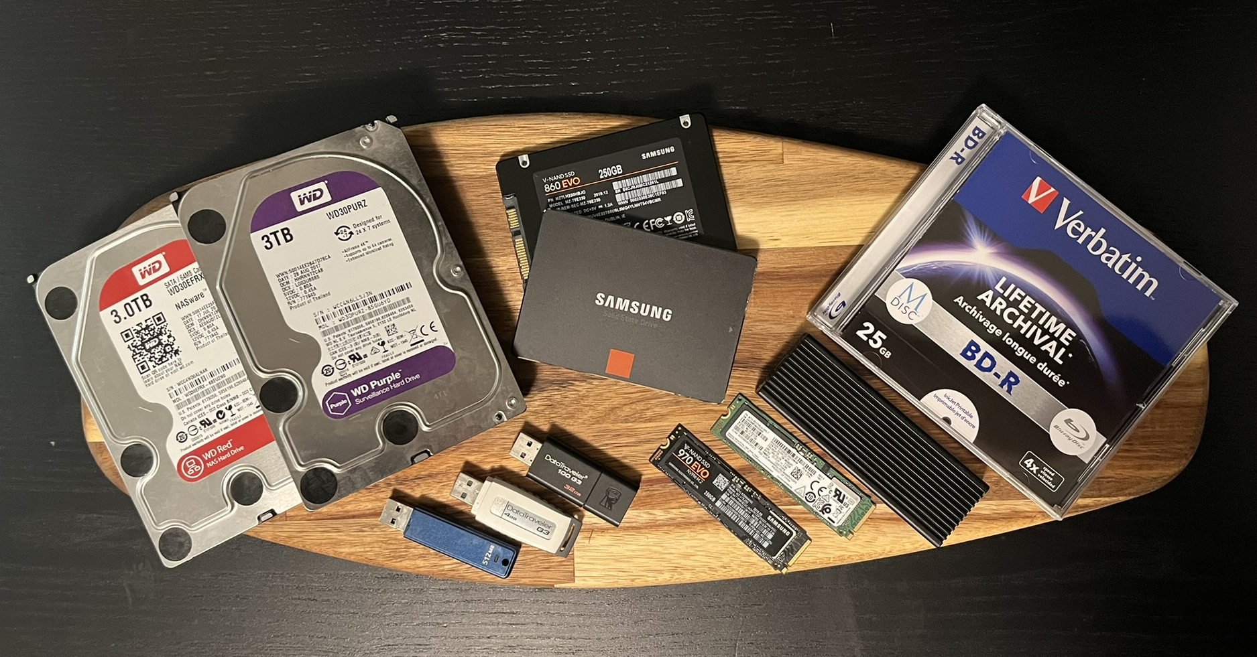
What are the areas we are interested in?
USB mass storage devices
Optical media
Hard disc drives (HDD) & Solid-state drives (SSD)
Excluding USB devices

Slide 4
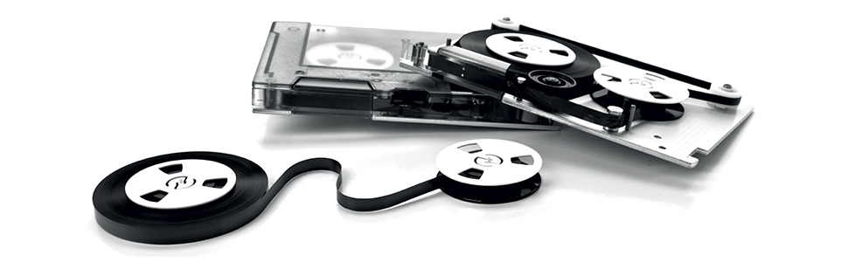
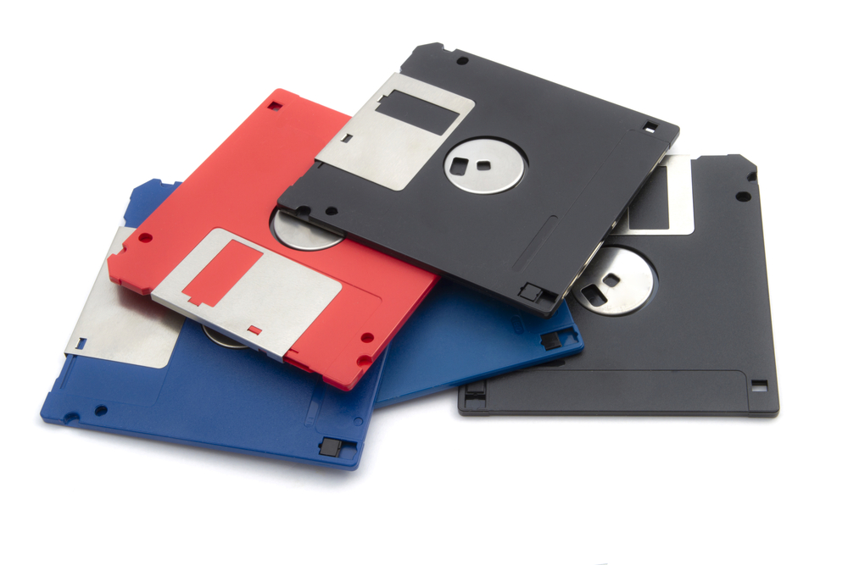
What is out of scope for this presentation?
Floppy discs
Magnetic-tape drives
To be considered legacy.
Not used in consumer electronics anymore.
Windows 10 / 11 no longer offer device drivers by default.
Linux should offer support in the stock kernel.
Mainly used for long-term storage and archiving.
Doesn’t really have a place in consumer electronics at the moment.

Slide 5
What should we be worried when dealing with storage media?
May contain malicious software (Malware)
Viruses
Worms
Trojan horses
Ransomware
Spyware
Adware / Scareware
Wipers
Keyloggers
Payload can be delivered/activated by:
User interaction
Autorun / Autoplay
USB device enumeration
Boot sector on host device boot

Slide 6
USB mass storage devices
HID

Slide 7
Optical media

Slide 8
Hard disc drives (HDD) & Solid-state drives (SSD)

Slide 9
What are the do’s and don’ts when dealing with storage media?

Slide 10
What countermeasures are there to mitigate storage media related threats?

Slide 11
Thank you!

