Slide 1


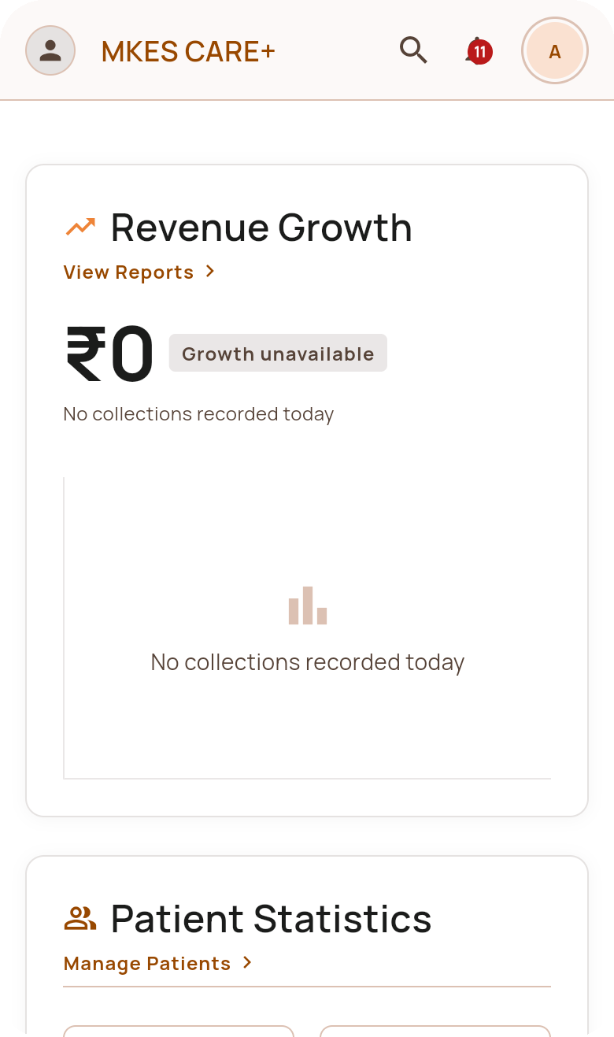

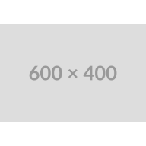
MKES CARE+
Academic Project Viva 2025–26 | Department of CSE / IT
MKES CARE+
Trusted Through Time. Caring for Tomorrow
An Integrated Android Application for Multi-Specialty Clinic Operations, Workflow Automation and Grounded AI Decision Support
Sponsored by Mohankheda Eye and Smile Care
Presented by:
TIRTHA SHAH (T008)
RIYA PATEL (T019)
TATVA JAIN (T058)
Mohankheda Eye & Smile Care
Guided by: MRS KRISHNA BHATT

Slide 2

MKES CARE+
00 | Presentation Overview & Agenda
Presentation Outline
01
1. Existing System, Problem Statement & Motivation
2. Proposed System & Functional Pillars
02
Operational fragmentation in multi-specialty clinics and project rationale.
Multi-specialty patient workflows, staff governance, dual supply chain, and automation.
03
3. Multi-Tier System Architecture & Data Flow
4. Production Technology Stack
04
Decoupled presentation layer, reactive Riverpod state, and Supabase cloud infrastructure.
Verified production stack: Flutter 3.3+, Dart, PostgreSQL with RLS, and WhatsApp deep-links.
05
5. Implementation Snapshots & Core Modules
6. Future Scope & System Roadmap
06
High-fidelity views of authentication, admin dashboard, clinical queues, staff, and inventory.
Conversational LLM Copilot, biometric attendance hardware, and DICOM diagnostic imaging.
07
7. Conclusion & Strategic Value
8. References (IEEE Format) & Viva Defense
08
Operational synthesis, elimination of clinical silos, and measurable administrative impact.
Peer-reviewed biomedical informatics literature, official documentation, and oral defense.

Slide 3
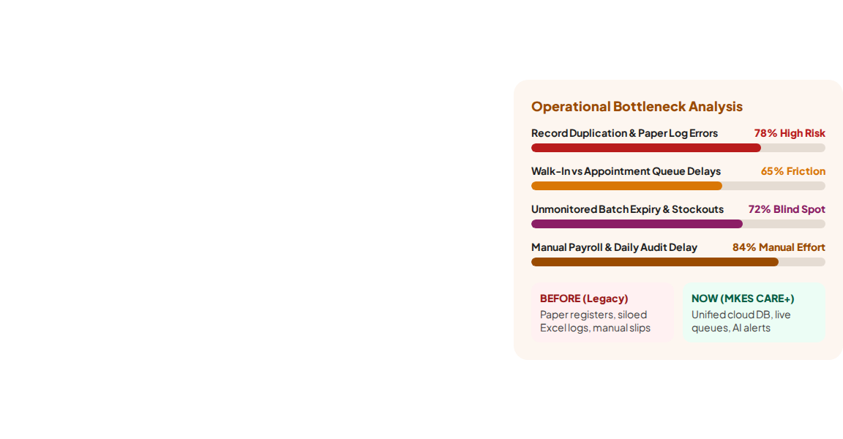
MKES CARE+
01 | Existing System & Limitations
Existing System: Limitations
01
01. Disconnected Records & Registries
02
02. Manual Queue Coordination
Coordination between walk-in queues and pre-booked appointments relies on manual paper slips, creating friction at reception desks and causing unpredictable patient waiting times.
Patient demographics, treatment sheets, and visit histories are maintained in separate paper logs or standalone spreadsheets, leading to duplicate records and lost longitudinal histories.
03
03. Dual-Specialty Supply Disconnect
04
04. Fragmented Admin Visibility
Clinic managers lack consolidated daily visibility across patient volume, staff attendance salary deductions, vendor purchase orders, and daily procedure revenue collections.
Optical goods (frames/lenses) and dental consumables operate on separate registers without unified low-stock thresholds or batch-expiry tracking, causing stockouts and expired inventory waste.

Slide 4

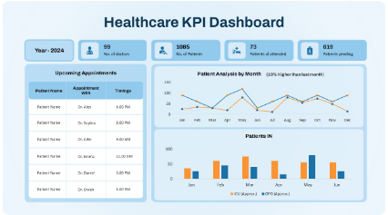
MKES CARE+
01 | Problem Statement
Problem Statement
01
Operational Silos in Multi-Specialty Care
Eye and dental clinics share administrative staff and physical facilities but operate as disconnected silos with incompatible record formats, leading to redundant entries, patient confusion, and lost clinical history.
02
Lack of Real-Time Queue & Task Synchronization
The absence of real-time multi-terminal data synchronization between reception desks, doctor consultation rooms, and billing stations leads to severe communication delays, bottlenecks, and uncoordinated queues.
Root Cause: Disconnected Clinic Terminals
03
High Administrative Friction & Compliance Burden
Manual attendance tracking, complex manual salary deduction calculations for leaves, and unautomated vendor follow-ups consume hours of staff time that should be dedicated to patient care.
Reception
Eye Care
Dental Unit

Slide 5
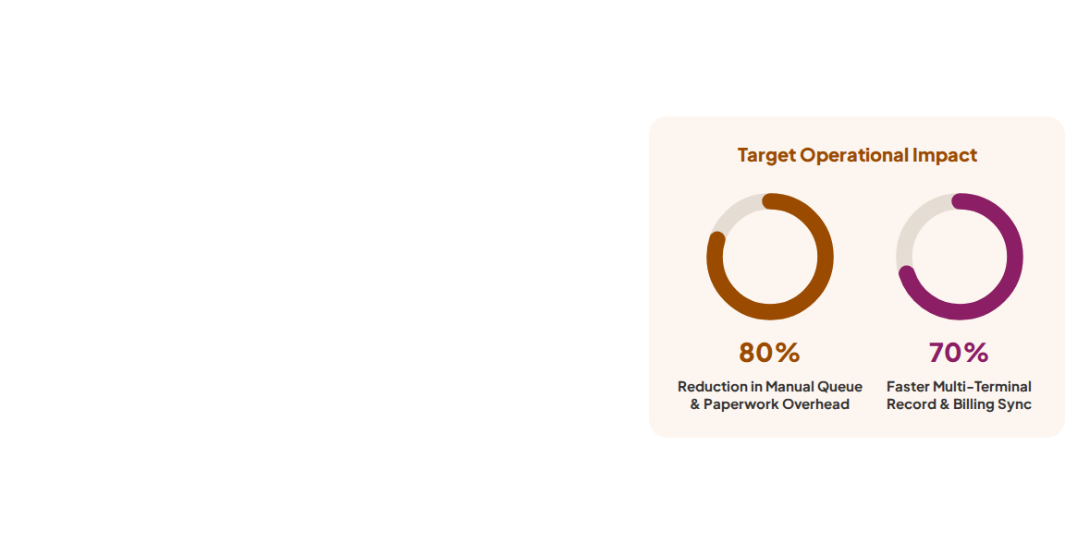
MKES CARE+
01 | Project Motivation & Strategic Objectives
Project Motivation & Strategic Goals
Mobile-First Clinical Governance:
Unified Android tablet & phone interface for doctors and desk staff.
Real-Time Cloud Synchronization:
Centralized PostgreSQL backend ensuring instant queue and record updates.
Automated Operational Workflows:
Deep-linked WhatsApp notices and scheduled multi-sheet Excel cloud backups.
Rule-Grounded Decision Support:
AI Copilot surfacing low inventory, expiring batches, and overdue tasks.
"MKES transforms fragmented eye and dental practices into a unified, data-driven healthcare operation."

Slide 6
MKES CARE+
02 | Proposed System & Functional Pillars
Proposed System: Core Pillars
01
01. Multi-Specialty Clinical Workflows
02. Staff Attendance & Payroll Engine
02
Dedicated patient numbering schemes ('EYE-' vs 'DEN-'), digital triage registries, scheduled vs walk-in queues, ophthalmic refraction logs, and dental procedure records.
Daily biometric/tap attendance logging, automated leave-to-salary deduction calculations according to clinic rules, dynamic staff shift allocation, and task delegation tracking.
03
03. Dual-Specialty Supply Chain
04. Integrated Invoicing & Cloud Sync
04
Real-time tracking of optical frames, prescription lenses, dental burs, and restorative materials with automated reorder alerts, batch expiry warnings, and vendor purchase orders.
Multi-item invoice generation (consultations, optical goods, dental procedures) paired with automated background Excel spreadsheet generation and cloud storage backup.

Slide 7
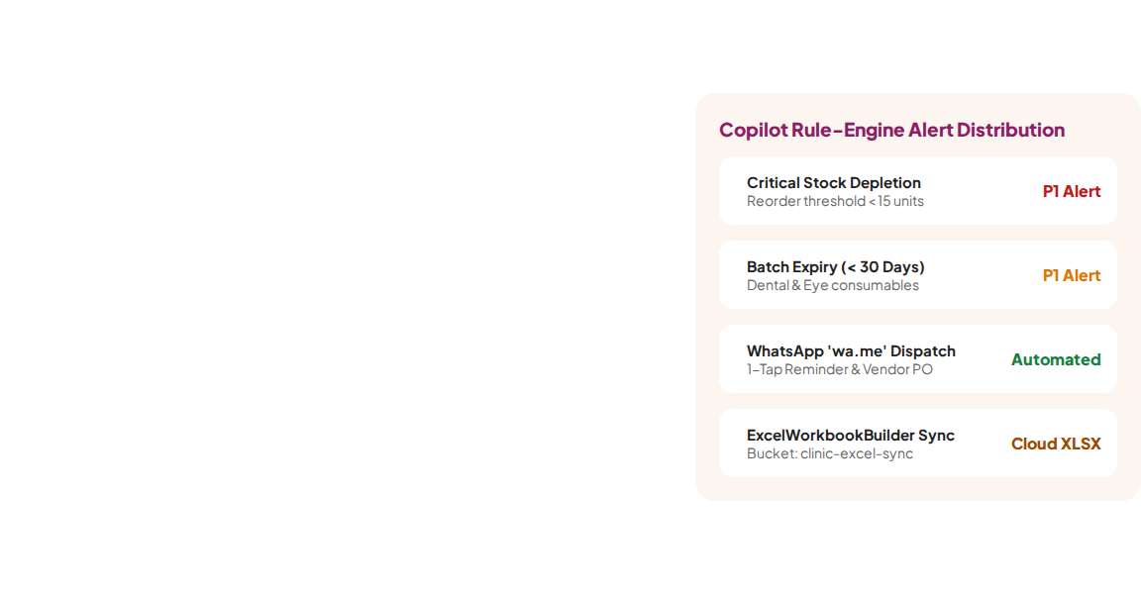
MKES CARE+
02 | Automation & AI Copilot Engine
AI Copilot & Automation
01
Rule-Grounded Copilot Insights (Core Differentiator)
Synthesizes live database transactions daily to generate prioritized alerts: flags critical stock depletion, identifies batches expiring within 30 days, highlights unassigned tasks, and detects queue surges.
02
Automated WhatsApp Communication Engine
Leverages deep-linked 'wa.me' URL protocols to generate one-tap personalized patient appointment reminders, spectacle collection notifications, and vendor purchase orders without manual typing.
03
Automated Excel Cloud Synchronization
Custom 'ExcelWorkbookBuilder' compiles multi-sheet clinical, inventory, and revenue audit spreadsheets on device, streaming them directly into Supabase 'clinic-excel-sync' storage for compliance.

Slide 8

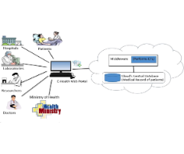
MKES CARE+
03 | System Architecture & Tier Breakdown
System Architecture: 2-Tier Design
Tier 2: Backend, DB & Cloud
Tier 1: Client & Presentation
• Supabase PostgreSQL 15+ with Row-Level Security (RLS)
• Flutter SDK (v3.3+) native Android rendering engine
• Realtime WebSocket channels for instant queue sync
• Riverpod (v2.6.1) reactive state & dependency injection
• Storage Bucket: 'clinic-excel-sync' for XLSX audits
• Material 3 UI Engine with MKES AppColors design tokens
• ExcelWorkbookBuilder multi-sheet report exporter
• 17 modular domain features across clinical, staff & supply
HTTPS REST + Realtime WebSockets
• Deep-Link communication layer via WhatsApp 'wa.me'

Slide 9
MKES CARE+
03 | Data Flow & Security Model
Data Flow & Security Model
1. Unidirectional Reactive State Flow
2. Real-Time WebSocket Event Distribution
User interactions trigger Riverpod StateNotifiers, causing immediate optimistic UI updates while asynchronously dispatching parameterized queries to Supabase via secure HTTPS/REST.
PostgreSQL write operations emit replication events over persistent WebSockets, synchronizing patient queue numbers across doctor consultation rooms and reception tablets in milliseconds.
3. Zero-Trust Row-Level Security (RLS)
4. Automated Multi-Sheet Cloud Export Pipeline
Security is enforced strictly at the database engine level via JWT claims. Receptionists are restricted from modifying medical diagnoses, and doctors have scoped access to their assigned specialty.
The 'ExcelWorkbookBuilder' constructs normalized multi-tab workbooks (Patients, Prescriptions, Financials) entirely in memory, uploading encrypted snapshots to Supabase Cloud Storage.

Slide 10
MKES CARE+
04 | Production Technology Stack — Frontend
Frontend & Mobile Engine
01
Client & State Frameworks
02
UI Engine & Local Services
• Flutter SDK (v3.3+) & Dart
• MKES AppColors Design Tokens
• Riverpod (v2.6.1) State Management
• SharedPreferences Session Cache
• Material 3 UI Engine
• Custom Form Validation Rules
• Google Fonts (Poppins / Inter)
• Multi-Specialty Currency Formatter
• flutter_dotenv & intl Formatting
• High-Performance Canvas Rendering
Verified Production Mobile Stack
Every technology is verified directly from the production repository: pubspec.yaml, Riverpod providers, Material 3 design tokens, and local cache handlers.

Slide 11
MKES CARE+
04 | Production Technology Stack — Backend & Cloud
Backend, Database & Cloud Stack
01
01. Supabase PostgreSQL 15+
02. Row-Level Security (RLS) Engine
02
Enterprise-grade relational database managing 15+ normalized relational tables (patients, appointments, staff, inventory, bills) with ACID transaction integrity.
Granular access control policies executed within PostgreSQL, validating JWT claims to isolate sensitive ophthalmic and dental records according to user roles.
03
03. Cloud Storage & Sync Bucket
04. Communication & AI APIs
04
Supabase Storage bucket ('clinic-excel-sync') storing encrypted, timestamped Excel operational workbooks generated automatically by the client device.
'url_launcher' powering deep-linked WhatsApp ('wa.me') transactional communications, paired with an extensible modular provider layer prepared for LLM API integration.

Slide 12

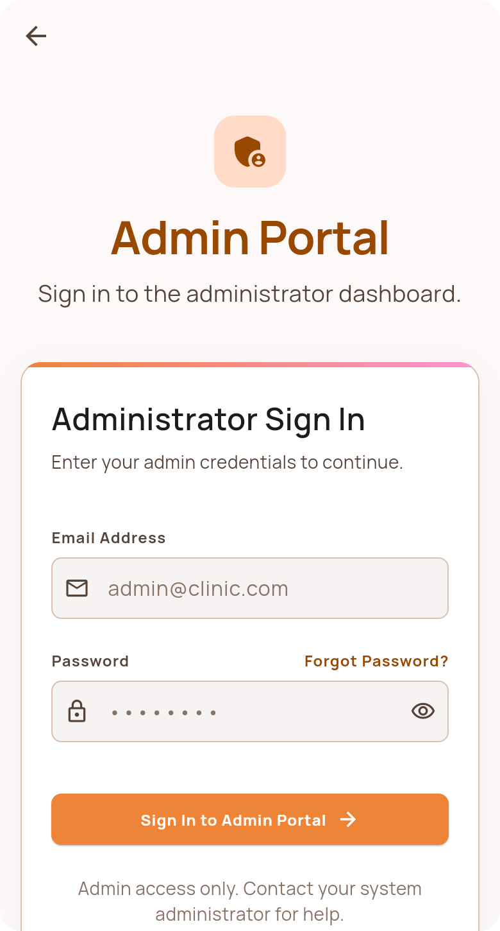
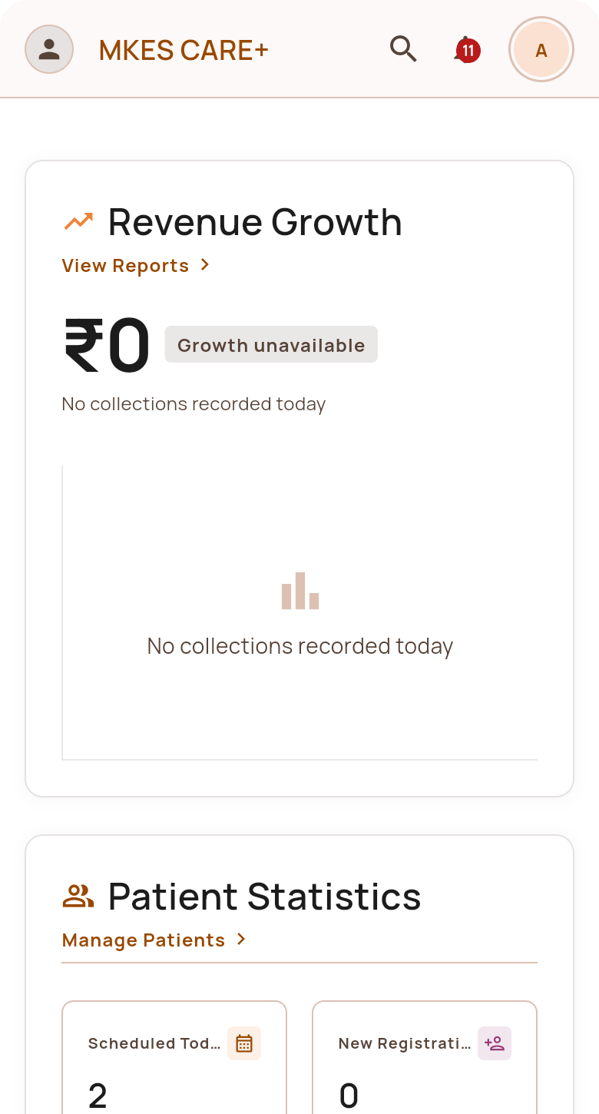
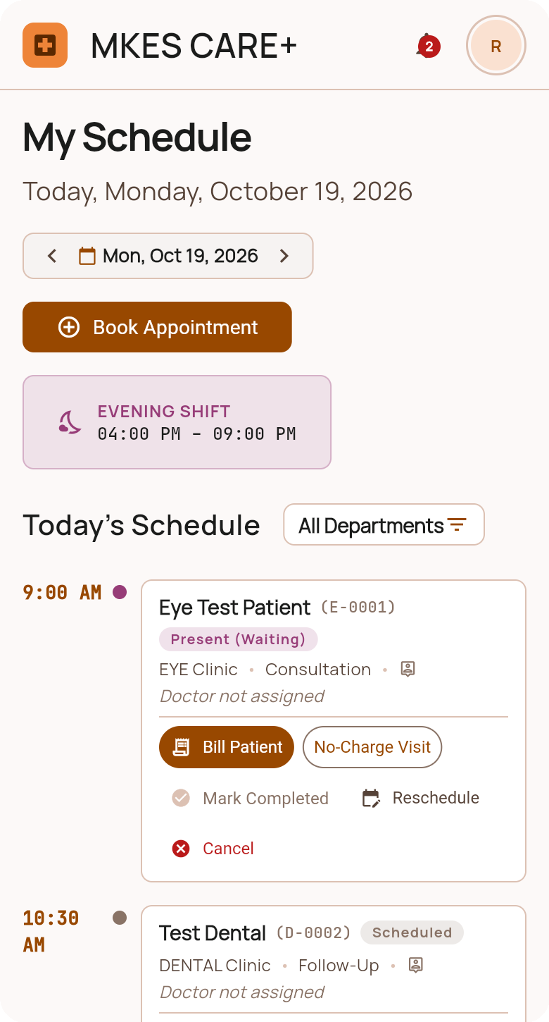
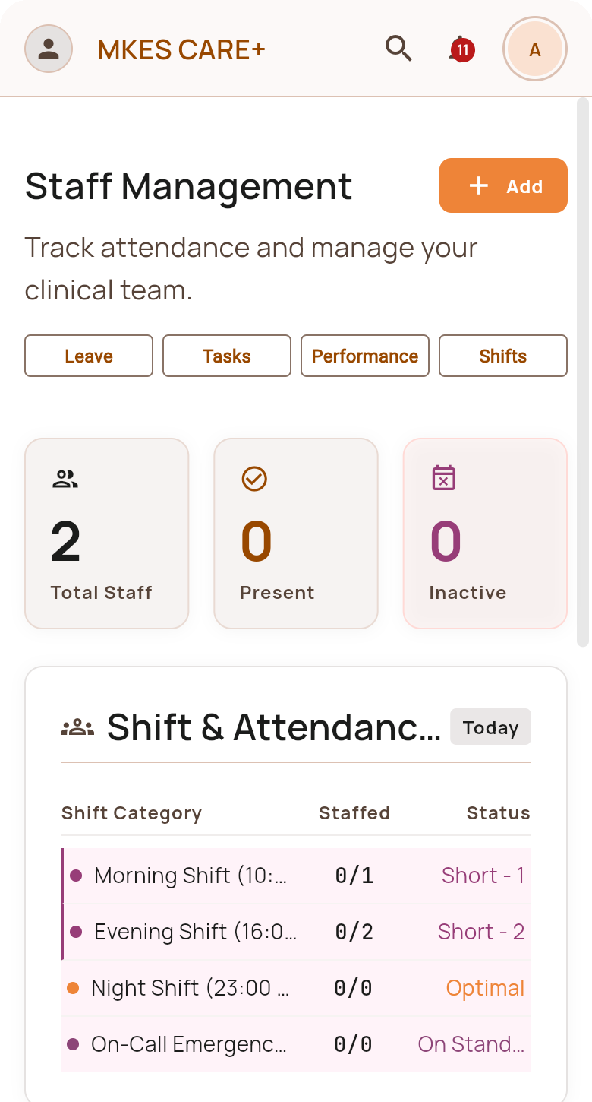
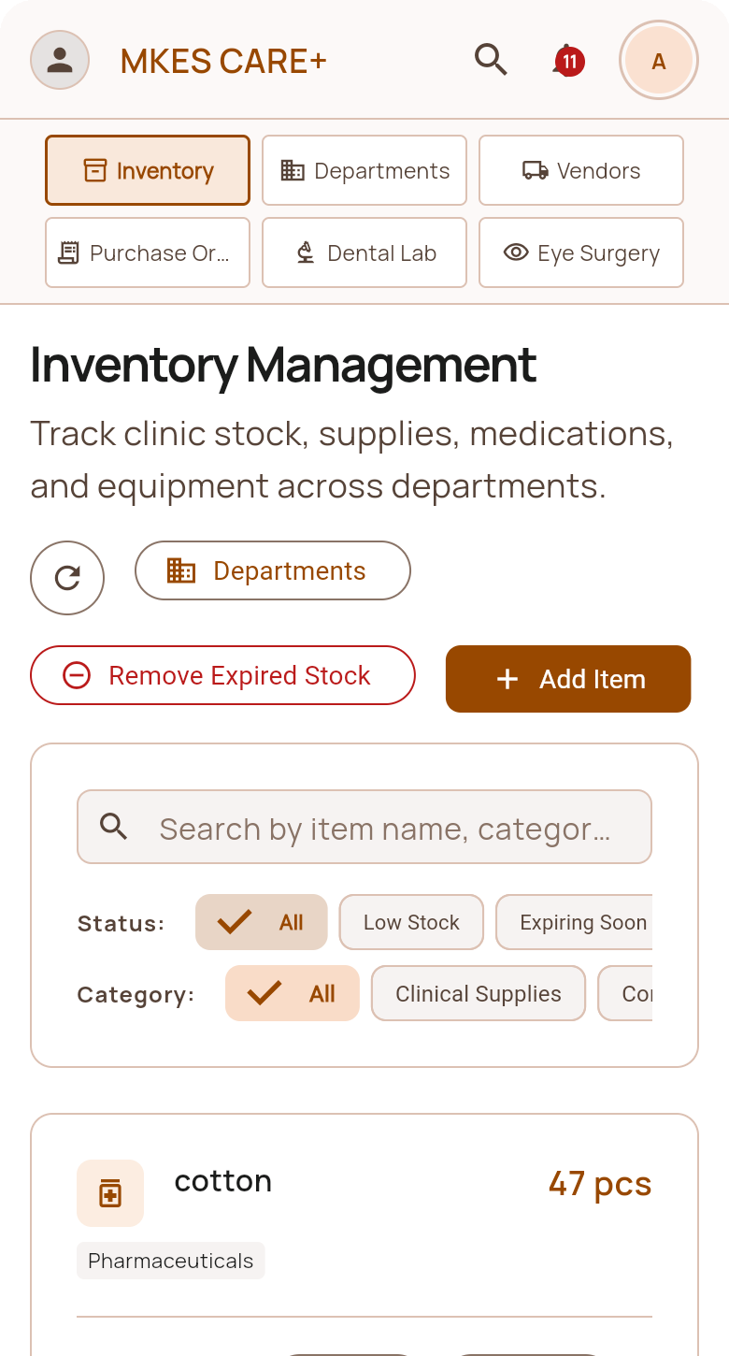
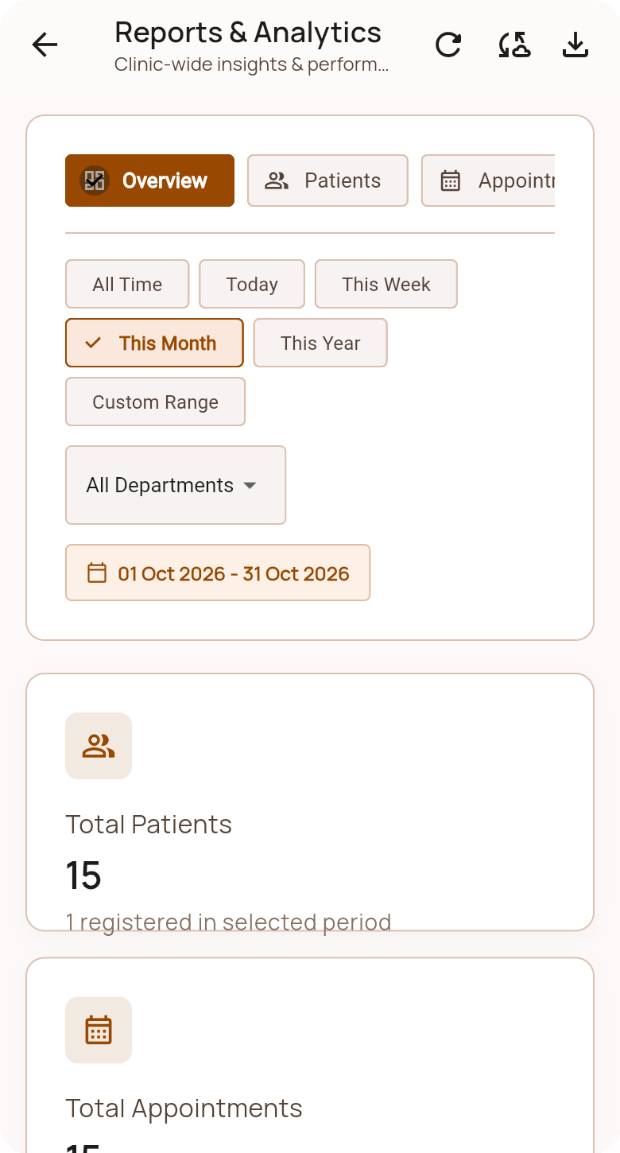





MKES CARE+
05 | Implementation Snapshots — Core Modules
Implementation: Six Core Modules
Six production-ready Android modules built with Flutter 3.3+ and Supabase PostgreSQL. Phone frames prepared for screenshot insertion.
1. Auth & Roles
2. Admin Dashboard
3. Patient Queues
4. Staff Portal
5. Clinic Inventory
6. Billing & Reports
Multi-role login (Admin, Doctor, Staff, Reception) with persistent session tokens.
Dual-specialty patient registry, triage numbering, and doctor consultation queues.
Attendance marking, leave salary deduction rules, and dynamic task tracking.
Dual-specialty stock levels, expiry indicators, and vendor purchase orders.
Multi-procedure invoicing, payment tracking, and automated Excel cloud sync.
Live clinic KPIs, fast action buttons, and rule-grounded Copilot Insights.

Slide 13
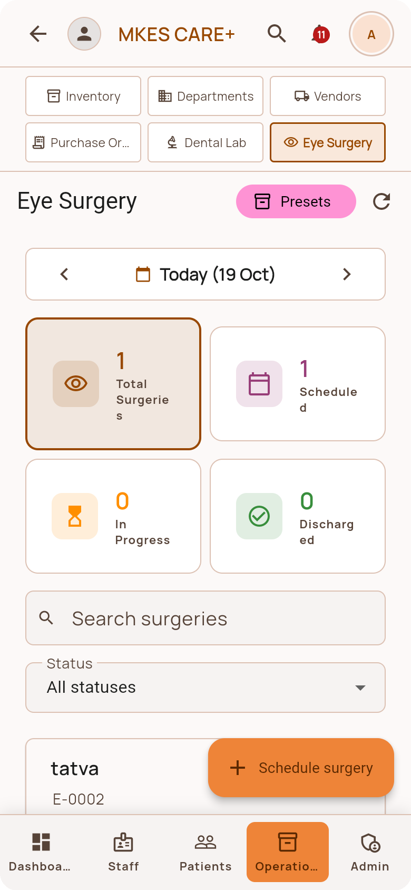
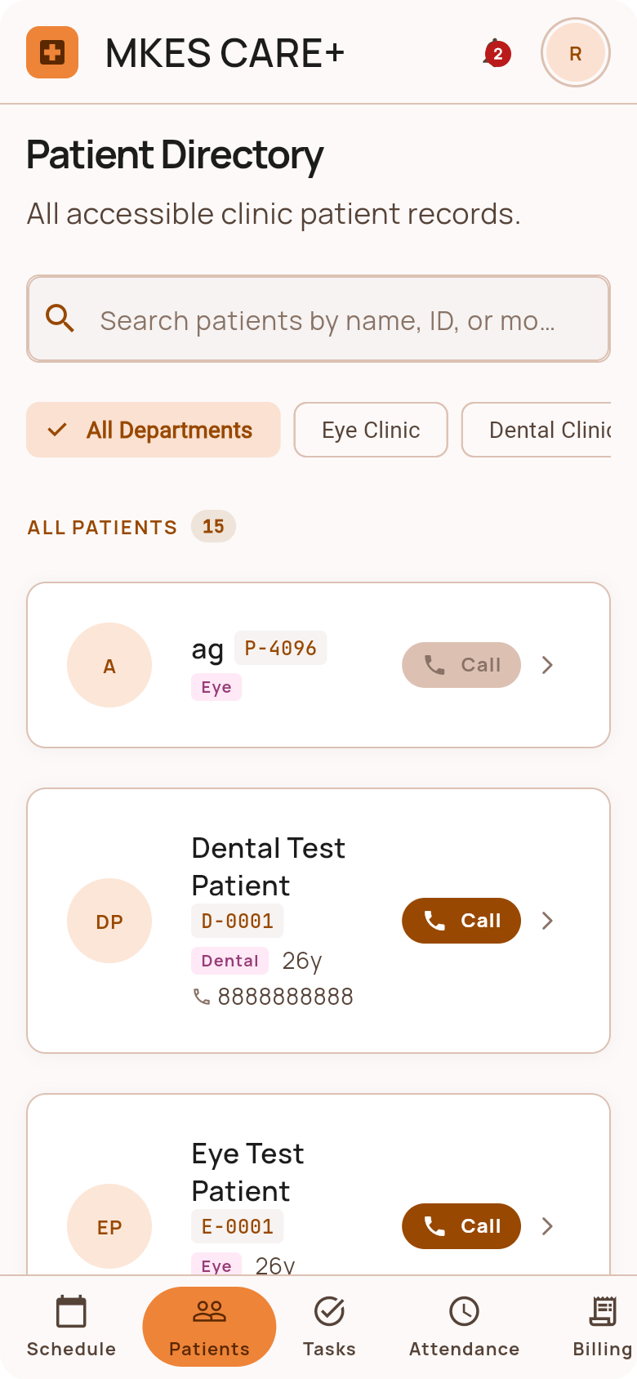
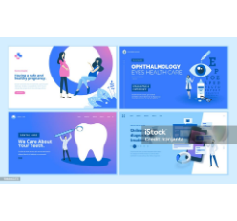
MKES CARE+
05 | Implementation Detail — Clinical Operations
Clinical Modules: Eye & Dental Care
Ophthalmology (Eye Care) Module
Dental Operatory Module
• Department-specific 'EYE-' patient registry & tracking
• Department-specific 'DEN-' patient numbering & triage
• Visual acuity & refraction parameter capture (Sph/Cyl/Axis)
• Procedure logging: scaling, fillings, root canals, extractions
• Optical frame & prescription lens dispensing linkage
• Dental laboratory case tracking & return date logging
• Pre-operative eye surgery checklists & follow-up notices
• Chairside consumable deduction upon visit completion
Dual-Specialty Triage ('EYE-' & 'DEN-')

Slide 14
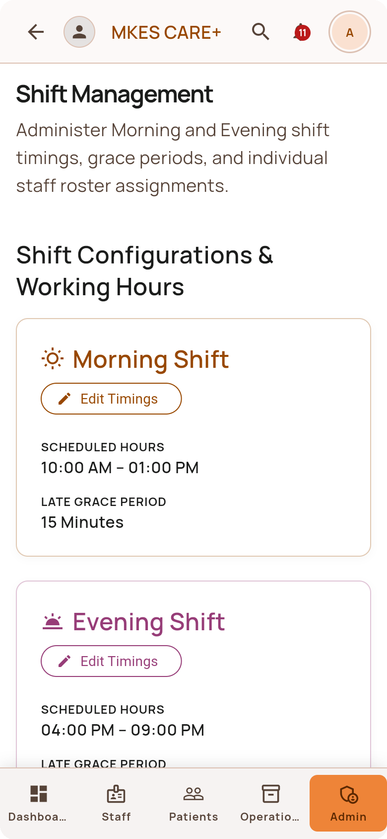
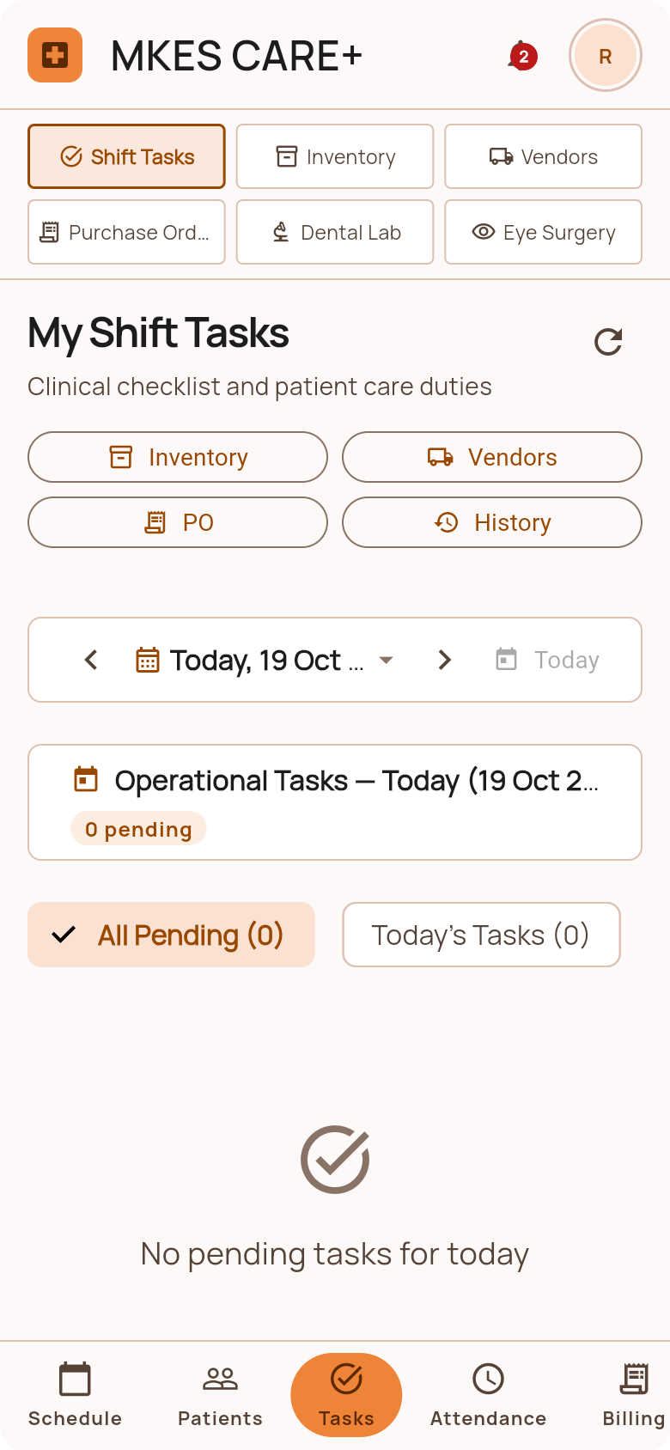
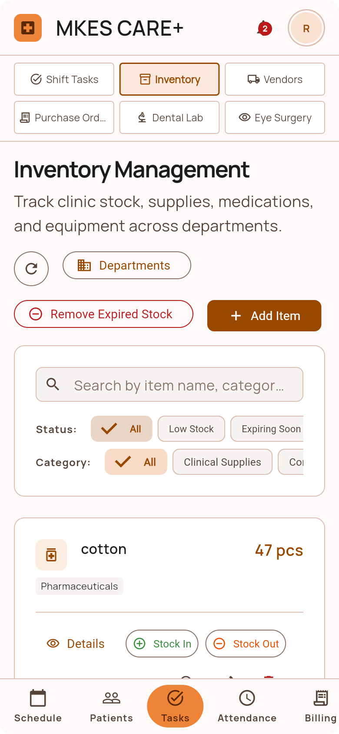

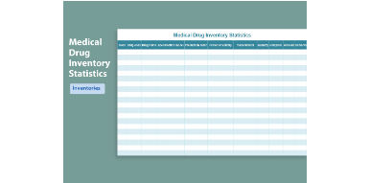
MKES CARE+
05 | Implementation Detail — Workforce & Inventory
Workforce & Supply Chain Control
Inventory Threshold & Batch Analytics
01
01. Daily Attendance Tracking
02. Salary Deduction Engine
02
One-tap mobile check-in/out with exact timestamp validation, logging present, absent, half-day, and on-leave statuses across clinic departments.
Calculates exact payroll deductions for unapproved leaves and half-days based on configurable clinic fiscal policies, eliminating manual payroll discrepancies.
03
03. Dual-Specialty Inventory
04. Batch Expiry & Low-Stock Alerts
04
Categorized catalog tracking optical frames, ophthalmic solutions, dental composites, and surgical consumables with real-time stock decrements upon billing.
Visual threshold alerts flagging critical low inventory levels and highlighting consumable batches approaching expiration within 30 or 60 days.
30-Day Expiry Alert
Auto Payroll Engine
Auto-flags dental & eye batches
Leave & half-day rule deductions

Slide 15
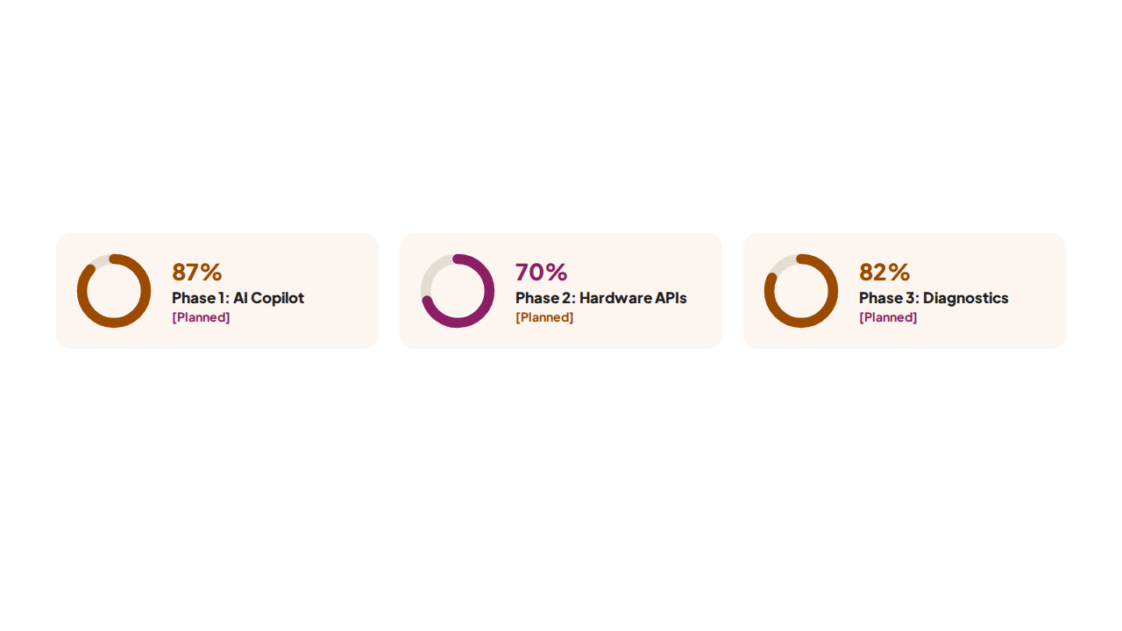
MKES CARE+
06 | Future Scope & System Roadmap
Future Scope & Strategic Roadmap
Planned Engineering Enhancements
• Advanced Conversational AI: Integration of LLM APIs for hands-free voice booking, doctor dictation, and predictive models for forecasting daily footfall.
• Hardware & Official Messaging: Direct API linkage with biometric attendance terminals (fingerprint/face recognition) and the official WhatsApp Business Cloud API.
• Clinical Imaging & Telehealth: DICOM ophthalmic diagnostic viewer, 3D dental scan rendering, secure patient portal, and multi-branch automated disaster recovery.

Slide 16
MKES CARE+
07 | Conclusion & Operational Summary
Conclusion: Strategic Value
Dual-Specialty Unification:
Verified System Deliverables
Unified eye and dental workflows eliminating operational silos.
17
15+
Operational Coordination:
Streamlined queues, staff attendance, leave deductions, and lab orders.
Modular Domain Features
Normalized RLS Tables
Grounded Clinical Intelligence:
Real-time Copilot alerts on stockouts, expired batches, and overdue tasks.
2
100%
Clinical Specialties Unified
Automated Cloud XLSX
Production-Grade Engineering:
Engineered on Flutter 3.3, Riverpod reactive state, and Supabase RLS.
"MKES brings clinic operations, automation, and intelligent decision support together in one integrated Android application."

Slide 17
MKES CARE+
08 | References (IEEE Format)
References (IEEE Format)
Verified Academic & Technical Literature
[1] Google LLC, "Flutter: Build apps for any screen from a single codebase," Flutter Official Documentation, 2024. [Online]. Available: https://docs.flutter.dev. [Accessed: Oct. 2026].
[2] Dart Team, "Dart Programming Language Specification and Core Libraries," Dart.dev, 2024. [Online]. Available: https://dart.dev.
[3] Supabase Inc., "Supabase Architecture, PostgreSQL and Row Level Security Guide," Supabase Documentation, 2024. [Online]. Available: https://supabase.com/docs.
[4] R. Rouhi et al., "Cloud-Based Electronic Health Record Systems: Architecture and Security Requirements," IEEE Access, vol. 9, pp. 12045–12058, 2021.
[5] E. H. Shortliffe and J. J. Cimino, Eds., Biomedical Informatics: Computer Applications in Health Care and Biomedicine, 5th ed. Cham, Switzerland: Springer, 2021.
[6] Meta Platforms, "WhatsApp Click to Chat API (wa.me) Integration Guide," Meta for Developers, 2024. [Online]. Available: https://developers.facebook.com.

Slide 18


09 | Academic Viva Defense & Q&A
Thank You & Viva Q&A
Sponsored by Mohankheda Eye and Smile Care
Presented by: TIRTHA SHAH (T008) • RIYA PATEL (T019) • TATVA JAIN (T058)
Guided by: MRS KRISHNA BHATT
Department of Computer Science & Engineering / IT • Academic Year 2025–2026
Platform: Flutter SDK 3.3+ (Android Native) • Backend: Supabase PostgreSQL 15+

Slide 19




Image Sources
https://www.slidekit.com/wp-content/uploads/2025/07/Editable-Healthcare-KPI-PowerPoint-Dashboard-Slide-Template.jpg
Source: www.slidekit.com
https://figures.semanticscholar.org/610a9387b57a09356a2b937567539d1059d45b64/3-Figure1-1.png
Source: www.semanticscholar.org
https://media.istockphoto.com/id/1066662272/vector/web-page-design-templates-collection-of-gynecology-ophthalmology-dental-care-online-medical.jpg?s=1024x1024&w=is&k=20&c=SToT7rXtDn6BTyq0u6rsLET59kWxDCu88CStZWbnYqk=
Source: www.istockphoto.com
https://newdocer.cache.wpscdn.com/photo/20211105/0f187704809440b786a928b8f4afeef4.jpg
Source: template.wps.com

