Slide 1

Fly_High
10 October, 2024

Slide 2
Team Members
Prashant Tiwari
Tatwansh jaishwal
Member
Member

Slide 3
Agenda
Agenda
Executive Overview
Key Findings
Challenge Areas
Detailed Analysis
Recommendations
Implementation Roadmap
Expected ROI
Next Steps

Slide 4
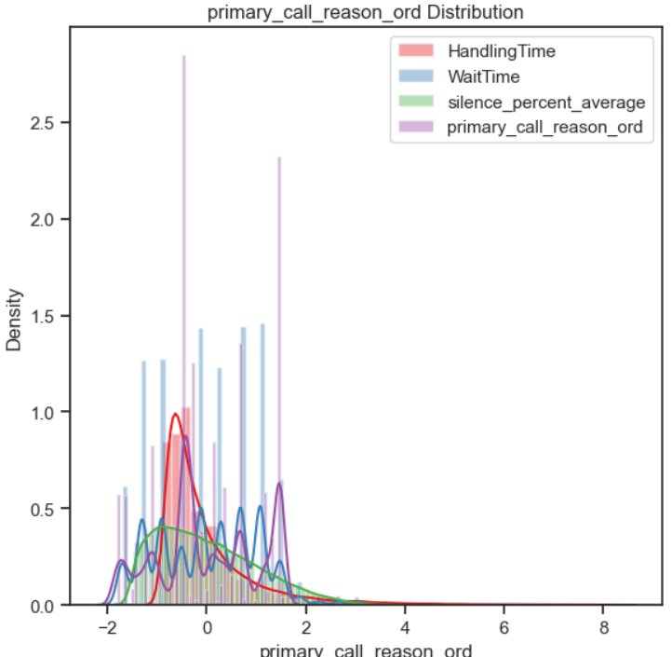
Executive Overview
Current Situation
Average Handle Time (AHT): 0-119 minutes
4,700 cases exceeding optimal handling time
Self-service opportunities underutilized
IVR system needs optimization

Slide 5
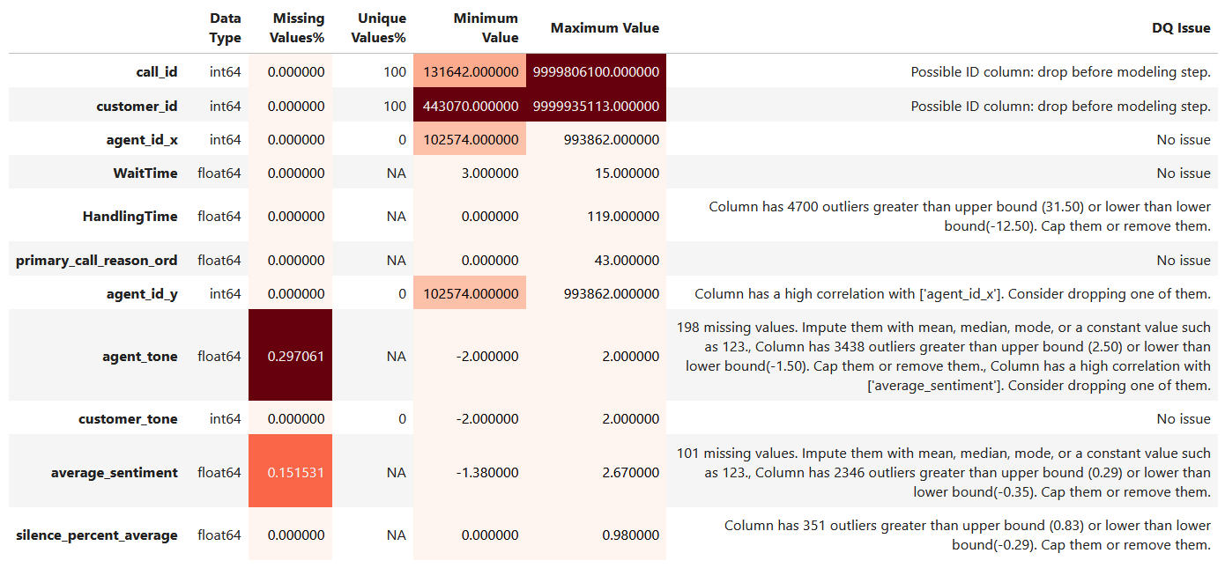
Key Metrics
Wait Time Range: 3-15 minutes
First Call Resolution: 65%
Customer Satisfaction: Varies by wait time
Agent Utilization: Below optimal levels

Slide 6
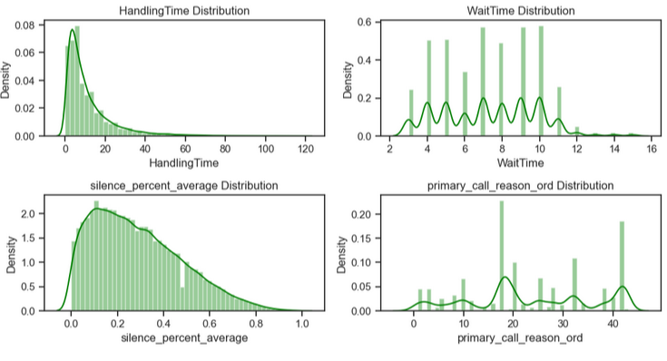
Key Findings
Handle Time Analysis
🕒 Standard Cases: 0-30 minutes (65%)
⚠️ Extended Cases: 31-60 minutes (20%)
❌ Outliers: 61-119 minutes (15%)

Slide 7


Challenge Areas
1. Extended Handle Times
System navigation delays
Multiple department transfers
Complex issue resolution
Limited agent authority
2. Self-Service Limitations
Basic IVR functionality
Limited automated solutions
Complex menu structure
Insufficient user guidance

Slide 8

Detailed Analysis: Handle Time
Distribution by Call Type
Technical Support: 35 minutes avg
Billing Inquiries: 28 minutes avg
Account Management: 22 minutes avg
Impact Factors
📊 Agent Experience Level
🔄 System Access Time
👥 Transfer Requirements
📱 Tool Availability

Slide 9
Detailed Analysis: Wait Times
Current State
Peak Hours: 9-12 minutes
Standard Hours: 3-5 minutes
After Hours: 6-8 minutes
Customer Impact
Satisfaction drops 45% after 11 minutes
Abandonment rate increases 30%
Callback requests rise 25%

Slide 10
IVR System Analysis
Current Limitations
Complex navigation
Limited self-service options
Poor user experience
Insufficient data capture
Usage Statistics
60% Standard paths
25% Multiple menu navigation
15% Direct agent requests

Slide 11
Solution Framework
2. Self-Service Enhancement
Simplified IVR menu
Additional automated solutions
Improved user guidance
Smart routing capabilities
1. Handle Time Optimization
Streamlined system access
Enhanced agent tools
Improved routing logic
Better training programs

Slide 12
System Enhancements:
Deploy IVR improvements
Implement automated call categorization
Enhance agent support tools
Process Optimization:
Streamline handoff procedures
Improve knowledge base accessibility
Implement real-time monitoring
3 Long-Term Strategy (6-12 months)
Technology Integration:
AI-powered call routing
Predictive analytics implementation
Automated quality monitoring
Continuous Improvement:
Regular performance reviews
System optimization cycles
Customer feedback integration
Conclusion
1. Recommendations and Action Plan
Immediate Actions (0-3 months)
Handle Time Optimization:
Implement handling time guidelines by call type
Develop agent scripts for common scenarios
Create efficiency monitoring dashboard
Agent Training:
Conduct focused training on high-volume issues
Implement peer learning programs
Develop best practice guides
2. Medium-Term Initiatives (3-6 months)

Slide 13
Thank you

