Slide 1
Digital Systems and Computer Architecture Session 1.8
Module 1b
Transistors and Circuits using them

Slide 2
Session 1.8: Focus
Invention of Transistor
Construction
Types and symbols
NPN and PNP
Biasing of Transistors
Double and Single Subscript Conventions
Transistors
Doping and Construction
Operation
Biasing of NPN Transistor
Biasing of PNP Transistor
Currents in the Transistor
I_{E}, I_{B} and I_{C}
Relationship among them
Circuits using Transistors

Slide 3
Transistors

Slide 4
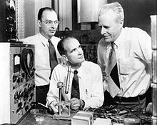
Invention of Transistor
On 23rd December 1947 electronics industry experienced a new direction of interest and development.
Three scientists, Dr. S William Shockley, Walter H Brattain and John Bardeen at the Bell Telephone Laboratories (Bell Labs), New Jersey, USA, demonstrated the amplifying action of the first transistor.
They received the Nobel Prize for Physics in 1956 for this wonderful contribution!!!
Transistors replaced vacuum tubes in electronics circuits because of being smaller in size, lightweight, rugged and being more power efficient.
Ref: History of Transistors

Slide 5
Transistors: An Introduction
Transistor is a three terminal device that amplifies the input AC signal when it is biased appropriately with a DC supply.
It is named as transistor because it transfers the resistance value experienced by the input signal at the input to a different value at the output.
The names of the three terminals are:
Emitter, base and collector.
It is also called Bipolar Junction Transistor (BJT).
Because current through this device is contributed by both electrons and holes (bipolar).
But mostly in electronics industry it is just called as transistor.

Slide 6


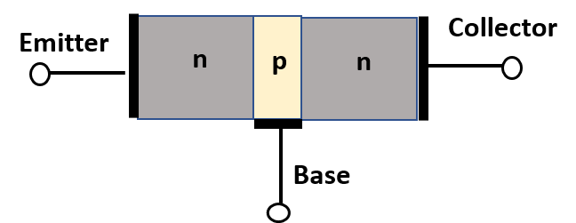
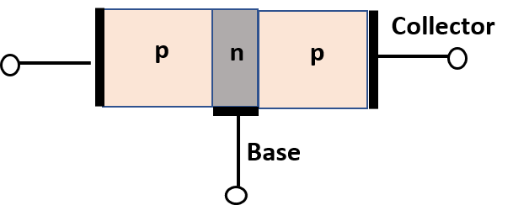
Transistor Construction
NPN Transistor
PNP Transistor
Transistor can be thought of as two diodes connected back-to-back.
However, during the transistor construction, many important modifications are done.
The base region of the transistor is very thin compared to the collector and the emitter regions.
Doping of emitter is higher compared to the collector and base is lightly doped.
These are all very crucial for the functioning of transistor.
Connecting of two diodes back to back will not behave like a transistor!!!

Slide 7
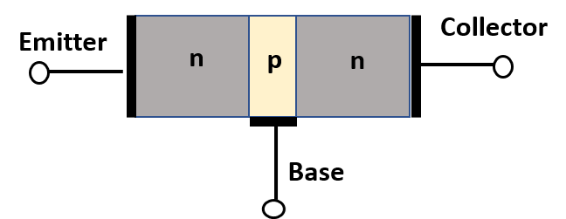

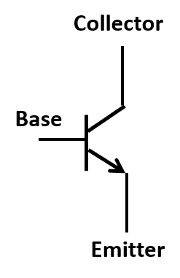
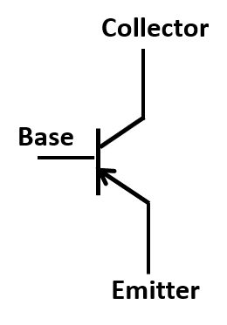
Transistor Types and Symbols
NPN Transistor
PNP Transistor
NPN Transistor
Symbol
PNP Transistor
Symbol

Slide 8

Biasing of Transistors
Emitter Base Junction
(EBJ)
Collector Base Junction
(CBJ)
EBJ
Forward Biased
CBJ
Reverse Biased
Forward Biased
Reverse Biased
+
+
-
-
V_{BE}
-
Base
V_{CE}
V_{BE}
V_{CE}
-
+
+
NPN Transistor
PNP Transistor
For normal operations, EBJ is forward biased and CBJ is reverse biased.
Transistors can be made either with Silicon (Si) or Germanium (Ge).
But, both the materials are not used in making a single transistor.
The forward biased EBJ junction will have the cut-in voltage of either 0.7V (Si) or 0.3V (Ge) based on the material used to construct the transistor.

Slide 9
Doping and Construction of Transistors

Slide 10
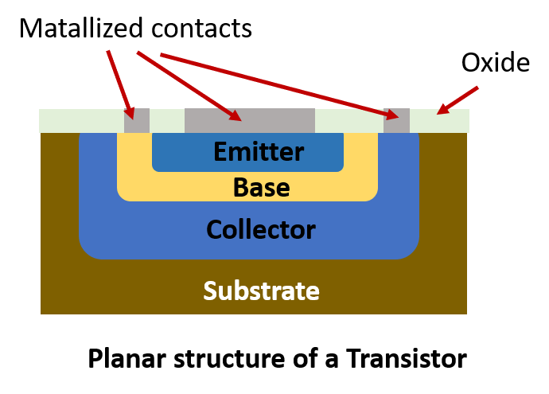
Doping of Transistors
NPN Transistor
PNP Transistor
The Emitter is heavily doped and has a wider width.
The Base region is very thin in terms width as well as it is very lightly doped.
The Collector is heavily doped compared to the Base but little lightly doped with respect to the Emitter.

Slide 11
Operation of Transistor

Slide 12
NPN Transistor: Operation
EBJ
Forward Biased
CBJ
Reverse Biased
+
+
V_{EE}
-
Base
V_{CC}
-
The emitter is heavily doped to inject more electrons into the base region.
Since the base region is thin and lightly doped it passes all of the electrons injected by the emitter on to the collector.
Because base is thin and lightly doped, the electrons will have less chance to recombine with the holes in the base region.
Once electrons cross the junction of collector-base, due to the positive potential at the collector, these electrons quickly pass through the collector region and cause collector current to flow.
Collector is named so, because it collects or gathers all the electrons coming from the emitter through the base region.

Slide 13
Biasing of NPN Transistor

Slide 14
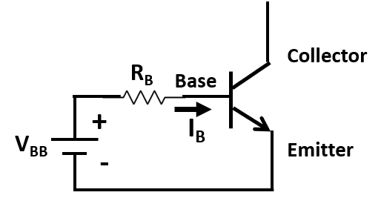
Base Biasing of NPN Transistor
For making the transistor operational some DC voltage needs to be supplied, which is called biasing of transistor.
The EBJ is forward biased with a positive voltage (V_{BB}) connected between the base and the emitter of NPN transistor.
The current flowing through the base-emitter diode is called the base current (I_{B}).
Though the collector terminal is left open here, current still flows through the EBJ.

Slide 15
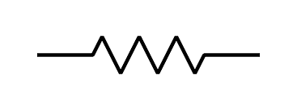
Problem 1: Find Base current (I_{B})
3 kΩ
N
P
4 V
I_{B}
+ 0.7V -
N
Assume that the transistor is made of Si.
Since EBJ is forward biased, and the transistor is made of Si, the cut-in voltage across EBJ is 0.7 V.
The polarity of 0.7 V across the EBJ is as shown above.
The KVL for the base-emitter loop:
Then, the base current (I_{B}) = (4 – 0.7) / 3k = 1.1 mA
-4 + 3k * I_{B} + 0.7 = 0

Slide 16
NPN Transistor: Collector Biasing
R_{C}
R_{C}
I_{C}
+
R_{B}
- V_{CB} +
+
V_{CC}
V_{CC}
-
-
+
V_{BB}
I_{B}
+ 0.7V -
-
I_{E}
Collector Biasing
Base and Collector Biasing
For the transistor to function as an amplifier of input signal, the collector-base junction (CBJ) needs to be reverse biased – This mode is called an active mode.
The figure above shows that positive terminal of V_{CC} is connected to the Collector, which reverse biases the CBJ.
The Base bias voltage V_{BB} forward biases the EBJ of the transistor.
Transistor is biased with DC supply voltages to maintain proper junction potentials to make them operational.

Slide 17
Biasing of PNP Transistors

Slide 18
Biasing of PNP Transistor
R_{C}
I_{C}
R_{B}
+ V_{CB} -
-
V_{CC}
-
+
V_{BB}
I_{B}
- 0.7V +
+
I_{E}
The above circuit shows the base and collector biasing of a PNP transistor.
Since the EBJ needs to be forward biased the negative terminal of V_{BB} is connected to the Base.
For the transistor to function as an amplifier of input signal, the collector-base junction (CBJ) needs to be reverse biased, thus negative terminal of V_{CC} is connected to the Collector.

Slide 19
Currents in the Transistor

Slide 20
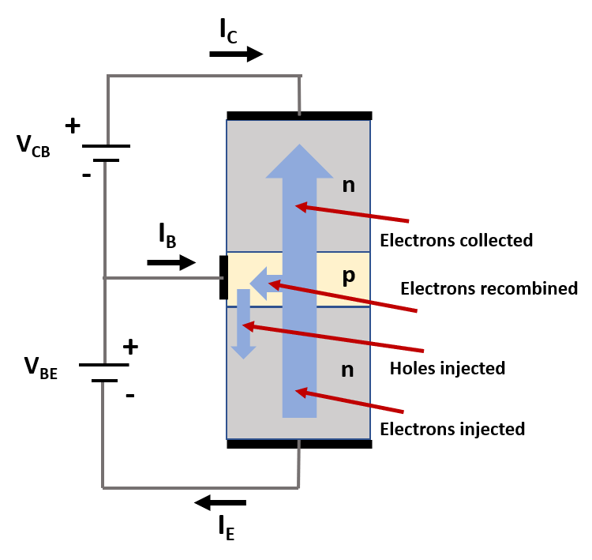
I_{E}: Emitter Current
The I_{E} is flowing out of the Emitter terminal because electrons are moving in from the Emitter to the Base region, contributing to I_{E}.
Due to the lighter doping in the Base, the electrons moving into the Base region from the Emitter is much larger than the holes moving into the Emitter from the Base.
So, I_{E} is dominated by the flow of electrons from the Emitter to the Base.

Slide 21
I_{B}: Base Current
The I_{B} flowing into the Base from the supplied voltage is due to small amount of holes moving into the Emitter.
Small number of holes lost due to the recombination of electrons in the Base region is also supplied by the I_{B}.
V_{BE} applied across EBJ forward biases the junction, I_{B} flows through base terminal.
Thus, I_{B} is in terms of μA.

Slide 22
I_{C}: Collector Current
Majority of electrons injected by the Emitter flows into the Collector crossing the lightly doped narrow Base region.
Wider Collector cross section enables electrons to be collected at the Collector.
These electrons get attracted towards the positive V_{CB} applied at the Collector.
Thus, I_{C} is shown as going into the Collector terminal because the electrons flow out of it.
Thus, I_{C} will be slightly lower than I_{E}.

Slide 23
Relationship between Transistor Currents
R_{C}
I_{C}
R_{B}
+
V_{CC}
-
+
V_{BB}
-
I_{B}
I_{E}
As per KCL, currents entering the Transistor must leave it too.
Assuming the transistor as a node, the currents entering the transistor should be equal the total current leaving the node.
I_{E} = I_{B} + I_{C}
Transistor starts conducting when the V_{BE} supplied is above the cut-in voltage.
Small I_{B} current starts flowing causing larger I_{C} to flow through the transistor.

Slide 24
Circuits using the Transistors

Slide 25
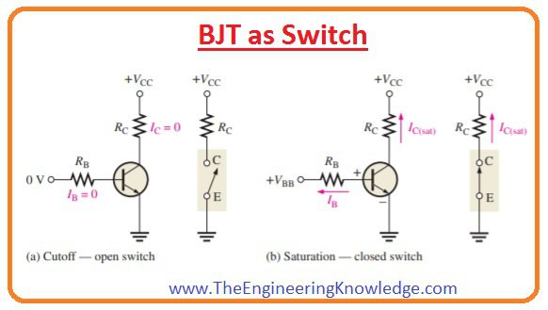
Transistor as a Switch

Slide 26
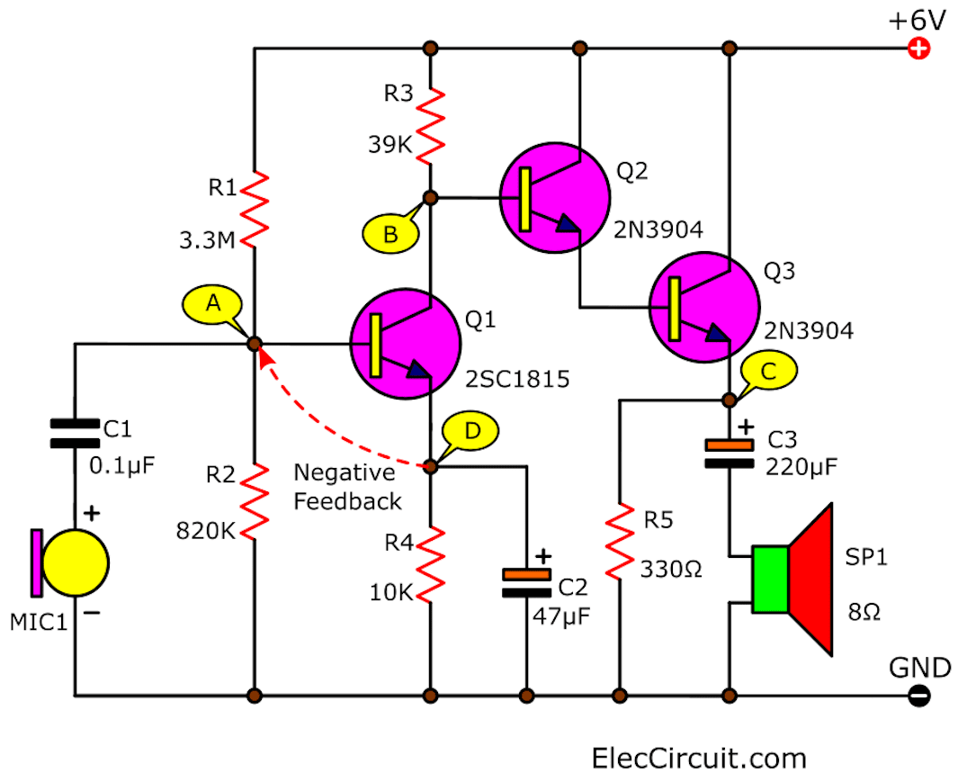
Audio Amplifier
It increases the amplitude of the audio signal fed to it without distorting the original waveform.

Slide 27
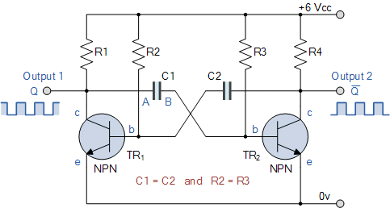
Oscillator: Square Wave Generator
Generates a Square waveforms.
The values of R2 and C2, R3 and C3, decide the frequency of the signal generated.

Slide 28
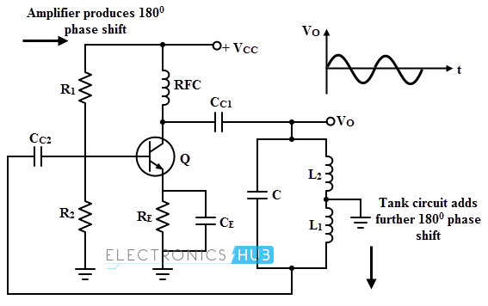
Oscillator: Sine Wave Generator
Generates a sine waveform.
The values of L and C in the tank cricuit, decide the frequency of the signal generated.

Slide 29
Session 1.8: Summary
Invention of Transistor
Construction
Types and symbols
NPN and PNP
Biasing of Transistors
Double and Single Subscript Conventions
Transistors
Doping and Construction
Operation
Biasing of NPN Transistor
Biasing of PNP Transistor
Currents in the Transistor
I_{E}, I_{B} and I_{C}
Relationship among them
Circuits using Transistors

