Slide 1

Intel Extension for PyTorch C++ SDK test utility
By Taufeq Razakh
University of Southern California

Slide 2
What do scientists who use Intel machines do ?
Molecular Dynamics
Climate Simualtion
Astrophysics

Slide 3
What is the scientists development ecosystem ?
Mostly code in C++/SYCL/FORTRAN
Run on accelerator enabled nodes
Assimilate AI into Physics

Slide 4
What is the scientists development ecosystem ?
Mostly code in C++/SYCL/FORTRAN
Run on accelerator enabled nodes
Assimilate AI into Physics
A huge need for better tools to combine AI frameworks and accelerator readiness

Slide 5
My Solution?
Let’s quickly test the AI framework’s readiness with CMake on accelerators and compilers

Slide 6
Simply specify compiler and path to framework library and CMake does the rest
$ cmake
..
-DCMAKE_CXX_COMPILER=icpx
- DCMAKE_CXX_FLAGS="-fsycl"
-DLIBTORCH_PREFIX=DLIBTORCH_PREFIX="…./../intel-pytorch/libtorch/"
$ mkdir build && cd build

Slide 7
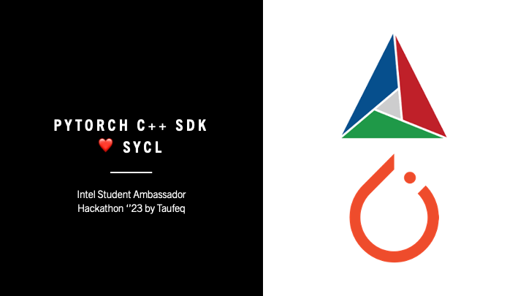
Submit a PR now to https://github.com/TaufeqRazakh/Hack-Intel-SA-23

