Slide 1
COMPUTE IN THE CLOUD
(EC2, Auto Scaling, Elastic Load Balancing,)
(messaging, containers, and serverless computing)

Slide 2
Index
Amazon EC2 instance types and pricing options
Amazon EC2 Auto Scaling
Elastic Load Balancing
AWS services for messaging, containers, and serverless computing

Slide 3
ec2
Amazon Elastic Compute Cloud (Amazon EC2) provides secure, resizable compute capacity in the cloud as Amazon EC2 instances.
Note :
instance refer to a refers to a virtual server that you can use to run applications on AWS
An instance is like a virtual computer that runs on physical hardware in Amazon's data centers. It has its own operating system and can run applications just like a physical computer.
Instances come in various types, each optimized for different tasks

Slide 4
Amazon EC2 instance types
General purpose instances ➔ basic config of hard ware (balance of compute, memory, and networking resources.)
Compute optimized instances ➔high-performance processors.
Memory optimized instances ➔high ram (fast performance for workloads that process large datasets in memory. )
Accelerated computing instances ➔hardware accelerators, or coprocessors , (GPU )
Storage optimized instances ➔more storage

Slide 5
Amazon EC2 Pricing
On-Demand ➔ you pay for only the compute time you use.
Reserved Instances ➔Instances for a 1-year or 3-year term →72 %
There are two available types of Reserved Instances:
Standard Reserved Instances
Convertible Reserved Instances
EC2 Instance Savings Plans ➔ 72 %
Spot Instances ➔ renting unused Amazon EC2 (withstand interruptions) → 90%
Dedicated Hosts ➔complete physical server to us

Slide 6
Difference b/w reserved and saving plan(chatgpt – version )
Sure! Here’s a simple explanation of the difference between Reserved Instances and EC2 Instance Savings Plans in AWS:
1. Reserved Instances (RIs):
- **Commitment:** You commit to using a specific instance type in a specific region for 1 or 3 years.
- **Flexibility:** Limited flexibility; you must use the instance type you selected.
- **Discount:** Significant discount compared to On-Demand pricing, but only for the specific instance type and region you committed to.
2. EC2 Instance Savings Plans:
- **Commitment:** You commit to a certain amount of spending per hour for 1 or 3 years.
- **Flexibility:** More flexible; you can use any instance type, in any region, and still get the discount as long as you stay within your committed spend.
- **Discount:** Also offers significant discounts, but with greater flexibility in terms of instance types and regions.
In summary:
- **RIs** are great if you know exactly which instance type you’ll need.
- **Savings Plans** are better if you want more flexibility in the types of instances and regions you use.

Slide 7
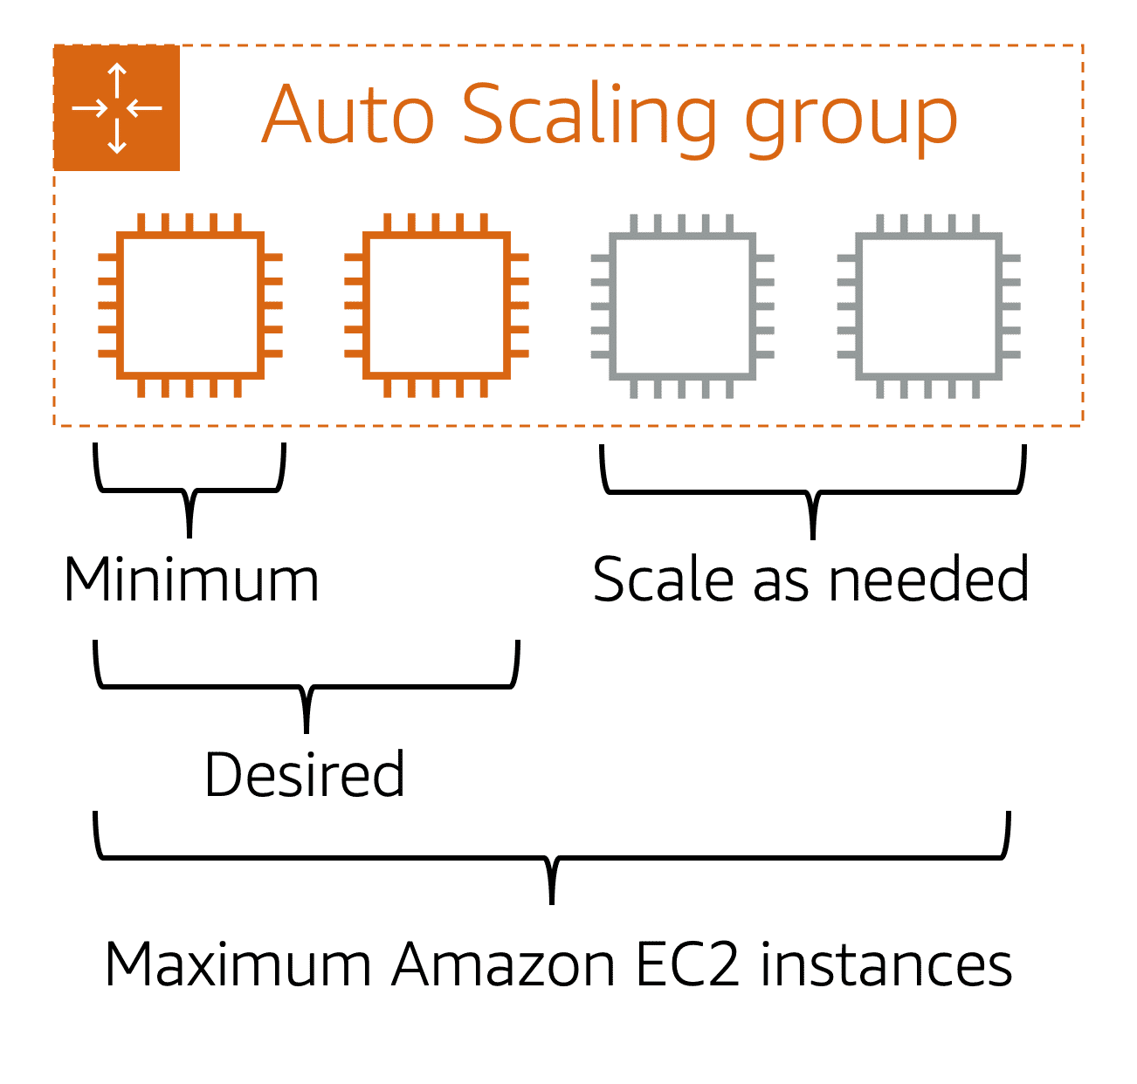
Amazon EC2 Auto Scaling
Minimum : min instance when not need
Desired : instances even though your application needs a minimum of a single Amazon EC2 instance to run
(Note If you do not specify the desired number of Amazon EC2 instances in an Auto Scaling group, the desired capacity defaults to your minimum capacity.)
Maximum : max instance when need to expand
(we can set the attributes to auto scale )

Slide 8
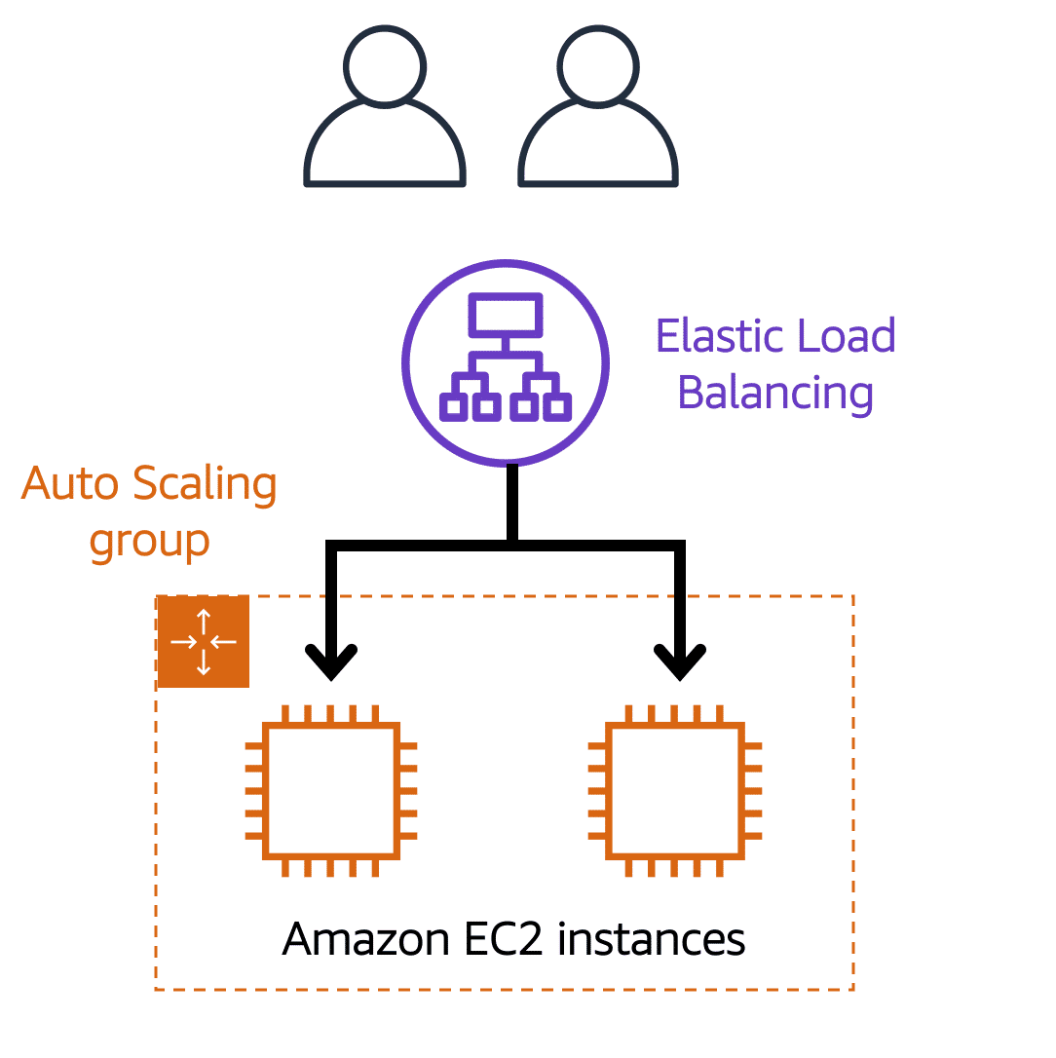
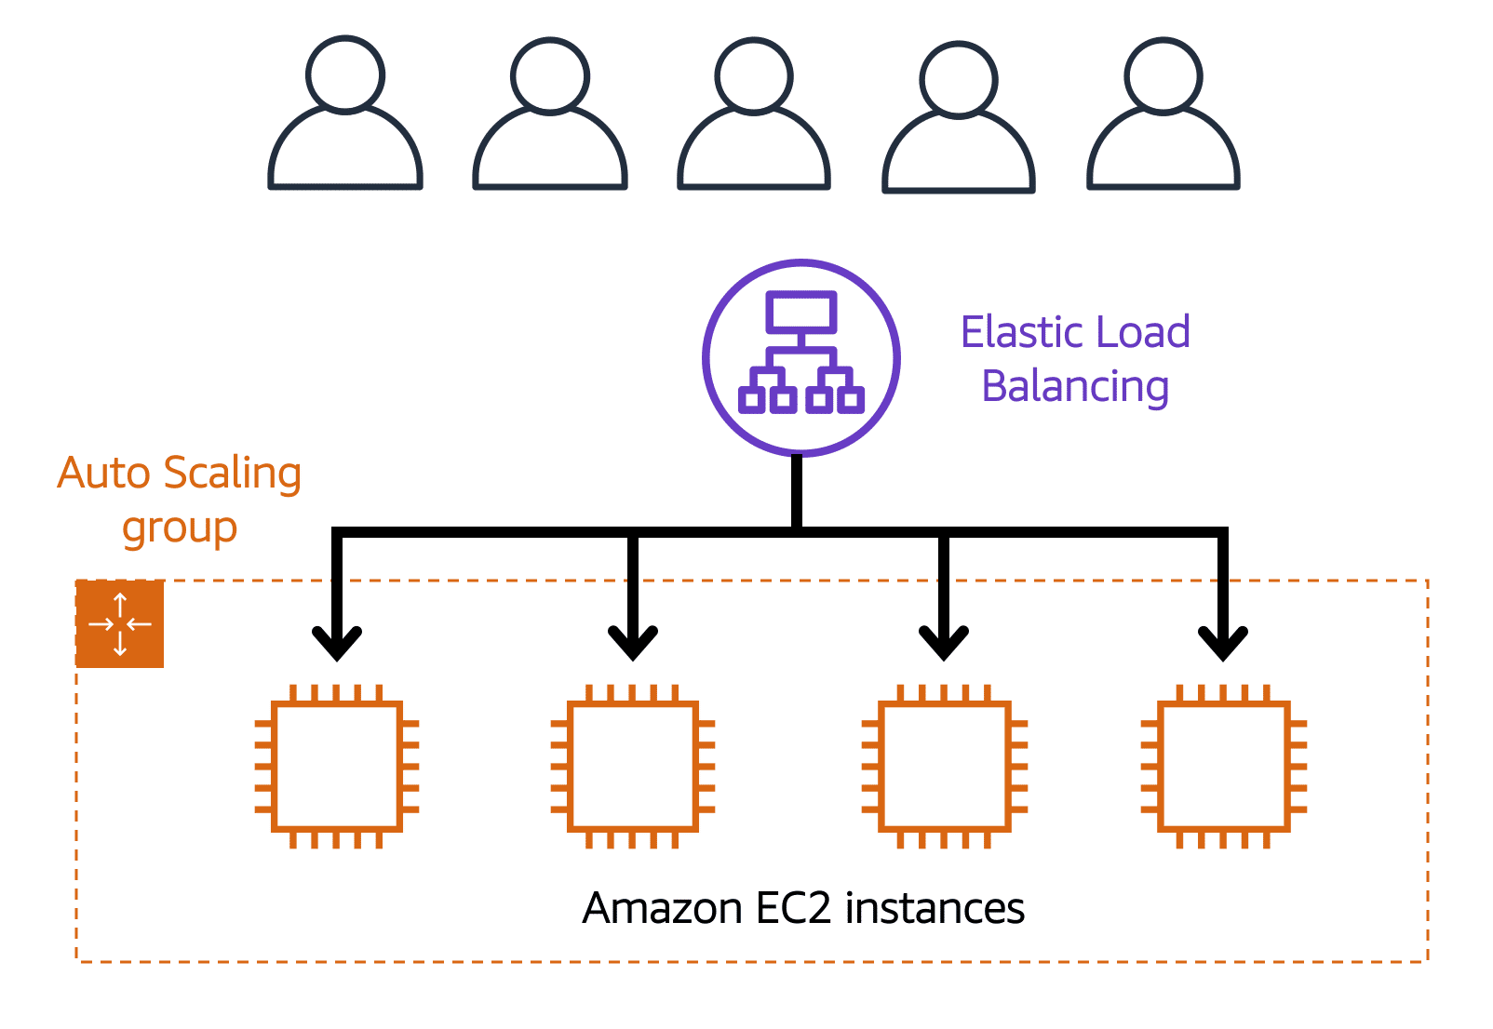
Elastic Load Balancing
It will not let A single instance to take more load when other are free. Share load equally to all instance

Slide 9
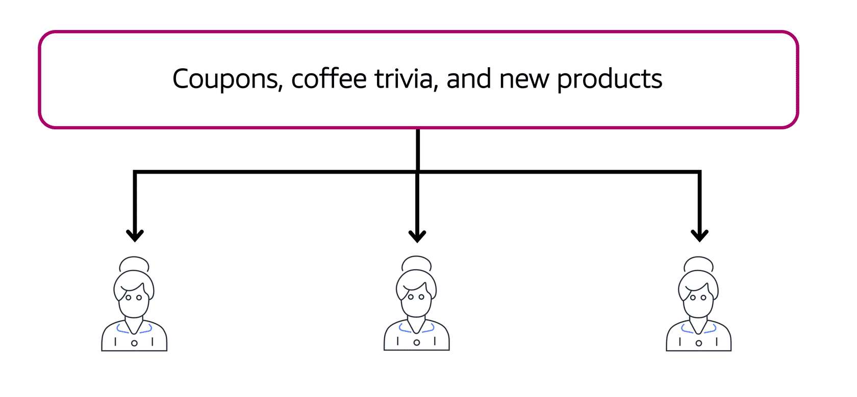
Amazon Simple Notification Service (Amazon SNS)
publish/subscribe service
Which sent notification to subscribers of the channel
Explanation of image
(Although these examples from the coffee shop involve subscribers who are people, in Amazon SNS, subscribers can be web servers, email addresses, AWS Lambda functions, or several other options.)

Slide 10
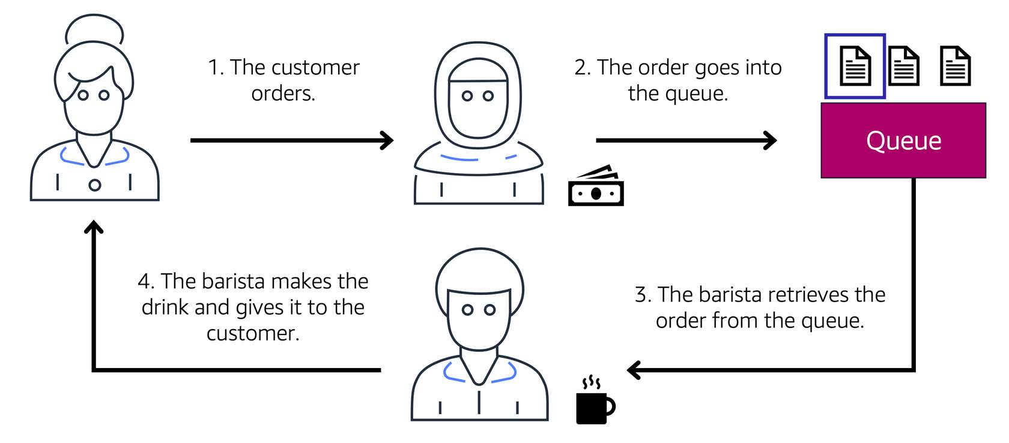
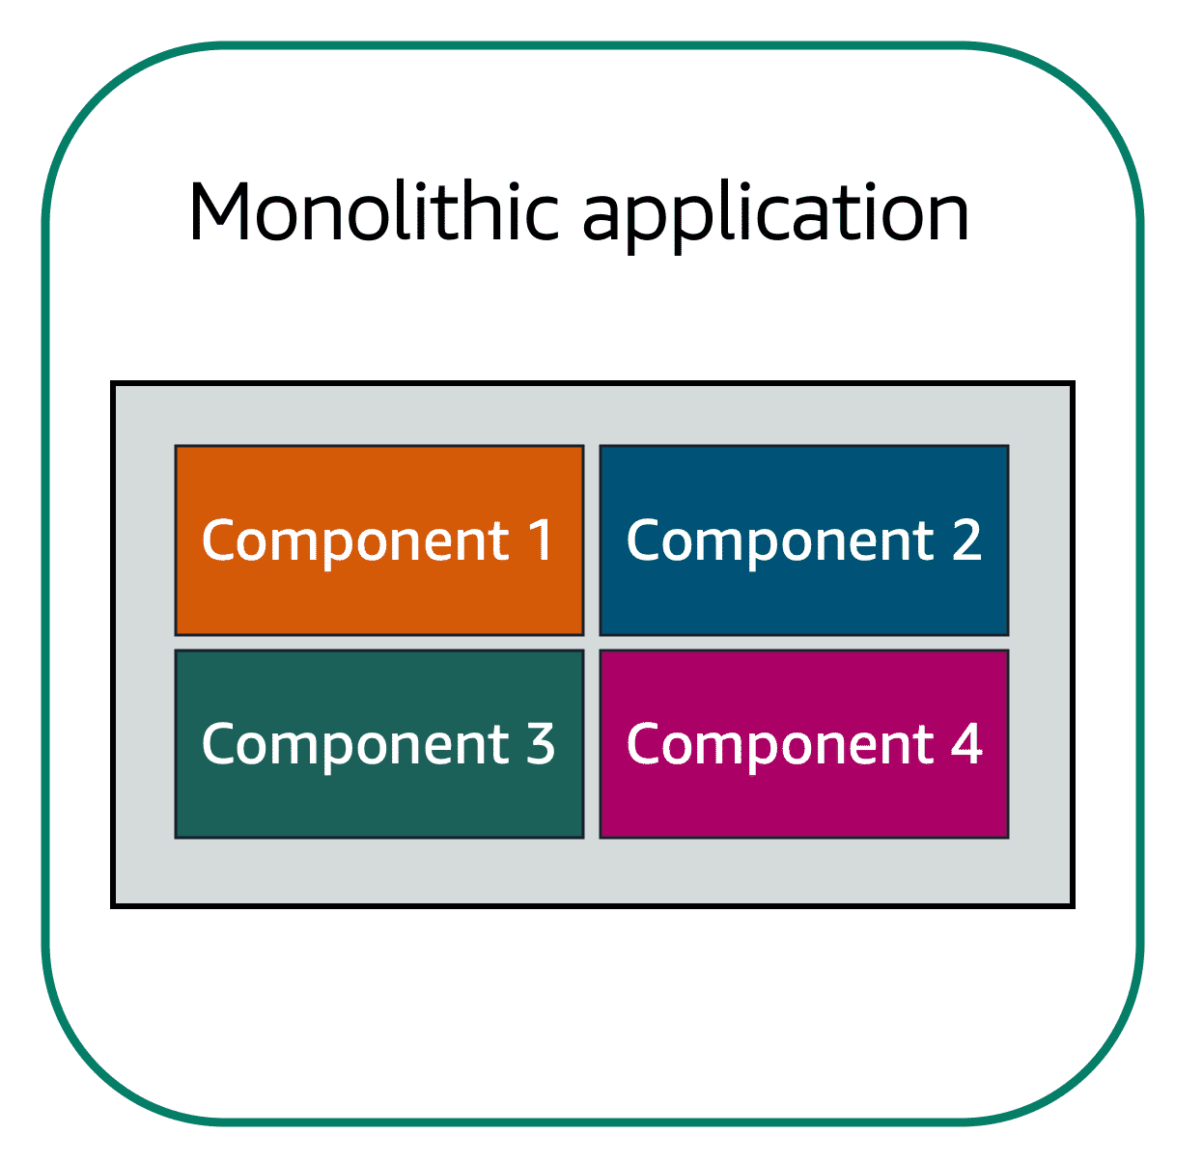
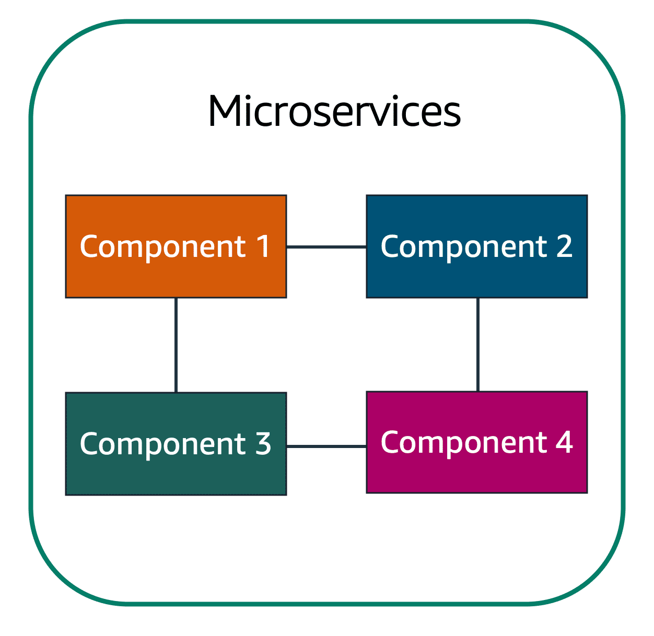
Amazon Simple Queue Service (Amazon SQS)
message queuing service.
Used in loosely coupled application
Messages can be requests etc
Monolithic & loosely coupled pic

Slide 11
AWS Lambda
a service that lets you run code without needing to provision or manage servers . (server less)
Trigger activated service run simple code (small )
At max the code runes with in 15 min
Billing is calculated by
Code running time (compute time )
Number request
Ex (when you upload a image then trigger activate Lamda function which resize the image)

Slide 12
Containers
Amazon Elastic Container Service-ecs
Amazon Elastic Kubernetes Service -eks
ECS supports Docker containers
run Kubernetes on AWS.
You can deploy in ec2 or if you don’t want to manage servers etc the you can use AWS Fargate
AWS Fargate is a serverless compute engine for containers. It works with both Amazon ECS and Amazon EKS.

