Slide 1
Global Infrastructure and Reliability
Regions and Availability Zones,
Edge locations and Amazon CloudFront
The AWS Management Console, AWS CLI, and SDKs
AWS Elastic Beanstalk
AWS CloudFormation

Slide 2
Index
AWS Regions and Availability Zones
Edge locations and Amazon CloudFront
The AWS Management Console, AWS CLI, and SDKs
AWS Elastic Beanstalk
AWS CloudFormation

Slide 3
Region
A Region is a geographical area where AWS has data centers.
Four factors to check when selecting a region
Compliance with data governance and legal requirements
Proximity to your customers (near to customer)
Available services within a Region
Pricing

Slide 4
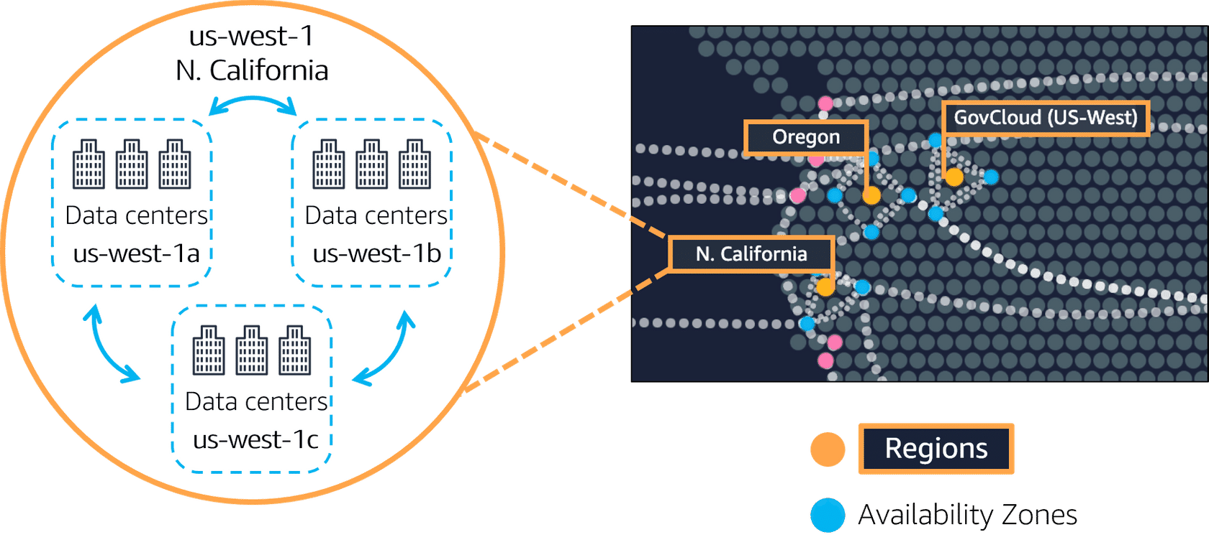
Availability Zones
single data center or a group of data centers within a Region.
Availability Zones are located tens of miles apart from each other. This is close enough to have low latency (the time between when content requested and received) between Availability Zones
if a disaster occurs in one part of the Region, they are distant enough to reduce the chance that multiple Availability Zones are affected.

Slide 5
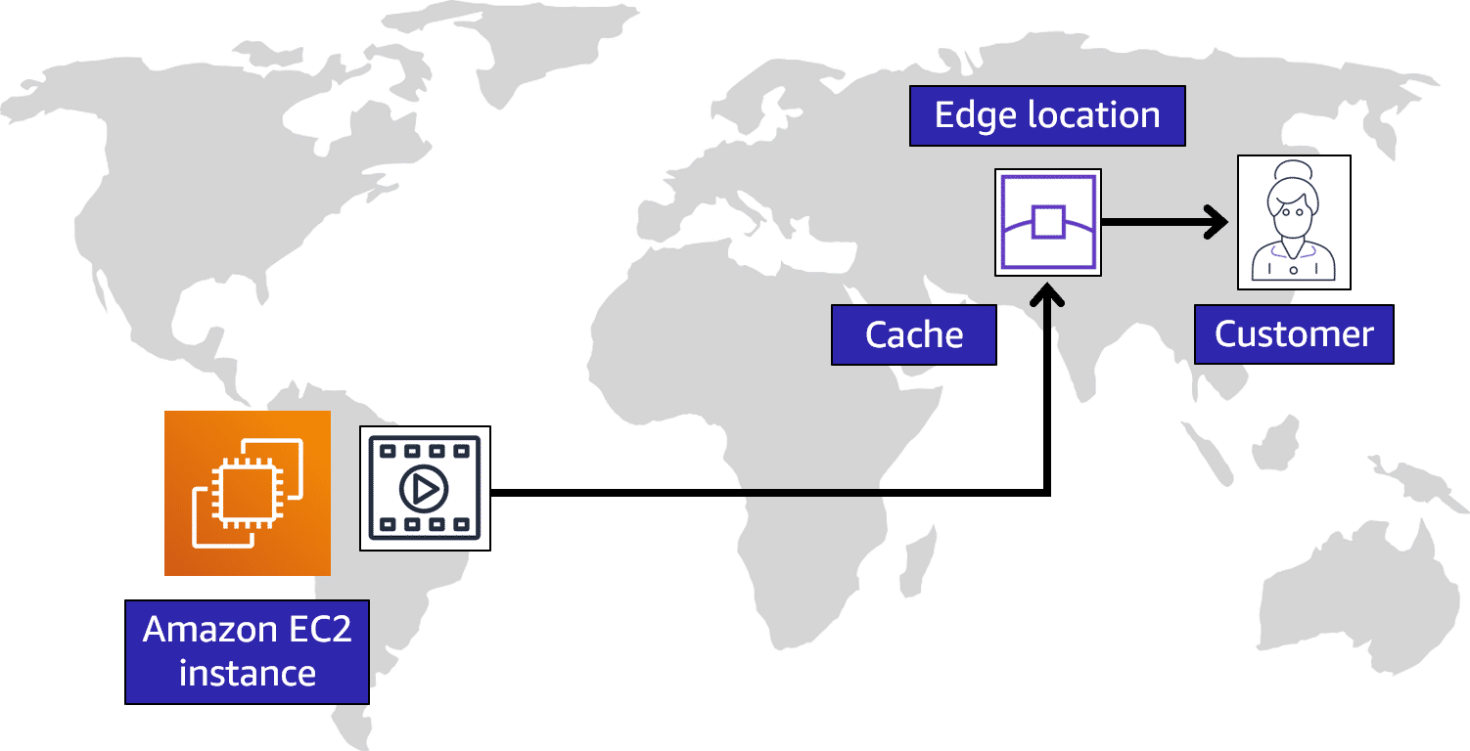
Edge locations
An edge location is a site that Amazon CloudFront uses to store cached copies of your content closer to your customers for faster delivery.
Amazon CloudFront
speeds up distribution of your static and dynamic web content, such as .html, .css, .js, and image files, to your users

Slide 6
Ways to interact with AWS services(API)
AWS Management Console ➔ web-based interface for accessing and managing AWS services (UI of web)
AWS Command Line Interface (AWS CLI)➔ command line
software development kits (SDKs)➔code integrations of services (APIs)

Slide 7
AWS Elastic Beanstalk
Upload your code and Elastic Beanstalk automatically handles the deployment—from capacity provisioning, load balancing, and auto scaling to application health monitoring.
With AWS Elastic Beanstalk, you provide code and configuration settings, and Elastic Beanstalk deploys the resources necessary to perform the following tasks
It store the desired config as image which can be used for others
still giving you the visibility and control of the underlying resources.
(server less )no need to manage server
Used for large code unlike lamda which is for small codes

Slide 8
AWS CloudFormation
You can treat your infrastructure as code.
You define your infrastructure (like servers, databases, and networks) in code using templates (written in JSON or YAML). CloudFormation then creates and configures those resources for you.

Slide 9
AWS CloudFormation & AWS Elastic Beanstalk difference (chatGpt)
AWS CloudFormation:
- **Purpose:** A service for automating the setup and management of AWS resources.
- **How it works:** You define your infrastructure (like servers, databases, and networks) in code using templates (written in JSON or YAML). CloudFormation then creates and configures those resources for you.
- **Use case:** Ideal for managing complex infrastructure setups and ensuring consistency across environments.
AWS Elastic Beanstalk:
- **Purpose:** A platform as a service (PaaS) for deploying and managing applications.
- **How it works:** You upload your application code, and Elastic Beanstalk automatically handles the deployment, including provisioning resources like servers, load balancers, and scaling.
- **Use case:** Perfect for quickly deploying and managing applications without worrying about the underlying infrastructure details.
In summary:
- **CloudFormation** is like an architect designing and constructing a building based on blueprints (templates) for complex and detailed setups.
- **Elastic Beanstalk** is like a ready-to-move-in apartment where you just bring your belongings (code), and everything else is taken care of for you.

