Slide 1
NETWORKING
Structuring and connecting to a VPC
subnet
virtual private network (VPN)
Securing VPC resources with network access control lists and security groups
AWS Direct Connect.
Using Amazon Route 53 and Amazon CloudFront to deliver content

Slide 2
Index
Structuring and connecting to a VPC
subnet
virtual private network (VPN)
Securing VPC resources with network access control lists and security groups
AWS Direct Connect.
Using Amazon Route 53 and Amazon CloudFront to deliver content

Slide 3
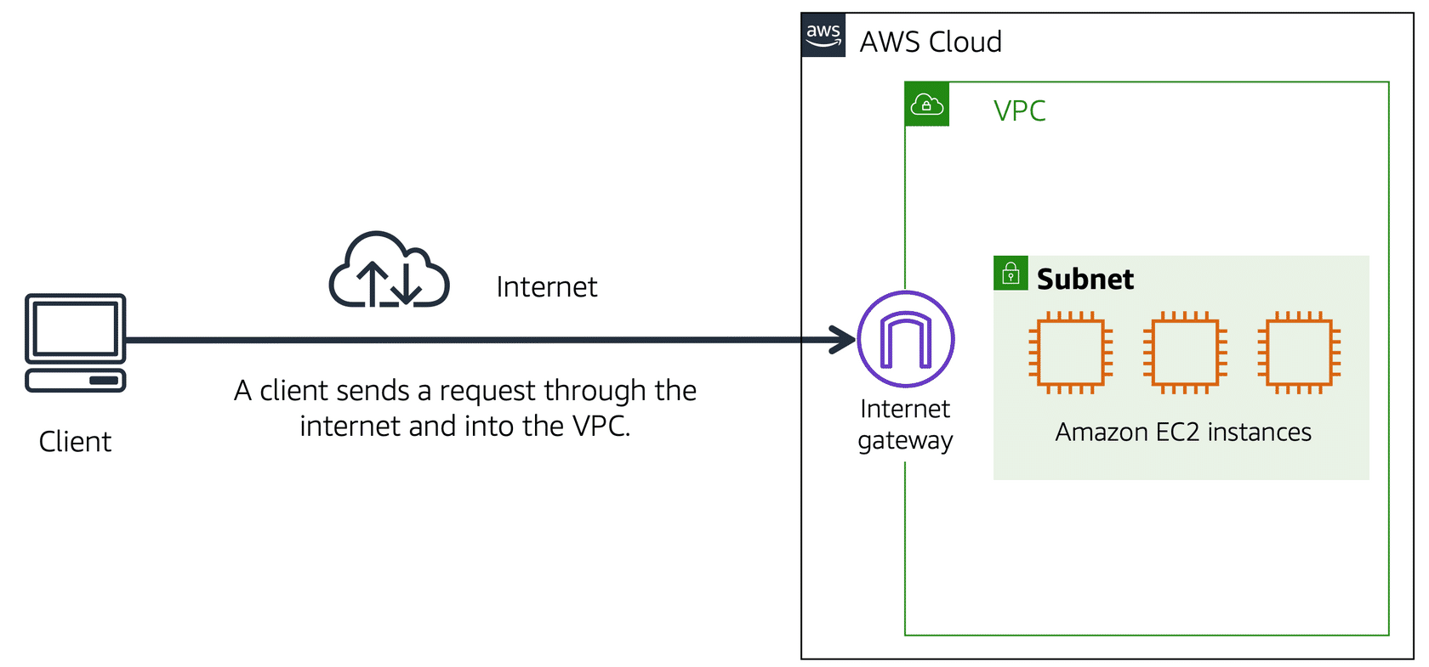
Amazon Virtual Private Cloud (Amazon VPC), Internet gateway

Slide 4
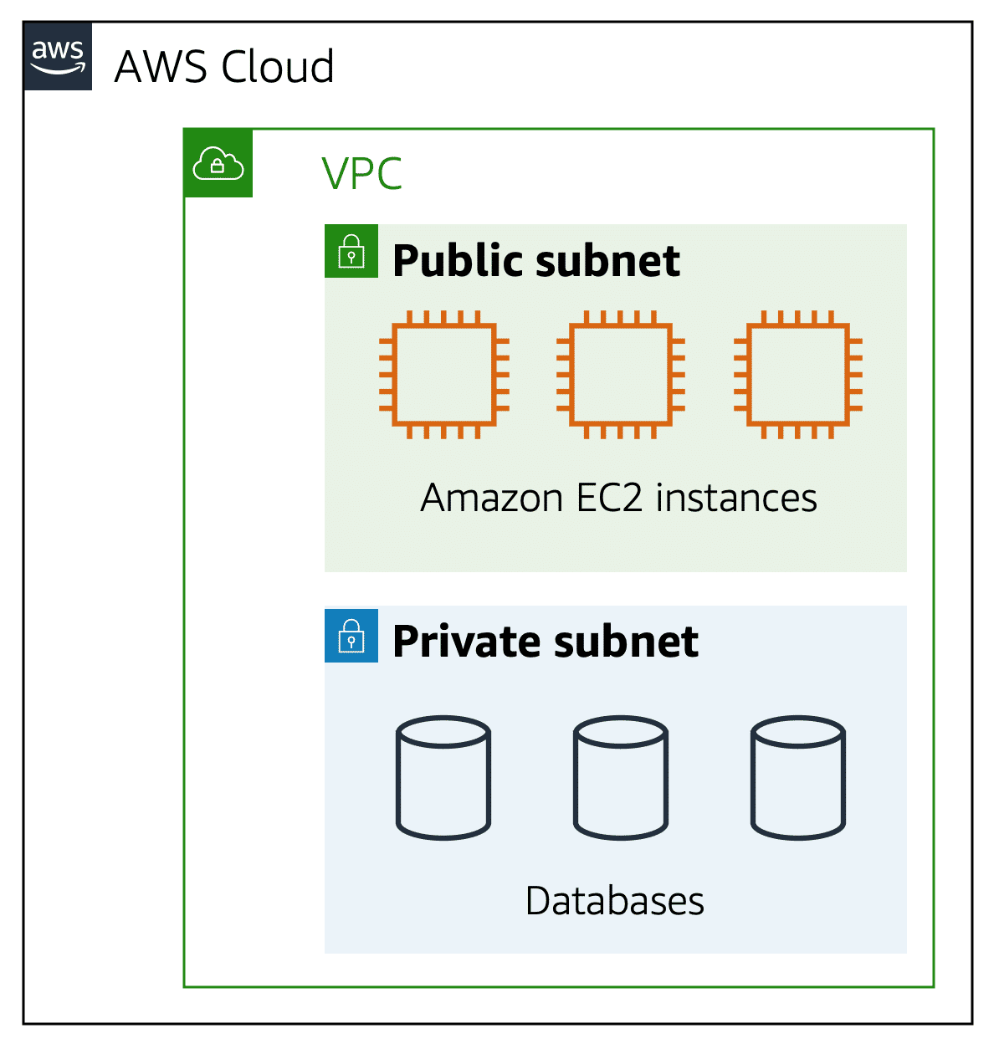
Subnet

Slide 5
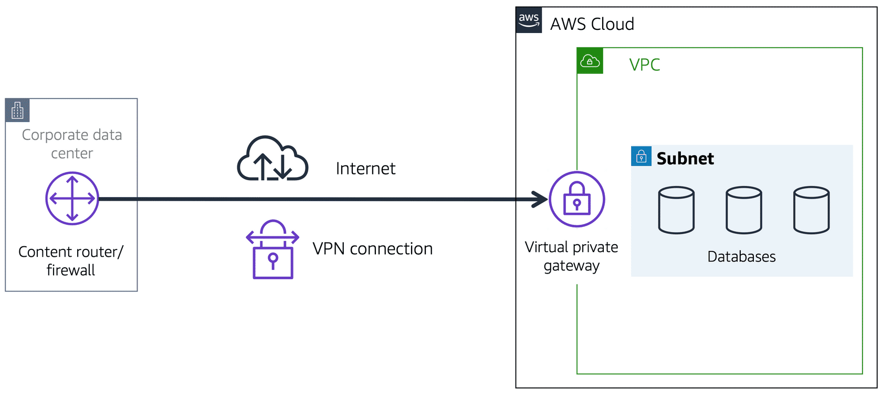
Virtual private gateway & VPN
A gate like Internet gateway which allow only private traffic (like onprim data center or company traffic rather that all public )
Create a VPN connection between the VPC and the internal corporate network.
VPN : it is like a connecting to vpc wit security
bodyguard is like a virtual private network (VPN) connection that encrypts (or protects) your internet traffic from all the other requests around it.

Slide 6
AWS Direct Connect
Establish a dedicated connection between the on-premises data center and the VPC.

Slide 7
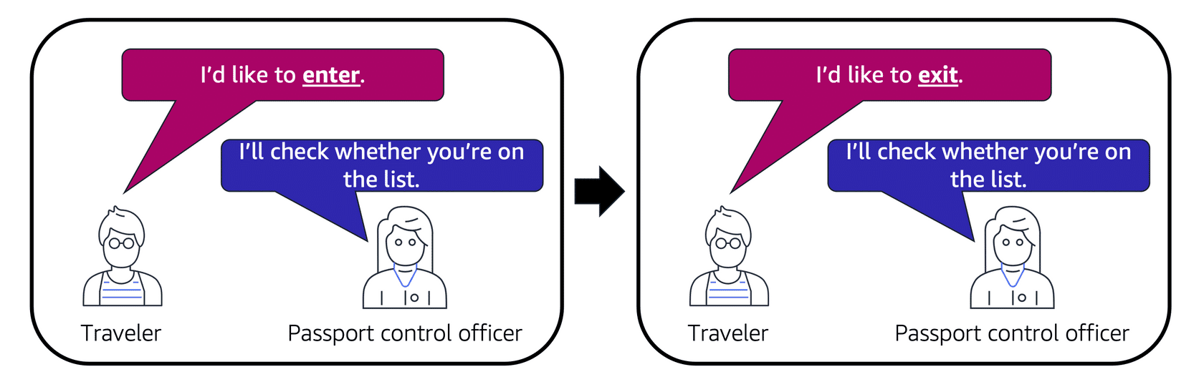
Network ACLs
A network ACL is a virtual firewall that controls inbound and outbound traffic at the subnet level.
Stateless packet filtering(two way check)
By default, your account’s default network ACL allows all inbound and outbound traffic

Slide 8
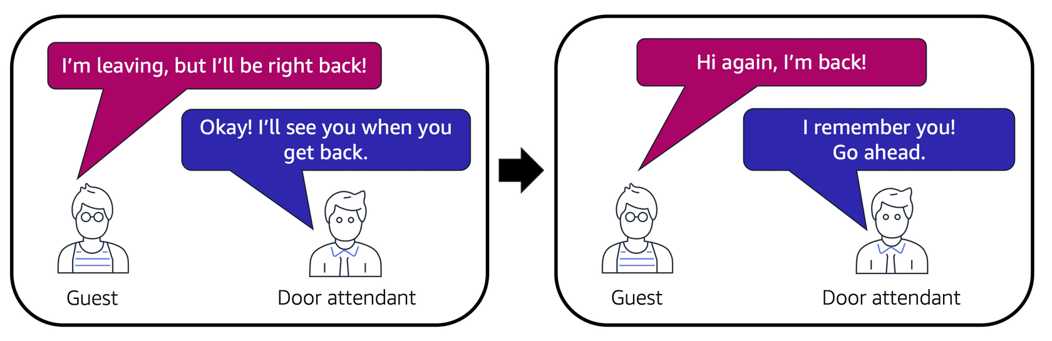
Security groups
A security group is a virtual firewall that controls inbound and outbound traffic for an Amazon EC2 instance.
Stateful packet filtering
By default, a security group denies all inbound traffic and allows all outbound traffic.

Slide 9
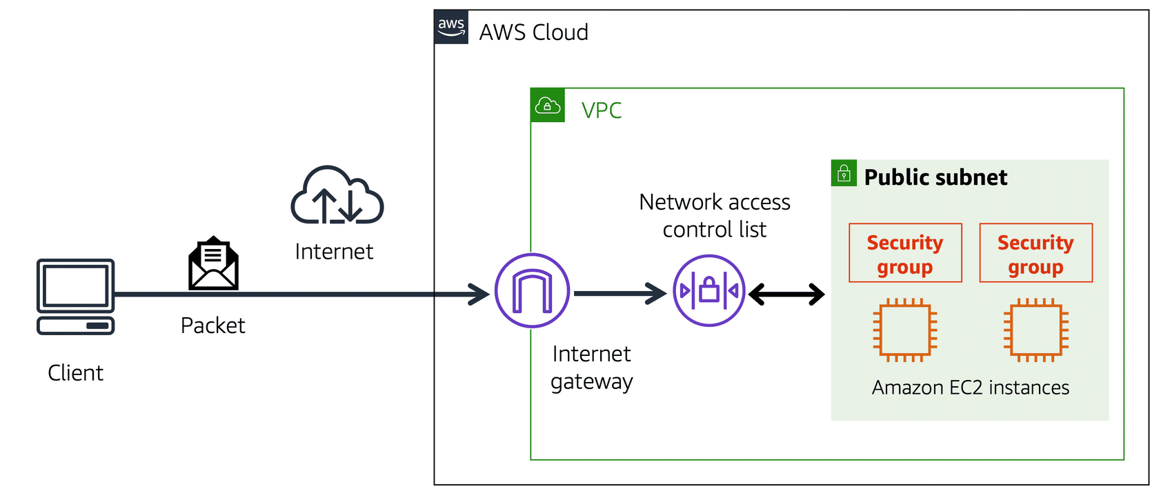

Slide 10
Amazon Route 53
Amazon Route 53 is a DNS web service. It gives developers and businesses a reliable way to route end users to internet applications hosted in AWS.

