Slide 1
Storage and Database
(Amazon EBS)
(Amazon S3)
(Amazon EFS)
(Amazon RDS)
(DynamoDB)

Slide 2
index
Amazon EC2 instance store and Amazon EBS
Amazon S3
Amazon EFS
Relational databases and Amazon RDS
Nonrelational databases and DynamoDB
Amazon Redshift
AWS DMS
Additional database services and accelerators

Slide 3
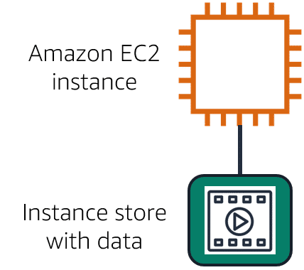
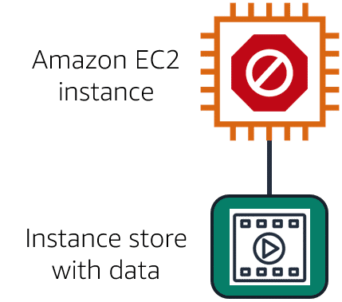
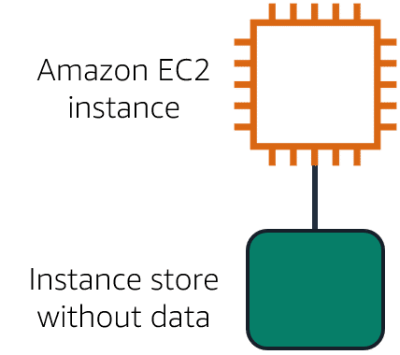
Instance stores
Amazon EC2 instances are virtual servers. If you start an instance from a stopped state, the instance might start on another host, where the previously used instance store volume does not exist. Therefore, AWS recommends instance stores for use cases that involve temporary data that you do not need in the long term.

Slide 4
Elastic block storage
divide a file in to blocks and store them , it divide the bits of the file in to blocks
if any changes done to the file only the changed bits will be updated rather than updating all
Volumes attach to EC2 instances
Availability Zone level resource
Need to be in the same Availability Zone to attach EC2 instances
Volumes do not automatically scale

Slide 5
s3
Store data as objects.
Store objects in buckets.
Upload a maximum object size of 5 T B.
Version objects.
Create multiple buckets
if a change is done in the file of the object the total object will get updated
Unlimited storage

Slide 6
Amazon S3 storage classes
S3 Standard
s3 Standard-Infrequent Access (S3 Standard-IA)
s3 One Zone-infrequent Access (S3 One Zone-IA)
s3 Intelligent-Tiering
s3 Glacier Instant Retrieval
s3 Glacier Flexible Retrieval
s3 Glacier Deep Archive
s3 Outposts

Slide 7
Amazon Elastic File System (Amazon EFS)
Multiple instances can access the data in EFS at the same time.
Multiple instances reading and writing simultaneously
Linux file system
Regional resource
Automatically scales

