Slide 1
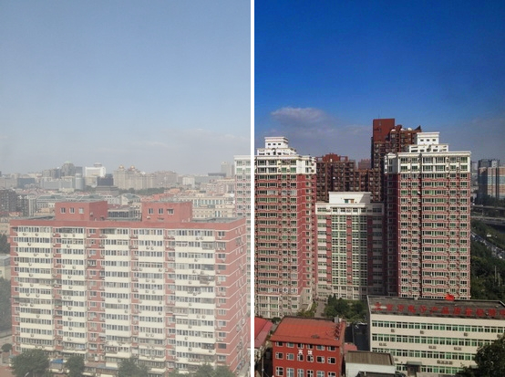
Single-Image Haze Removal via Dark Channel Prior
with a temporally consistent video extension
Sohail Memon · Kathan Patel · Md Taufique Hussain
CS7.404 Digital Image Processing
Notes:
Left half of the picture is the hazy input, right half our dehazed output (SOTS outdoor, classical DCP, no learning). Three students, CS7.404. Everything in this talk is classical image processing: no learned component in the dehazing method itself.

Slide 2




One hazy image has too many unknowns; a statistical prior closes the gap
How good is our implementation?
The scattering model
Full DCP pipeline, validated on synthetic haze and benchmarked on RESIDE SOTS.
I = J·t + A·(1 − t)
What makes video flicker?
Seen: I. Wanted: J. Unknown per pixel: A and t. Under-constrained from one image.
Per-frame DCP jitters because A and t come from extremal statistics.
Dark Channel Prior (He, Sun, Tang, CVPR 2009): in haze-free outdoor patches, one colour channel is almost always dark.
Can classical smoothing fix it?
Four variants V0–V3, scored against clean ground-truth video (REVIDE).
Notes:
Haze model I = J t + A(1-t). DCP supplies the extra constraint. Three questions drive the talk: how good is our implementation, what makes video flicker, can classical temporal smoothing fix it. No learned component anywhere in the dehazing method.

Slide 3
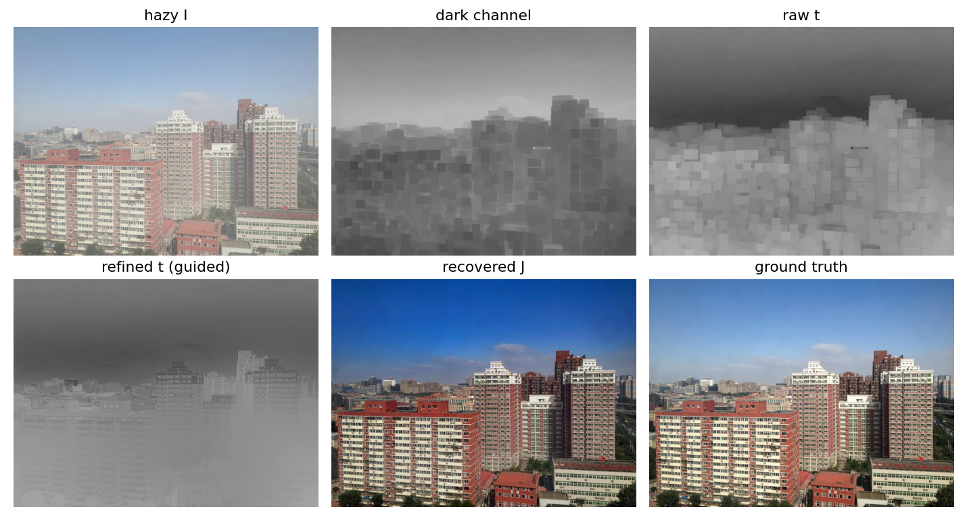
Five classical stages, every intermediate output exposed
1 Dark channel
2 Atmospheric light A
3 Raw transmission t
4 Refine t
5 Recover J
Refiners compared
Soft matting · guided filter · fast guided filter
Synthetic round trip
Known A and t recovered; A within 0.044 per channel
Watch the sky
Recovered J over-saturates it: foreshadows the failure case
Notes:
Walk the figure left to right: the dark channel shows the patch-min block structure; the raw t inherits it; guided refinement snaps t to image edges; J is recovered with t floored at 0.1. Note the over-saturated sky in J: that is the failure case later. The synthetic round-trip test recovers A within 0.044 per channel.

Slide 4
Refinement adds 1.3–1.9 dB; soft matting costs ~100× more for no gain
19.82
dB, indoor (SOTS, 500 images)
17.03
dB, outdoor (SOTS, 500 images)
Defaults: patch 15, ω 0.95, t₀ 0.1, guided filter
Seconds per image: none 0.2 · guided 0.3 · fast guided 0.2 · matting ≈ 38
Notes:
Defaults on all 500 images per split: indoor 19.82 dB / 0.859, outdoor 17.03 / 0.859. The chart is a fixed 25-image subset because matting is ~35-40 s per image; the axis starts at 14 dB so differences are visible, which exaggerates them. Matting is about 0.1 dB below guided and ~100x slower. Fast guided matches guided within 0.04 dB at ~60% of the time. Timings were taken on a shared CPU, so only the relative ordering is reliable. Published DCP numbers vary 16.95-20.15 dB indoor across papers, so we only claim ours is inside that spread.

Slide 5
The paper's defaults are not PSNR-optimal on SOTS, and we did not tune on test
Factor | Indoor | Outdoor
patch 7 | 17.5 | 15.0
patch 15 (default) | 19.8 | 17.0
patch 31 | 21.4 | 19.2
t₀ 0.1 (default) | 19.8 | 17.0
t₀ 0.3 | 20.3 | 18.4
A: brightest (default) | 19.8 | 17.0
A: mean of candidates | 19.9 | 17.4
PSNR in dB, one factor changed at a time. Plausible reason (not verified): SOTS haze is synthetic and uniform, and PSNR rewards conservative dehazing. We keep the paper defaults as the baseline.
Notes:
One-factor-at-a-time on the full 500 images per split. Larger patches, smaller omega and a larger t0 all score higher than the paper defaults on SOTS. Picking a best setting from these numbers would be tuning on the test set, so we report the defaults as the baseline and show this as a sensitivity study. It says nothing about visual quality or real haze. The mean-of-candidates A estimator is slightly better than the brightest pixel.

Slide 6
Four variants isolate what each kind of temporal smoothing buys
V0
V1
V2
V3
Per-frame DCP
EMA on A
V1 + EMA on t
V1 + warped EMA on t
Baseline: nothing shared between frames
Smooth the atmospheric light; re-estimate t under it
Naive: blend t with the previous frame's t
Flow-warp previous t; forward-backward occlusion mask
Flicker index = flow-warped frame difference ÷ the clean video's own (1.0 = natural change; higher = spurious flicker)
REVIDE indoor test split: 6 clips, width 640. Camera moves 5–28 px/frame, so the proposal's static-ROI variance became a grid-block error variance.
Notes:
V0 baseline, V1 smooth A, V2 add naive t smoothing, V3 add flow-warped t smoothing with a forward-backward occlusion mask; alpha is the weight on history. Flicker index is measured with flow computed on the clean ground-truth clip so it does not depend on dehazing artefacts. Deviation to mention: the camera moves, so the proposal's static-ROI variance cannot be computed; we use a grid-block error variance. Indoor only: REVIDE outdoor is unreleased.

Slide 7
Smoothing A cuts flicker; smoothing t does not
2.04 → 1.58
V1 vs V0 at α = 0.9
≈ 2× slower
V3 runs at 5.5 FPS vs 10 for V0 (CPU, width 640)
V3 with ground-truth flow is also worse than V1, so flow quality is not the cause. We found no verified mechanism.
Notes:
Only V1 clearly helps: 2.04 to 1.58 at alpha 0.9. V2 and V3 do not reduce flicker; V3 is about twice as slow. V3 with ground-truth flow is also worse than V1, so it is not a flow-quality problem; we tested and rejected exposure jitter in the hazy input, and we do not have a verified mechanism. Be upfront that this is a negative result. PSNR is low (~12.7 dB for every variant) because DCP handles dense indoor haze poorly. Six clips, no significance tests.

Slide 8
Atmospheric-light jitter is the largest removable cause; 1/t noise gain also shows
Where the flicker lives
≈ 3×
natural flicker in the haziest quartile of t
≈ 1.3×
in the clearest quartile
Consistent with 1/t noise amplification, a fourth cause beyond the proposal's three; not isolated by a direct intervention.
Notes:
Interventions on V0, mean over 6 clips. Freezing A to the clip median drops the flicker index from 2.04 to 1.58; the effect is strong on some clips (J004, W002, L006) and small on others (C005, E005). Raising t0 barely helps, so boundary clipping is a minor cause; smoothing t on top of frozen A adds flicker. Splitting V0's flicker by quartile of t: 0.0289, 0.0208, 0.0150, 0.0124 against 0.0094 for the clean video, i.e. about 3x in the haziest quartile and 1.3x in the clearest. That fits noise amplification by 1/t, but we did not isolate it directly.

Slide 9
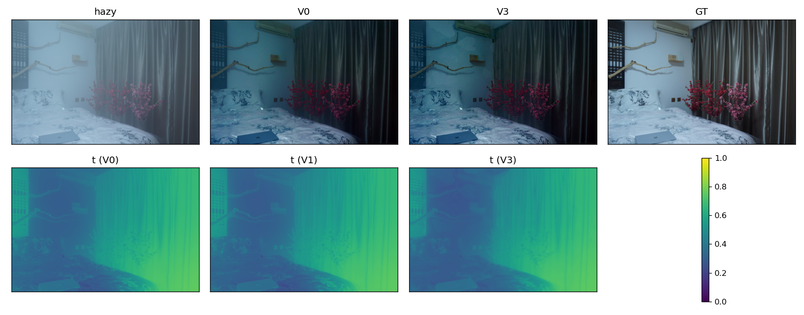
Before and after on clip J004: smoother t, but no less flicker
Full side-by-side clip (hazy | V0 | V1 | V3 | GT): figures/demo_J004.mp4. V3's transmission map is visibly smoother, but that does not lower flicker in the recovered video.
Notes:
Play figures/demo_J004.mp4 if time allows: hazy, V0, V1, V3, GT side by side. The maps show transmission for V0, V1, V3. V3 is visibly smoother but that does not translate into lower flicker in J. Note the darkening typical of DCP on indoor scenes.

Slide 10
Sky breaks the dark-channel prior; a transmission floor wins back 2.4 dB
r = −0.50
PSNR vs sky fraction, 200 outdoor images
Sky has no dark channel, so t is underestimated and the region is over-amplified.
Mitigation: raise t to 0.6 inside the detected sky region (classical detector, no learning).
Caveat: the floor value and thresholds were chosen once, not tuned, but scored on the same images used for the analysis, so the gain is somewhat optimistic.
Notes:
DCP assumes some channel is dark in every patch; sky violates that. PSNR correlates with sky fraction at r = -0.50 over 200 fixed SOTS-outdoor images. A sky-aware transmission floor of 0.6 lifts images with at least 25% sky from 14.47 to 16.87 dB and barely changes images without sky. The floor and thresholds were chosen once, not tuned, but evaluated on the same images used for the analysis; a held-out check was not done. The y axis starts at 12 dB.

Slide 11




What we learned, and what we cannot claim
What worked
What did not
Limits
Refinement adds 1.3–1.9 dB. Smoothing A cuts flicker (2.04 → 1.58). A sky floor lifts sky-heavy images by 2.4 dB.
Flow-warped smoothing of t never beat smoothing A alone, even with ground-truth flow. No verified mechanism.
Indoor-only video, 6 clips, no significance tests, mitigation scored on its analysis set, CPU timings under load.
Everything regenerates with scripts/run_all.sh (verified from empty results/); design decisions and deviations are in IMPLEMENTATION_LOG.md.
Notes:
Take-aways: refinement adds 1.3-1.9 dB; stabilise A for video; sky is a quantifiable failure mode a simple floor partly repairs. Limits: indoor-only video, six clips, no significance tests, mitigation scored on the same images used to analyse it, CPU timings under load. Everything regenerates with scripts/run_all.sh; details and deviations are in IMPLEMENTATION_LOG.md. Invite questions.

