Slide 1
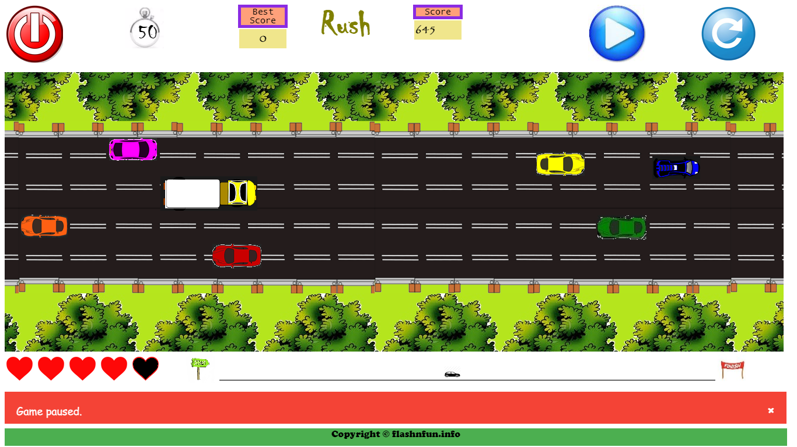
Rush
Game Development Modules:
Player Car movement & collision Detection
Traffic Collision & randomization
Timer, Life & Distance-meter
Game Control(pause/play, restart, quit, score, message-bar)
Game UI & Animation(road, scenery, traffic, player-car)

Slide 2
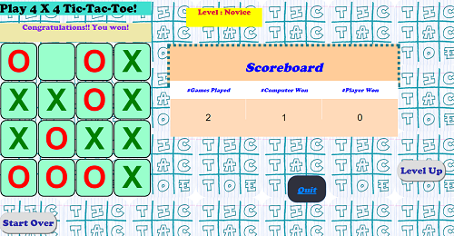
4x4 Tic-Tac-Toe
Game Development Modules:
Minimax & Alpha-Beta pruning
Can_I_Fork & Has_User_Forked
Game UI( scoreboard, playing-board)
Game Control( start, quit, level-setter, message-bar, score)

Slide 3
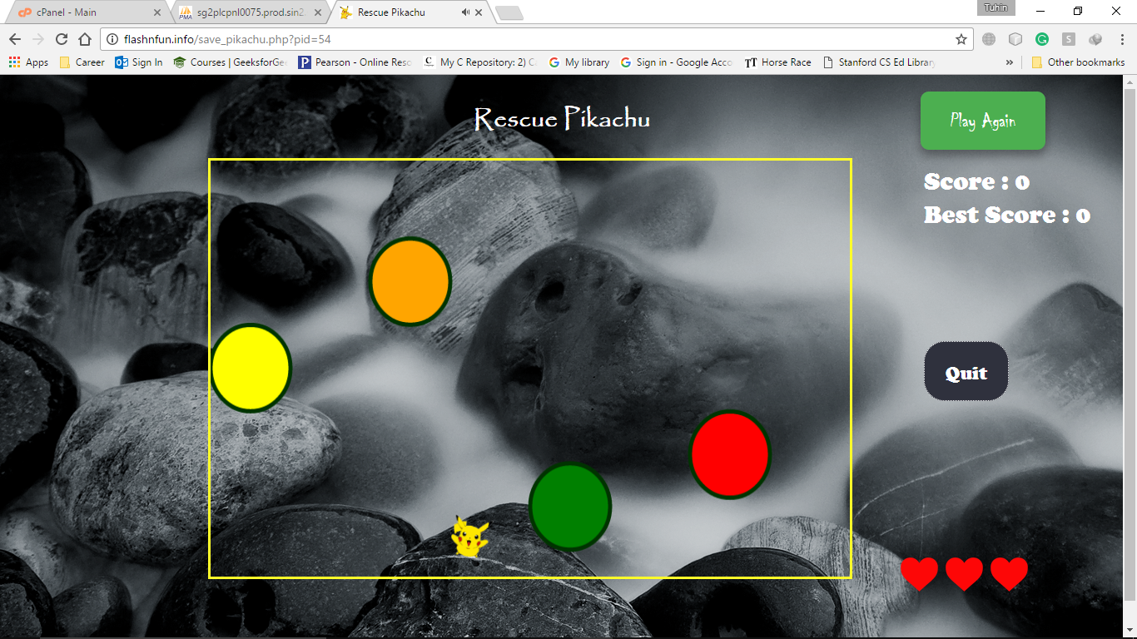
Rescue Pikachu
Game Development modules:
Game UI & Animation( Rock, Pikachu)
Game control( Quit, play-again, Life, score)
Pika movement & collision detection

Slide 4
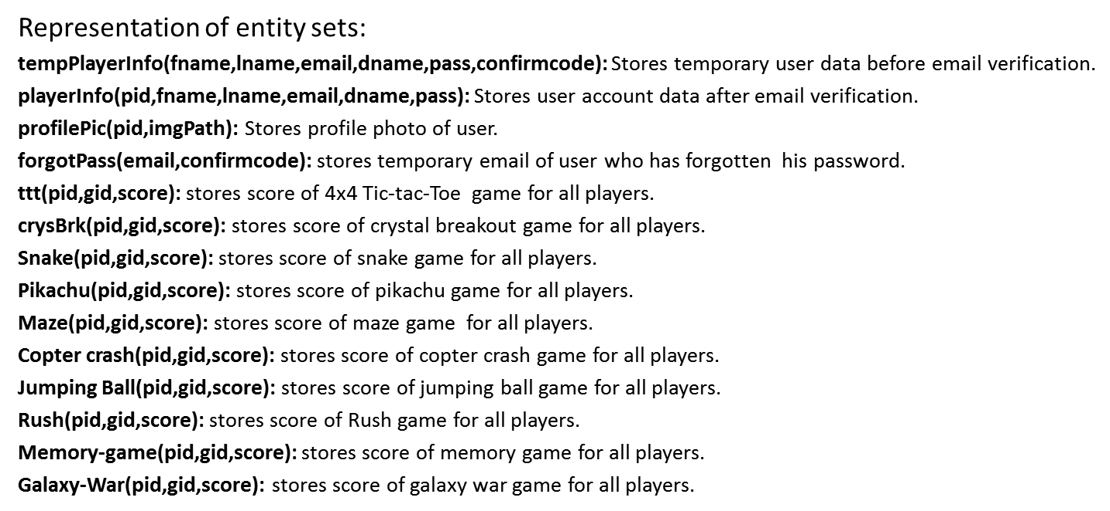
Database Design

Slide 5
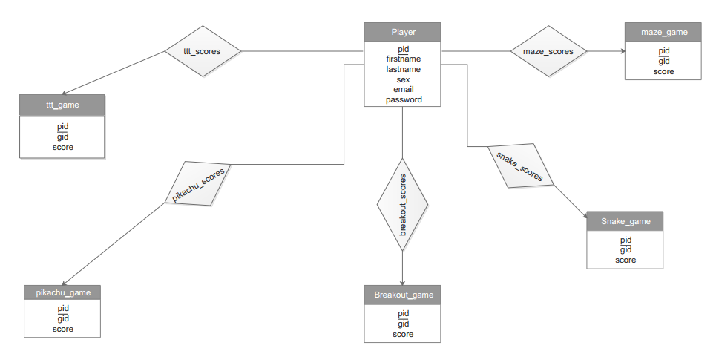
E-R Diagram

