Slide 1
NLP BASED RESUME PARSER
K. Kavya (19B65A0508)
M. sri harshini (18B61A0596)
Md. Tauheed (19B65A0511)
Md. Nawazuddin (18B61A05A4)

Slide 2
Abstract
Job Requirement is considered one of the major activities for humans which is a very strenuous job to find a fruitful talent. Our proposed model is basically to extract the details and statistics from the resume and ranking the resume based on the preference of the company associated and its requirements using the Natural Language Processing (NLP) techniques. Parsing and ranking the resume makes the hiring process easy and efficient. A resume contains various minute data within it and any respectable parser needs to extract out these data such as education, experience, project, address etc. So, basically we are going to build a job portal where the employees and applicants would upload their resume for any particular job and using the NLP technique, the necessary information will be parsed and a structured resume with information will be generated and also the resumes of employee will be ranked according to the requirement of the company skill set and employees skills in the provided resume.
Keywords : Resumes, NLP, Parser, Extract Information, Skillset, Ranking.

Slide 3
LITERATURE SURVEY
NLP Based Extraction of Relevant Resume using Machine Learning:
This technique stated parsing of the resumes with least limit and the parser works the utilization of two or three rules which train the call and address. Scout bundles use the CV parser system for the determination of resumes. As resumes are in amazing arrangements and it has different sorts of real factors like set up and unstructured estimations, meta experiences, etc. The proposed CV parser approach gives the component extraction method from the moved CV's.
E-Recruitment System Through Resume Parsing, Psychometric Test And Social Media Analysis:
It follows an approach of 4 stages, the first stage was to get the data (resume) and convert them into structured format and then perform the analysis using deep learning techniques. Second step includes the psychometric test where the text mining is used to generate scores for each candidate. In the third step they perform web scraping on various social media sites to get the additional information about the candidates and recommend suitable jobs to them. In the fourth step, the system will recommend the skills and requirements in which the students are lacking and also help them to get recruited in the desired company.

Slide 4
SUMMARY
Previously, we have studied the existing system architecture and also our proposed system architecture. The existing system architecture has its own unique features and ideas behind it with advantages and disadvantages. In our proposed system we are going to deal with these type of disadvantages. In this proposed methodology we are using Optical Character Recognition(OCR) to extract the data from Resume. The main technique used here is Natural Language Processing and Ranking Algorithm which is helpful for ranking the resume according to the particular companies. Additionally our other goal is to extract the data from Social Media like LinkedIn for applying jobs which will make the recruitment process easier getting quality applicants from various regions by avoiding unfair and discriminatory practice.

Slide 5
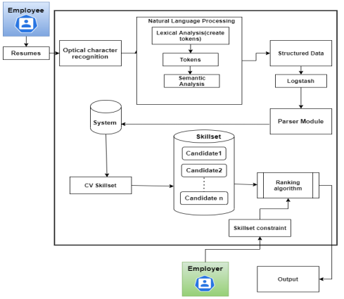
SYSTEM ARCHITECTURE

Slide 6
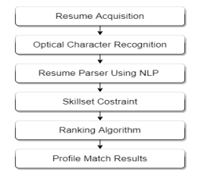
OVERVIEW

Slide 7
CONCLUSION
Our approach is to make the work of companies and candidates easier and effective. Basically our aim is to ease the recruitment process. The process will provide the quality of applicants for the companies. The unfair and discriminatory practice in the process will be dampened. Based on the information in the form of technical skills the resumes will be ranked in order.

Slide 8
THANK YOU

