Slide 1

SIMULATION AND MODELING
Climate-Aware Intelligent Urban Drone Network
An Integrated Simulation Framework for Battery-Aware Multi-Drone Delivery Optimization
Case study: Dumki, Patuakhali, Bangladesh
Hub: PSTU Main Campus
A.K.M. Tauhiduzzamana Nibir
ID 2202033 | Registration 11224 | Session 2022–2023
[Course Code] | [Semester] | [Submission Date]
Supervisor: Dr. Md. Samsuzzaman Sobuz, Professor, CCE
Co-supervisor: Sarna Majumder, Associate Professor, CCE
Patuakhali Science and Technology University
Conceptual visualization
Software-only project
Notes:
Introduce the project as a simulation framework, not deployed hardware. The central contribution is battery-aware assignment under modeled climate and charging constraints.

Slide 2



MOTIVATION
Why optimize drone delivery?
Access
Return risk
Contention
Rural road connectivity can delay urgent deliveries.
Payload and adverse weather raise modeled energy demand. Delivery can succeed while the return flight fails.
Limited charging bays can leave drones waiting for energy.
How can dispatch ensure enough energy for safe round trips?
Notes:
A successful drop-off is insufficient if the drone cannot return. Dispatch must account for the complete mission and the charging queue.

Slide 3
STUDY AREA AND SCOPE
A simulation network centered on PSTU and Dumki
Real geography, synthetic experiments
4 campus nodes
Real coordinates; synthetic orders, drone parameters and weather.
DEPOT-PSTU
Implemented
PSTU Main Campus
Spatial-temporal simulation, climate and battery models, FCFS vs BAPA, charging queues, dashboard and tests.
6 regional nodes
Outside scope
Schematic grouping, not a precise map.
No physical deployment, real deliveries, live weather or obstacle-aware routing.
0.20–5.34 km
Approximate one-way Haversine distances
Notes:
The schematic groups destinations rather than inventing names or exact map positions. Distances use real geographic coordinates, while operational inputs are synthetic.

Slide 4
SYSTEM DESIGN
Modular architecture and mission workflow
Domain
Spatial + dispatch
SimPy engine
Presentation
DroneSpecs, WeatherScenario, drone, battery, request, synthetic generator
DumkiNetwork, Haversine, FCFS and BAPA
Arrival, scheduler, mission process, charging resource
Streamlit, Folium map, 2D radar, Plotly charts
01
02
03
04
05
Arrival
Dispatch
Outbound + delivery
Return
Charging queue
If needed, then available
Virtual time advances between scheduled events.
Notes:
Modules separate model assumptions, dispatch decisions and presentation. Follow one request through the mission process; the charging resource models contention.

Slide 5

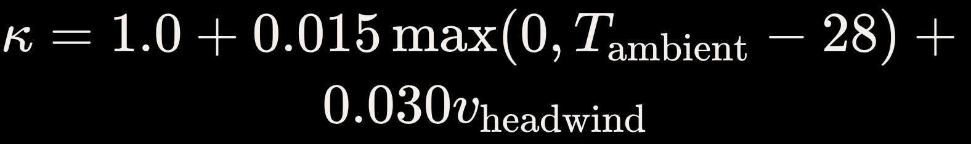
ENERGY MODEL
Modeling flight energy and battery constraints
Time and power
Climate-adjusted energy
12 m/s · 180 Wh · 2.5 kg maximum payload · BAPA reserve 20%
Charger 300 W at 90% efficiency
1.060×
1.180×
1.405×
Temperate
Moderate Summer
Extreme Heatwave
Parameterized ambient air temperature and representative headwind. Satellite land surface temperature is neither ambient air nor internal battery temperature.
Notes:
Distance is in kilometers, payload mass in kilograms, and energy in watt-hours. Climate multipliers are scenario assumptions. Estimate loaded outbound and empty return separately.

Slide 6
DISPATCH POLICIES
From naive dispatching to battery-aware assignment
FCFS
BAPA
First suitable idle drone.
Checks availability and payload, but not round-trip energy or 20% reserve.
Assesses loaded outbound and empty return.
Requires projected SoC ≥ 20%; selects the feasible drone with minimum safe surplus.
01
02
03
04
Payload check
Round-trip energy
Reserve check
Best-fit selection
If no candidate is feasible, the order waits.
Notes:
BAPA filters for feasibility before choosing a drone. Minimum safe surplus is a best-fit rule, not a learned policy. Waiting is preferable to dispatching an infeasible mission.

Slide 7
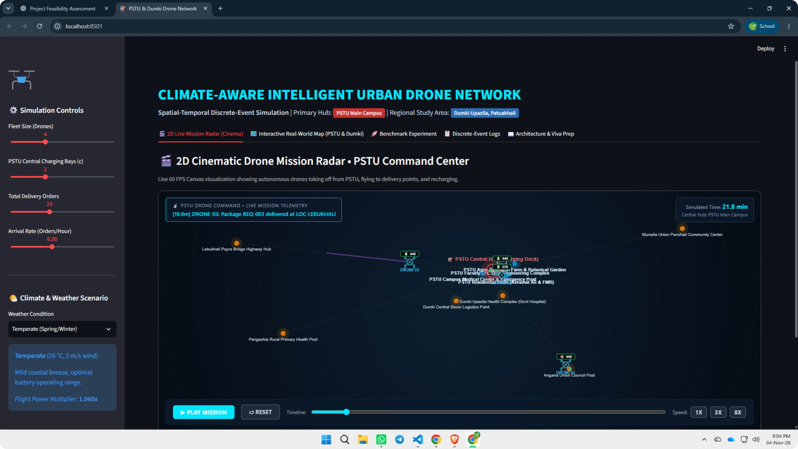
IMPLEMENTED INTERFACE
Interactive simulation dashboard: PSTU Drone Command Center
Simulation controls
Mission radar
Telemetry
Notes:
Use the original interface as the demonstration reference. Explain only visible controls, radar and telemetry. This dashboard visualizes simulated missions, not physical operations.

Slide 8
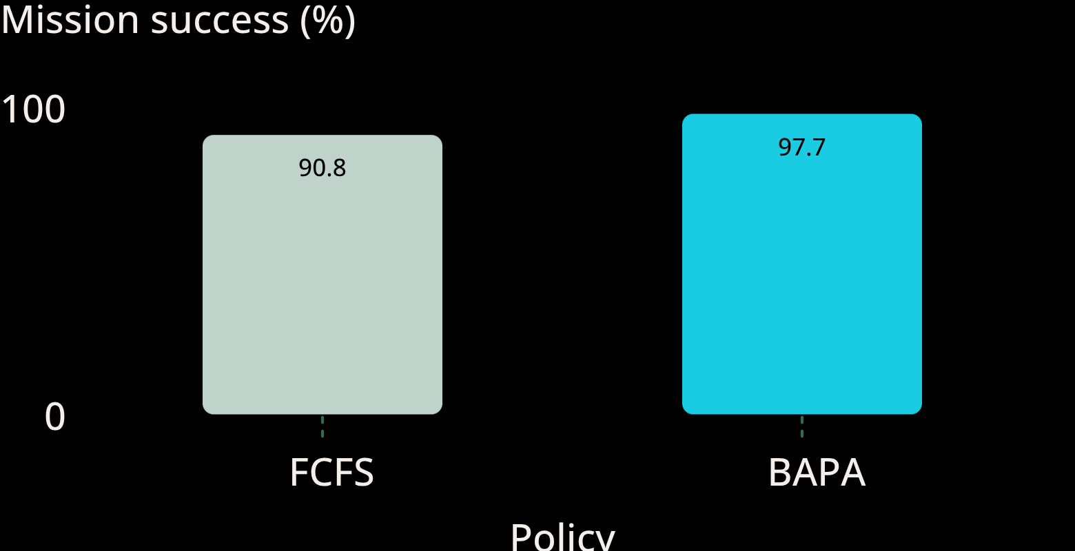
HIGH-LOAD HEATWAVE · FIVE-SEED MEANS
High-load heatwave: BAPA improves mission success
97.70%
mission success, BAPA vs FCFS 90.84%
Mission success (%)
Metric | FCFS | BAPA
Delivery success | 95.42% | 97.70%
Return failures/run | 1.60 | 0.00
Delivery time (min) | 30.44 | 19.13
Total energy (Wh) | 1420.95 | 1429.37
Energy was slightly higher for BAPA in this scenario.
5 independent seeds × 3 weather scenarios × 2 regimes × 2 policies = 60 runs; 480-minute horizon.
Across reported BAPA benchmark runs: zero return failures and zero reserve violations. Reported verification: 29/29 tests passed.
Notes:
Lead with mission success, which includes returning safely. Delivery success alone masks return failures. BAPA also reduced mean delivery time here, but did not reduce total energy. These are simulation benchmark means, not field measurements.

Slide 9
RESEARCH ROADMAP
Limitations and future research directions
Current limitation |  | Future direction
Direct single-hop Haversine corridors | → | Obstacle-aware Dijkstra/A* routing
Queued orders do not expire | → | Deadline-aware scheduling and expiration
Scalar wind; linear battery and charging models | → | Directional wind, nonlinear battery and CC–CV charging
Radar smoothly interpolates between events | → | More accurate trajectory interpolation
Proposed extensions, not implemented project features.
Notes:
Prioritize improved route feasibility and deadlines, then richer environmental and battery dynamics. The radar is a visualization between events, not a high-fidelity flight dynamics model.

Slide 10

CONCLUSION
Conclusion: Toward safer and more reliable drone delivery
Battery-aware round-trip feasibility supports reliability.
Demonstrated under demanding simulated weather and load conditions.
Software-only SimPy simulation: PSTU plus 10 destinations; FCFS and BAPA; payload, climate, reserves and charging queues.
Interactive Streamlit dashboard · 60 benchmark runs · reported 29/29 tests passed.
Thank You
Questions & Discussion
Conceptual visualization
No physical deployment
Notes:
The project demonstrates that dispatch decisions should consider the full mission, including the return reserve. Results support reliability within the stated simulation assumptions. Invite questions on the energy model, policy comparison and experimental design.

