Slide 1
A Comparison of Machine Learning Algorithms on Twitter Sentiment Analysis

Slide 2
Group Information
Presented By :
180104134 Emon Ghosh
180104148 Tauhidur Rahman
180104151 Mohammad Arman

Slide 3
Introduction:
Building an comparison method of finding and categorizing subjective information in text data which is known as sentiment analysis
Classification of emotions within a textual material
Twitter continuously draws users who want to express their thoughts and perspectives
People tend to make their statements shorter by employing slang, acronyms

Slide 4
Motivation :
For reducing the use of racist /sexist tweets.
Identifying racist/sexist group of people.
For developing interaction between human language and computer.

Slide 5
Literature Review :
Paper 01 : Study of Twitter Sentiment Analysis using Machine Learning Algorithms on Python.[1]
Author :Gupta, Moniak Negi.
Showed 85.0% accuracy by applying the svm techniques and 66.24% by applying naive bayes classifier on their dataset.

Slide 6
Literature Review
Paper 02 : [3]Twitter Sentiment Analysis Using Machine Learning Techniques, Bac Le and Huy Nguyen.
Author :TBac Le and Huy Nguyen
Showed 79.54% accuracy using naive bayes and 79.58% accuracy using svm on on stanford sentiment dataset.

Slide 7
Literature Review
Paper 03 : [3]Sentiment Analysis of Twitter Data Using Machine Learning Approaches and Semantic Analysis,
Author : Geetika Gautam, Divakar yadav
Showed 88.024% accuracy using naive bayes and 85.55% accuracy using svm on amazon product review dataset

Slide 8
Datastet:
The dataset[4] contains information about 31,962 tweets and their corresponding unique attributes. A training sample of tweets and labels, where label ’1’ denotes the tweet is racist/sexist and label ’0’ denotes the tweet is not racist/sexist. In the dataset, 29270 samples are classified as positive or not racist/sexist, and 2242 are classified as negative or racist/sexist.

Slide 9
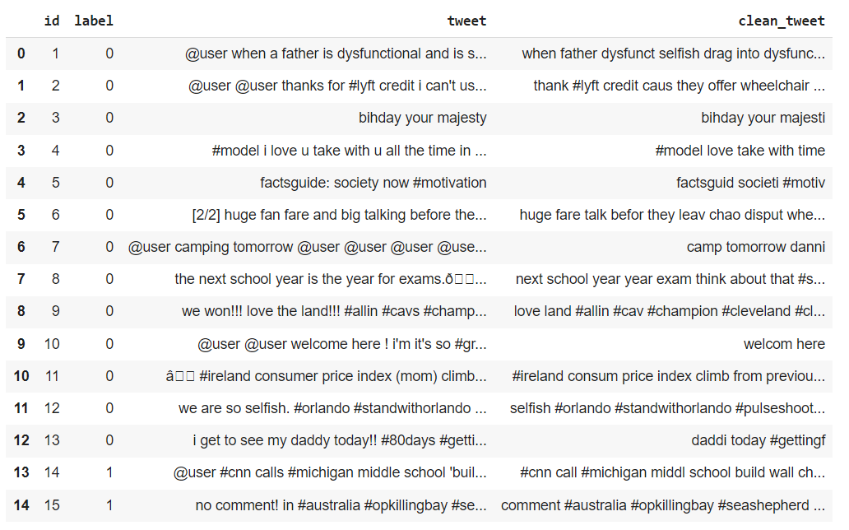
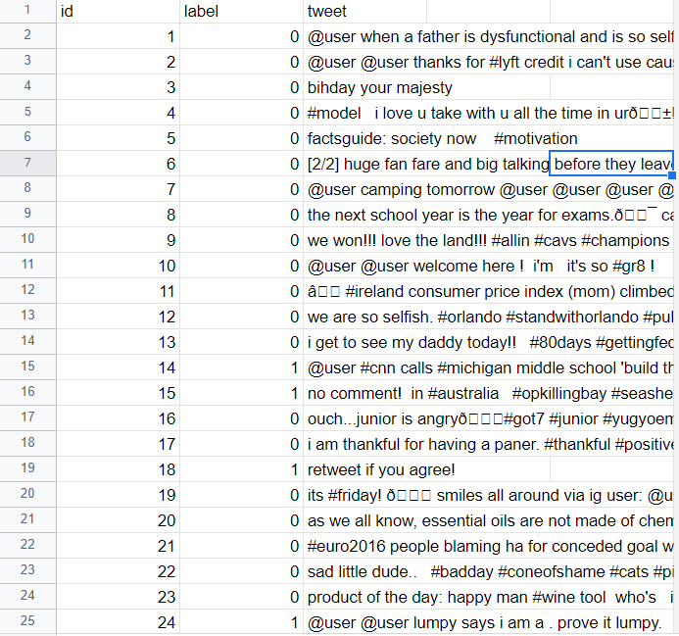
Datastet:
Before Processing Dataset
After Processing Dataset

Slide 10
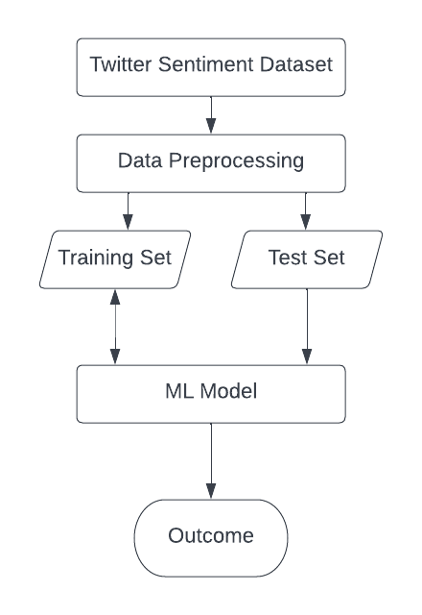
Methodology:

Slide 11
Result Analysis
Model Name | Test Accuracy % | Model Name | Test Accuracy %
Random Forest | 94.2 | Decision Tree | 93.14
Logistic Regression | 94.69 | Naive Bayes | 93.56
SVM | 94.73 | Adaboost | 94.44
KNN | 94.06

Slide 12
Comparative Analysis
We compared the hate speech classification of Twitter Sentiment Analysis Dataset on seven different model.
From the models accuracy-wise SVM is giving us the best accuracy 95.73 %.
ROC-Curve wise Naive Bayes is giving us the best result.

Slide 13
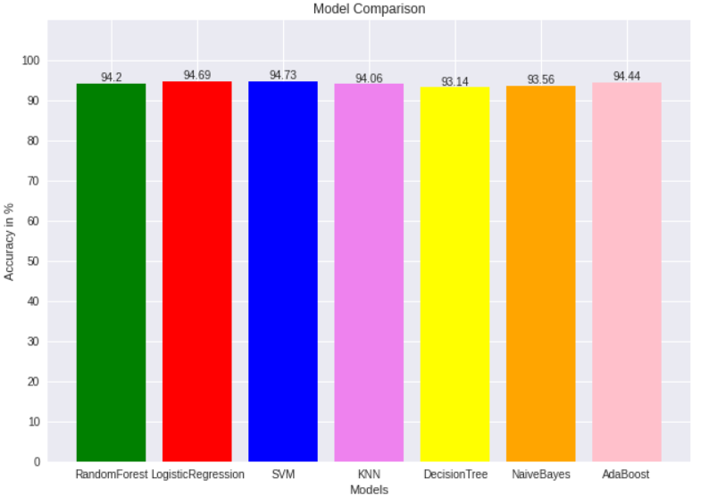
Comparative Analysis

Slide 14
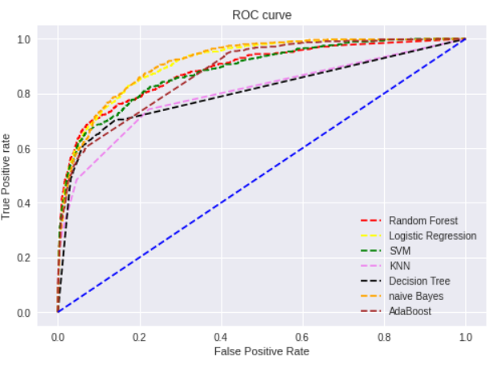
ROC Curve

Slide 15
Future Work
we plan to collect a more enriched dataset which will help us to classify racist/-
sexist tweets with higher confidence. In addition to this, we also plan to extend this
work to evaluate how complex classifiers based on Artificial Neural Network (ANN) or other deep learning techniques perform.

Slide 16
References :
[1] Study of Twitter Sentiment Analysis using Machine Learning Algorithms on Python, Bhumika Gupta, Monika Negi, Kanika Vishwakarma, Goldi Rawat, Priyanka Badhani
[2] Bac Le and Huy Nguyen ,Twitter Sentiment Analysis Using Machine Learning Techniques
[3] Geetika Gautam,Divakar yadav,Sentiment Analysis of Twitter Data Using Machine Learning Approaches and Semantic Analysis
[14 https://www.kaggle.com/datasets/arkhoshghalb/twitter-sentiment-analysis-hatred-speech

Slide 17
Thank you

