Slide 1
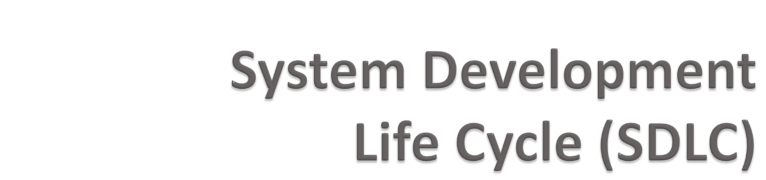

Slide 2

Complex ≠ complicated
Complex = composed of many simple parts
related to one another
Complicated = not well understood, or explained

Slide 3





Setting posts
[ 3 time units ]
Cutting wood
[ 2 time units ]
Nailing
[ 2 time units for unpainted;
3 time units otherwise ]
Painting
[ 5 time units for uncut wood;
4 time units otherwise ]
Setting posts < Nailing, Painting
Cutting < Nailing
…shortest possible completion time = ?
[ ⇒ “simple” problem, but hard to solve without a pen and paper ]
Notes:
SOURCE: Goodaire & Parmenter, Discrete Mathematics with Graph Theory, Third Edition, Pearson Prentice Hall, 2006. [ Section 11.5, p. 361 ]

Slide 4


A bridge from customer needs to programming implementation
Customer
Software Engineering
Programmer
First law of software engineering
Software engineer is willing to learn the problem domain
(problem cannot be solved without understanding it first)
Notes:
"You cannot solve it, unless you understand it."

Slide 5

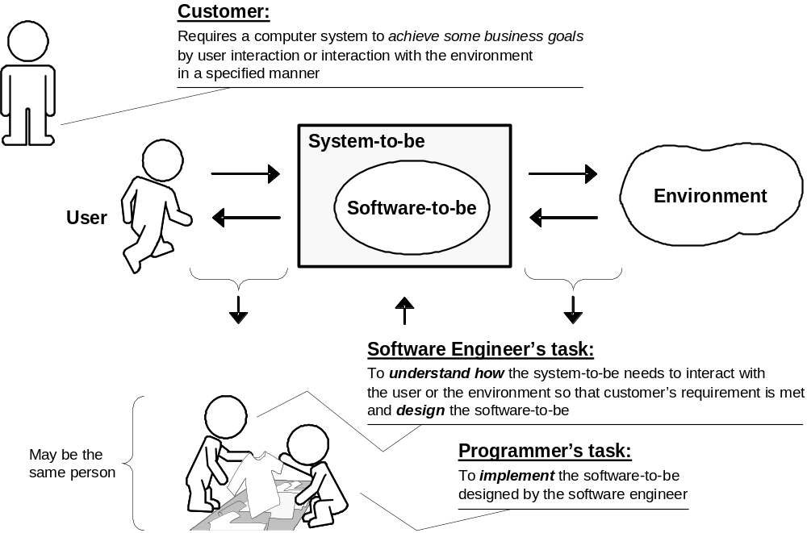

Slide 6

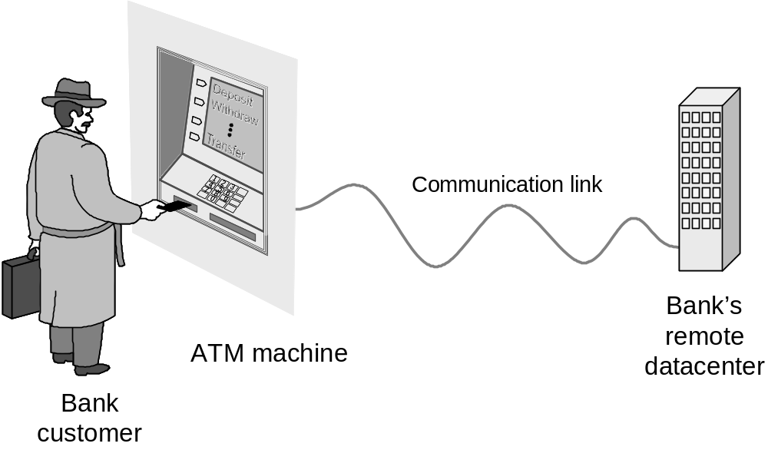
Understanding the money-machine problem:

Slide 7

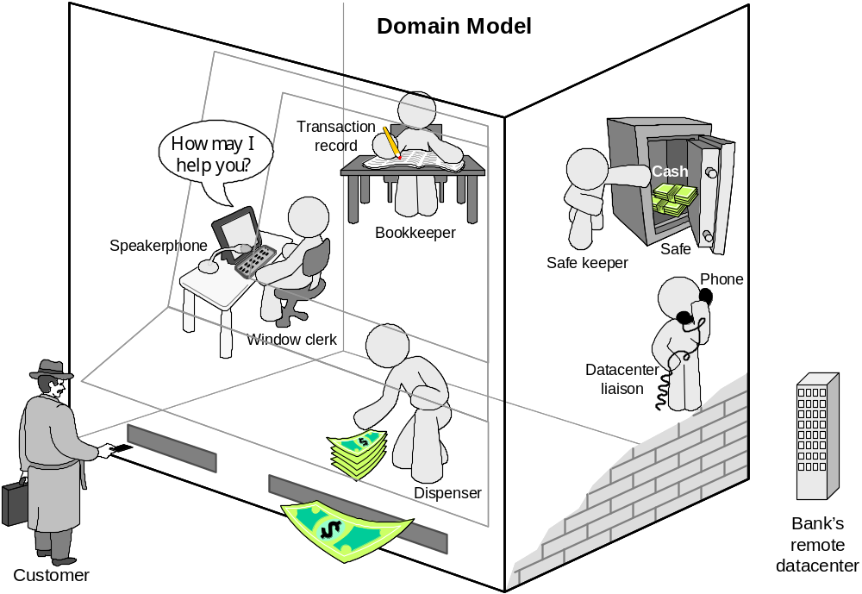
Domain model created with help of domain expert

Slide 8

Software engineering is concerned with all aspects of software production from the early stages of system specification through to maintaining the system after it has gone into use.

Slide 9

A bench-mark for measuring the maturity of an organization’s software process
CMM defines 5 levels of process maturity based on certain Key Process Areas (KPA)

Slide 10

Level 5 – Optimizing (< 1%)
  -- process change management
  -- technology change management
  -- defect prevention
Level 4 – Managed (< 5%)
  -- software quality management
  -- quantitative process management
Level 3 – Defined (< 10%)
  -- peer reviews
  -- intergroup coordination
  -- software product engineering
  -- integrated software management
  -- training program
  -- organization process definition
  -- organization process focus
Level 2 – Repeatable (~ 15%)
  -- software configuration management
  -- software quality assurance
  -- software project tracking and oversight
  -- software project planning
  -- requirements management
Level 1 – Initial (~ 70%)

Slide 11

A framework that describes the activities performed at each stage of a software development project.

Slide 12

Preliminary Investigation
  Assesses feasibility and practicality of system
System Analysis
  Study old system and identify new requirements
  Defines system from user's view
System Design
  Design new/alternative system
  Defines system from technical view

Slide 13

System Development
  New hardware and software is acquired, developed, and tested
System Implementation
  System installation and training
System Operation & Maintenance
  Daily operation
  Periodic evaluation and updating

Slide 14

Preliminary
Investigation
System
System Operation
Analysis
& Maintenance
System
System
Implementation
n
Design
System
D
evelopment

Slide 15

Determine if a new system is needed
Three primary tasks:
  Define the problem
    By observation and interview, determine what information is needed by whom, when, where and why
  Suggest alternative solutions
  Prepare a short report- feasibility report, project plan.

Slide 16

In depth study of the existing system to determine what the new system should do- Requirement Analysis.
  Expand on data gathered in Phase 1
In addition to observation and interviews, examine:
  Formal lines of authority (org chart)
  Standard operating procedures
  How information flows
  Reasons for any inefficiencies

Slide 17

Checklists - list of questions
Top-down analysis - start with top level components, break down into smaller parts through each successive level
Grid charts - to show relationship between inputs and outputs
System flowcharts - charts flow of input data, processing, and output which show system elements and interactions

Slide 18

Complete description of current system and its problems- FRD/SRS and/or BRD
Requirements for new system including:
  Subject
  Scope
  Objectives
  Benefits
Possible development schedule- Gantt chart

Slide 19

Uses specifications from the systems analysis to design alternative systems
Evaluate alternatives based upon:
  Economic feasibility - Do benefits justify costs?
  Technical feasibility - Is reliable technology and training available?
  Operational feasibility - Will the managers and users support it?

Slide 20
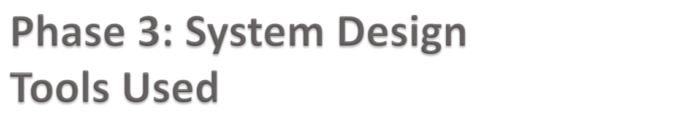
Computer-Aided Software Engineering (CASE) tools are software-based products designed to help automate the production of information systems.
Examples:
  Diagramming Tools
  Data Repositories
  Prototyping Tools
  Test Data Generators
  Documentation Tools
  Project Management Tools

Slide 21

System Design Report
  Describe Alternatives including:
    Inputs/Outputs
    Processing
    Storage and Backup
  Recommend Top Alternative based upon:
    System Fit into the Organization
    Flexibility for the future
    Costs vs. benefits

Slide 22

Build the system to the design specifications
  Develop the software
    Purchase off-the-shelf software OR
    Write custom software
  Acquire the hardware
  Test the new system
    Module (unit) test - tests each part of system
    Integration testing - tests system as one unit
  Create manuals for users and operators

Slide 23

Convert from old system to new system
Train users
Compile final documentation
Evaluate the new system

Slide 24
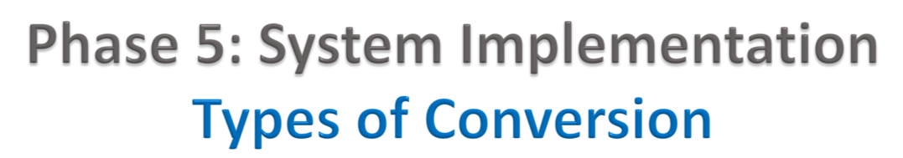
Direct/plunge/crash approach – entire new system completely replaces entire old system, in one step
Parallel approach - both systems are operated side by side until the new system proves itself
Pilot approach - launched new system for only one group within the business -- once new system is operating smoothly, implementation goes company-wide
Phased/incremental approach - individual parts of new system are gradually phased-in over time, using either crash or parallel for each piece.

Slide 25

User Training
  Ease into system, make them comfortable, and gain their support
  Most commonly overlooked
  Can be commenced before equipment delivery
  Outside trainers sometimes used

Slide 26

Types of changes:
  Physical repair of the system
  Correction of new bugs found (corrective)
  System adjustments to environmental changes
  Adjustments for users’ changing needs (adaptive)
  Changes to user better techniques when they become available (perfective)

Slide 27
Evaluation Methods
  Systems audit - performance compared to original specifications
  Periodic evaluation - “checkups” from time to time, modifications if necessary

Slide 28

Approved Feasibility
Study
Abort Project
Preliminary
Investigation
Goto next phase
Problem
Specifications
Goto Previous phase
System
Analysis
System
Design Specifications
Design
System
Coded and
Tested System
Development
Begin building
new system
System
System converted
Implementation
Users trained
System
Maintenance
Operational System
Documentation completed

