Slide 1

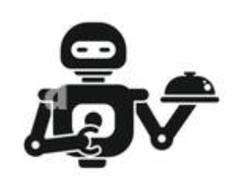



Food court Fun – Chatbot on the run
Mounika Atmakuri
Sridhar Reddy Maram
Tauseef Taufiq K
Surya Teja Avvaru

Slide 2
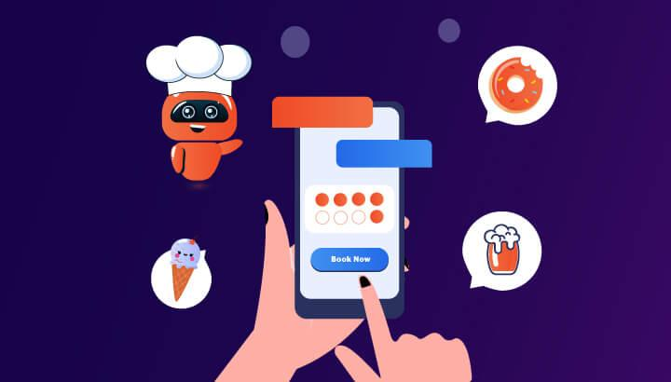
Problem Statement:
The project focuses on creating a chatbot for campus food courts to provide real-time menu updates, nutritional information , and ingredient lists.
Utilizing Dialogflow for NLP, Fast API for backend integration, and MySQL for data management, it automates customer interactions. A web interface allows users to view menus for enhancing the ordering experience.

Slide 3
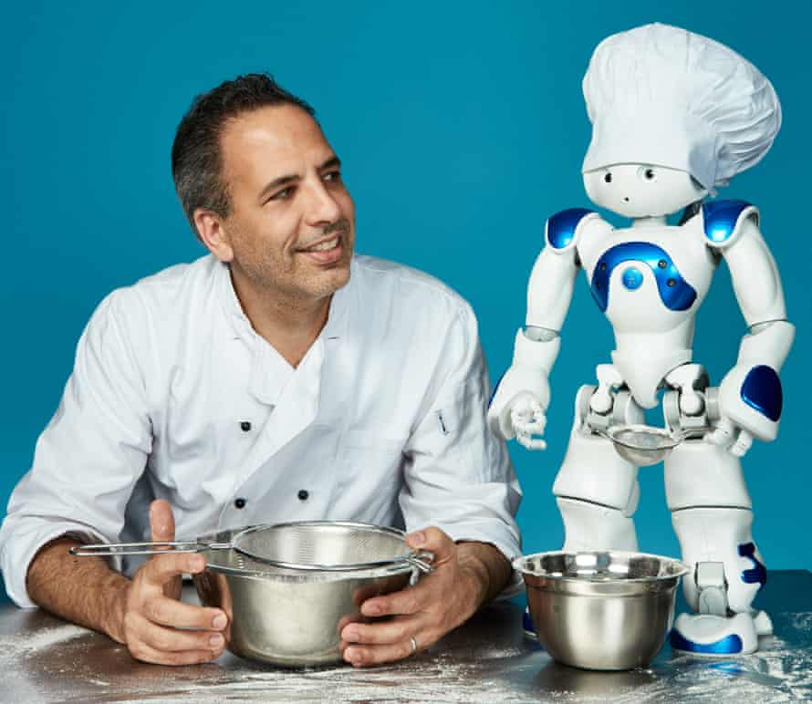
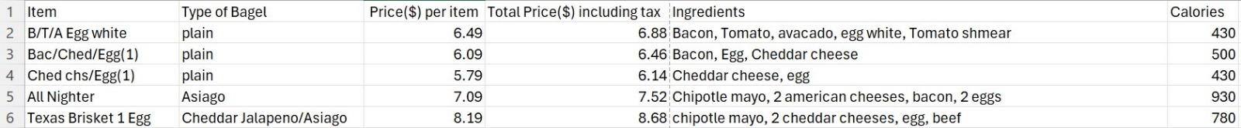
Data Preparation
Data for one of the campus food courts was
collected manually, while data for the other
food courts will be gathered in the future through
web scraping from "dineoncampus.com/UMBC."

Slide 4
Data Overview
Egg Sandwiches:
Lunch Sandwiches:

Slide 5
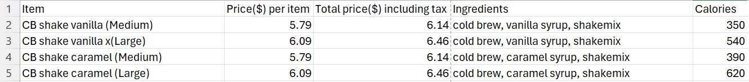
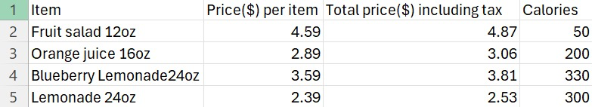
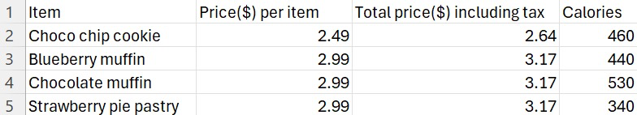
Data Overview
Drinks:
Bagels with cream cheese:
Grab and Go:
Deserts and Snacks:

Slide 6
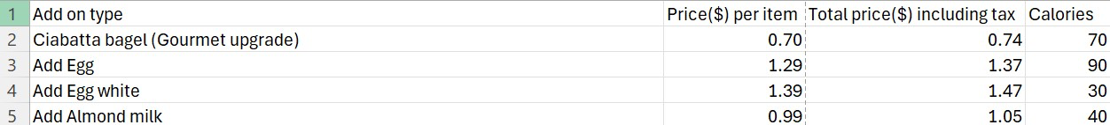
Data Overview
Meal Deal:
Add-On:

Slide 7
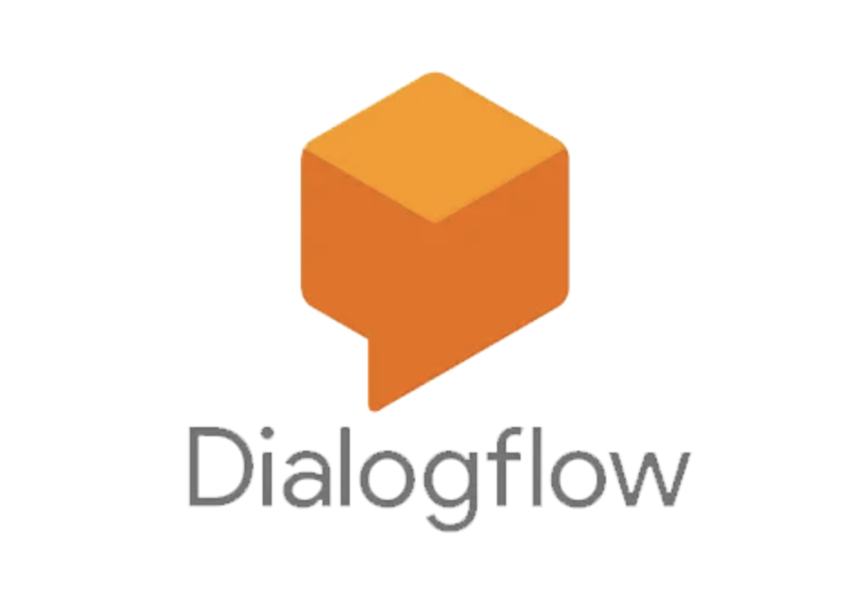



Architecture Diagram [ Implementation ]
Chatbot
Development
Backend
Integration
Database
Management
Web Interface

Slide 8
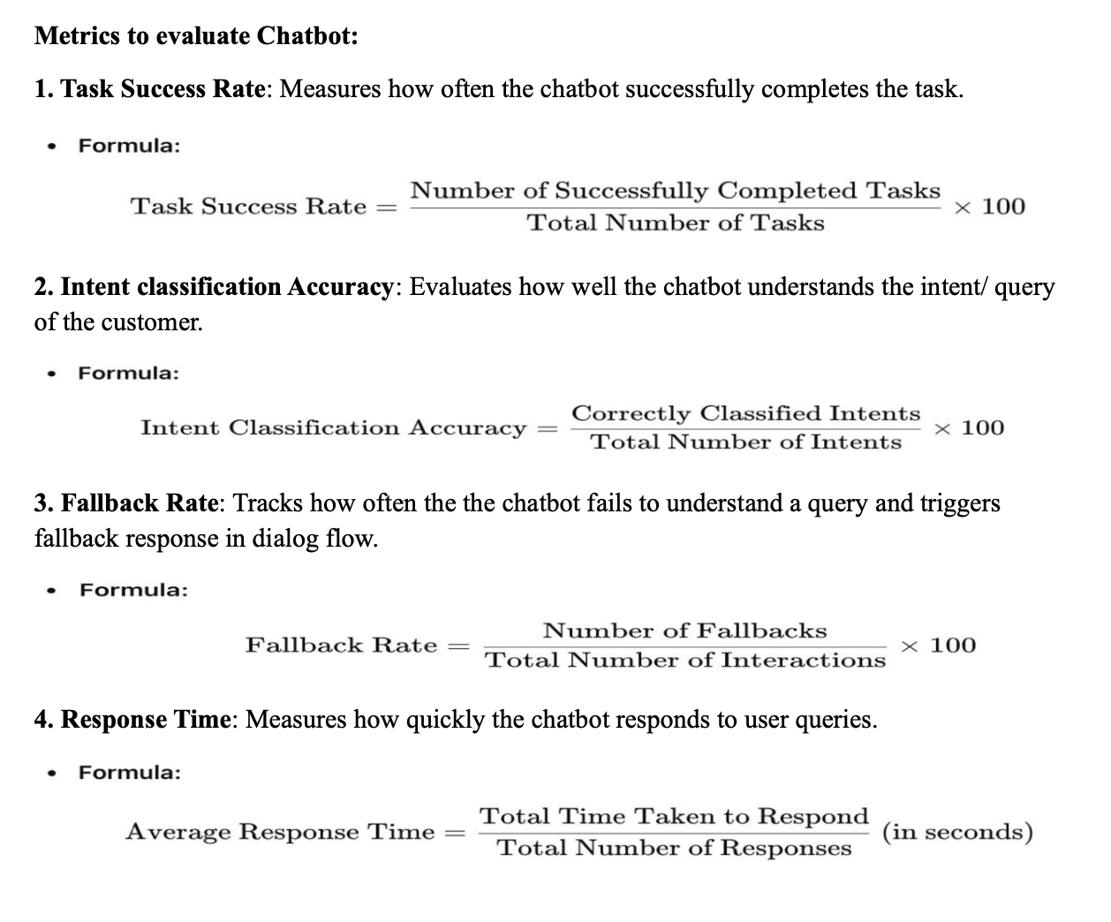
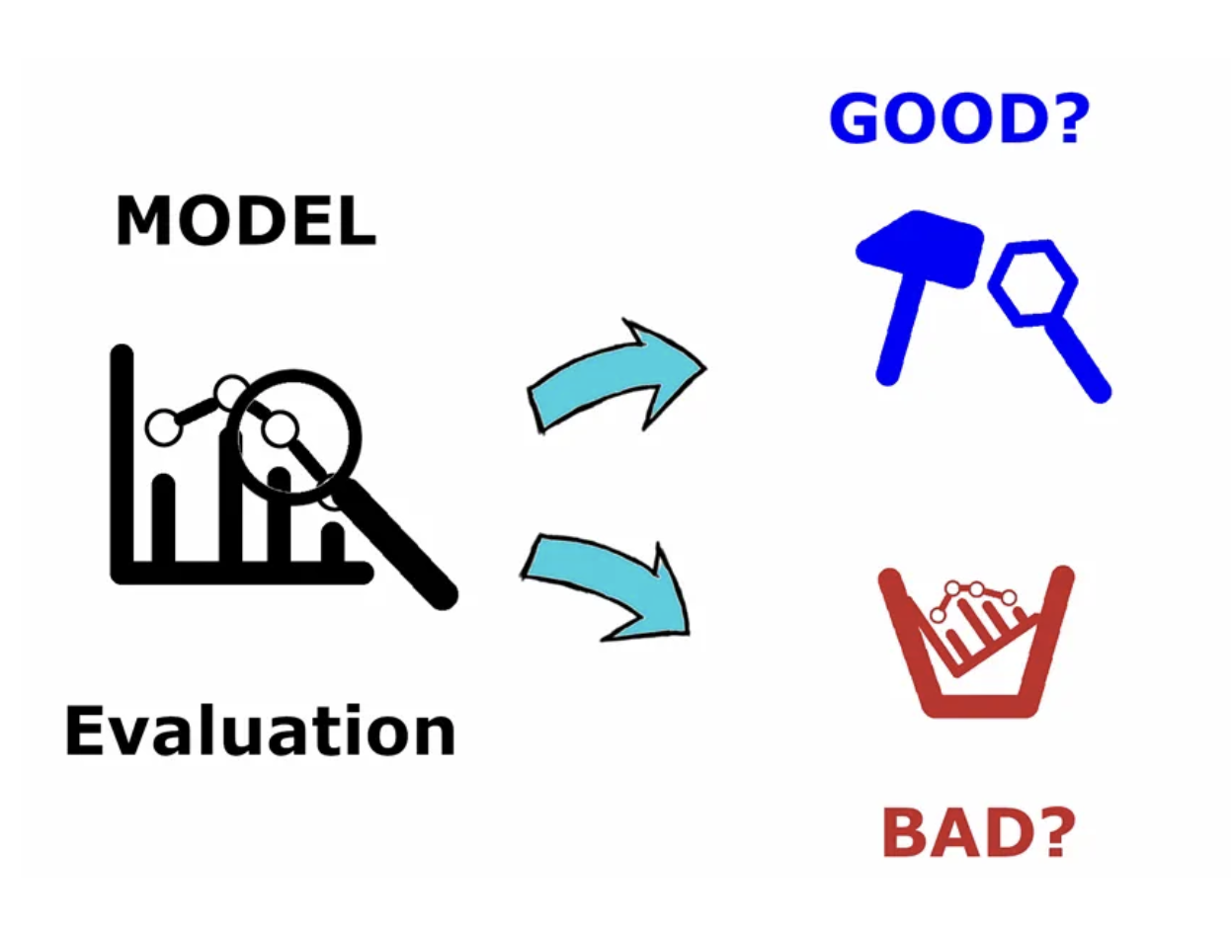
Performance Metrics

Slide 9
References
https://github.com/AhmadYasser1/Food-Recommending-Chatbot
Mr. Hungry
Main Points: A task-oriented food recommending chatbot that uses a "Restaurant.csv" file to offer personalized meal suggestions based on user preferences and dietary restrictions. It integrates with food delivery services and uses natural language processing for quick responses.
Architecture: The chatbot's architecture includes a CSV data source for restaurant menus, natural language processing for user interactions, and an interface module for integration with food delivery services.

Slide 10
References
https://github.com/yenxuan1381/food-ordering-chatbot-using-ai
Kayo – AI-Based Food Ordering Chatbot
Main Points: Kayo is an AI-based chatbot using NLTK and TensorFlow for natural language processing to interact with users via Telegram, presenting menus, handling orders, and calculating total prices. It requires Python 3.6+, NLTK, TensorFlow, and a Telegram bot token.
Architecture: The architecture includes Python scripts (`main.py` for logic, intents.json` for predefined responses), NLTK and TensorFlow for NLP, menu data in JSON format, and Telegram integration using the Telebot library for real-time user interaction.

Slide 11

THANK YOU

