Slide 1
Smart Dermatology with Deep Learning
Team members:
Shiva Shankar Kanike
Sridhar Kandi
Tauseef Taufiq K

Slide 2
Steps Followed
Data Collection
Data Preparation
Data Preprocessing
Model Development
Train the Model
Model Evaluation and Testing
Integration with MongoDB
Data Visualization through PowerBI

Slide 3
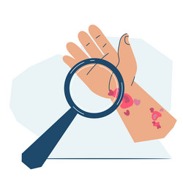
Problem Statement
Millions globally are affected by skin diseases, impacting both physical health and quality of life.
Accurate and early diagnosis is crucial but often hindered by the lack of available specialized medical expertise.
Specialized care for skin diseases is not uniformly accessible, particularly in remote and underserved areas.
Developing an automated system for image analysis can significantly enhance early diagnosis capabilities.
Such a system can reduce the diagnostic burden on healthcare professionals and provide vital support to areas lacking specialized care.

Slide 4
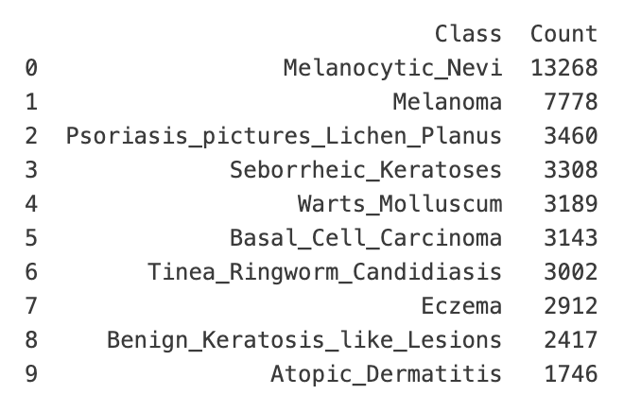
Project Overview
Utilize TensorFlow to develop a deep learning model that classifies various skin diseases from images, supporting early dermatological diagnosis and improving treatment strategies.
Leverage a diverse dataset with over 40,000 images, categorized into ten specific skin conditions such as Melanoma, Eczema, and Psoriasis, each stored in distinct folders for systematic training.
Use MongoDB to store and manage test results, enabling efficient retrieval and analysis of model performance data.
Employ convolutional neural networks and data augmentation, visualizing results in Power BI for in-depth performance analysis.
Deploy the model in a Streamlit application for real-time predictions, with plans to expand the dataset and explore more complex architectures.

Slide 5
What was Implemented?
Leveraged Apache Spark to manage and process a 20GB dataset of skin disease images efficiently.
Developed a convolutional neural network using TensorFlow and Keras to classify various skin diseases.
Utilized MongoDB for storing and managing the results of the model predictions, ensuring scalability and efficient data access.
Used Power BI to visualize and analyze the data, providing insights into model accuracy and performance metrics.
Created a user-friendly web application that allows users to upload images and receive predictions on skin diseases.
Integrated functionalities in the web app for users to interact with the model easily, enhancing user experience and accessibility.

Slide 6
Original Defense v/s Tasks Implemented
Originally aimed to develop an animal recognition model, shifted focus to skin diseases due to a dataset clash while retaining the original technical setup(Change).
Utilized Apache Spark, MongoDB, and Power BI for data processing, storage, and visualization, maintaining system efficacy despite dataset changes(Implemented).
Adapted the web application to support skin disease Recognition(Implemented).
Enhanced model evaluation with confusion matrices, learning curves, and accuracy tracking over training iterations to assess performance dynamics(Implemented).

Slide 7
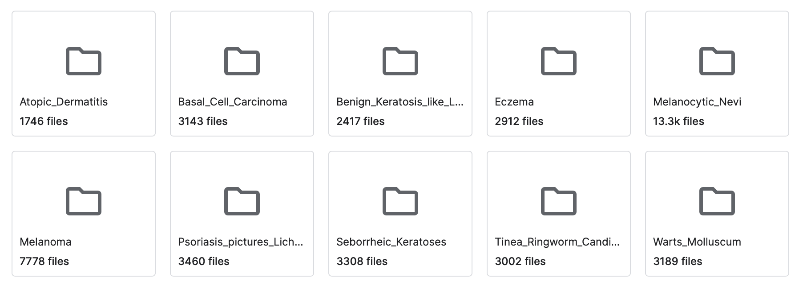
Data set details
Reference: https://www.kaggle.com/datasets/mohdshadab23/skin-disease-dataset?select=Dataset

Slide 8
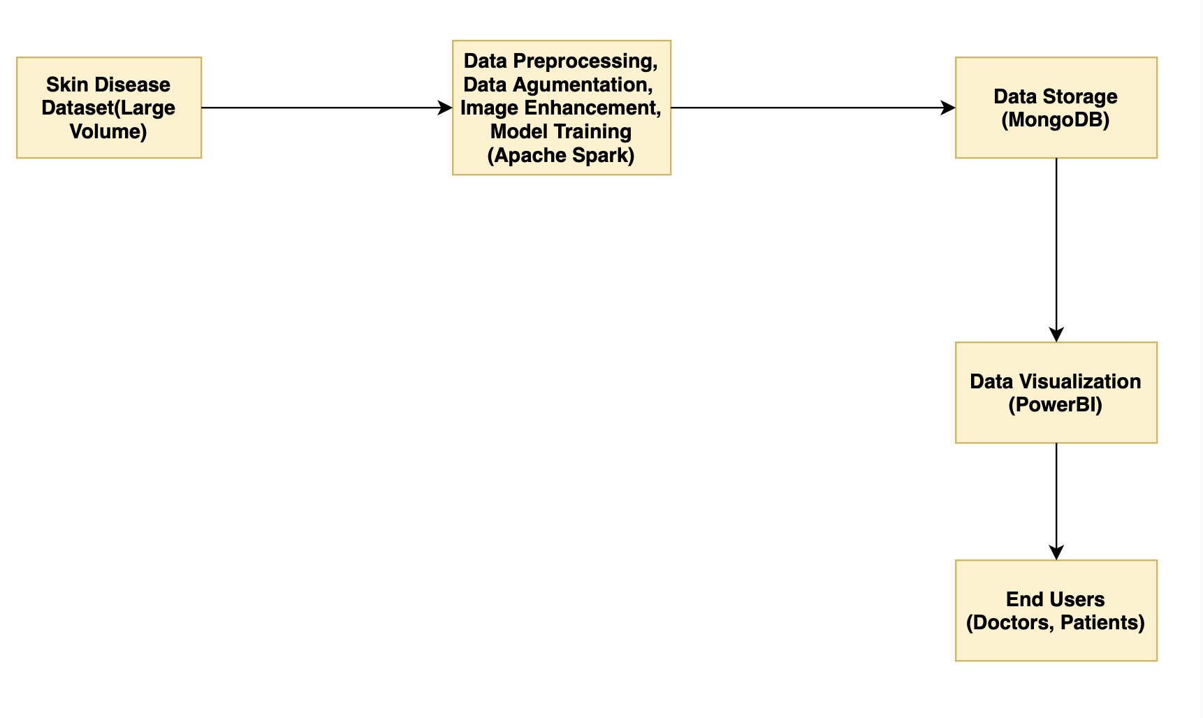



Architecture Diagram

Slide 9
Data Preprocessing
Data Loading:
Loaded images from the specified directory.
Ensured compatibility by using a consistent image format.
Data Augmentation:
Applied transformations like rotation, flipping, scaling, and color jittering.
Increased the diversity of training data to improve model generalization.
Data Splitting:
Divided the dataset into training and validation sets.
Maintained a representative distribution across both sets.
Image Resizing and Normalization:
Resized images to a consistent size (e.g., 224x224 or 299x299 pixels).
Normalized pixel values to a standard range (e.g., 0-1).
Data Transformation and Loaders:
Converted images to tensors for compatibility with deep learning frameworks.
Created data loaders for efficient batch processing during training.

Slide 10
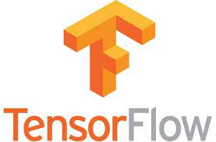
Model Development
Employed Convolutional Neural Networks(CNN) for effective image classification capturing spatial hierarchies through convolutional filters.
Utilize TensorFlow integrated with Apache Spark to develop robust neural models while handling large-scale datasets efficiently.
Monitor accuracy, precision, recall, and F1-score to assess and enhance model effectiveness during the training process.
Connect the trained TensorFlow model to a Streamlit UI for real-time image classification, enabling practical deployment and user interaction.

Slide 11
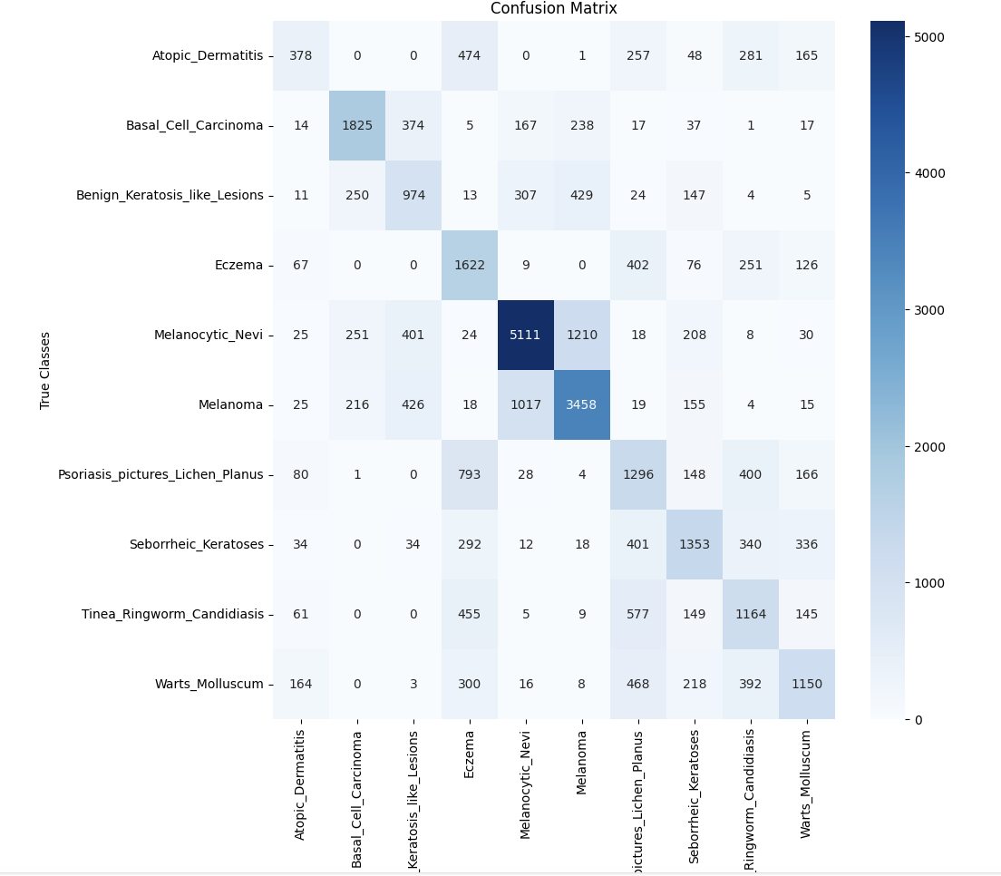
Confusion Matrix

Slide 12
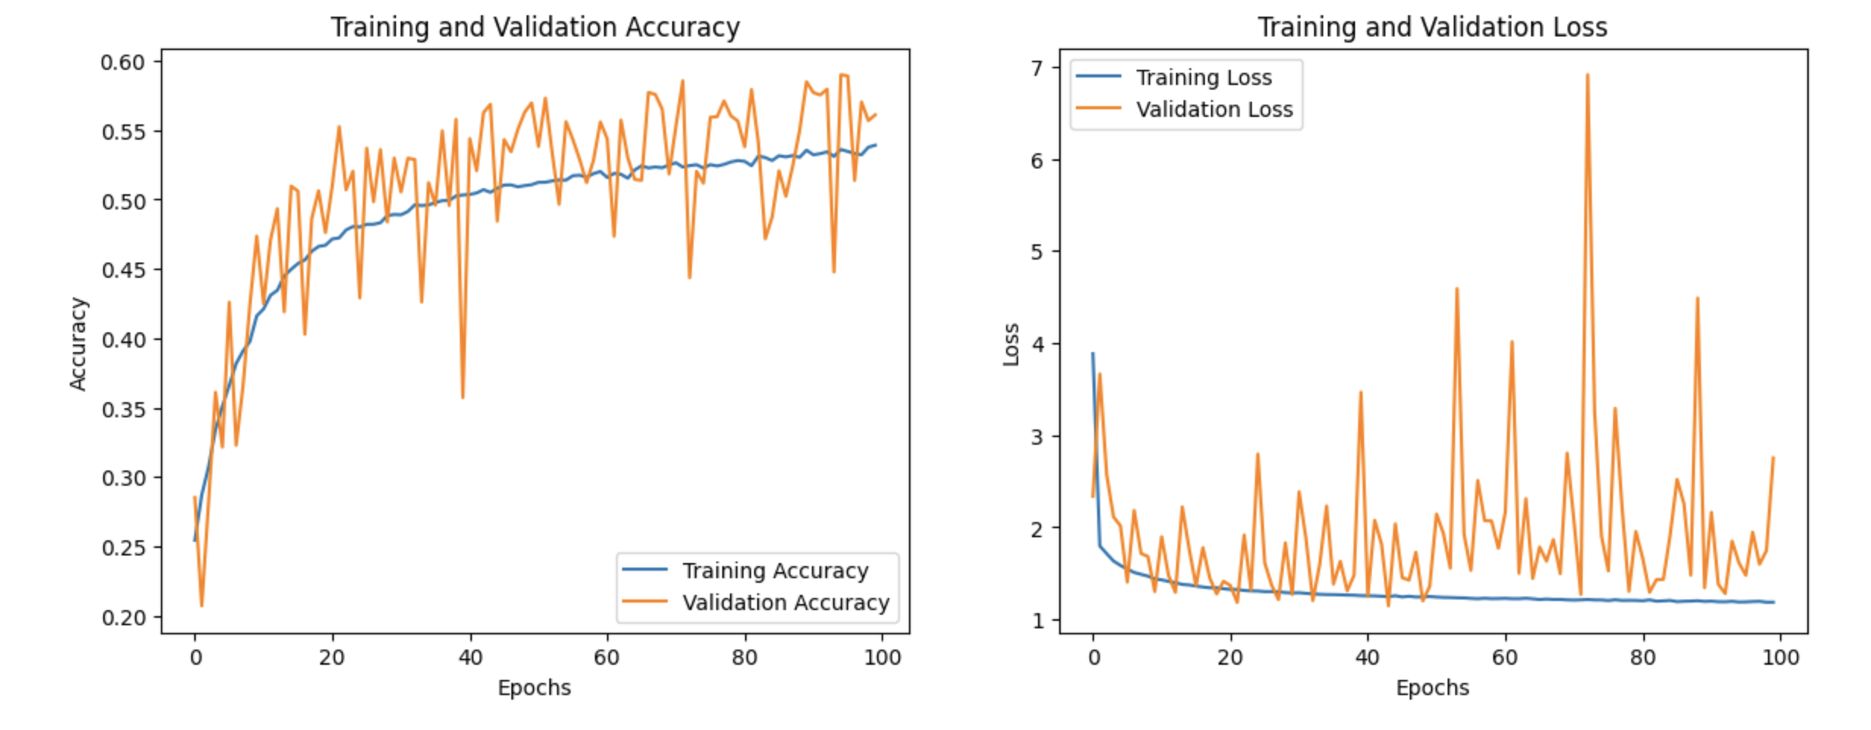
Accuracy & Loss Over Epocs

Slide 13
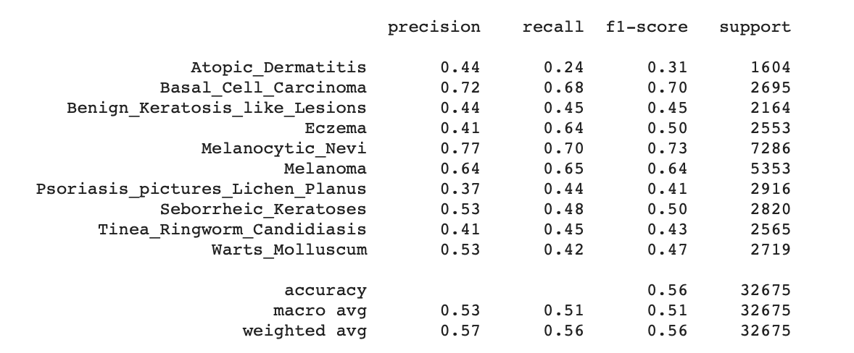
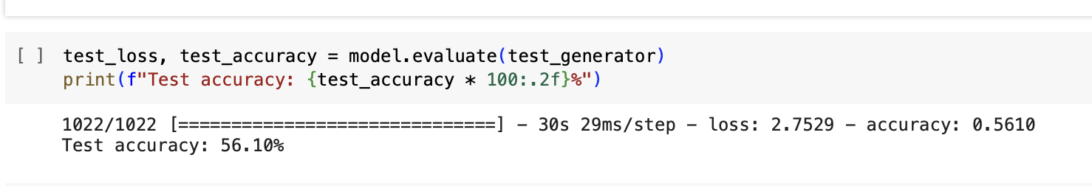
Model Evaluation and Testing

Slide 14
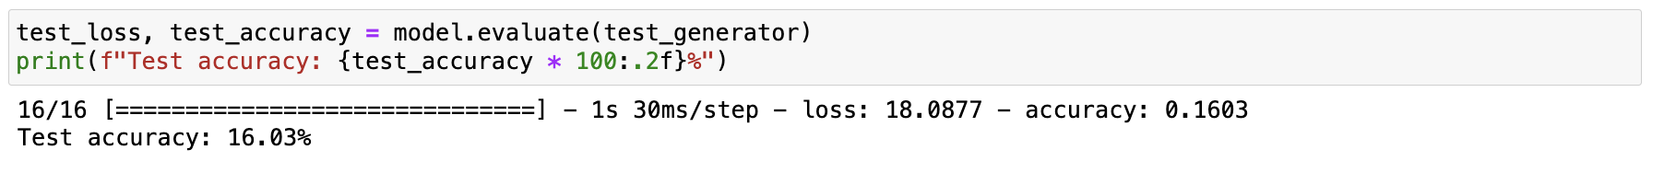
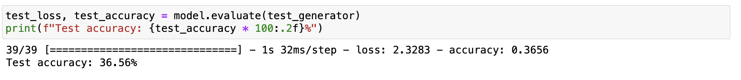
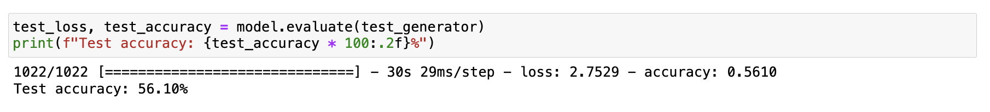
Results
When tested with 2000 Images: [ Accuracy is 16.03% ]
When tested with 5000 Images: [ Accuracy is 36.56% ]
When tested with 100000 Images: [ Accuracy is 56.10% ]

Slide 15


Integration with MongoDB
Results Storage: Store training, testing outcomes, and image metadata in MongoDB for streamlined analysis and access.

Slide 16
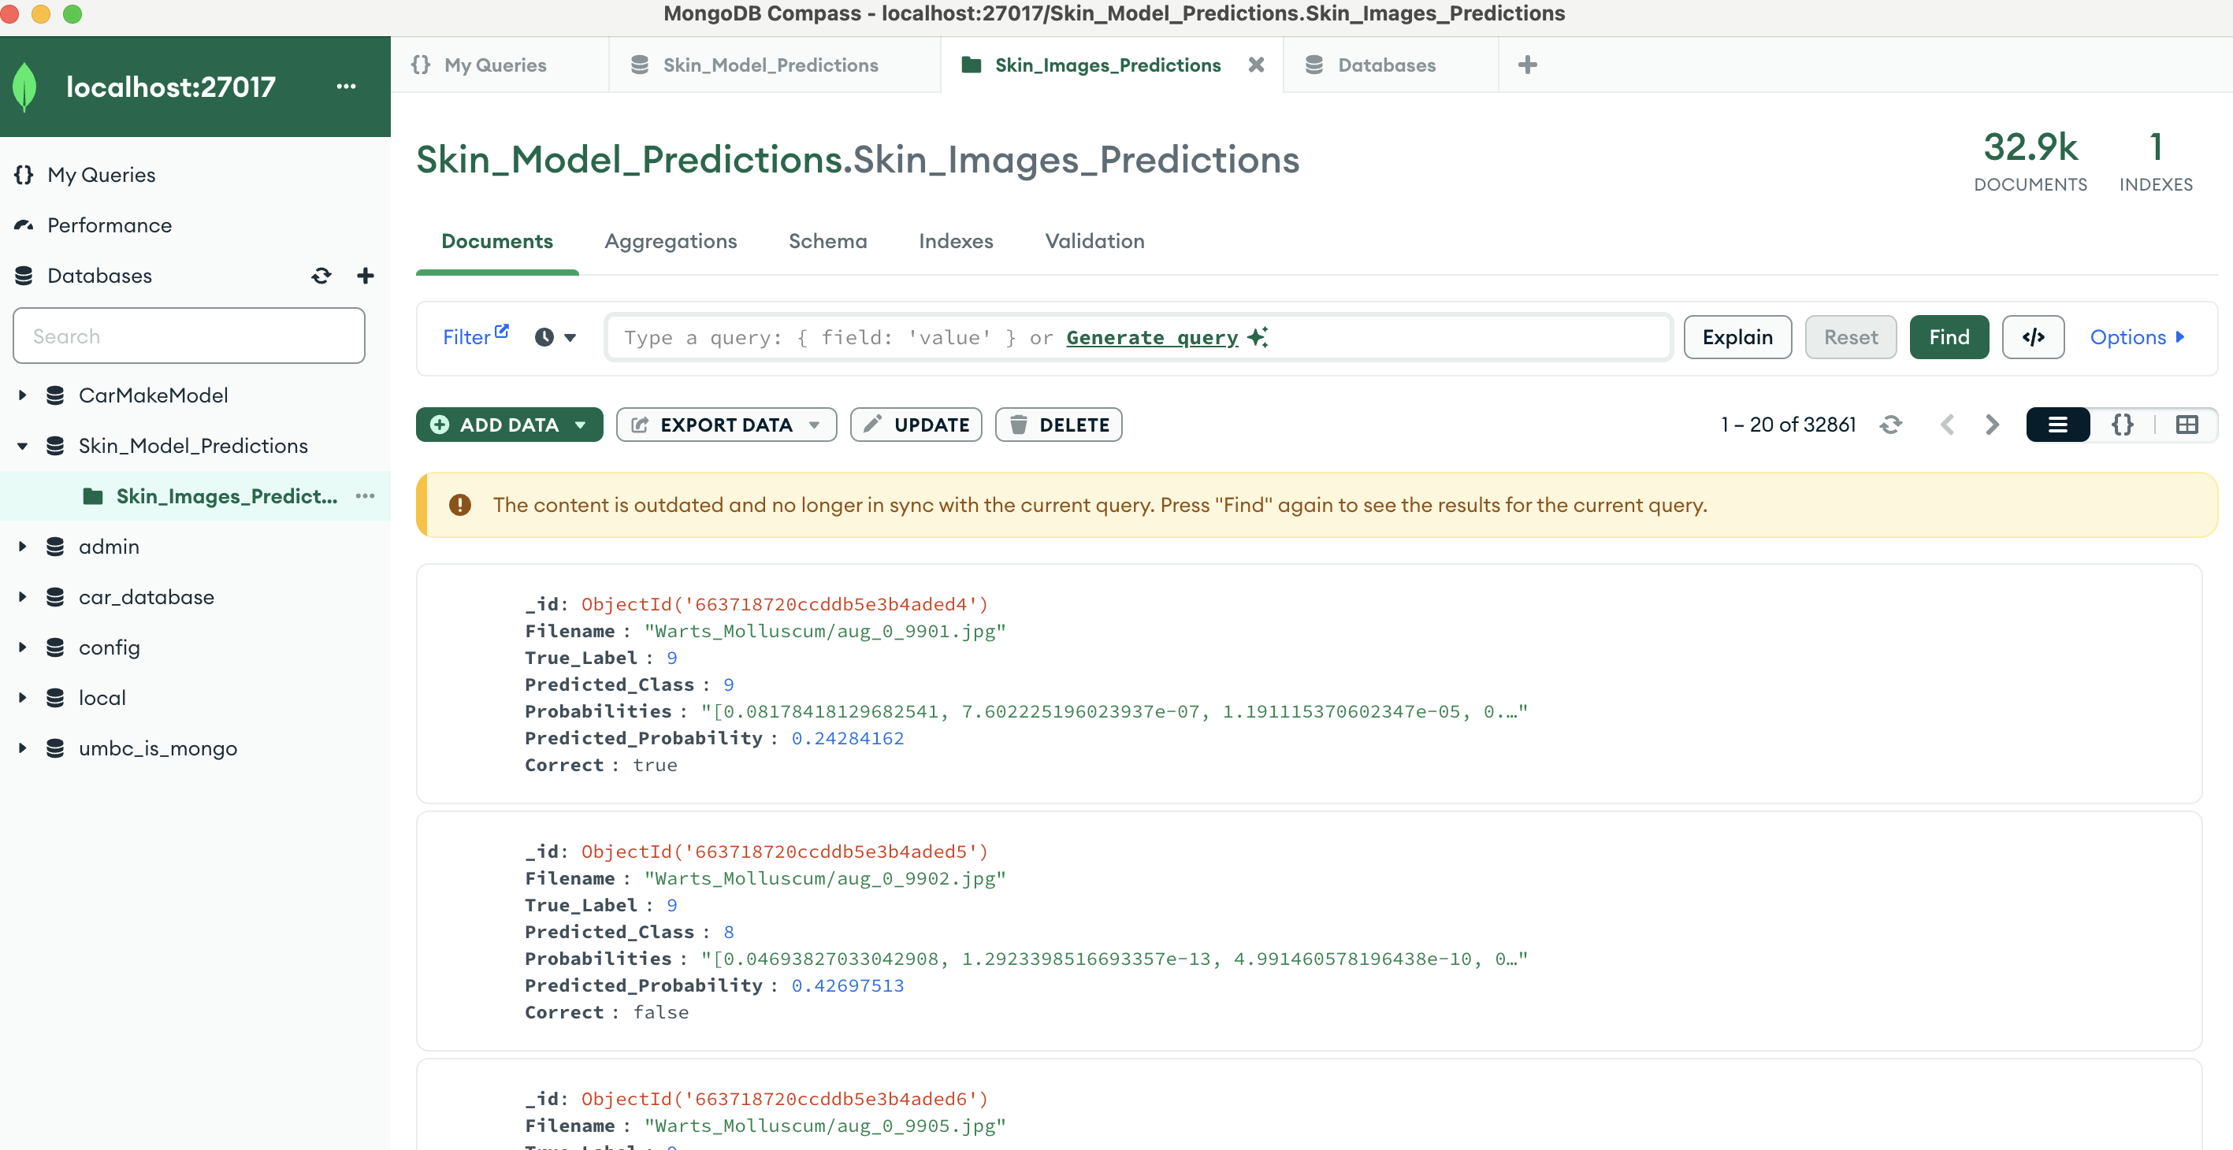
MongoDB Results

Slide 17

UI Interface using Streamlit:
Streamlit is a user-friendly, open-source Python library designed for rapid development of interactive web applications. With minimal code, data scientists can create compelling data-driven apps seamlessly integrating with popular libraries
Advantages:
Simplicity
Easy deployment
Fastness
Easy integration

Slide 18
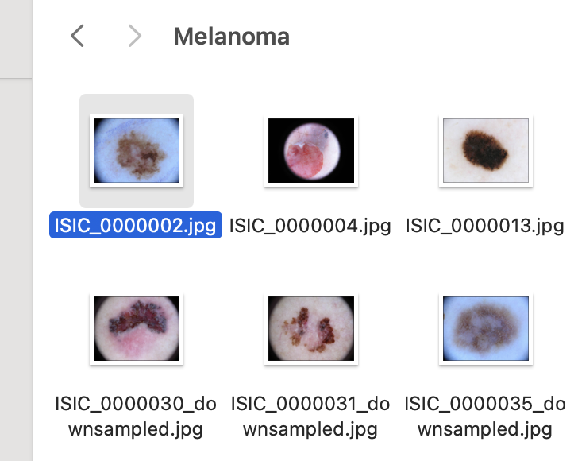
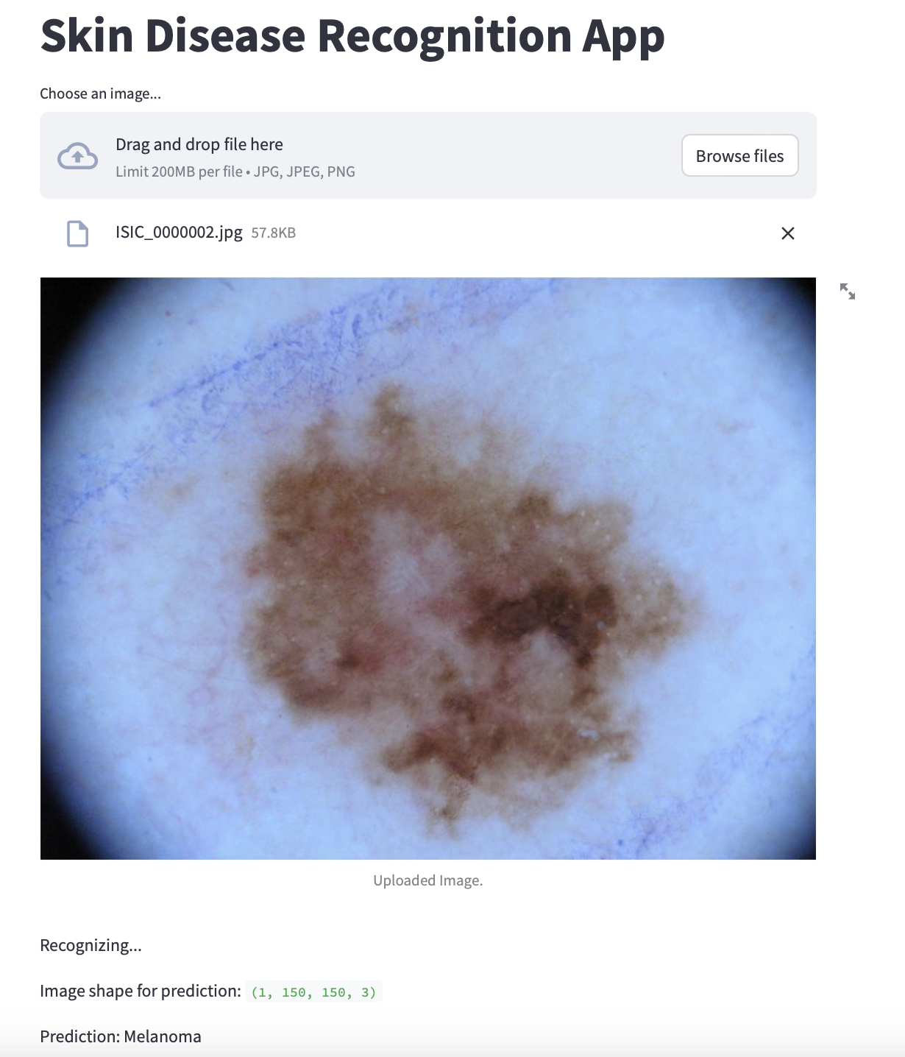
Results Visualization
App Output
From the Pictures we can observe that the image uploaded from the image directory is predicted correctly.

Slide 19
Conclusion
Effectively classified skin disease images into ten distinct categories using a convolutional neural network (CNN), showcasing the model’s capabilities.
Recorded a test dataset accuracy of 56.10%, highlighting opportunities for improved generalization across unseen data.
Anticipate that refining the CNN architecture and allocating more computational resources will significantly enhance model performance.
Utilized Apache Spark for data processing, MongoDB for data management, and Power BI for visualization, creating a scalable and robust solution.
Developed a Streamlit web app for on-the-fly model testing and user engagement, extending the model’s practical usability.

Slide 20
Learning
Proficient in MongoDB: Efficient data storage, quick retrieval for large datasets.
Applied Apache Spark: Advanced image processing, enhancing distributed computing.
Enhanced model robustness by leveraging TensorFlow's extensive library and implementing vital data augmentation techniques
Developed fine-tuned CNN: Skin disease recognition, optimizing neural networks.
Created end-to-end workflow: MongoDB, Pandas, PowerBI, seamless data management.
Developed user-friendly web app: Facilitating model interaction, enhancing accessibility.
Enhanced versatility: Integrated Spark, TensorFlow, PowerBI for complex data projects.

Slide 21
THANK YOU
😊

