Slide 1
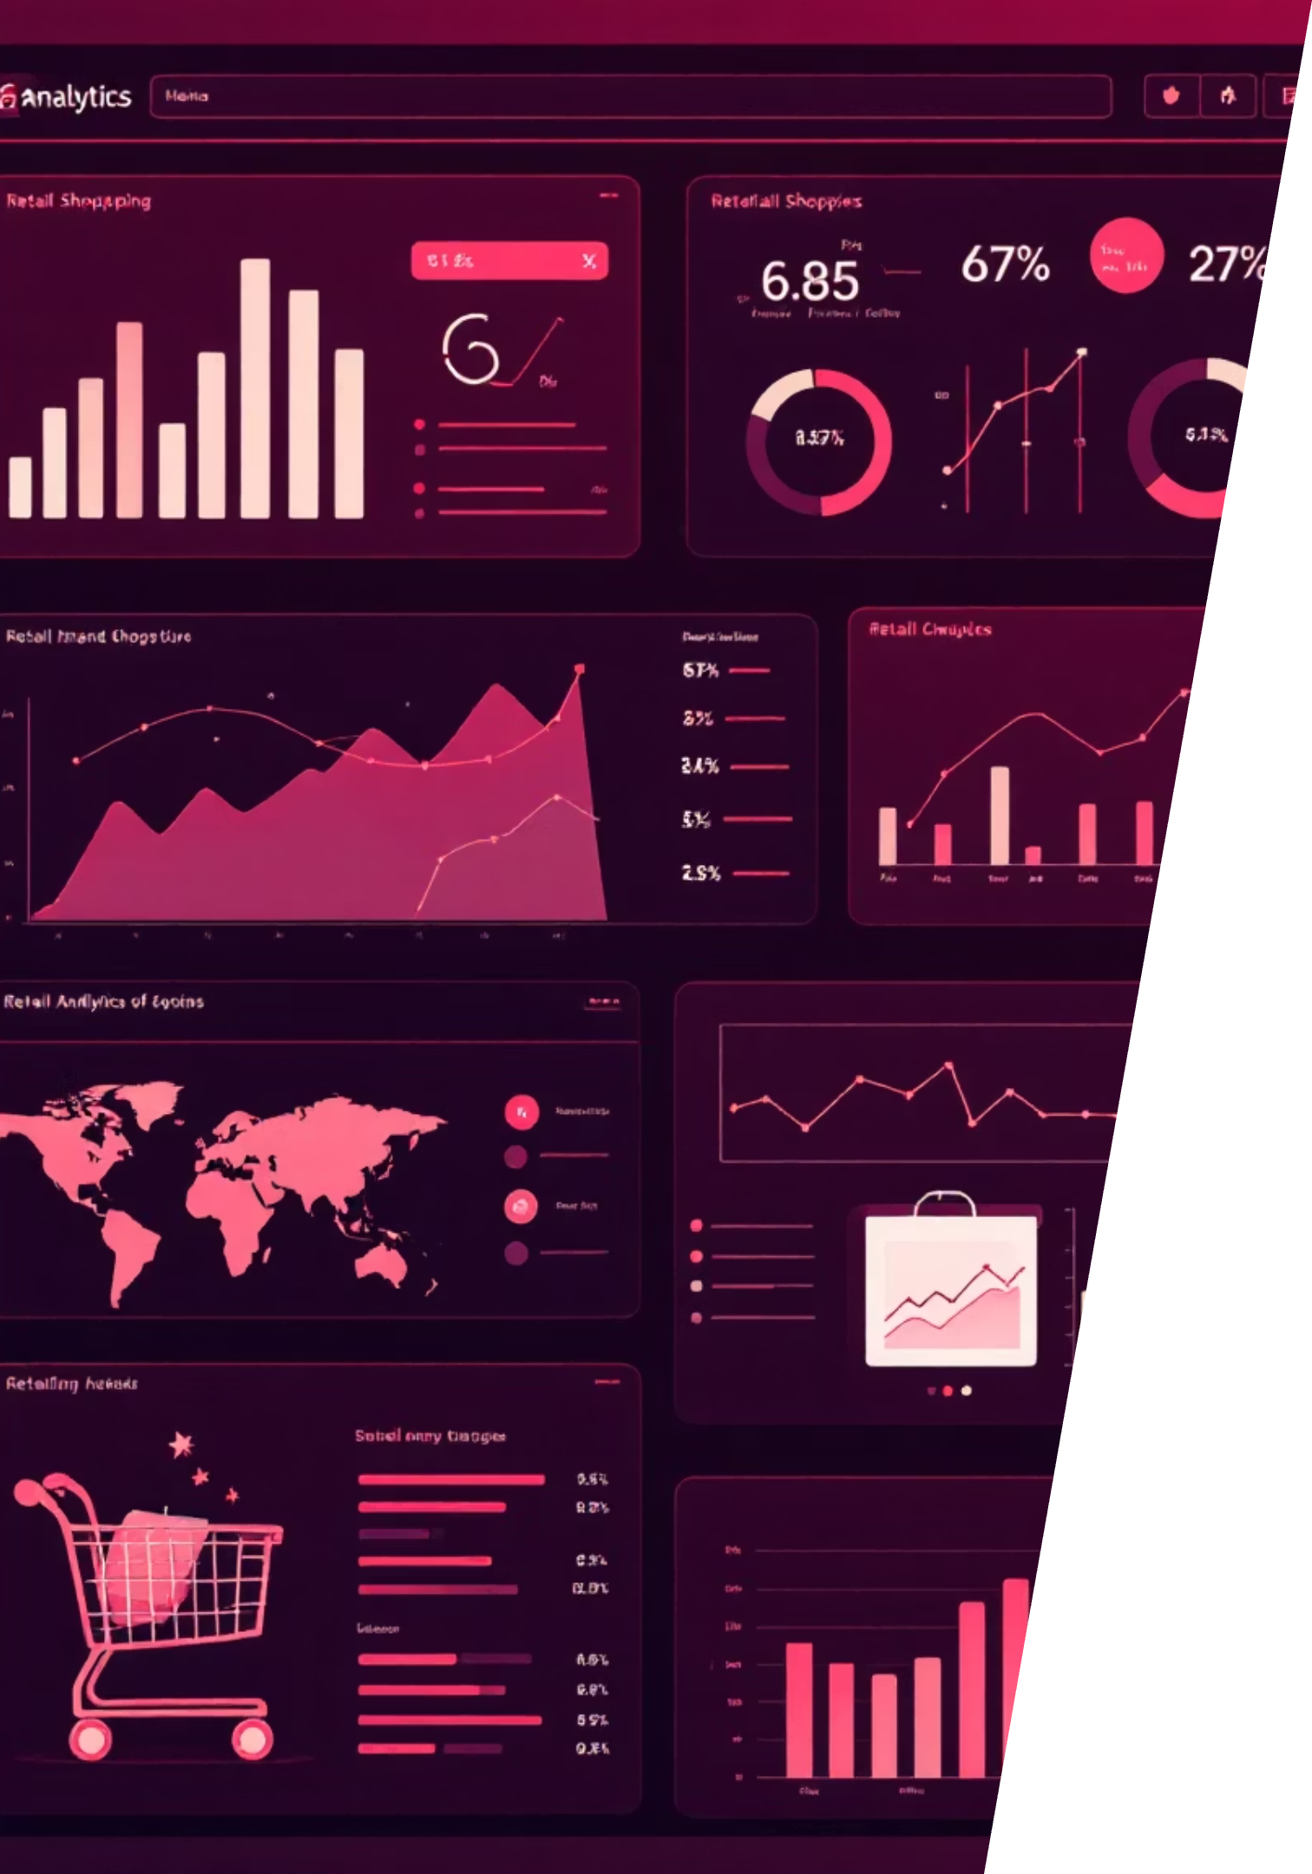
Customer Shopping Behavior Analysis
Uncovering insights from 3,900 purchases to drive strategic decisions

Slide 2
Dataset at a Glance
3,900
18
50
25
Total Purchases
Data Points
Locations
Products
Transactions analyzed across all categories
Features per customer transaction
Geographic coverage across regions
Unique items purchased
Key Features Tracked
Data Quality
Customer demographics & subscription status
37 missing values in Review Rating column - handled through median imputation by category
Purchase details & seasonal patterns
Shopping behavior & review ratings
Shipping preferences & discount usage

Slide 3
Data Preparation Journey
01
02
03
Data Loading & Exploration
Missing Data Handling
Feature Engineering
Imported dataset, checked structure with df.info() and summary statistics
Imputed Review Rating nulls using median by product category
Created age_group bins and purchase_frequency_days columns
04
05
Data Consistency
Database Integration
Standardized columns to snake_case, removed redundant promo_code_used field
Connected to PostgreSQL for advanced SQL analysis

Slide 4
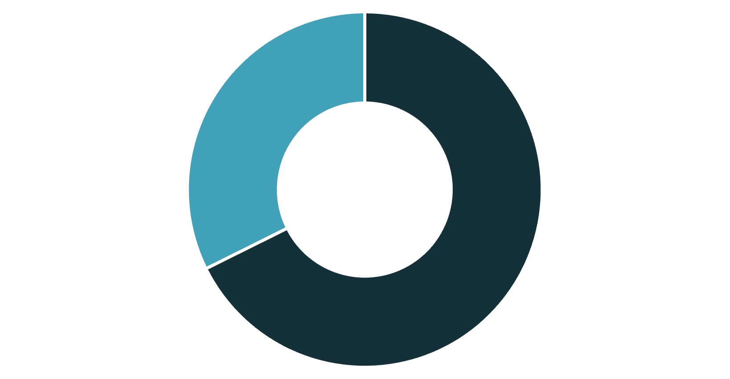
Revenue Insights: Gender & Spending Patterns
Male Customers Drive Revenue
Male shoppers generate $157,890 vs. female shoppers at $75,191
This 68% male revenue share suggests opportunities for targeted campaigns
Male
Female
High-Value Discount Users
839 customers used discounts but spent above average - smart shoppers seeking value

Slide 5


Product Performance Leaders
1
2
3
Gloves
Sandals
Boots
Highest rated at 3.86 average rating
Strong performance at 3.84 rating
Solid customer satisfaction at 3.82
4
5
Hat
Skirt
Consistent quality at 3.80 rating
Rounds out top 5 at 3.78 rating
Insight: Top-rated products span multiple categories - leverage in marketing campaigns

Slide 6
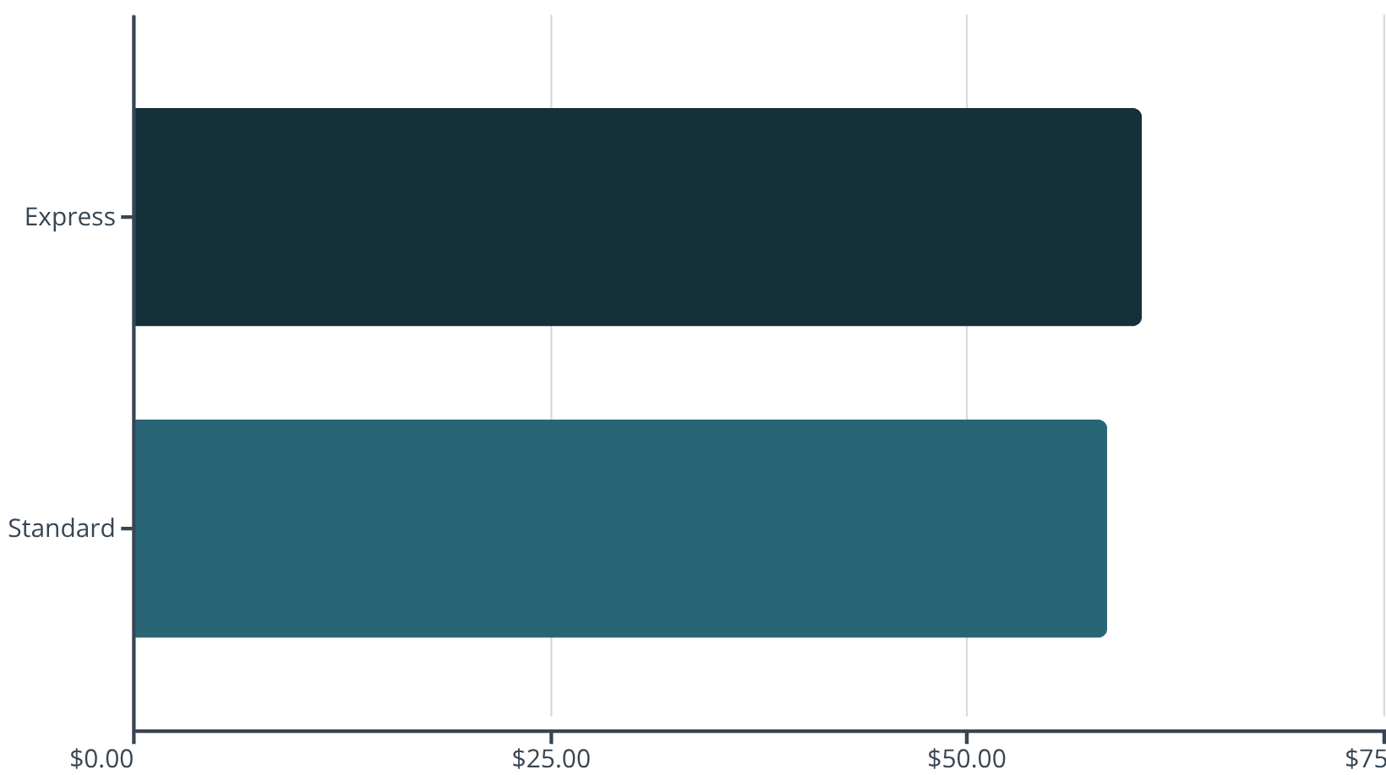
Shipping & Subscription Analysis
Shipping Type Comparison
Subscription Status Impact
Subscribers: 1,053 customers, $59.49 avg spend
Non-subscribers: 2,847 customers, $59.87 avg spend
Total subscriber revenue: $62,645
Total non-subscriber revenue: $170,436
Minimal spending difference - focus on conversion benefits
Express shipping customers spend $2 more on average

Slide 7





Discount Strategy Insights
50%
49.66%
49.07%
Hat
Sneakers
Coat
Highest discount dependency
Nearly half sold with discount
Strong discount reliance
48.17%
47.37%
Sweater
Pants
Frequent promotional item
Rounds out top 5
Critical Finding: These products may be over-reliant on discounts - test pricing strategies to protect margins

Slide 8




Customer Segmentation Breakdown
Returning Customers
701 customers
18% showing repeat behavior - conversion opportunity
Loyal Customers
3,116 customers
80% of customer base - core revenue drivers
New Customers
83 customers
2% fresh acquisition - nurture for retention
Repeat Buyers & Subscription Correlation
Among customers with 5+ purchases:
Opportunity to convert high-frequency buyers into subscribers with targeted benefits
958 are subscribers
2,518 are non-subscribers

Slide 9
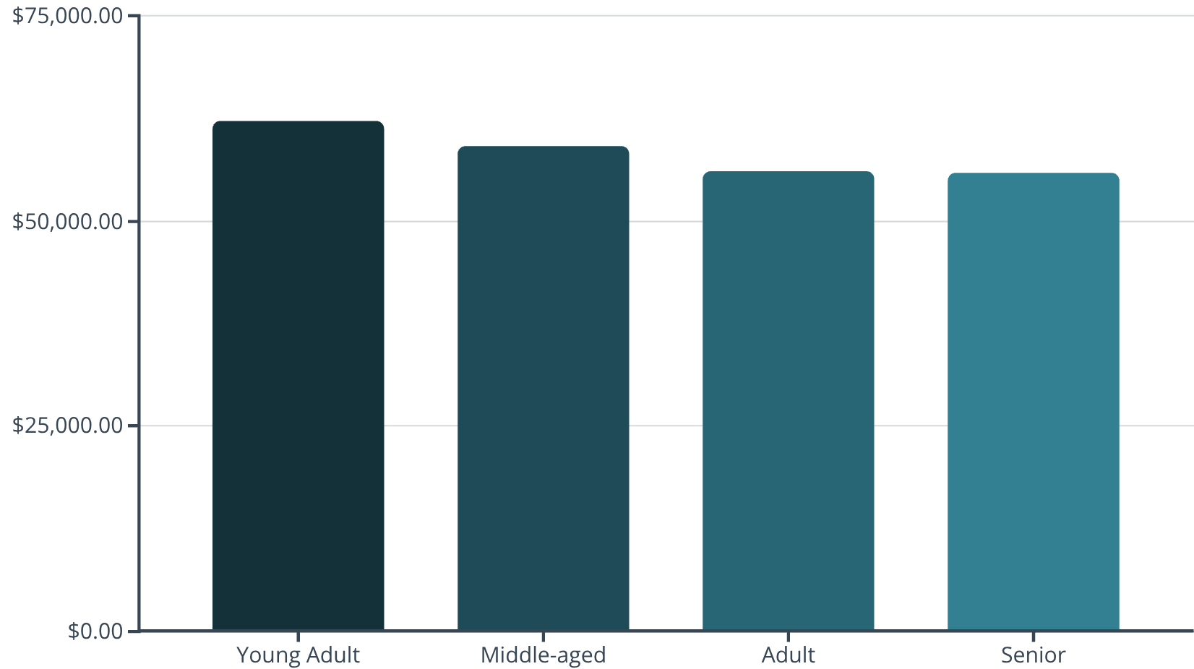
Category Performance Deep Dive
Accessories
Clothing
Footwear
Outerwear
Top sellers: Jewelry (171), Sunglasses (161), Belt (161)
Top sellers: Blouse (171), Pants (171), Shirt (169)
Top sellers: Sandals (160), Shoes (150), Sneakers (145)
Top sellers: Jacket (163), Coat (161)
Revenue by Age Group
Young adults lead revenue generation at $62,143
Relatively balanced across age groups - broad appeal maintained

Slide 10



Strategic Recommendations
Boost Subscriptions
Loyalty Programs
Promote exclusive benefits to convert 2,518 repeat buyers into subscribers
Reward repeat buyers to accelerate movement into "Loyal" segment
Review Discount Policy
Test pricing on high-discount products to protect margins while maintaining volume
Product Positioning
Highlight top-rated items (Gloves, Sandals, Boots) in marketing campaigns
Targeted Marketing
Focus on young adults, male customers, and express shipping users for maximum ROI
Next Steps: Implement these insights through A/B testing and monitor impact on customer lifetime value

