Slide 1
WealthE
Finance Management and Tax Filing System
CSE408 Project

Slide 2
A2 Group-7
2005050 - Nabila Tabassum
2005052 - Tausif Rashid
2005056 - Azmal Karim

Slide 3
Layered Architecture
Separation of concerns among each layer
Scalability and reusability for individual layers
Suitable implementation for a monolithic service

Slide 4
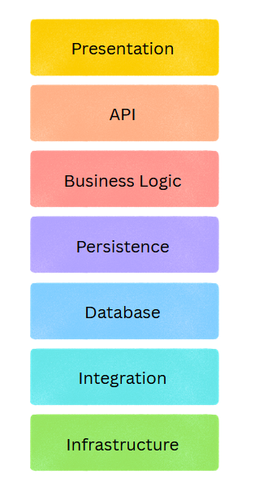
Layer Overview
Presentation Layer
API Layer
Business Logic Layer
Persistence Layer
Database Layer
Integration Layer
Infrastructure Layer

Slide 5
Presentation Layer
Purpose:
Provides user-friendly interface for taxpayers, and administrators to interact with the system.
It ensures accessibility and securely routes user inputs to backend services for accurate processing.

Slide 6
Presentation Layer
Components:
Taxpayer Interface
Personal Information
Income UI
Expense UI
Asset-Liability UI
Investments UI
Tax estimation and Rebate Dashboard
Tax Return UI
Tax History dashboard

Slide 7
Presentation Layer
Components:
Admin Interface
Admin Information UI
Rules Portal
Files and Feedback UI

Slide 8



Presentation Layer
Tech Stack:
Reactjs
Tailwind CSS
Shadcn UI

Slide 9
2. API Layer
Purpose:
Provide connection to Presentation Layer with Business Logic Layer
Enforce authentication

Slide 10
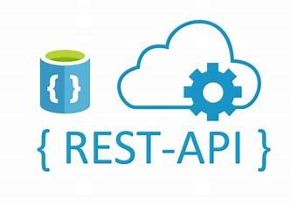

2. API Layer
Components:
CRUD Operations Service
Input Validation
Checking Authentication
Tech :
REST API, JWT auth

Slide 11
3. Business Logic Layer
Purpose:
Implements calculations, and workflows, ensuring accurate processing of data and returns.
Manages tax rules and logic.

Slide 12
3. Business Logic Layer
Components/Services:
User
UserService : User Registration, Login, Handles Personal Information
Financial Service : Manage financial items ie. Income, expenses, assets, investments etc.
TaxService: Calculate and Estimate Tax, View Rebate Plans, Return Submission
PaymentService : Ensure Tax payment validation and coordination with the Integration Layer.
HistoryService : View Previous Tax and Financial History

Slide 13
3. Business Logic Layer
Components/Services:
Admin
Rules Management Service : Manage and Add Different Tax Rules such as, income slabs, Rebate rules, Minimum Tax by Zone etc.
FeedBack Service : Provides service for Viewing and giving feedback to users on Return Submissions

Slide 14


3. Business Logic Layer
Tech Stack:
Spring Boot
Java
Ensures Enterprise Standard

Slide 15
4. Persistence Layer
Purpose:
Abstracts database interactions from the business layer
Provides a clean interface for CRUD operation on database

Slide 16

4. Persistence Layer
Components:
Data Access Objects (DAO) : handle CRUD operations and complex queries
User : PersonalInfo, TaxInfo
Financial Item: Income, Expense, Asset, Liability, Investment
Tax: Tax Return, Payment
Admin : Rules
Tech Stack:
Spring Data JPA (Java Persistence API)

Slide 17
5. Database Layer
Purpose:
Data Storage : Store rules, User information, income/expense records
Data Retrieval : Efficient query of data
Integrity : Ensure data accuracy, consistency
Relations : Support complex relation

Slide 18

5. Database Layer
Components:
Relational Database : Store UserInfo, TaxInfo, Rules etc data in a structured manner.
Tech Stack :
PostgreSQL

Slide 19
6. Integration Layer
Purpose:
Facilitates communication with external services and APIs, such as payment gateways, sms verification, and email notification.

Slide 20


6. Integration Layer
Components:
Payment Gateway Integration: Manages interaction with third-party services eg. bKash . Tech Stack : bkash API(mock)
Email Notification: Send Submission Confirmation, Login Alert. Tech Stack : SendGrid
External API Integration : NBR api (mock) for TIN, NID Number verification
AI features: Google AI studio

Slide 21
7. Infrastructure Layer
Purpose:
Provides foundational support for hosting, scalability and deployment.
Ensure smooth performance in various environments

Slide 22


7. Infrastructure Layer
Component:
Hosting : Runs the application on a scalable cloud service. Tech Stack : Azure VM
Containerization : Ensures consistent deployment across environments. Tech Stack : Docker
Storage and Data Backup : Storage for application and regular backup for Disaster Recovery. Tech Stack : Azure PostgreSQL
Monitoring and Logging : Tracks System performance, identifies bottlenecks, logs critical events. Tech Stack : Azure Monitor + Application Insights

Slide 23
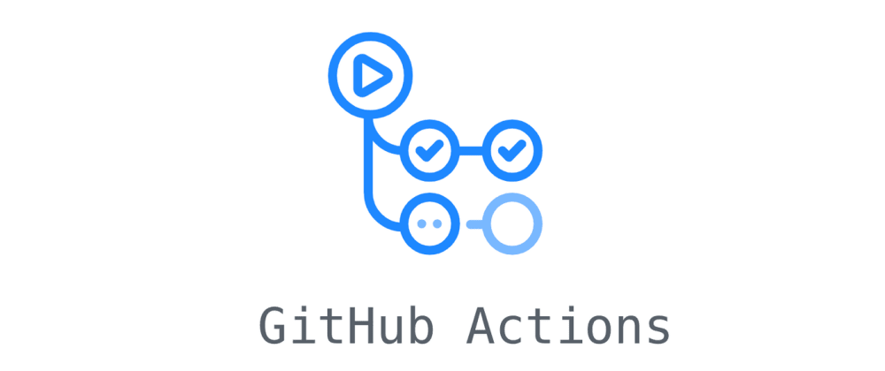

7. Infrastructure Layer
Component:
CI/CD : Automates the build, test, and deployment processes. Tech Stack : Github Actions
Load Balancing : Scale servers dynamically based on traffic . Tech Stack : NGINX, Kubernetes
Security : Ensure https, protection from DDOS attacks
Tech Stack : Cloudflare + Spring config, azure for TLS certificate

Slide 24
Thank You!

