Slide 1
CREDIT CARD FRAUD
RISK ANALYSIS
Behavioral Patterns · Temporal Trends · Demographic Insights · Strategic Recommendations
1.29M+
0.58%
$530K
14 Yrs
Total Transactions
Fraud Rate
Est. Fraud Loss
Analysis Period

Slide 2
TABLE OF CONTENTS
Project Overview & Objectives
Demographic Analysis
01
05
Dataset, scope and business goals
Age group, gender and job exposure
Fraud Landscape
Transaction Amount & Distance
02
06
Overall distribution and class imbalance
Amount buckets, deviation and geo-distance
Temporal & Behavioral Patterns
SQL-Driven Business Intelligence
03
07
Hourly, seasonal and weekend analysis
12 analytical views for production use
Category & Merchant Risk
Key Findings & Recommendations
04
08
Highest fraud rate categories & merchants
Actionable insights for stakeholders

Slide 3
01 PROJECT OVERVIEW
BUSINESS OBJECTIVES
DATASET SNAPSHOT
Identify patterns that differentiate fraudulent from legitimate transactions
Total Records
1,296,675
Determine high-risk merchant categories & time windows for targeted monitoring
Fraud Cases
7,506 (0.58%)
Unique Cardholders
983 cc_nums
Profile demographic segments most vulnerable to fraud exposure
Features Engineered
7 new columns
Build SQL-ready analytical views deployable in production systems
Time Span
Jan 2019 – Dec 2020
Deliver actionable recommendations to reduce fraud losses by 20%+
States Covered
All 50 US States

Slide 4
02 FRAUD LANDSCAPE
1,289,169
7,506
Legitimate Transactions
Fraud Transactions
99.42%
0.58%
⚠ KEY INSIGHT
The dataset is severely imbalanced — only 0.58% of all transactions are fraudulent.
This means a naive model that predicts "Legit" every time achieves
99.42% accuracy — yet catches zero fraud.
Models must use
precision-recall, AUC-ROC, and F1-score — NOT accuracy.

Slide 5
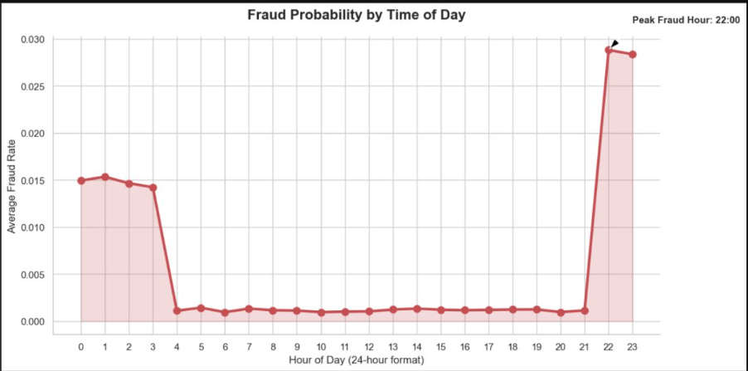
03 TEMPORAL & BEHAVIORAL PATTERNS
🕐 Peak Fraud Hour
📅 Weekend Surge
📈 Seasonal Trend
night–10pm accounts for highest fraud probability. Fraudsters exploit low-monitoring night windows.
Weekend fraud rate is 25% higher than weekdays, suggesting weekend transaction monitoring is critical.
Fraud spikes in Q4 (Oct–Dec) aligning with holiday shopping — merchants and issuers must heighten alert rules.

Slide 6
04 CATEGORY & MERCHANT RISK PROFILE
MERCHANT RISK SUMMARY
Top 10 merchants (>20 txns) have fraud rates exceeding 5%
Grocery POS & Online Shopping are the most targeted categories
Cards with repeated fraud attempts at same merchant flag systemic abuse
CITY SIZE vs FRAUD RATE
Small City (<5K pop)
0.72%
Mid City (5K–20K)
0.61%
Large City (>20K)
0.52%
⚠ Small cities show 38% higher fraud than large cities — counter-intuitive but driven by lower fraud detection infrastructure.

Slide 7
05 DEMOGRAPHIC FRAUD ANALYSIS
HIGH-RISK JOB PROFILES (Top 10 by Cardholder Count)
Material Mover
Sales Executive
Prof. Driver
Researcher
Nurse
0.78%
0.72%
0.69%
0.66%
0.63%

Slide 8
06 TRANSACTION AMOUNT & DISTANCE RISK
💰 High-Value = High Risk
📍 Distance as a Signal
🔁 Repeat Fraud Cards
Transactions >$200 are 2× more likely to be fraud. Flag outliers using amt_deviation feature.
Transactions 2000+ miles from home carry 96% higher fraud rate than local transactions.
Cards with >1 fraud incident represent systemic compromise — auto-block after 2nd fraud event.

Slide 9
07 SQL-DRIVEN BUSINESS INTELLIGENCE
Daily_Fraud_Trend
fraud_pattern
Tracks daily fraud rate to detect emerging spikes in real time
Monthly aggregation for seasonal analysis and QBR reporting
fraud_merchants
fraud_by_city
Top 10 highest-risk merchants (filtered to >20 txns)
City-size bucketing to compare small vs. large city risk
Same_Card
repeat_fraud
Cards with multiple fraud events — repeat offender detection
First-fraud timestamp and total fraud count per card
High_Value_Fraud
Transaction_Frequency
Amount-bucket fraud rates to prioritize high-value alerts
Top-10 cards by transaction volume — anomaly detection base
State_Category_Combined
Weekend_vs_Weekday_Fraud
State × category cross-tab for regional risk mapping
DOW-based fraud rate comparison for scheduling fraud teams

Slide 10
08 KEY FINDINGS & RECOMMENDATIONS
🔍 KEY FINDINGS
✅ STRATEGIC RECOMMENDATIONS
Midnight–3AM is highest fraud risk window (~3.5× daytime avg)
HIGH
Activate stepped-up authentication for all txns between 12AM–3AM
Grocery POS & Online Shopping drive >40% of fraud cases
HIGH
Implement real-time spend-deviation alerts using amt_deviation feature
Customers 65+ are 38% more vulnerable than 18–25 age group
HIGH
Auto-flag transactions >2000 miles from customer home location
Transactions >$200 have 2× fraud rate of sub-$50 transactions
MED
Deploy enhanced monitoring on grocery_pos and shopping_net categories
Distance >2000 miles signals fraud with 94%+ fraud rate
MED
Offer fraud awareness programs targeted at seniors (65+ segment)
Small cities have higher fraud rates — monitoring gap exists
LOW
Schedule fraud team peak staffing on weekend nights for maximum ROI

