Slide 1

LMS
Jason Brunelle, Fabian Hernandez Nieto, Tom Phan, Tristen Stacks, Vi Ta

Slide 2
Team Model
Democratic Team
Each member was encouraged to help find faults in the code. Power struggle didn’t occur since no one was competing for management, as we were all working together for a school project.

Slide 3
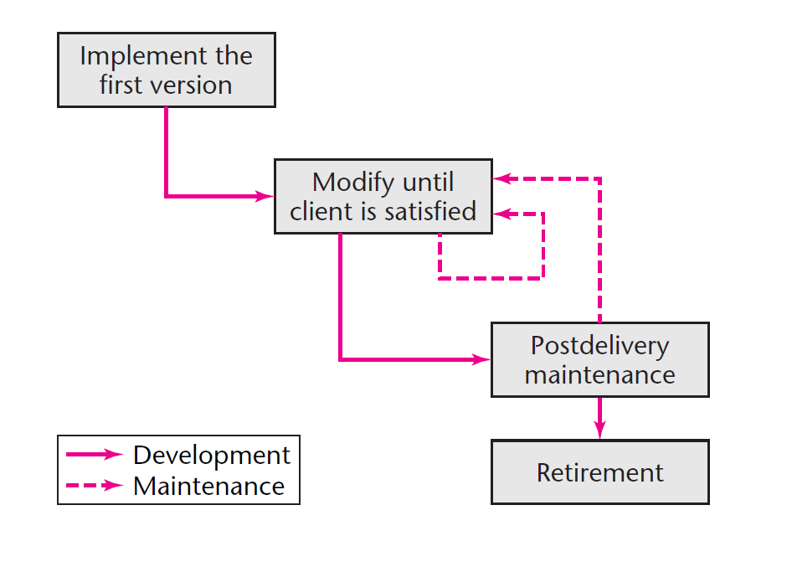
Workflow Model

Slide 4
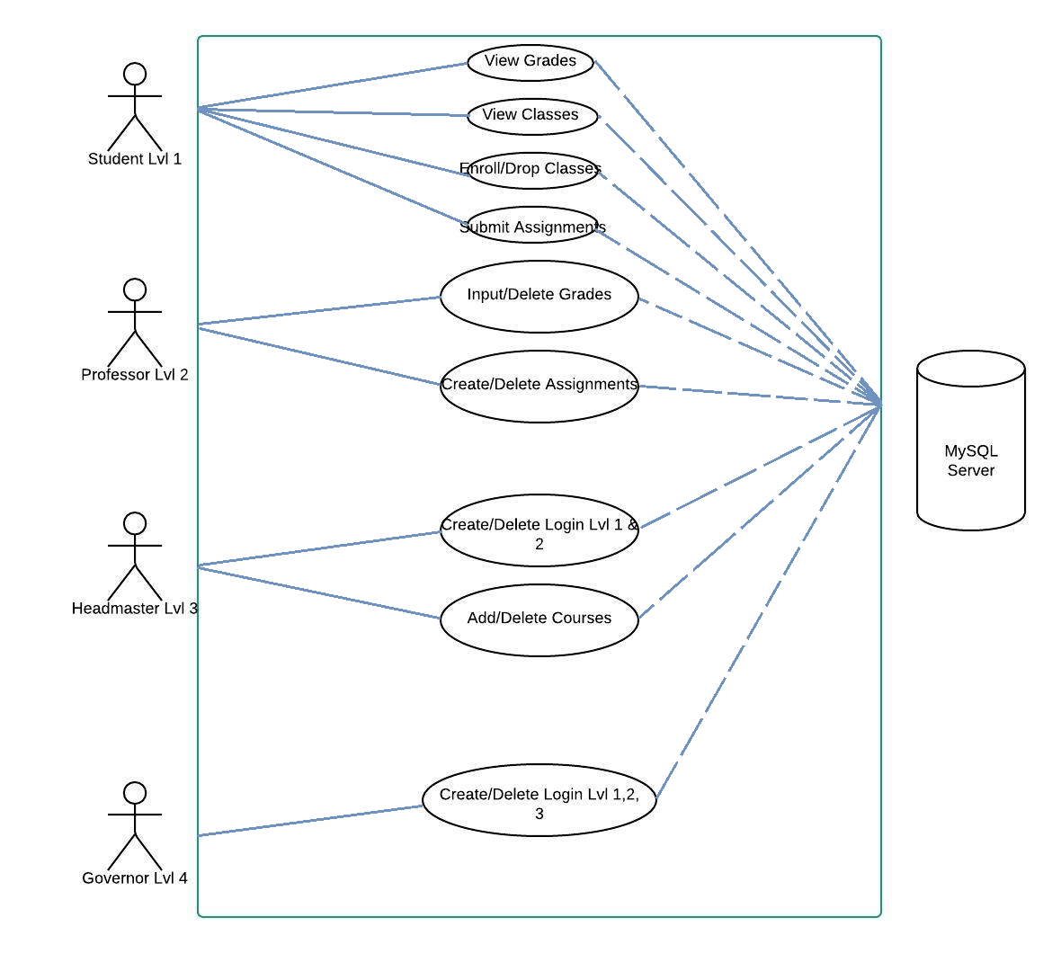
UML

Slide 5
Use Cases
Use Case 1 (Add/Disable Users)
Gilderoy Lockhart did not work out as a professor. Albus Dumbledore logs in and disables Gilderoy Lockhart’s account.
Dumbledore adds a new teacher: Remus Lupin.
Username: Remus.Lupin
Password: RLPass
Role: Professor
System discovers what will be his unique id in the system.
All IDs start with 900 followed by role (teacher is 2) followed by 2 digits which is one more than last entry.
Dumbledore Logs off.

Slide 6
Use Cases cont.
Use Case 2 (Students enroll in classes)
Harry Potter, Hermione Granger, and Ron Weasley all enroll in the following classes:
Charms Year 3
Herbology Year 3
Divination Year 3
Potions Year 3
Transfiguration Year 3
Fred Weasley, George Weasley, and Angelina Johnson all enroll in the following classes:
Charms Year 5
Herbology Year 5
Divination Year 5
Potions Year 5
Transfiguration Year 5
All users log out when they are done.
Note: only classes listed are the ones that match their "year" entry in their enroll-in-courses table.

Slide 7
Use Cases cont.
Use Case 3 (Create, Turn-in, and Grade Assignment(s) and View Grades)
Severus Snape assigns the following assignment to the 5th year potions class:
1 roll of parchment on the properties of moonstones. Total point 10. Due in 2 days.
Snape logs out.
Angelina logs in and sees the assignment is due. She turns it in immediately.
Fred Weasley logs in and sees the assignment is due but turns it in at the last minute.
George Weasley fails to turn in the assignment.
Seversus Snape logs in and records their grades: Angelina: 6, Fred: 3, George: 0
Angelina, Fred and George log and view their grades.
All users log off.

Slide 8
CRC Cards
CLASS
User class
RESPONSIBILITY
Access Username Access Password Privilege (if student, professor, headmaster, or governor)
COLLABORATION
Login class
CLASS
Login class
RESPONSIBILITY
Verify input (w/i login class) Check privilege (if student, professor, headmaster, or governor) Load home page Dashboard class
COLLABORATION
Dashboard class
CLASS
Student class
RESPONSIBILITY
Display name Display ID Enroll/Drop courses Exam scores for each course Calculate GPA View GPA Turn in assignments Log out (go to login panel)
COLLABORATION
Dashboard class Student class
CLASS
Dashboard class
RESPONSIBILITY
Display name of user Modify buttons on (if role < 4) send request to student class Modify buttons off (if role == 4) Display student info. (if headmaster) Display assignments/courses (if role >= 2) Edit Assignments (If professor) Edit Courses (if headmaster) Add/Remove Users (if governor) Log out (go to login form)
COLLABORATION
Login class Student class

Slide 9
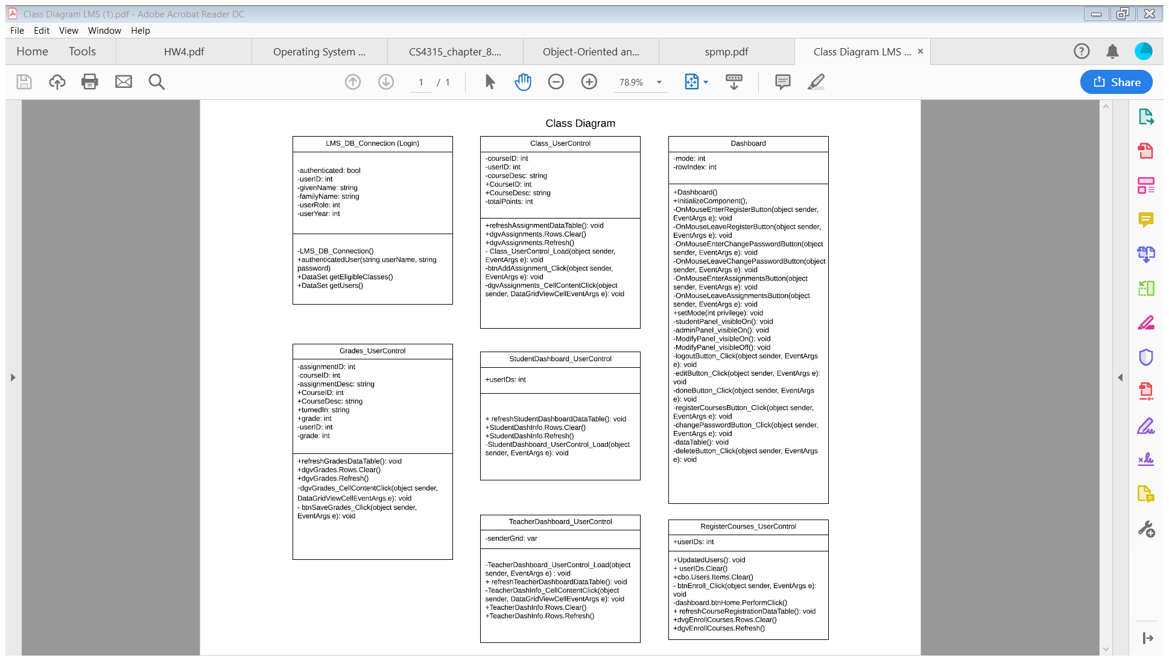
Class Diagram

Slide 10
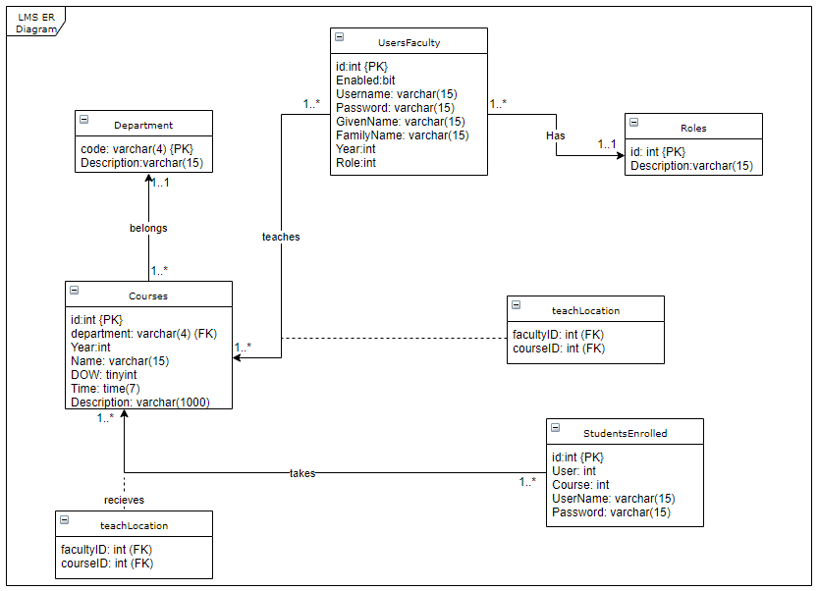

Slide 11
Users
Field Name | id* | Enabled | userName | Password | Given Name | Family Name | Year | Role
Data Type | int | bit | varchar(15) | varchar(15) | varchar(15) | varchar(15) | int | int
 | 90010 | 1 | Lucius.Malfoy | LMPass | Lucius | Malfoy |  | 1
 | 90020 | 1 | Albus.Dumbledore | ADPass | Albus | Dumbledore |  | 2
 | 90030 | 1 | Severus.Snape | SSPass | Severus | Snape |  | 3
 | 90031 | 1 | Pomona.Sprout | PSPass | Pomona | Sprout |  | 3
 | 90032 | 1 | Minerva.McGonagall | MMPass | Minerva | McGonagall |  | 3
 | 90033 | 1 | Gilderoy.Lockhart | GLPass | Filius | Flitwick |  | 3
 | 90034 | 1 | Sybill.Trelawney | STPass | Sybill | Trelawney |  | 3
 | 90040 | 1 | Harry.Potter | HPPass | Harry | Potter | 3 | 4
 | 90041 | 1 | Hermione.Granger | HGPass | Hermione | Granger | 3 | 4
 | 90042 | 1 | Ron.Weasley | RWPass | Ronald | Weasley | 3 | 4
 | 90043 | 1 | Fred.Weasley | FWPass | Fred | Weasley | 5 | 4
 | 90044 | 1 | George.Weasley | GWPass | George | Weasley | 5 | 4
 | 90045 | 1 | Angelina.Johnson | AJPass | Angelina | Johnson | 5 | 4
Roles
Field Name | id* | Desc
Data Type | int | varchar(15)
 | 1 | Governer
 | 2 | Headmaster/Headmistress
 | 3 | Teacher
 | 4 | Student
Departments
Field Name | Code* | Desc
Data Type | varchar(4) | varchar(15)
 | HERB | Herbology
 | POT | Potions
 | CHAR | Charms
 | TRAN | Transfiguration
 | DIV | Divination

Slide 12
Test Cases
Test | Expectation | Pass/Fail
Login (as governor, headmaster, professor, and student) | Display appropriate dashboard content if successful login. If login is unsuccessful, message is shown. | Pass
Enroll Courses | Student can select which courses to enroll in and add them to registered courses. Will update info in database. | Pass
Drop Courses | Student can deselect enrolled courses and update the info to remove course from student’s registered courses. | Pass
Create Assignments | Professor can create assignments and assign to course(s). | Pass
Delete Assignments | Professor can delete assignments and remove associated grades if turned in already. | Pass
GPA calculation | GPA is calculated for each student with given grades and can be viewed by students. Cannot be edited by lv 1,2,or 3 users. | Fail

Slide 13
Test Cases cont.
Test | Expectation | Pass/Fail
Add/Disable Users | Governor can add and disable users (student, professor, or headmaster). New users can login and disabled users can no longer login. | Pass
Grade Assignments | Professor can grade assignments for students enrolled in their courses. | Pass
View Grades | Students can view assignment grades. Cannot modify grades. | Pass
View Assignments | Students can view assignments for enrolled classes. | Pass
Submit Assignments | Students can submit assignments for a given coursework. | Pass
Logout | User returns to login screen and is required to login again to use system. Login flag is off. | Pass

Slide 14
Github
https://github.com/Tavi66/3321_LMS

