Slide 1
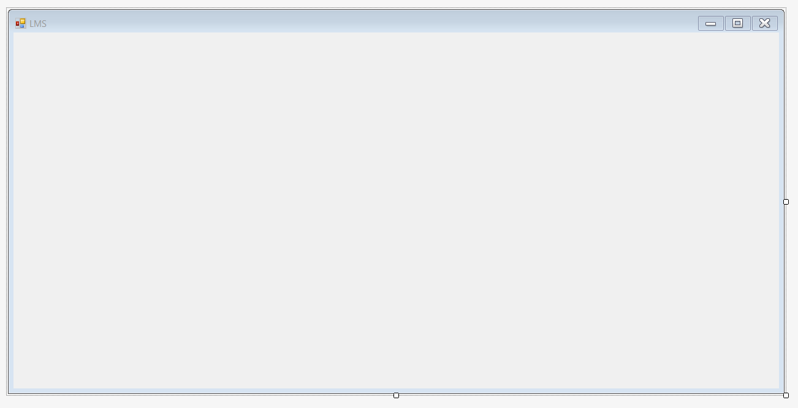
Username
Password
LOGIN

Slide 2
Invalid username/ or password.
Username
Password
LOGIN

Slide 3
Password is required.
Username
XXXXXX
Password
LOGIN

Slide 4
Username is required.
Username
Password
******
LOGIN

Slide 5
Grade
Score <Type> [Course]
Expand/ collapse info. (tree-view control)
85 <Exam> [Software Engineering]
actionPanel
USERNAME
Student Name | ID | GPA | Courses | Grades
Dashboard
+
xxxxxxxxxxxxxxx | ######## | 3.50 | … | …
EDIT
Courses
+
EDIT
Students
+
Are you sure you want to delete entries?
EDIT
…
+
EDIT
CANCEL
DELETE
EDIT
+
+
EDIT
+
EDIT
+
EDIT
LOGOUT
SAVE
Custom prompt box (new form)

Slide 6
ADMIN MODE
USERNAME
Student Name | ID | GPA | Courses | Grades
Dashboard
+
xxxxxxxxxxxxxxx | ######## | 3.50 | … | …
EDIT
Courses
+
EDIT
Students
+
EDIT
…
+
EDIT
+
EDIT
+
EDIT
+
EDIT
+
EDIT
LOGOUT
SAVE

Slide 7
ADMIN MODE
USERNAME
Course | Semester | Status | Enrolled
Dashboard
+
… | 08/2018-12/2018 | Active | ##
EDIT
Courses
+
EDIT
Students
+
EDIT
…
+
EDIT
+
EDIT
+
EDIT
+
EDIT
+
EDIT
LOGOUT
SAVE

Slide 8
ADMIN MODE
USERNAME
Course | Semester | Status | Enrolled
Dashboard
+
… | 08/2018-12/2018 | Active | ##
EDIT
Courses
+
EDIT
Students
+
EDIT
…
+
EDIT
+
EDIT
+
EDIT
+
EDIT
+
EDIT
LOGOUT
SAVE

Slide 9
ADMIN MODE
USERNAME
Course | Semester | Status | Enrolled
Dashboard
… | 08/2018-12/2018 | Active | ##
Assignments | Due Date
... | 10/13/2018
... | 10/14/2018
Courses
-
EDIT
Students
…
+
EDIT
+
EDIT
+
EDIT
+
EDIT
+
EDIT
LOGOUT
SAVE

Slide 10
USER MODE
USERNAME
Student Name | ID | GPA | Courses | Grades
Dashboard
+
… | ######## | 3.50 | … | …
Courses
+
Students
+
…
+
+
+
+
+
LOGOUT

Slide 11
USER MODE
USERNAME
Course | Semester | Status | Enrolled
Dashboard
+
… | 08/2018-12/2018 | Active | ##
Courses
+
Students
+
…
+
+
+
+
+
LOGOUT

Slide 12
USER MODE
USERNAME
Course | Semester | Status | Enrolled
Dashboard
… | 08/2018-12/2018 | Active | ##
Assignments | Due Date
... | 10/13/2018
... | 10/14/2018
Courses
-
Students
…
+
+
+
+
+
LOGOUT

