Slide 1
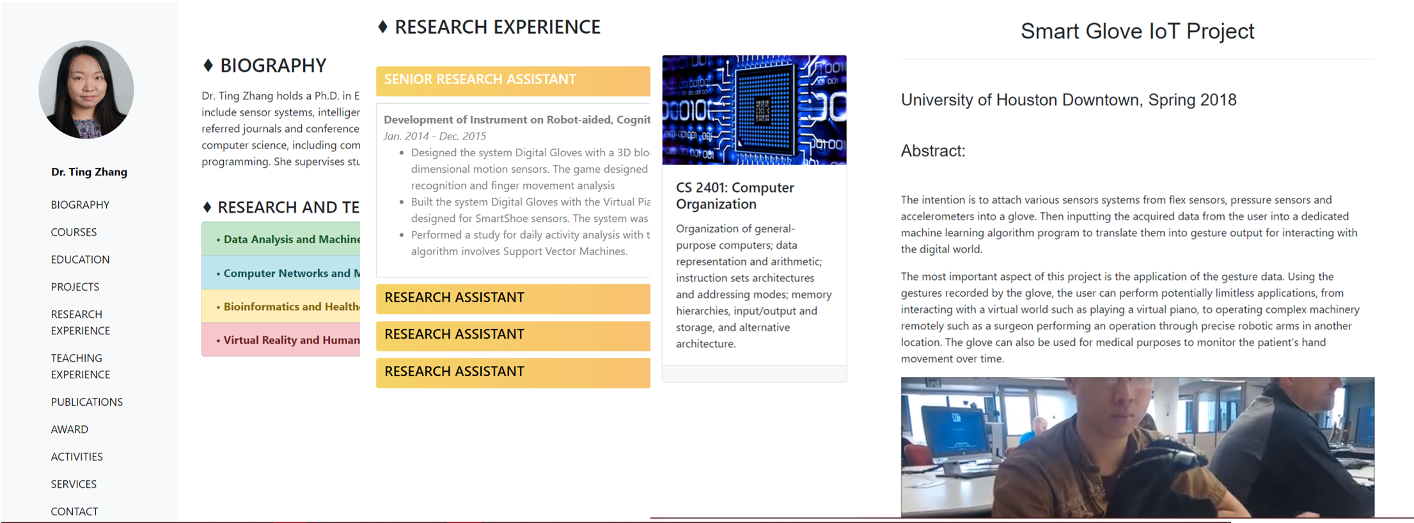
FACULTY PAGE
Nicole Britt, Brian Case, Nguyen Phan, Sang Tran, Vi Ta

Slide 2
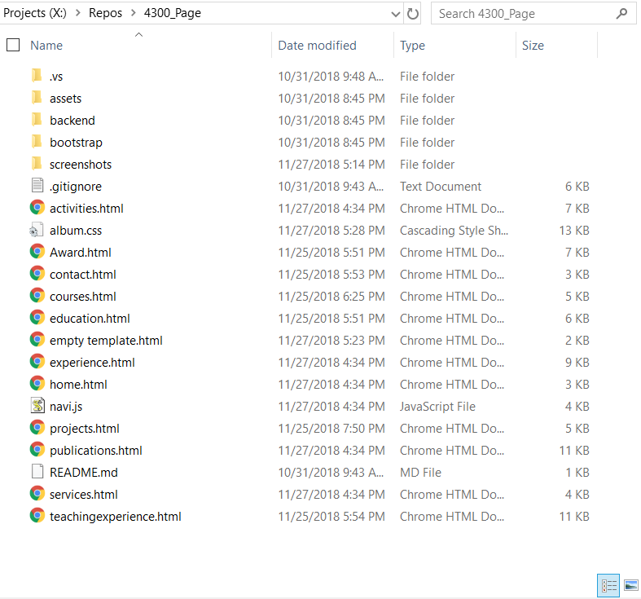
Files
Images in: assets/img
CSS: album.css
navi.js: JavaScript used to handle navigation bar
Each section has an individual HTML page
CSS is external and embedded
Bootstrap files within bootstrap folder
Sample screenshots of styles for certain classes/ids in screenshot folder

Slide 3
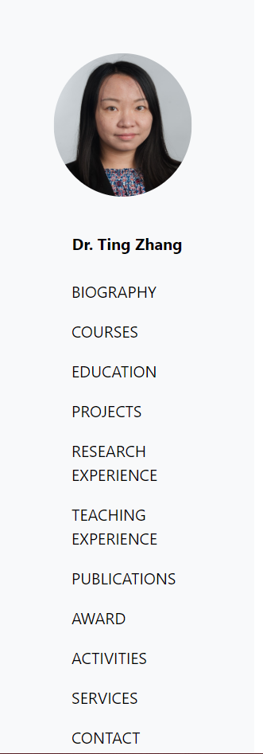
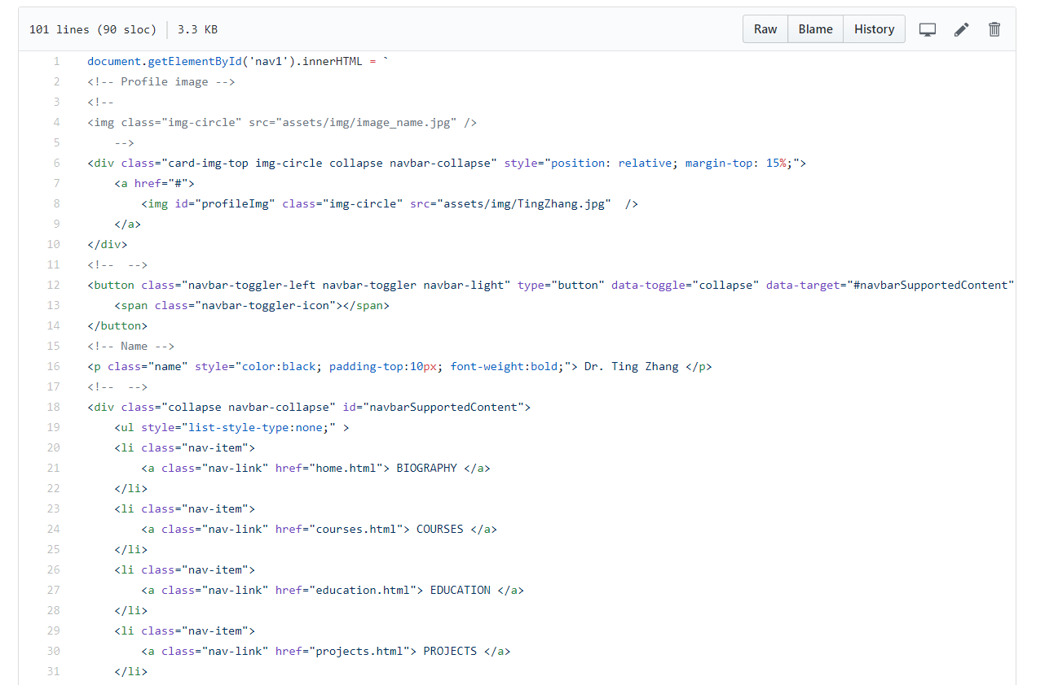
Navigation Bar

Slide 4
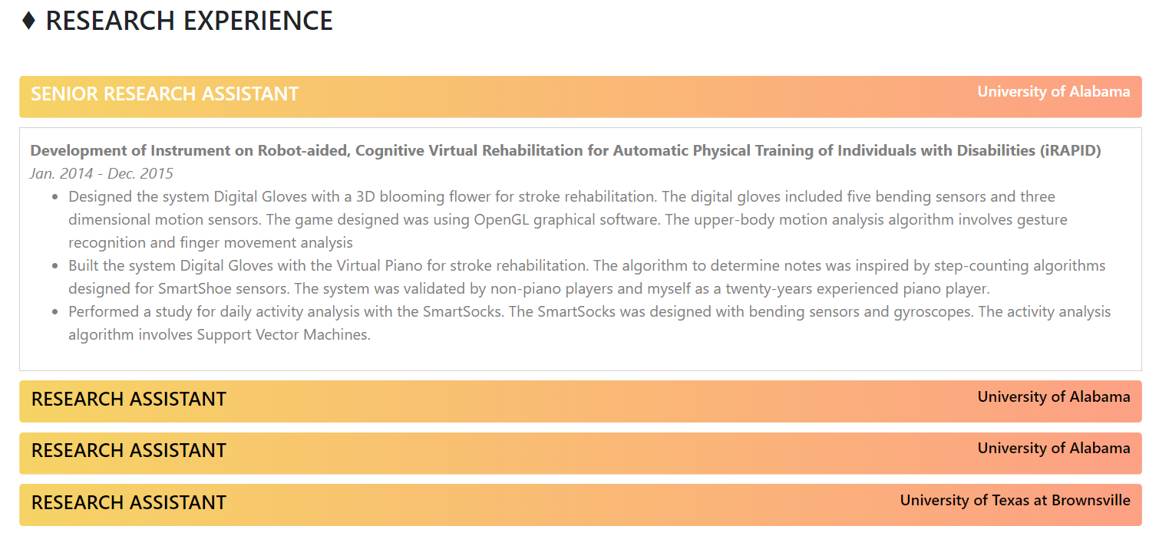

Slide 5
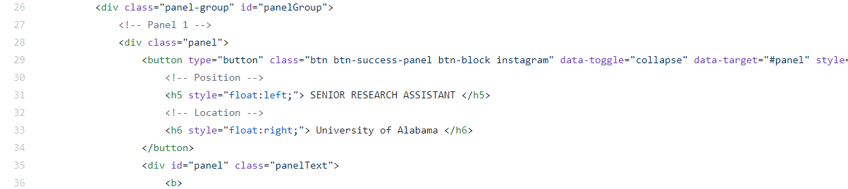
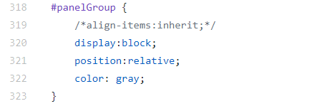
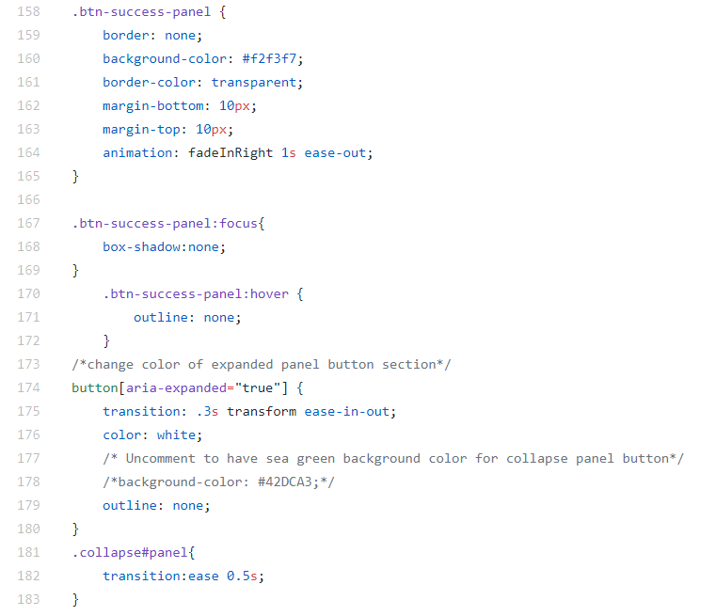
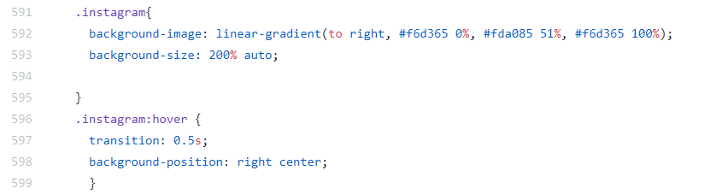
Can change color of research experience panels by changing in album.css:
.instagram background-image
Or
Remove instagram class from panel button and edit
button[aria-expanded=“true”] background-color

