Slide 1

Detecting Vulnerabilities In C/C++ Source Code Using Machine Learning Approaches Sorin-Octavian Furdui Master of Machine Learning Politehnica University of Timişoara Timişoara, Timiş, Romania sorin.furdui@student.upt.ro

Slide 2
Introduction
Problem statement
Paper structure

Slide 3

Paper structure
Introduction
Literature Review
Static and dynamic code analysis techniques
Machine learning in software security
Dataset
Synthetic dataset
Real-world functions dataset
EDA
Methodology
Feature engineering
Classical ML techniques
DL techniques
Experiments
Classical ML
CNN + LSTM
GNN +LSTM
Conclusion

Slide 4

Literature review Static and dynamic code analysis techniques
Static analyzers inspect the code without executing it, aiming to find potential vulnerabilities through code pattern recognition and logic inference.
Clang
SonarQube
Dynamic analysis, on the other hand, involves executing the code and monitoring its behavior under various inputs.
Valgrind
AdressSanitizer

Slide 5
Literature Review Machine learning in software security
Simple ML models
RF
DT
kNN
Deep learning:
RNN
GNN
CNN
Different types of datasets
Synthetic data
Real-world projects

Slide 6
Dataset Synthetic dataset
Juliet SATE IV test suite - It consists of thousands of small, isolated C/C++ code samples, each annotated with specific vulnerability types based on the CWE system.
buffer overflows
memory leaks
null pointer dereferences
integer overflows

Slide 7
Dataset Real-world functions dataset
2020
BigVul
2023
DiverseVul
2024
MegaVul

Slide 8
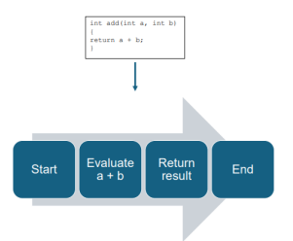
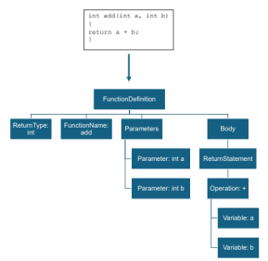
Methodology
Control Flow Graph
Abstract Syntax Tree

Slide 9
Methodology ML Models
Decision Trees
Random Forests
Logistic Regression
kNN
Gradient Boosting
AdaBoost

Slide 10
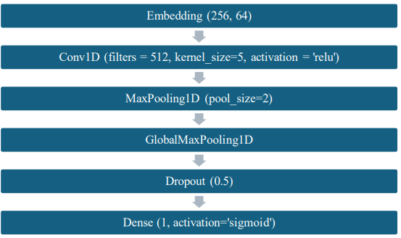
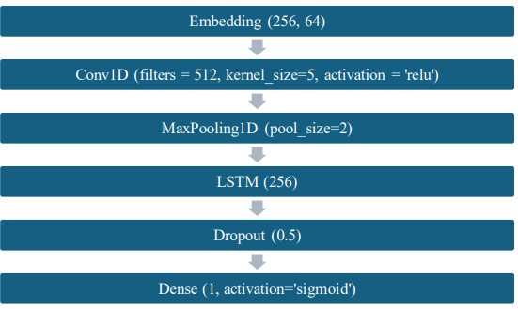
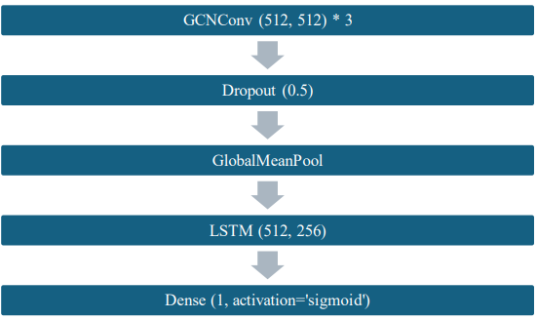
Methodology DL models
CNN
CNN + LSTM
GNN + LSTM

Slide 11
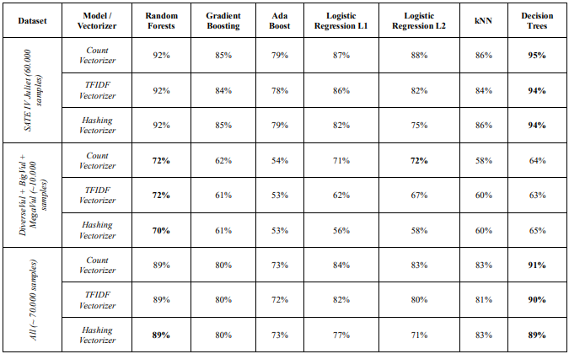
Experiments ML Models

Slide 12
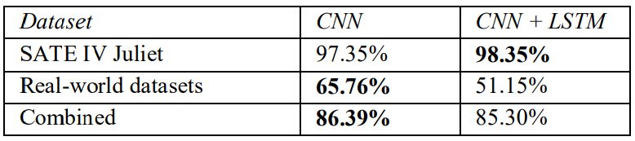
Experiments CNN models

Slide 13
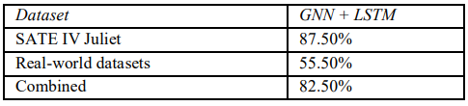
Experiments GNN models

Slide 14
Conclusions
Classical ML (DT, RF):
Fast training, easier deployment
Good for explainability-focused applications
Deep Learning (CNNs, LSTMs on ASTs):
Capture complex patterns
Higher accuracy on real-world data
High computational cost, less interpretable
GNNs on CFGs:
Promising for dynamic behavior modeling

Slide 15
Thank you for your attention!

