Slide 1
COMPUTER NETWORK
5G/6G Heterogeneous Networks (HetNets) — ML-driven Performance Improvements
PRESENTATION

Slide 2
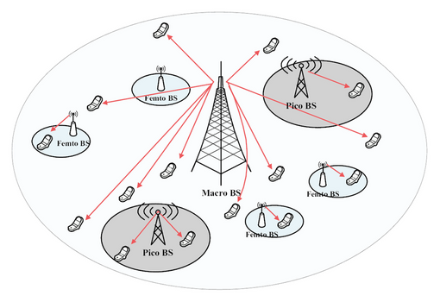
Introduction to HetNets
What are Heterogeneous Networks (HetNets)?
Integration of multiple cell types — macro, micro, pico, femto cells
Combine multiple Radio Access Technologies (RATs) such as LTE, Wi-Fi, mmWave, and 6G sub-THz links
Aim: To enhance coverage, capacity, and data rates while minimizing interference
Enable seamless connectivity for diverse user environments (urban, rural, indoor)

Slide 3
Challenges in 5G/6G Networks
Key Challenges in Next-Gen Networks
Massive device connectivity in 5G and 6G networks introduces a major challenge as billions of IoT and Machine-to-Machine (M2M) devices generate enormous volumes of data. This surge in connected devices leads to spectrum scarcity, since available frequency bands are limited and must be efficiently shared among users. Another issue is interference management, as overlapping small and macro cells can cause signal distortion and degrade network performance. Mobility and handover also become complex when users move rapidly between different cells, often resulting in connection delays or data loss. Additionally, real-time optimization of such dense and dynamic networks is difficult, making manual configuration nearly impossible. Finally, maintaining energy efficiency remains a critical concern, as small-cell networks consume significant power to ensure continuous connectivity across diverse environments.

Slide 4
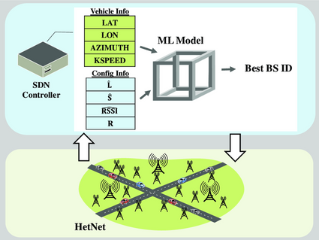
Role of Machine Learning in HetNets
Why Machine Learning?
Machine Learning enables self-learning and adaptive networks, often referred to as Self-Organizing Networks (SON), which can automatically manage and optimize their operations. It processes vast amounts of network data, including traffic patterns, signal strength, and Quality of Service (QoS) metrics, to make accurate predictions and informed decisions. Through this data-driven approach, ML provides automated decision-making for resource allocation and interference management, reducing the need for manual tuning and improving network scalability. Furthermore, it helps networks predict and prevent potential failures before they affect users. For example, predictive ML models can anticipate congestion and proactively shift users to less-loaded cells, maintaining consistent network quality and performance.

Slide 5
ML-driven Performance Improvements
How ML Enhances HetNet Performance
Machine Learning significantly enhances the performance of heterogeneous networks through various intelligent functions. It enables accurate traffic prediction by forecasting user load patterns and dynamically allocating network resources to maintain smooth service. Handover optimization allows the network to predict the best time and target cell for switching, minimizing call drops and delays during user movement. Interference reduction is achieved as ML algorithms learn interference patterns and automatically adjust transmission power to maintain signal quality. Load balancing ensures that users are distributed efficiently across multiple base stations, preventing congestion in heavily loaded areas. Additionally, ML contributes to energy saving by intelligently deactivating idle base stations during periods of low demand, thereby improving energy efficiency. It also supports automatic fault detection by identifying and correcting network anomalies in real time, ensuring stable and reliable network performance.

Slide 6
ML Techniques Used in HetNets
Machine Learning Techniques Applied
Different Machine Learning techniques play distinct roles in improving the performance of heterogeneous networks. Supervised learning is used to predict network Quality of Service (QoS), user demand, and link quality by training models on labeled network data. Unsupervised learning, on the other hand, helps in clustering users based on patterns such as mobility or location, which supports efficient load balancing and service optimization. Reinforcement learning (RL) enables the network to learn the best possible actions—such as making accurate handover decisions—through continuous interaction and feedback in the form of rewards. Deep learning models are widely applied for complex tasks like channel estimation, interference classification, and predicting user mobility patterns, leveraging neural networks to extract deep insights from large datasets. Additionally, federated learning introduces a decentralized approach that allows base stations to train models collaboratively without sharing raw data, thus preserving user privacy while enhancing overall network intelligence.

Slide 7
Benefits and Performance Gains
Benefits of ML-driven HetNets
Machine Learning-driven heterogeneous networks offer several key benefits that significantly enhance performance and reliability. They provide higher throughput through smarter and more efficient resource utilization, resulting in improved overall data rates. Reduced latency is achieved by enabling faster handovers and more efficient routing, which ensures smooth connectivity even in high-mobility scenarios. The Quality of Experience (QoE) for users also improves, supporting seamless activities like streaming, gaming, and AR/VR applications without interruptions. Additionally, energy efficiency is enhanced through intelligent sleep scheduling and reduced power wastage, helping networks operate sustainably. ML-powered systems also exhibit self-healing capabilities by automatically detecting and correcting faults, minimizing downtime and maintenance efforts. Moreover, these networks are highly scalable, capable of adapting to millions of connected devices and users simultaneously. For example, a reinforcement learning-based HetNet system can reduce handover failures by up to 40% compared to traditional rule-based methods, demonstrating the substantial performance gains enabled by ML integration.

Slide 8
Future Scope & Conclusion
Future of ML in 6G HetNets
The future of 6G networks will be deeply intertwined with Artificial Intelligence, as AI will be integrated natively into the core network architecture to enable intelligent, autonomous operations. One major advancement will be the rise of edge intelligence, where Machine Learning models are deployed directly at the network edge to provide faster response times and real-time decision-making. Another promising concept is the use of digital twins—virtual replicas of network environments—that allow simulation, testing, and optimization without affecting live systems. Additionally, quantum machine learning is expected to enhance predictive accuracy, processing speed, and security through the power of quantum computing. Future networks will also be continuously self-evolving, capable of adapting to new devices, user behaviors, and environmental changes without human intervention. In conclusion, Machine Learning will transform heterogeneous networks into fully autonomous, energy-efficient, and user-centric systems, paving the way for a truly intelligent and adaptive 6G communication era.

