Slide 1
B.Tech. Artificial Intelligence & Data Science
Final Presentation (Sem VII)
A.Y. 2026–2027
Project Title: VERITAS: Multi-Agent Deepfake Detection and Reasoning
Presented by: Harshil Kamde, A024
Siddhant Patil, A045
Tavis Fernandes, A117
Under the guidance of: Dr. Preeti Agarwal, Faculty Mentor, STME
Notes:
Introduce the team, the mentor and the project title.

Slide 2
Roadmap
Introduction and motivation
Problem statement and objectives
Literature survey
Proposed system and architecture
Detectors, fusion and verdict flow
Implementation and interface
Results and robustness analysis
Conclusion and future scope
References
Notes:
Outline of the talk.

Slide 3
INTRODUCTION AND MOTIVATION
Deepfakes: faces or voices synthesised or altered by GANs, diffusion, face-swap, lip-sync and voice-cloning models [1]-[4]
One forgery can alter the face, the voice or both; a single-modality detector misses the other half
Media shared online is re-encoded, so detectors must survive compression, rescaling and blur [5]
Goal: one tool that checks all available evidence, explains it, and abstains when unsure
Spatial evidence
Blending seams and texture artefacts in a single frame
Temporal evidence
Flicker and unnatural motion across frames
.
Audio evidence
Synthesis and voice-cloning artefacts in the spectrum
Capstone Project Review, AY 26-27, STME, NMIMS Navi Mumbai
3
Notes:
Explain what a deepfake is and why one forgery can touch the face, the voice or both. The three cards are the three kinds of evidence VERITAS checks. Stress that uploaded media is almost always re-encoded, which is why robustness matters later in the talk.

Slide 4
PROBLEM STATEMENT AND OBJECTIVES
Design and implement a multimodal system that analyses spatial, temporal and audio evidence in images, videos and audio, fuses it into one verdict with a manipulation type, abstains when evidence is insufficient, explains each detector, and is evaluated with a leakage-controlled protocol.
01
Spatial detector for face frames
02
Temporal detector for face videos
03
Audio detector for speech
04
Fusion with verdict, type and abstention
05
Streaming web console and JSON report
06
Identity-disjoint training and robustness tests
Capstone Project Review, AY 26-27, STME, NMIMS Navi Mumbai
4
Notes:
Read the problem statement once, then walk through the six objectives. Point out objective 6: every result in this talk says which data split it came from.

Slide 5
LITERATURE SURVEY
Work | Modality | Key idea | Limitation for our goal
MesoNet [9] | Frame | Compact CNN on mesoscopic features | Two manipulation types only
FaceForensics++ [5] | Frame | XceptionNet on face crops | Accuracy drops under strong compression
Face X-ray [10] | Frame | Detects the blending boundary | Assumes a blending step
LipForensics [12] | Video | Lip-reading pre-training | Visual only
RawNet2 [14], AASIST [15] | Audio | Raw-waveform / graph-attention anti-spoofing | Audio only
Emotions [25], MDS [26] | Audio + video | Joint audio-visual consistency | Less clear which modality was faked
VERITAS | Image, video, audio | Per-modality detectors + transparent fusion with abstention | Fixed rule; temporal not robust
Gap: single-modality detectors, binary answers without abstention, and robustness to re-encoding rarely measured when choosing a deployed model.
Capstone Project Review, AY 26-27, STME, NMIMS Navi Mumbai
5
Notes:
This is a qualitative comparison; the cited works used different datasets, so their numbers are not comparable with ours. The gap: single-modality detectors, binary decisions without abstention, and little measured robustness to re-encoding.

Slide 6
PROPOSED SYSTEM ARCHITECTURE
Browser: React 19 + Vite console - upload, live progress, verdict, JSON report
POST /api/analyse/stream
FastAPI backend: 50 MB limit, routing by file type, YuNet face crop, ffmpeg audio → 16 kHz mono
Spatial
EfficientNet-B0
224×224 face crop
Temporal
R3D-18
16 frames, 112×112
Audio
EfficientNet-B0
128-band log-mel, 3 s
Context
Explanation only
never votes
corrected_fixed fusion: P_visual = (0.40 sp + 0.30 te) / 0.70 P_fake = 1 − (1 − P_visual)(1 − P_audio)
NDJSON stream: 4 agent results → final verdict (score, verdict, manipulation type) → done
Capstone Project Review, AY 26-27, STME, NMIMS Navi Mumbai
6
Notes:
Follow one upload top to bottom. The backend routes by file type, runs only the detectors that apply, streams each result, and fuses them. The context box is grey because it explains but never votes.

Slide 7
SPATIAL DETECTOR: EFFICIENTNET-B0
Image or middle video frame
Checkpoint: spatial_agent_lc_v2_aug_s0.pth
ImageNet init [21]; AdamW 3e-4, 5 epochs, class-weighted
Augmentation: H.264 CRF 24–38, JPEG q25–95, rescale ×0.3–0.9, blur σ 0.3–1.8, crop jitter, colour, flip
Selected on mean detector_val AUC over clean, JPEG, half-scale and H.264 copies
Provenance (manifest hash, augmentation, seed) stored in the checkpoint
YuNet face crop (training framing)
Resize 224×224, ImageNet normalisation
EfficientNet-B0 [20] + 2-layer head
AUC 0.87–0.98
across 8 degradations on fusion_val (previous model: 0.46-0.83 under re-encoding)
P(fake), threshold 0.50
Capstone Project Review, AY 26-27, STME, NMIMS Navi Mumbai
7
Notes:
EfficientNet-B0 looks at one face crop. The production checkpoint was trained with compression, rescaling and blur augmentation and selected on robust AUC, so it stays usable on re-encoded uploads.

Slide 8
TEMPORAL DETECTOR: R3D-18
16 frames at ~8 fps (2 s, centre of video)
Checkpoint: temporal_agent_lc.pth (epoch 3 of 4)
Input tensor 3 x 16 x 112 x 112; AdamW 2e-4, batch 8
Videos shorter than 16 frames are reported as unanalysable, not padded
Not trained with degradation augmentation
Same face crop applied to every frame
Resize 112×112, Kinetics normalisation
R3D-18 3D CNN [22] (Kinetics init [23])
0.998
AUC on clean fusion_val clips
85 / 115
fakes missed after H.264 CRF 32 re-encoding
P(fake), threshold 0.35 (from detector_val)
Capstone Project Review, AY 26-27, STME, NMIMS Navi Mumbai
8
Notes:
R3D-18 looks at 16 frames over about 2 seconds. It is near-perfect on clean clips but was not trained with degradation augmentation, which is its main weakness.

Slide 9
AUDIO DETECTOR AND CONTEXT COMPONENT
ffmpeg → 16 kHz mono WAV
Checkpoint: audio_agent_lc_v2_aug_s1.pth
Trained on corrected audio (313 files had been given another file's audio)
Augmentation: MP3 / AAC 64k, 44.1 kHz stereo, gain, noise
fusion_val: 0 of 86 fake clips missed in every format; at most 1 of 129 false alarms
No-speech guard: silence < −60 dBFS or pure tone → unavailable
Centre 3 s → 128-band log-mel spectrogram
EfficientNet-B0 on the spectrogram [24]
Context component (explanation only)
Compares the visual and audio scores and states the gap, e.g. 'visual 100% and audio 100% point the same way'. Never votes; not a lip-sync detector.
P(fake), threshold 0.50
Capstone Project Review, AY 26-27, STME, NMIMS Navi Mumbai
9
Notes:
Audio is always converted to 16 kHz mono first. The no-speech guard stops silence and pure tones from being scored. The context component only restates whether the visual and audio scores agree.

Slide 10
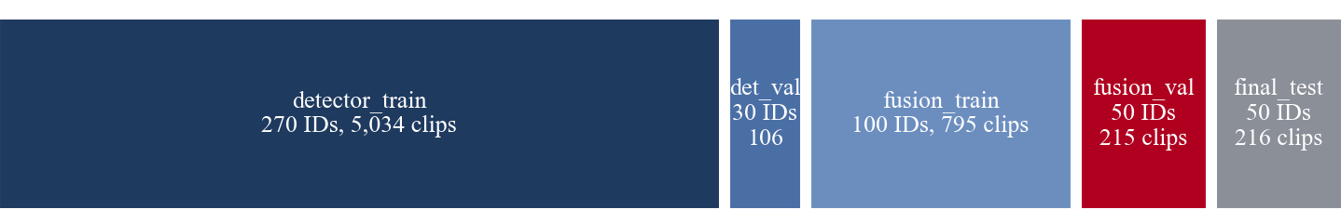
DATA, FUSION AND VERDICT FLOW
Identity-disjoint split of FakeAVCeleb [8] (manifest v3)
corrected_fixed fusion (no trained parameters)
P_visual = (0.40 sp + 0.30 te) / 0.70
P_fake = 1 − (1 − P_visual)(1 − P_audio)
type probabilities from P_visual and P_audio
0
0.45
0.55
1
AUTHENTIC
DEEPFAKE + type
INCONCLUSIVE
No detector produced evidence (pure tone, no face) → Can't verify, no score shown
AUTHENTIC demoted to inconclusive if a face was not found or the video picture was never checked
PPO fusion [27] (VERITAS_FUSION_MODE=ppo) is experimental; it falls back to corrected_fixed when detectors differ
Capstone Project Review, AY 26-27, STME, NMIMS Navi Mumbai
10
Notes:
Visual scores are combined first, then visual and audio are treated as independent events. The 0.45 to 0.55 band is reported as inconclusive; no usable evidence gives Can't verify, never authentic.

Slide 11
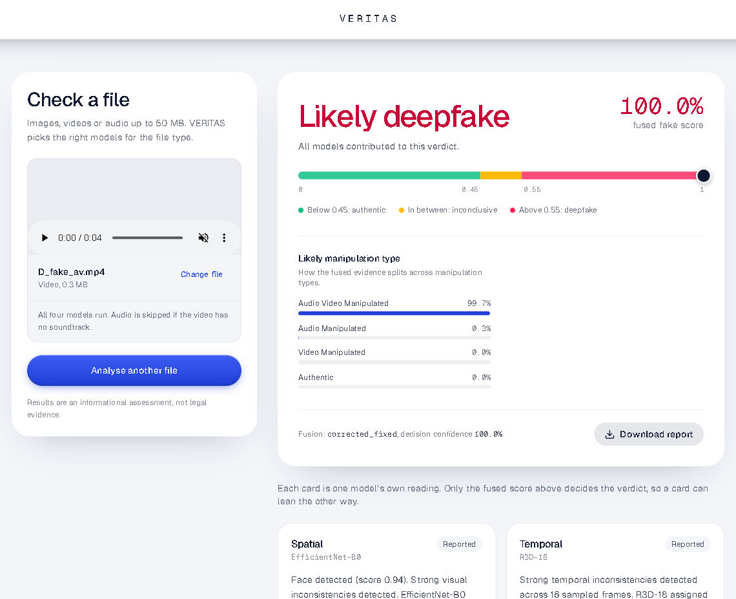
IMPLEMENTATION AND INTERFACE
1 Upload image, video or audio (checked: type, 50 MB)
2 Detectors stream in: "Analysing, n of 4 reported"
3 Verdict, fused score on the 0.45 / 0.55 scale
4 Manipulation type (a hypothesis when inconclusive)
5 Download JSON report
Stack: React 19, Vite 7, Tailwind CSS 4 | FastAPI, PyTorch 2.6 (CPU inference), OpenCV, ffmpeg
Console after analysing a FakeAVCeleb fake-video, fake-audio clip
Capstone Project Review, AY 26-27, STME, NMIMS Navi Mumbai
11
Notes:
Walk through a real run: upload, four detector cards fill in as results stream, then the verdict, manipulation type and downloadable JSON report.

Slide 12
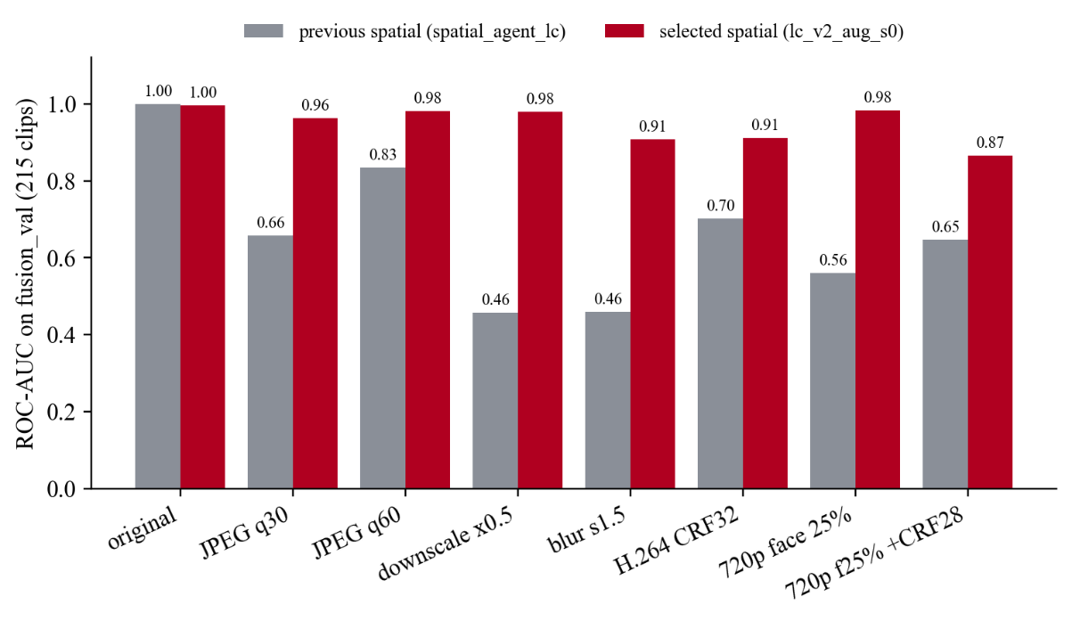
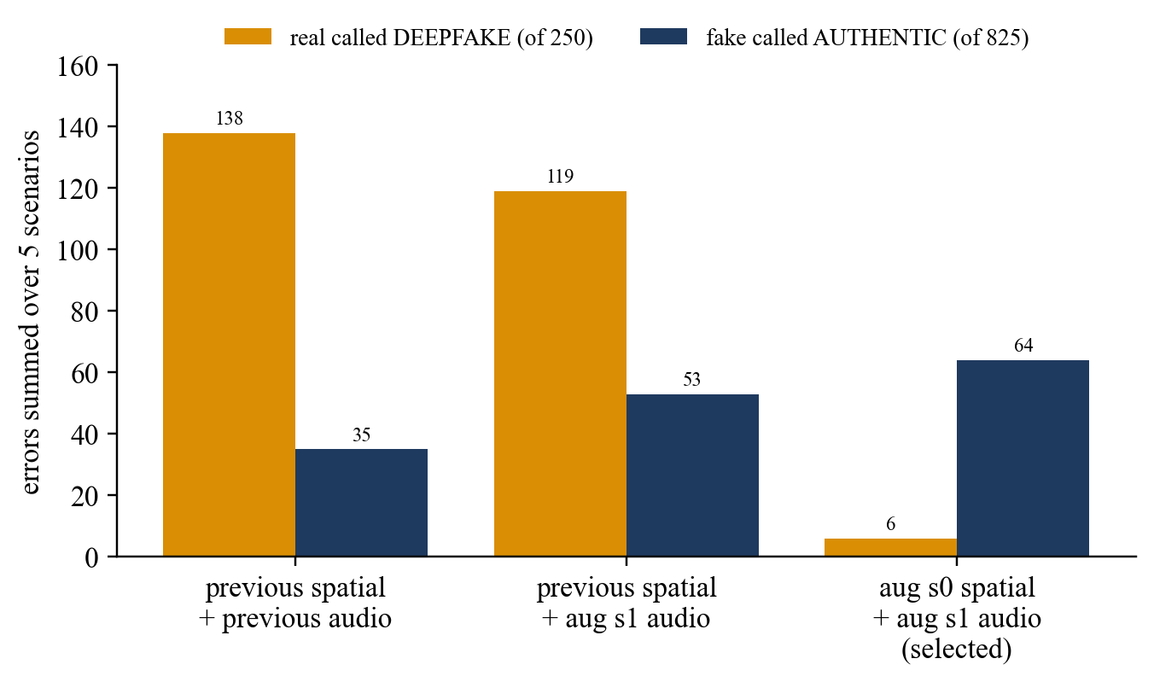
RESULTS AND ANALYSIS
Spatial ROC-AUC under 8 degradations (fusion_val, 215 clips)
System errors, corrected_fixed, over 5 degraded scenarios (fusion_val)
Selected detectors: false DEEPFAKE on degraded real clips 119 → 6 of 250; missed fakes 53 → 64 of 825 (a deliberate trade-off).
Evidence level: fusion_val was also used to select the models, so these are development results, not real-world accuracy. final_test has been inspected repeatedly and is not reported.
Capstone Project Review, AY 26-27, STME, NMIMS Navi Mumbai
12
Notes:
All numbers are on fusion_val, which was also used to pick the models, so they are development evidence. Left: spatial AUC under degradation. Right: system errors summed over five degraded scenarios.

Slide 13
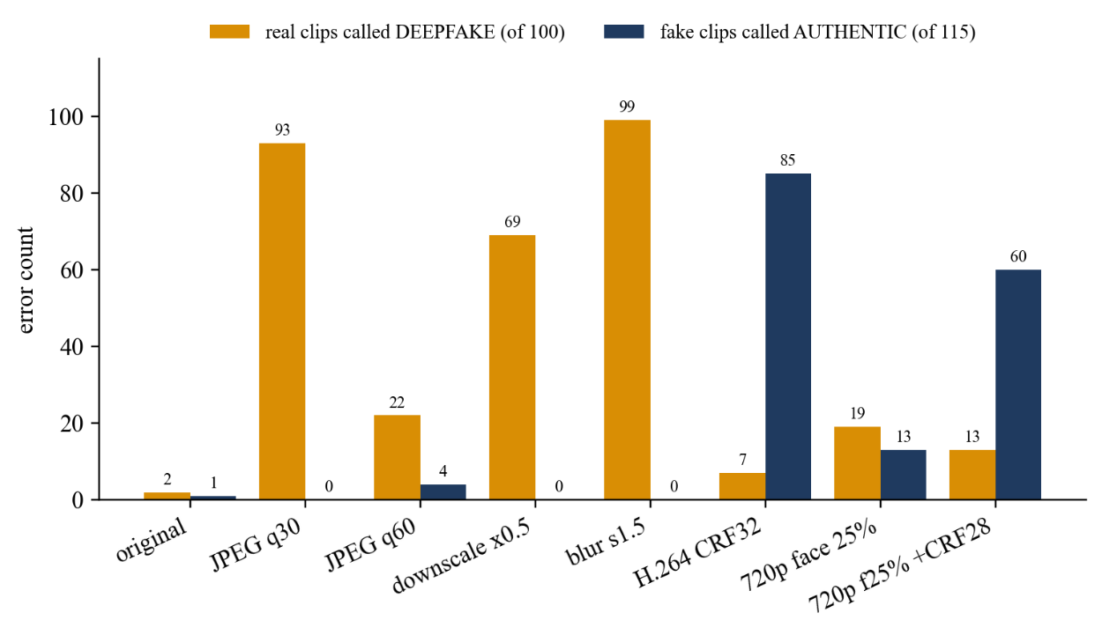
ROBUSTNESS, ERRORS AND LIMITATIONS
Temporal detector errors under degradation (fusion_val, 215 clips)
Temporal: JPEG and blur make real clips look fake; H.264 hides fakes
All 64 missed fakes of the selected system are fake-video, real-audio clips after heavy compression
Audio caught every fake-audio clip in every scenario
Audio-and-video fakes can be attributed to audio only when visual evidence weakens
Silence and pure tones → Can't verify; music and noise are still scored
No independent real-world accuracy estimate yet
Browser QA (10 inputs: images, videos with and without audio, audio-only, unverifiable) and 85/85 backend tests passed; QA checks execution, not accuracy.
Capstone Project Review, AY 26-27, STME, NMIMS Navi Mumbai
13
Notes:
Temporal is the weak point: compression and blur cause false alarms, H.264 hides fakes. Every missed fake of the selected system is a fake-video, real-audio clip after heavy compression.

Slide 14
CONCLUSION
4
input types handled: image, video with / without audio, audio
6 / 250
false DEEPFAKE on degraded real clips (fusion_val)
85 / 85
backend tests passing
VERITAS delivers an end-to-end multimodal detector: spatial, temporal and audio models, transparent fusion, abstention and a streaming console
Augmented spatial and audio models are far more robust to re-encoding; the temporal model remains the weak point
All quantitative results are development evidence on FakeAVCeleb; independent evaluation is still required
Intended as decision support for human review, not as conclusive forensic proof
Capstone Project Review, AY 26-27, STME, NMIMS Navi Mumbai
14
Notes:
Summarise what works end to end and the honest limits: development evidence only, temporal weakness, attribution weakens with compression. VERITAS supports human review; it is not forensic proof.

Slide 15
FUTURE SCOPE
Temporal robustness
Retrain R3D-18 with JPEG, rescale, blur and H.264 augmentation
Independent evaluation
New data gathered after model selection, used once
Broader data
More generators, including recent diffusion face and voice synthesis
Audio-visual consistency
Learned sync model and better manipulation-type attribution
Calibration and OOD
Calibrated probabilities; flag music, non-face and other unseen input
Explanations and fusion
Validated Grad-CAM [29] heatmaps; retrain PPO fusion on current detectors
Capstone Project Review, AY 26-27, STME, NMIMS Navi Mumbai
15
Notes:
These are proposals, not completed work. The first two, temporal retraining and an independent evaluation set, matter most.

Slide 16
REFERENCES AND ACKNOWLEDGEMENTS
[1] I. J. Goodfellow et al., "Generative adversarial nets," in NeurIPS, 2014.
[2] J. Ho et al., "Denoising diffusion probabilistic models," in NeurIPS, 2020.
[3] R. Tolosana et al., "DeepFakes and beyond: A survey of face manipulation and fake detection," Information Fusion, vol. 64, 2020.
[4] Y. Mirsky and W. Lee, "The creation and detection of deepfakes: A survey," ACM Computing Surveys, vol. 54, no. 1, Art. no. 7, 2021.
[5] A. Rössler et al., "FaceForensics++: Learning to detect manipulated facial images," in ICCV, 2019.
[8] H. Khalid et al., "FakeAVCeleb: A novel audio-video multimodal deepfake dataset," in Proc. Neural Information Processing Systems Track on Datasets and Benchmarks, 2021.
[9] D. Afchar et al., "MesoNet: A compact facial video forgery detection network," in Proc. IEEE Int. Workshop on Information Forensics and Security (WIFS), 2018.
[10] L. Li et al., "Face X-ray for more general face forgery detection," in CVPR, 2020.
[12] A. Haliassos et al., "Lips don't lie: A generalisable and robust approach to face forgery detection," in CVPR, 2021.
[14] H. Tak et al., "End-to-end anti-spoofing with RawNet2," in ICASSP, 2021.
[15] J.-w. Jung et al., "AASIST: Audio anti-spoofing using integrated spectro-temporal graph attention networks," in ICASSP, 2022.
[20] M. Tan and Q. V. Le, "EfficientNet: Rethinking model scaling for convolutional neural networks," in Proc. 36th Int. Conf. Machine Learning (ICML), PMLR vol. 97, 2019.
[21] J. Deng et al., "ImageNet: A large-scale hierarchical image database," in CVPR, 2009.
[22] D. Tran et al., "A closer look at spatiotemporal convolutions for action recognition," in CVPR, 2018.
[23] W. Kay et al., "The Kinetics human action video dataset," arXiv preprint arXiv:1705.06950, 2017.
[24] S. Hershey et al., "CNN architectures for large-scale audio classification," in ICASSP, 2017.
[25] T. Mittal et al., "Emotions don't lie: An audio-visual deepfake detection method using affective cues," in Proc. 28th ACM Int. Conf. Multimedia (MM), 2020.
[26] K. Chugh et al., "Not made for each other: Audio-visual dissonance-based deepfake detection and localization," in Proc. 28th ACM Int. Conf. Multimedia (MM), 2020.
[27] J. Schulman et al., "Proximal policy optimization algorithms," arXiv preprint arXiv:1707.06347, 2017.
[29] R. R. Selvaraju et al., "Grad-CAM: Visual explanations from deep networks via gradient-based localization," in ICCV, 2017.
Numbering follows the project report. We thank Dr. Preeti Agarwal, Faculty Mentor, STME, and STME, SVKM's NMIMS, Navi Mumbai.
Capstone Project Review, AY 26-27, STME, NMIMS Navi Mumbai
16
Notes:
Numbering follows the project report. Thank the mentor and institution.

