Slide 1
BLOOD & ORGANS DONATION SYSTEM
GROUP-3
S.M. TAWFIQ RASHID 20-43518-1
MOHAMMAD ADNAN ABEDIN 18-38821-3
MD. TAFIQUZZAMAN 18-36743-1
MD. FERDOUS ALVI 19-41317-3

Slide 2
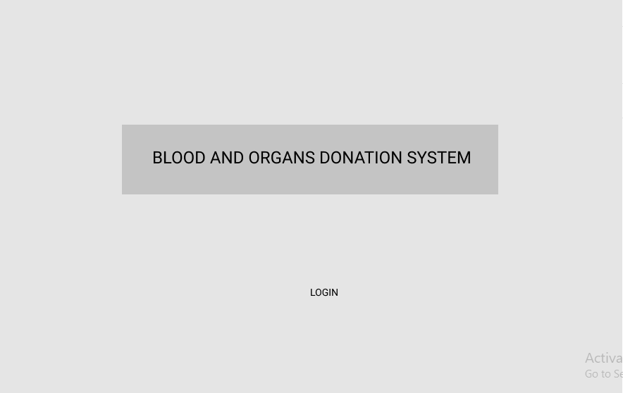

Slide 3
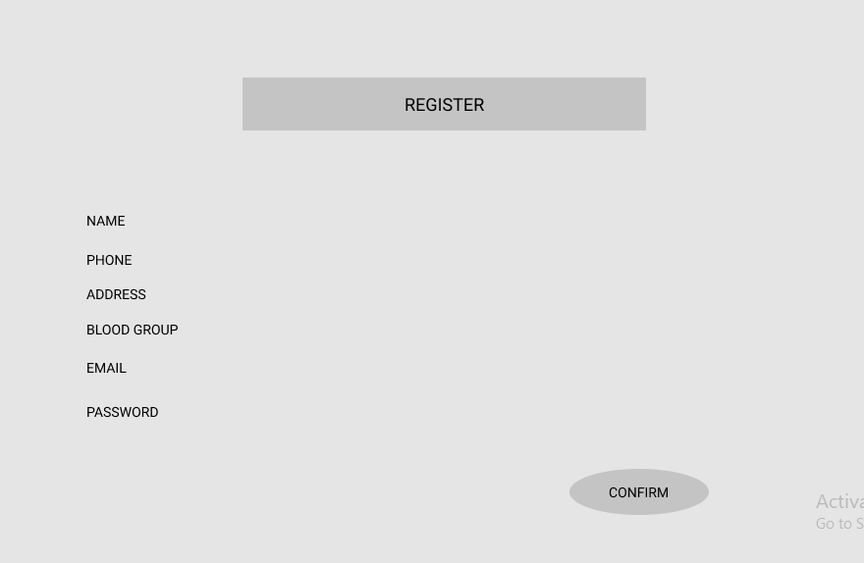

Slide 4
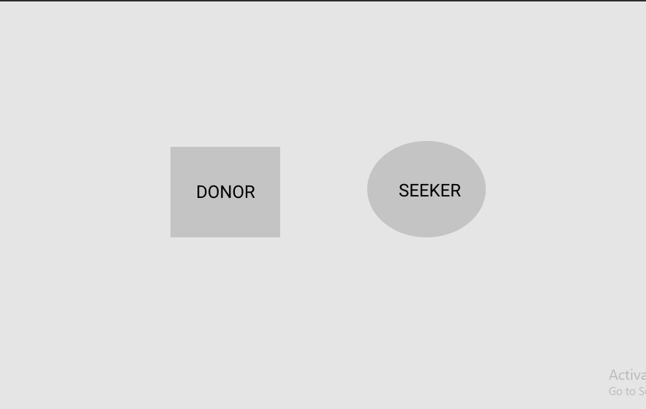

Slide 5
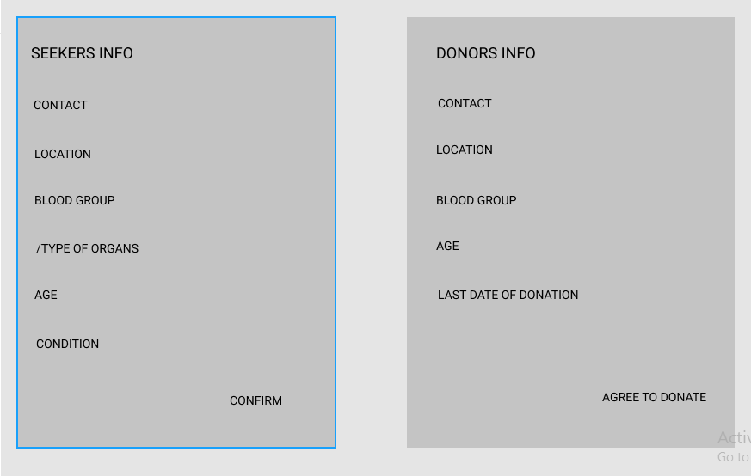

Slide 6
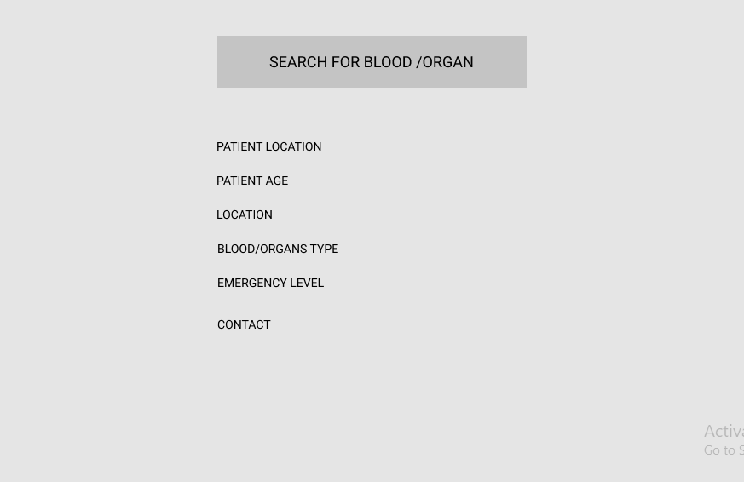

Slide 7


